Slide 3
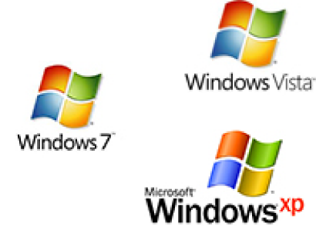

Slide 15
To run the
program:
You need
the OS:
To run the
program:
You need
the OS:

Slide 16
Your computer is running:
You want it to also run:

Slide 17
Your computer is running:

Slide 18
Your computer is running:
You want it to also run:

Slide 19
Your computer is running:
VirtualBox
You want it to also run:

Slide 20
Your computer is running:
VirtualBox
VMWare
You want it to also run:

Slide 21
Your computer is running:
VirtualBox
VMWare
Parallels
You want it to also run:

Slide 22
Your computer is running:
VirtualBox
VIRTUAL
MACHINE
SLOT
VIRTUAL
MACHINE
SLOT
VIRTUAL
MACHINE
SLOT
VIRTUAL
MACHINE
SLOT

Slide 23
Your computer is running:
VirtualBox
VIRTUAL
MACHINE
SLOT
VIRTUAL
MACHINE
SLOT
VIRTUAL
MACHINE
SLOT
VIRTUAL
MACHINE
SLOT

Slide 24
Your computer is running:
VirtualBox
VIRTUAL
MACHINE
SLOT
VIRTUAL
MACHINE
SLOT
VIRTUAL
MACHINE
SLOT
VIRTUAL
MACHINE
SLOT

Slide 25
Your computer is running:
VirtualBox
Parallels
VIRTUAL
MACHINE
SLOT
VIRTUAL
MACHINE
SLOT
VIRTUAL
MACHINE
SLOT
VIRTUAL
MACHINE
SLOT

Slide 26
Host Operating System:
Virtualization Software:
VirtualBox
VMWare
Parallels
Virtual Machines
(Guest OS)
(.vdi,.vdmk, .hdd, …):
SEA
Linux VM

Slide 27
File sharing
Memory
Installed programs
Parallels too smooth?

