Slide 1
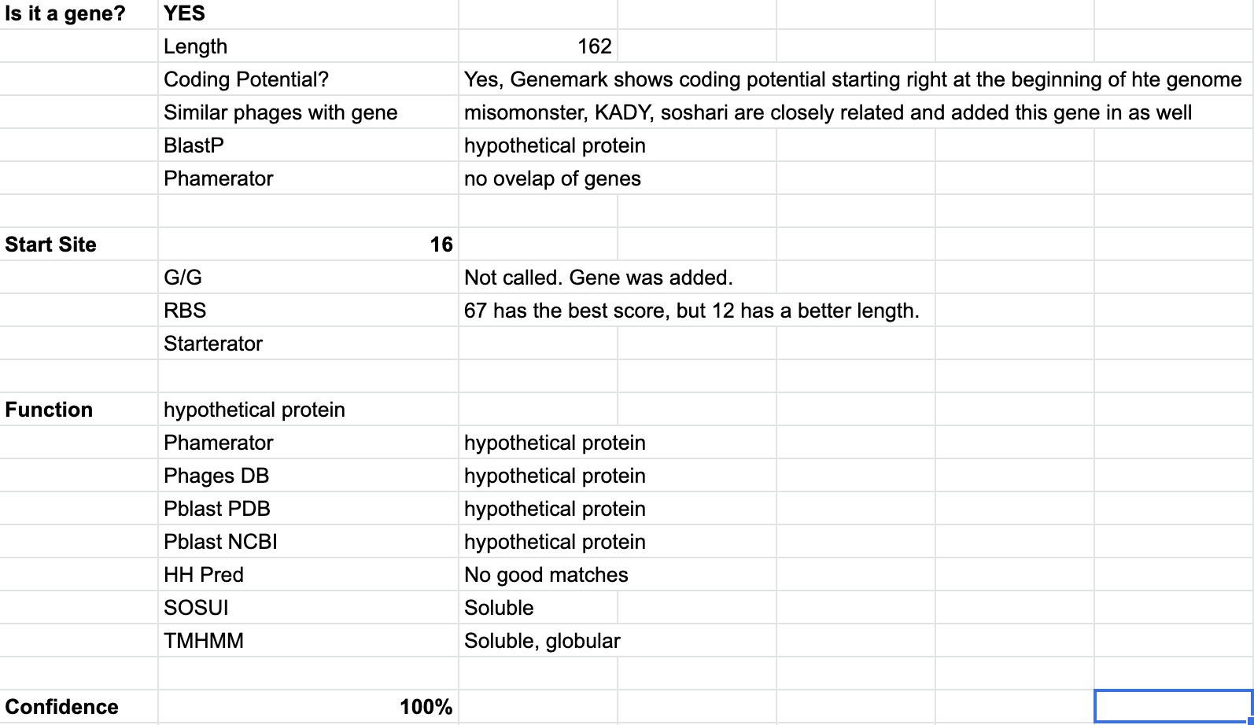
177 (1)

Slide 2
820 (2)

Slide 3
1276 (3)
There were many conflicting calls, terminase small subunit, tail protein, and unknow being the most common. Most closely related phages called terminase small subunit. HH preds best matches were to terminase small subunit.

Slide 4
1682 (4)

Slide 5
2716 (5)

Slide 6
3352 (6)

Slide 7
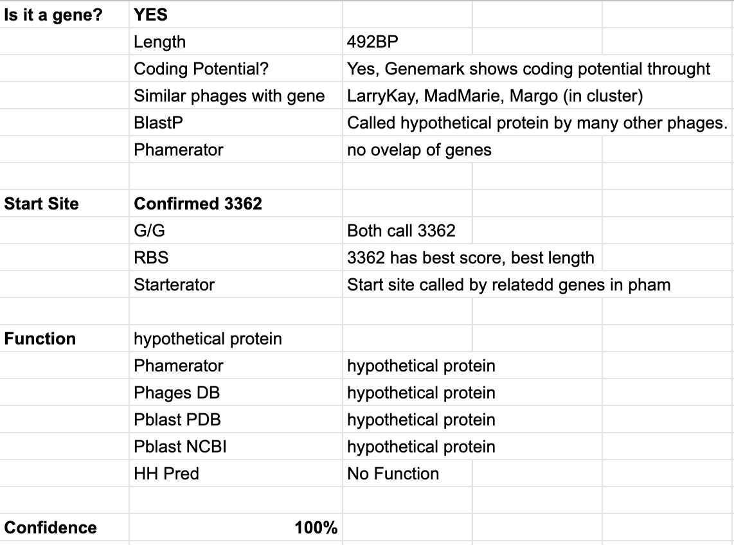
3853 (7)

Slide 8
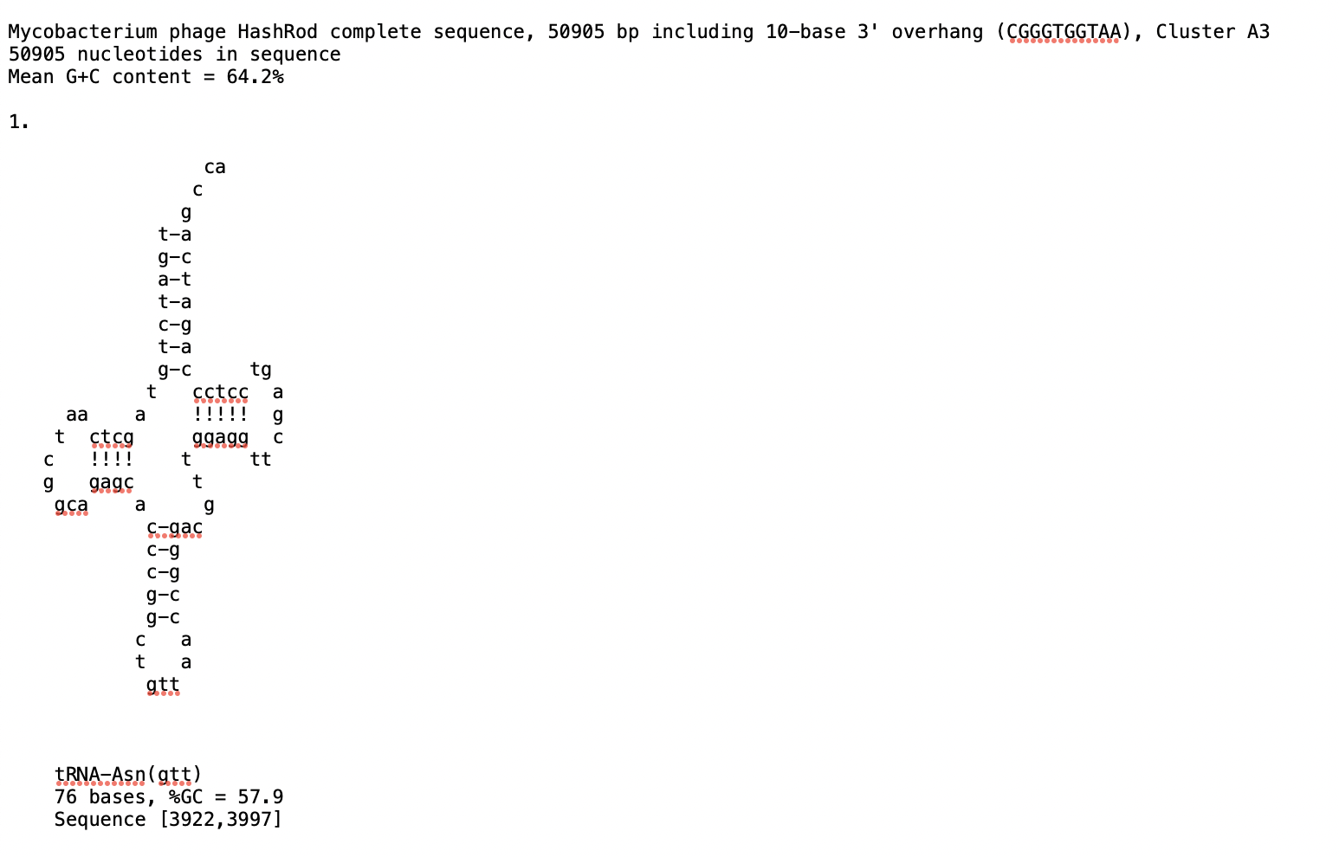
3997 (8)

Slide 9
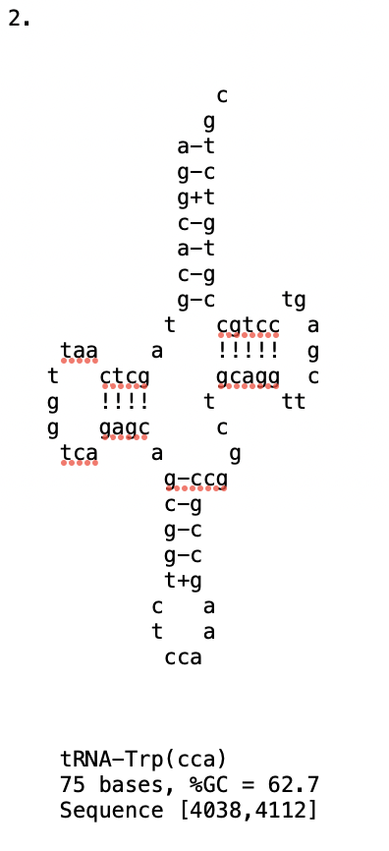
4112 (9)

Slide 10
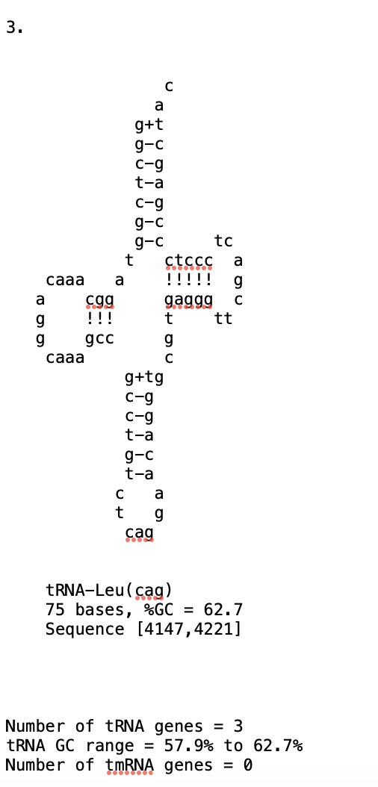
4147 (10)

Slide 11
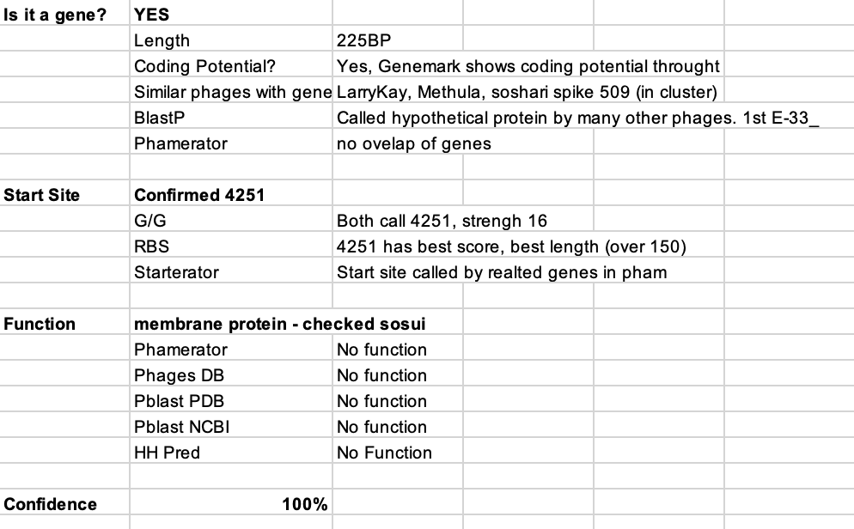
4505 (11)

Slide 12
6046 (12)

Slide 13
7011 (13)

Slide 14
8741 (14)

Slide 15
10192 (15)

Slide 16
10189 (16)

Slide 17
11590 (17)

Slide 18
12615 (18)

Slide 19
12871 (19)
Checked SOSUI & TMHMM, not a membrane protein

Slide 20
13251 (20)

Slide 21
13382 (21)

Slide 22
13747 (22)

Slide 23
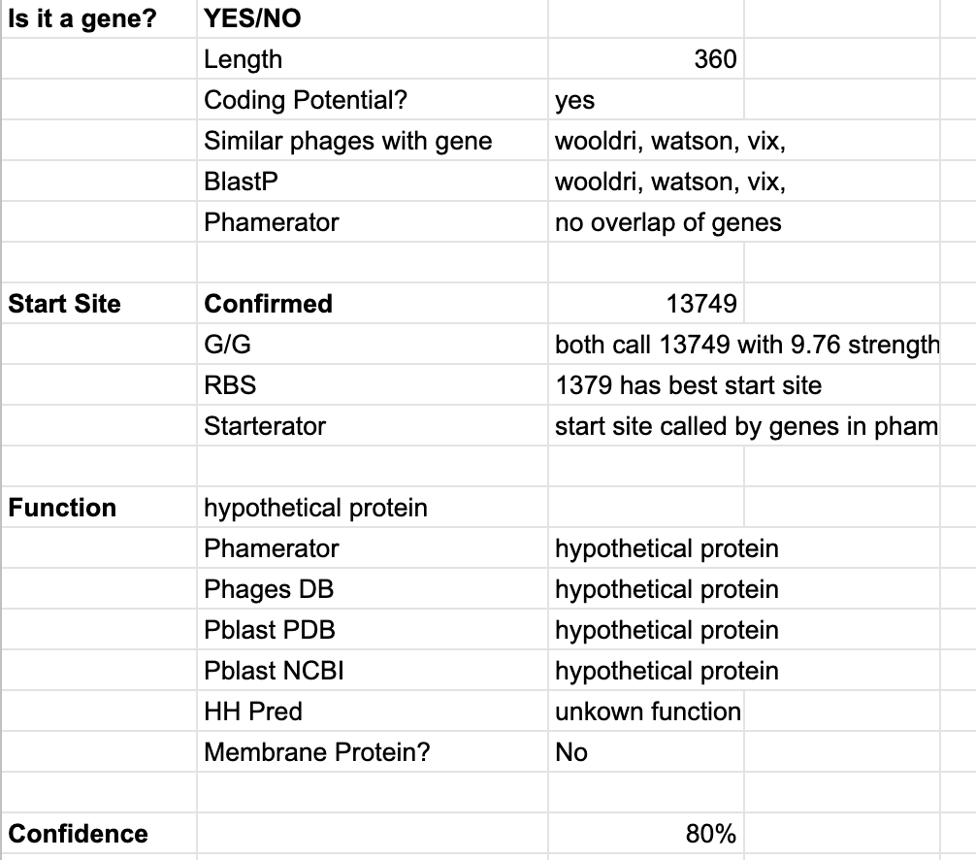
14108 (23)

Slide 24
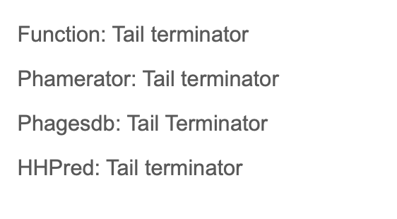
14526 (24)

Slide 25
15153 (25)

Slide 26
15665 (26)

Slide 27
16063 (27)- Note- Frameshift Annotated in DNA Master

Slide 28
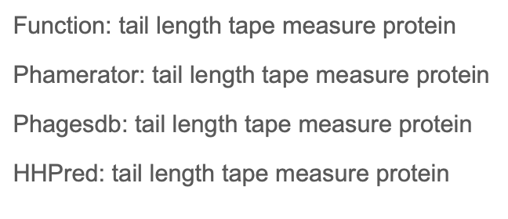
19080 (28)

Slide 29
20469 (29)

Slide 30
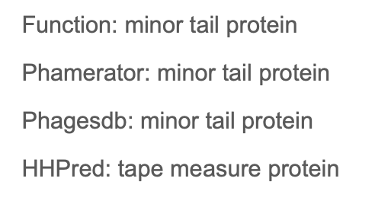
22262 (30)

Slide 31
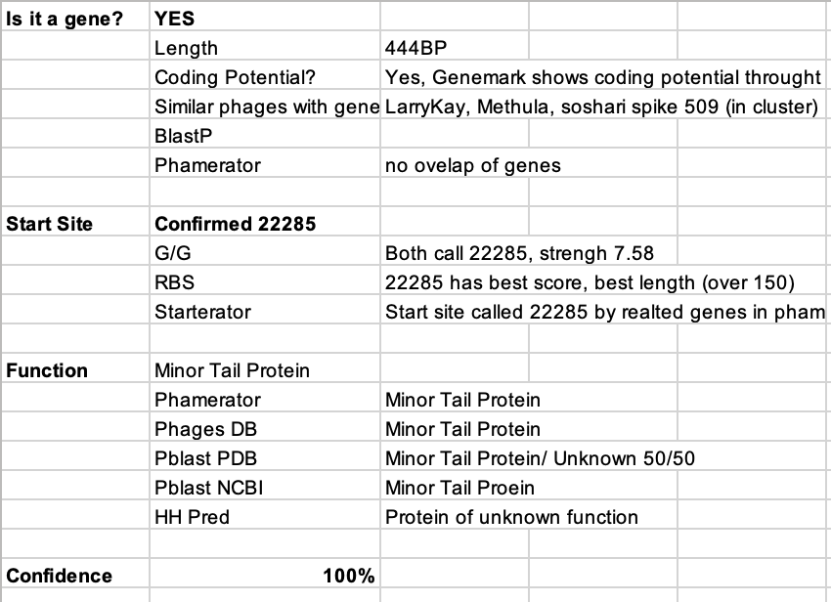
222728 (31)

Slide 32
23053 (32)

Slide 33
23352 (33)

Slide 34
25115 (34)

Slide 35
25396 (35)

Slide 36
25457 (36)

Slide 37
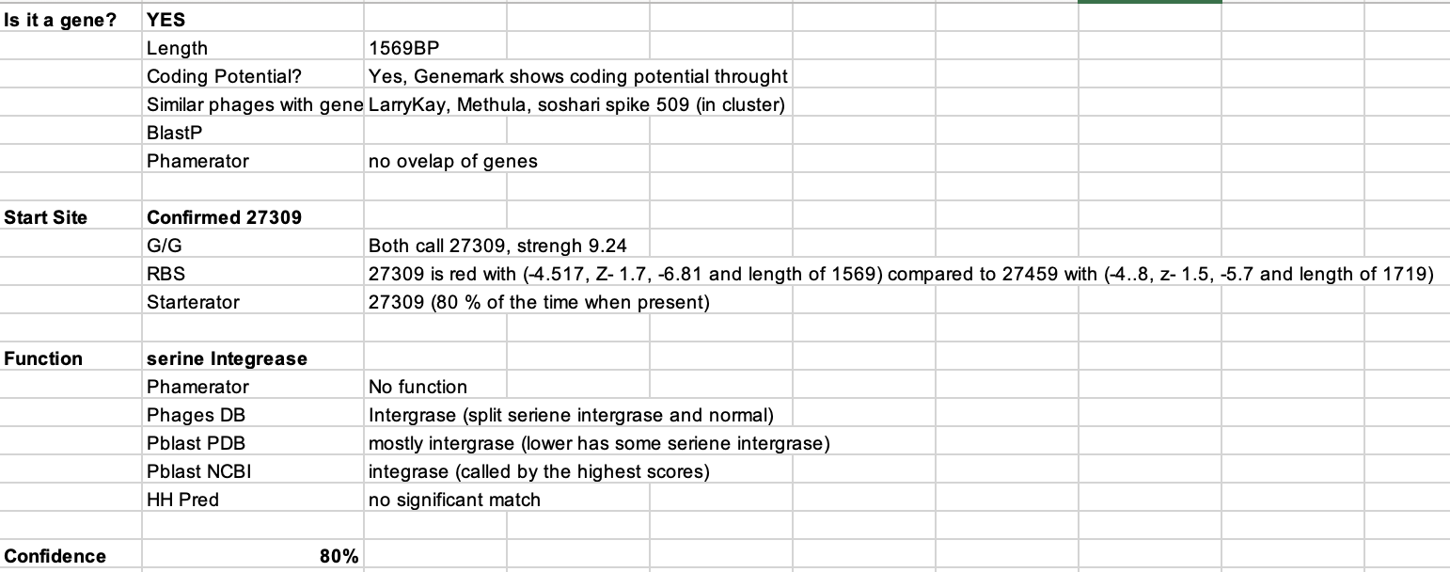
25741 (37)

Slide 38
27833 (38)

Slide 39
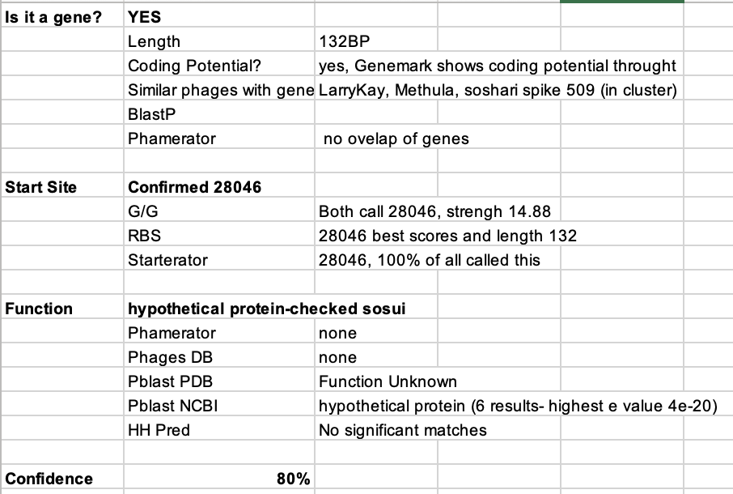
27915 (39)

Slide 40
28047 (40)

Slide 41
28191 (41)

Slide 42
28191 (42)

Slide 43
28861 (43)

Slide 44
29093 (44)

Slide 45
29478 (45)

Slide 46
29663 (46)

Slide 47
29857 (47)

Slide 48
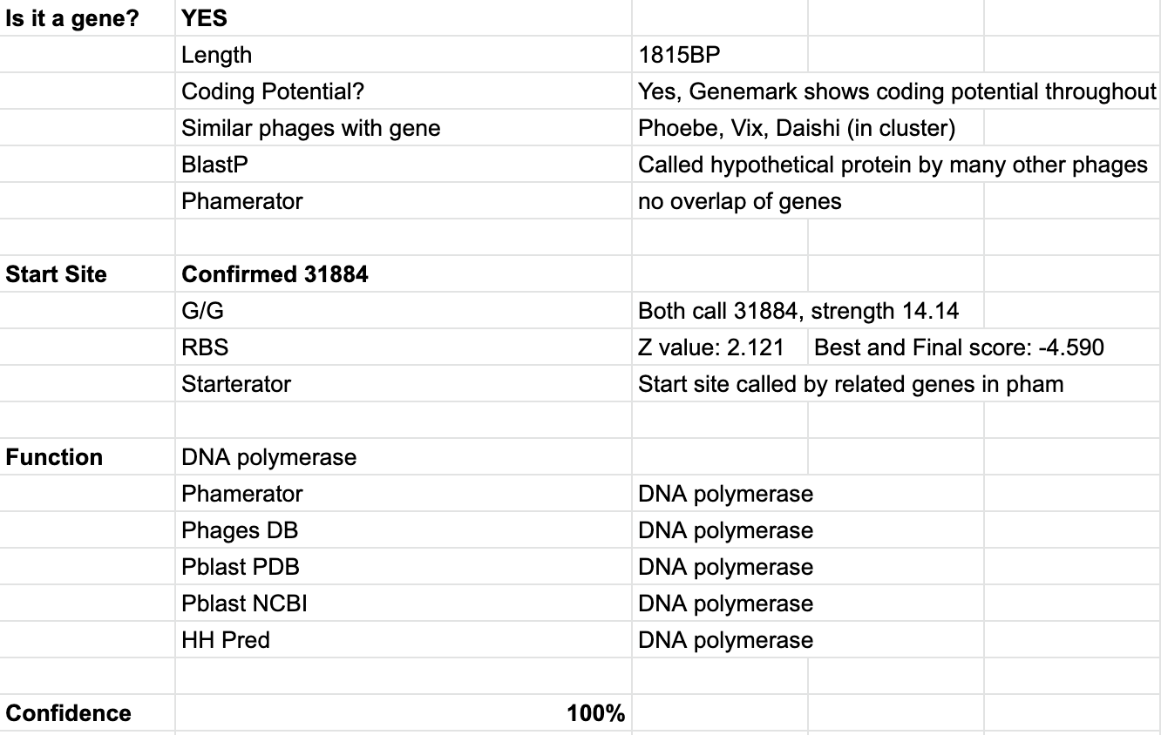
30070 (48)

Slide 49
31894 (49)

Slide 50
32091 (50)

Slide 51
32332 (51)

Slide 52
32530 (52)

Slide 53
33297 (53)
Checked SOSUI- not a membrane protein

Slide 54
33916 (54)

Slide 55
35931 (55)
Checked SOSUI- not a membrane protein

Slide 56
36127 (56)
Checked SOSUI- not a membrane protein

Slide 57
36237 (57)

Slide 58
36963 (58)

Slide 59
37727 (59)

Slide 60
38017 (60)

Slide 61
38178 (61)

Slide 62
38267 (62)

Slide 63
38742 (63)
Start site was changes to 39149 as this site better aligns with DNA primase blast results and HH Pred Results

Slide 64
39173 (64)

Slide 65
39630 (65)
This is a membrane protein according to SOSUI and TMHMM

Slide 66
39731 (66)

Slide 67
40522 (67)

Slide 68
40968 (68)

Slide 69
41222 (69)

Slide 70
42031(70)
According to SOSUI this is a membrane protein

Slide 71
42102 (71)
Not a membrane protein

Slide 72
42161 (72)

Slide 73
42466 (73)

Slide 74
42657 (74)

Slide 75
42869 (75)

Slide 76
43093 (76)

Slide 77
43262 (77)

Slide 78
44074 (78)

Slide 79
44524 (79)

Slide 80
45394 (80)

Slide 81
45654 (81)

Slide 82
45836 (82)

Slide 83
46071 (83)

Slide 84
46303 (84)

Slide 85
47162 (85)

Slide 86
47425 (86)

Slide 87
47805 (87)

Slide 88
48033 (88)

Slide 89
48193 (89)

Slide 90
48532 (90)

Slide 91
49278 (91)

Slide 92
49407 (92)

Slide 93
49542 (93)

