Slide 1
The past, present, and future of DNA sequencing
Dan Russell

Slide 2
Overview
Prologue: Assembly and Finishing
The Past: Sanger
The Present: Next-Gen (454, Illumina, …)
The Future: ? (Nanopore, MinION, Single-molecule)

Slide 3
Overview
Prologue: Assembly and Finishing
The Past: Sanger
The Present: Next-Gen (454, Illumina, …)
The Future: ? (Nanopore, MinION, Single-molecule)

Slide 4
Method | Read Length
Sanger | 600-1000 bp
454 | 300-500 bp
Illumina | ~100 bp
Ion Torrent | ~200 bp
But…
Phage Genome: 30,000 to 500,000 bp
Bacteria: Several million bp
Human: 3 billion bp

Slide 5
Shotgun Genome Sequencing
Complete genome copies
Fragmented genome chunks

Slide 6
Shotgun Genome Sequencing
Fragmented genome chunks
NOT REALLY DONE BY DUCK HUNTERS
Hydroshearing, sonication, enzymatic shearing
Notes:
Fragment sizes differ for different seq platforms.

Slide 7
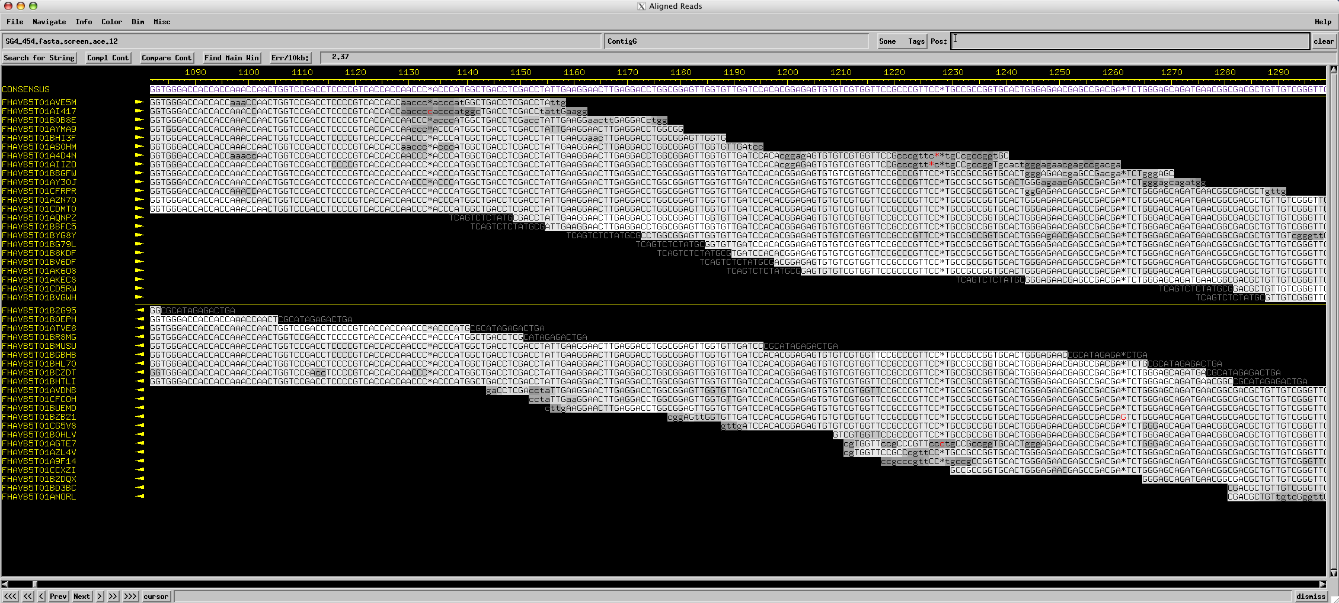
All the King’s horses and all the King’s men…
Assembly, aka
ATTGTTCCCACAGACCG
CGGCGAAGCATTGTTCC
ACCGTGTTTTCCGACCG
AGCTCGATGCCGGCGAAG
TTGTTCCCACAGACCGTG
TTTCCGACCGAAATGGC
ATGCCGGCGAAGCATTGT
ACAGACCGTGTTTCCCGA
TAATGCGACCTCGATGCC
AAGCATTGTTCCCACAG
TGTTTTCCGACCGAAAT
TGCCGGCGAAGCCTTGT
CCGACCGAAATGGCTCC

Slide 8
Dan’s recommended assemblers
Your Sequencing Technology | Recommended Assembler
Sanger | phredPhrap
Ion Torrent/454 | Newbler
Illumina | velvet
REGARDLESS OF ASSEMBLY PROGRAM, I’D RECOMMEND USING CONSED FOR FINISHING!

Slide 9
Special use of the word “finish”
Some words have special meanings in scientific context
THEORY
FINISH
Before annotation, phage genomes should be sequenced AND finished.

Slide 10
What is finishing?

Slide 11
What is finishing?
When we put all the reads back together this time:
GAP!
But now we at least know the sequence on each side, so we can design primers to run a sequencing reaction towards the gap, and hopefully connect our contigs.

Slide 12
What is finishing?

Slide 13
What is finishing?
A combination of computer and wet-bench work to ensure that the entire genome sequence is present and that all bases are high quality.

Slide 14
From DNA to Annotatable Sequence
Shotgun sequencing to generate reads
Assembly of reads
Identification of weak areas
Targeted sequencing runs to fix
Verification of finished sequence
Generation of final fasta file
Done for all phages sequenced at Pitt
Done by most independent seq facilities
NOT DONE by most seq facilities

Slide 15
From DNA to Annotatable Sequence
Shotgun sequencing to generate reads
Assembly of reads
Identification of weak areas
Targeted sequencing runs to fix
Verification of finished sequence
Generation of final fasta file
Done for all phages sequenced at Pitt
Done by most independent seq facilities
NOT DONE by most seq facilities
= “FINISHING”

Slide 16
Overview
Prologue: Assembly and Finishing
The Past: Sanger
The Present: Next-Gen (454, Illumina, …)
The Future: ? (Nanopore, MinION, Single-molecule)

Slide 17
Fragments were cloned:

Slide 18
Notes:
One tube per 2 sequences with Sanger and cloning. Not so bad if you only want 100 sequences. What if you want 1 million?

Slide 19
Sanger Sequencing Reactions
For given template DNA, it’s like PCR except:
Uses only a single primer and polymerase to make new ssDNA pieces.
Includes regular nucleotides (A, C, G, T) for extension, but also includes dideoxy nucleotides.
Dideoxy Nucleotides
G
A
T
C
Regular Nucleotides
T
C
G
A
C
G
A
T
G
G
A
T
G
T
C
G
A
A
T
A
C
T
G
G
A
T
A
T
G
Labeled
Terminators
T
A
C
C
G
A
C
C
A
T
A
C
G

Slide 20
Sanger Sequencing
Primer
5’
G T C T T G G G C T
T G C G C G G C C C A
A C G C G C C G G G T C A G A A C C C G A T C G C G
3’
5’

Slide 21
Sanger Sequencing
Primer
5’
G T C T T G G G C T A G C G C
T G C G C G G C C C A
A C G C G C C G G G T C A G A A C C C G A T C G C G
3’
5’
5’
21 bp
G T C T T G G G C T
T G C G C G G C C C A

Slide 22
Sanger Sequencing
Primer
5’
G T C T T G G G C T A
T G C G C G G C C C A
A C G C G C C G G G T C A G A A C C C G A T C G C G
3’
5’
5’
21 bp
G T C T T G G G C T
T G C G C G G C C C A
5’
26 bp
G T C T T G G G C T A G C G C
T G C G C G G C C C A

Slide 23
Sanger Sequencing
Primer
5’
G
T G C G C G G C C C A
A C G C G C C G G G T C A G A A C C C G A T C G C G
3’
5’
5’
21 bp
G T C T T G G G C T
T G C G C G G C C C A
5’
26 bp
G T C T T G G G C T A G C G C
T G C G C G G C C C A
5’
22 bp
G T C T T G G G C T A
T G C G C G G C C C A

Slide 24
Sanger Sequencing
Primer
5’
G T C T T G G G C
T G C G C G G C C C A
A C G C G C C G G G T C A G A A C C C G A T C G C G
3’
5’
5’
21 bp
G T C T T G G G C T
T G C G C G G C C C A
5’
26 bp
G T C T T G G G C T A G C G C
T G C G C G G C C C A
5’
22 bp
G T C T T G G G C T A
T G C G C G G C C C A
5’
12 bp
G
T G C G C G G C C C A

Slide 25
Sanger Sequencing
Primer
5’
G T C T T
T G C G C G G C C C A
A C G C G C C G G G T C A G A A C C C G A T C G C G
3’
5’
5’
21 bp
G T C T T G G G C T
T G C G C G G C C C A
5’
26 bp
G T C T T G G G C T A G C G C
T G C G C G G C C C A
5’
22 bp
G T C T T G G G C T A
T G C G C G G C C C A
5’
12 bp
G
T G C G C G G C C C A
5’
20 bp
T G C G C G G C C C A
G T C T T G G G C

Slide 26
Sanger Sequencing
A C G C G C C G G G T C A G A A C C C G A T C G C G
3’
5’
5’
21 bp
G T C T T G G G C T
T G C G C G G C C C A
5’
26 bp
G T C T T G G G C T A G C G C
T G C G C G G C C C A
5’
22 bp
G T C T T G G G C T A
T G C G C G G C C C A
5’
12 bp
G
T G C G C G G C C C A
5’
20 bp
T G C G C G G C C C A
G T C T T G G G C
5’
16 bp
G T C T T
T G C G C G G C C C A

Slide 27
Sanger Sequencing
A C G C G C C G G G T ? ? ? ? ? ? ? ? ? ? ? ? ? ? ?
3’
5’
5’
21 bp
G T C T T G G G C T
T G C G C G G C C C A
5’
26 bp
G T C T T G G G C T A G C G C
T G C G C G G C C C A
5’
22 bp
G T C T T G G G C T A
T G C G C G G C C C A
5’
12 bp
G
T G C G C G G C C C A
5’
20 bp
T G C G C G G C C C A
G T C T T G G G C
5’
16 bp
G T C T T
T G C G C G G C C C A
Notes:
Has to be done in a single tube per rxn.

Slide 28
Sanger Sequencing
Laser Reader
5’
5’
5’
5’
5’
5’
5’
5’
5’
5’
5’
20 bp
21 bp
19 bp
13 bp
18 bp
22 bp
16 bp
14 bp
15 bp
17 bp
12 bp
G T C T T G G G C
T G C G C G G C C C A
G T C T T G G G C T
T G C G C G G C C C A
G T C T T G G G
T G C G C G G C C C A
G T C T T G G
T G C G C G G C C C A
T G C G C G G C C C A
G T C T T G G G C T A
G
G T
G T C T T
G T C T
G T C T T G
T G C G C G G C C C A
T G C G C G G C C C A
T G C G C G G C C C A
T G C G C G G C C C A
T G C G C G G C C C A
T G C G C G G C C C A
G T C

Slide 29
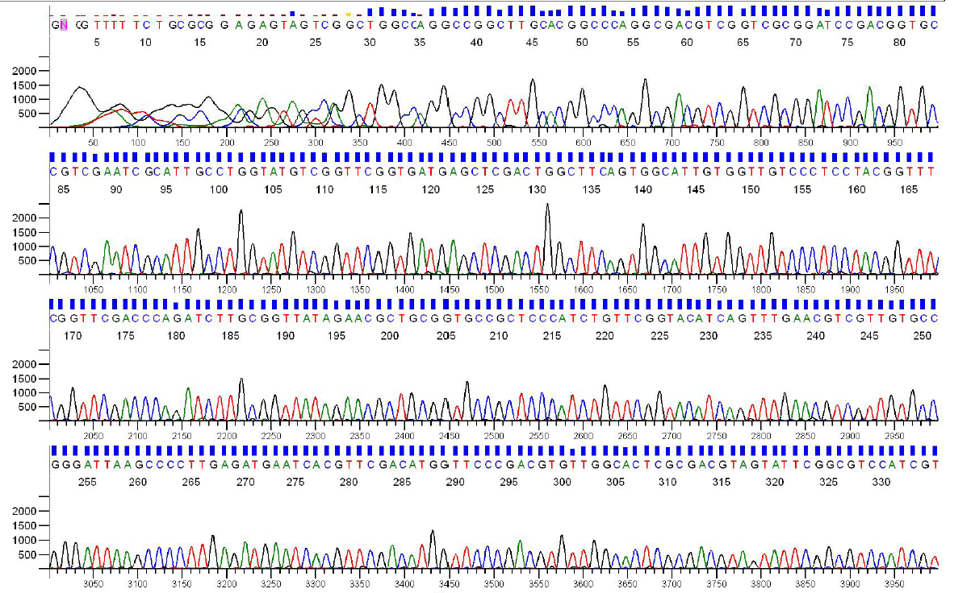
Sanger Sequencing Output
Each sequencing reaction gives us a chromatogram, usually ~600-1000 bp:

Slide 30
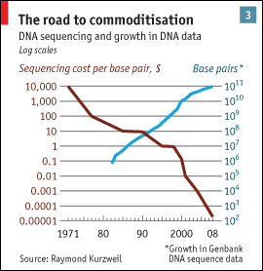
Sanger Throughput Limitations
Must have 1 colony picked for every 2 reactions
Must have 1 PCR tube for each reaction
Must have 1 capillary for each reaction
Improvements in cost
from making Sanger
higher throughput
Improvements in cost
from Next-Gen
sequencing technologies
from The Economist

Slide 31
Overview
Prologue: Assembly and Finishing
The Past: Sanger
The Present: Next-Gen (454, Illumina, …)
The Future: ? (Nanopore, MinION, Single-molecule)

Slide 32
Shotgun sequencing by Ion Torrent Personal Genome Machine and 454

Slide 33
Shotgun sequencing by PGM/454
Genomic
Fragment
Adapters

Slide 34
Shotgun sequencing by PGM/454
Genomic
Fragment
Barcode

Slide 35
Shotgun sequencing by PGM/454

Slide 36
Shotgun sequencing by PGM/454
Bead/ISP
Adapter
Complement
Sequences
The idea is that each bead should be amplified
all over with a SINGLE library fragment.

Slide 37
Shotgun sequencing by PGM/454

Slide 38
Shotgun sequencing by PGM/454

Slide 39
Shotgun sequencing by PGM/454

Slide 40
Shotgun sequencing by PGM/454

Slide 41
Shotgun sequencing by PGM/454

Slide 42
Shotgun sequencing by PGM/454

Slide 43
Shotgun sequencing by PGM/454

Slide 44
Shotgun sequencing by PGM/454

Slide 45
Shotgun sequencing by PGM/454

Slide 46
Shotgun sequencing by PGM/454

Slide 47
Shotgun sequencing by PGM/454

Slide 48
Shotgun sequencing by PGM/454
~3.5 µm for Ion Torrent, ~30 µm for 454

Slide 49
Shotgun sequencing by PGM/454
Only give polymerase one nucleotide at a time:
T
T
T
Primer
T
T
5’
T G C G C G G C C C A
A C G C G C C G G G T C A G A A C C C G A T C G C G
3’
5’
If that nucleotide is incorporated, enzymes turn by-products into light:
1 2 3 4 5
T C A G T C A G T C A G

Slide 50
Shotgun sequencing by PGM/454
Only give polymerase one nucleotide at a time:
C
C
C
Primer
C
C
5’
T G C G C G G C C C A
A C G C G C C G G G T C A G A A C C C G A T C G C G
3’
5’
If that nucleotide is incorporated, enzymes turn by-products into light:
1 2 3 4 5
T C A G T C A G T C A G

Slide 51
Shotgun sequencing by PGM/454
Only give polymerase one nucleotide at a time:
A
A
A
Primer
A
A
5’
T G C G C G G C C C A
A C G C G C C G G G T C A G A A C C C G A T C G C G
3’
5’
If that nucleotide is incorporated, enzymes turn by-products into light:
1 2 3 4 5
T C A G T C A G T C A G

Slide 52
Shotgun sequencing by PGM/454
Only give polymerase one nucleotide at a time:
G
G
G
Primer
G
G
5’
G
T G C G C G G C C C A
A C G C G C C G G G T C A G A A C C C G A T C G C G
3’
5’
If that nucleotide is incorporated, enzymes turn by-products into light:
1 2 3 4 5
T C A G T C A G T C A G

Slide 53
Shotgun sequencing by PGM/454
Only give polymerase one nucleotide at a time:
T
T
T
Primer
T
T
5’
G
T
T G C G C G G C C C A
A C G C G C C G G G T C A G A A C C C G A T C G C G
3’
5’
If that nucleotide is incorporated, enzymes turn by-products into light:
1 2 3 4 5
T C A G T C A G T C A G

Slide 54
Shotgun sequencing by PGM/454
Only give polymerase one nucleotide at a time:
C
C
C
Primer
C
C
5’
G
T
T G C G C G G C C C A
C
A C G C G C C G G G T C A G A A C C C G A T C G C G
3’
5’
If that nucleotide is incorporated, enzymes turn by-products into light:
1 2 3 4 5
T C A G T C A G T C A G

Slide 55
Shotgun sequencing by PGM/454
Only give polymerase one nucleotide at a time:
A
A
A
Primer
A
A
5’
G
T
T G C G C G G C C C A
C
A C G C G C C G G G T C A G A A C C C G A T C G C G
3’
5’
If that nucleotide is incorporated, enzymes turn by-products into light:
1 2 3 4 5
T C A G T C A G T C A G

Slide 56
Shotgun sequencing by PGM/454
Only give polymerase one nucleotide at a time:
G
G
G
Primer
G
G
5’
G
T
T G C G C G G C C C A
C
A C G C G C C G G G T C A G A A C C C G A T C G C G
3’
5’
If that nucleotide is incorporated, enzymes turn by-products into light:
1 2 3 4 5
T C A G T C A G T C A G

Slide 57
Shotgun sequencing by PGM/454
Only give polymerase one nucleotide at a time:
T
T
T
Primer
T
T
5’
G
T
T G C G C G G C C C A
C
T T
A C G C G C C G G G T C A G A A C C C G A T C G C G
3’
5’
If that nucleotide is incorporated, enzymes turn by-products into light:
1 2 3 4 5
T C A G T C A G T C A G

Slide 58
Shotgun sequencing by PGM/454
Only give polymerase one nucleotide at a time:
C
C
C
Primer
C
C
5’
G
T
T G C G C G G C C C A
C
T T
A C G C G C C G G G T C A G A A C C C G A T C G C G
3’
5’
If that nucleotide is incorporated, enzymes turn by-products into light:
1 2 3 4 5
T C A G T C A G T C A G

Slide 59
Shotgun sequencing by PGM/454
Only give polymerase one nucleotide at a time:
A
A
A
Primer
A
A
5’
G
T
T G C G C G G C C C A
C
T T
A C G C G C C G G G T C A G A A C C C G A T C G C G
3’
5’
If that nucleotide is incorporated, enzymes turn by-products into light:
1 2 3 4 5
T C A G T C A G T C A G

Slide 60
Shotgun sequencing by PGM/454
Only give polymerase one nucleotide at a time:
G
G
G
Primer
G
G
5’
G
T
T G C G C G G C C C A
C
T T
G G G
A C G C G C C G G G T C A G A A C C C G A T C G C G
3’
5’
If that nucleotide is incorporated, enzymes turn by-products into light:
1 2 3 4 5
The real power of this method is that it can take place in millions of tiny wells in a single plate at once.
T C A G T C A G T C A G

Slide 61
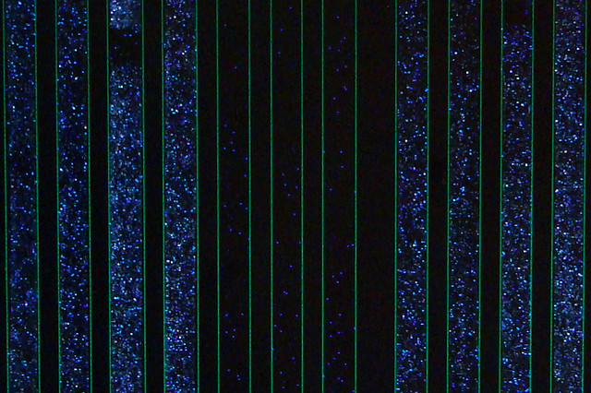
Raw 454 data
Only give polymerase one nucleotide at a time:
G
G
G
Primer
G
G
5’
G
T
T G C G C G G C C C A
C
T T
G G G
A C G C G C C G G G T C A G A A C C C G A T C G C G
3’
5’
If that nucleotide is incorporated, enzymes turn by-products into light:
1 2 3 4 5
The real power of this method is that it can take place in millions of tiny wells in a single plate at once.
T C A G T C A G T C A G

Slide 62
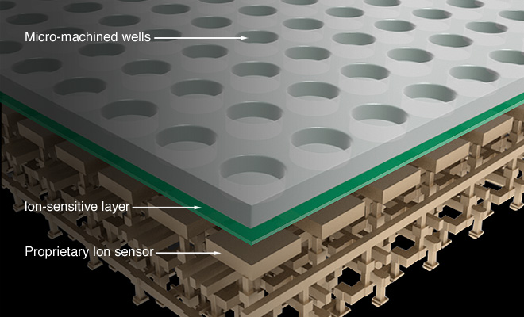
Ion Torrent Sequencing

Slide 63
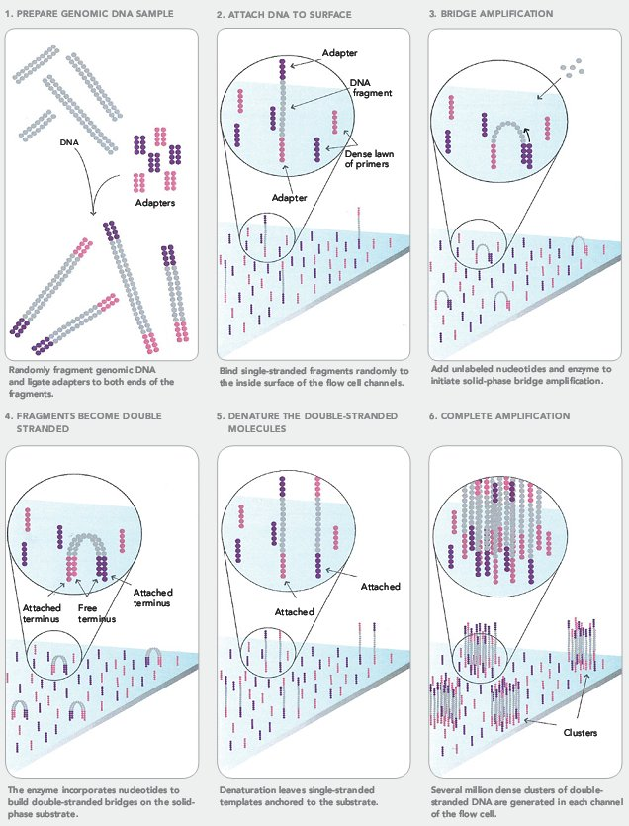
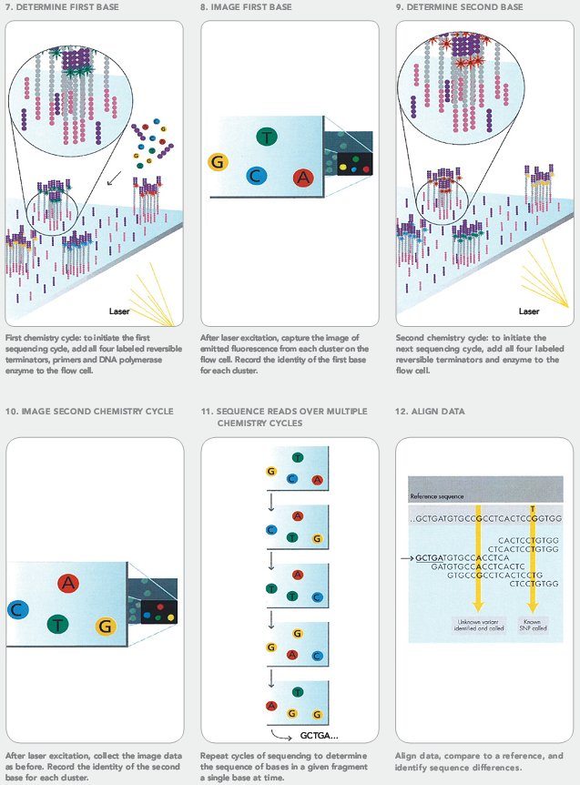
Illumina Sequencing

Slide 64
Next-Gen Sequencing
Take home message: Massively Parallel
1,000 monkeys at 1,000 typewriters is nothing
We’re talking 100,000 to 100 million concurrent reads

Slide 65
Overview
Prologue: Assembly and Finishing
The Past: Sanger
The Present: Next-Gen (454, Illumina, …)
The Future: ? (Nanopore, MinION, Single-molecule)

Slide 66
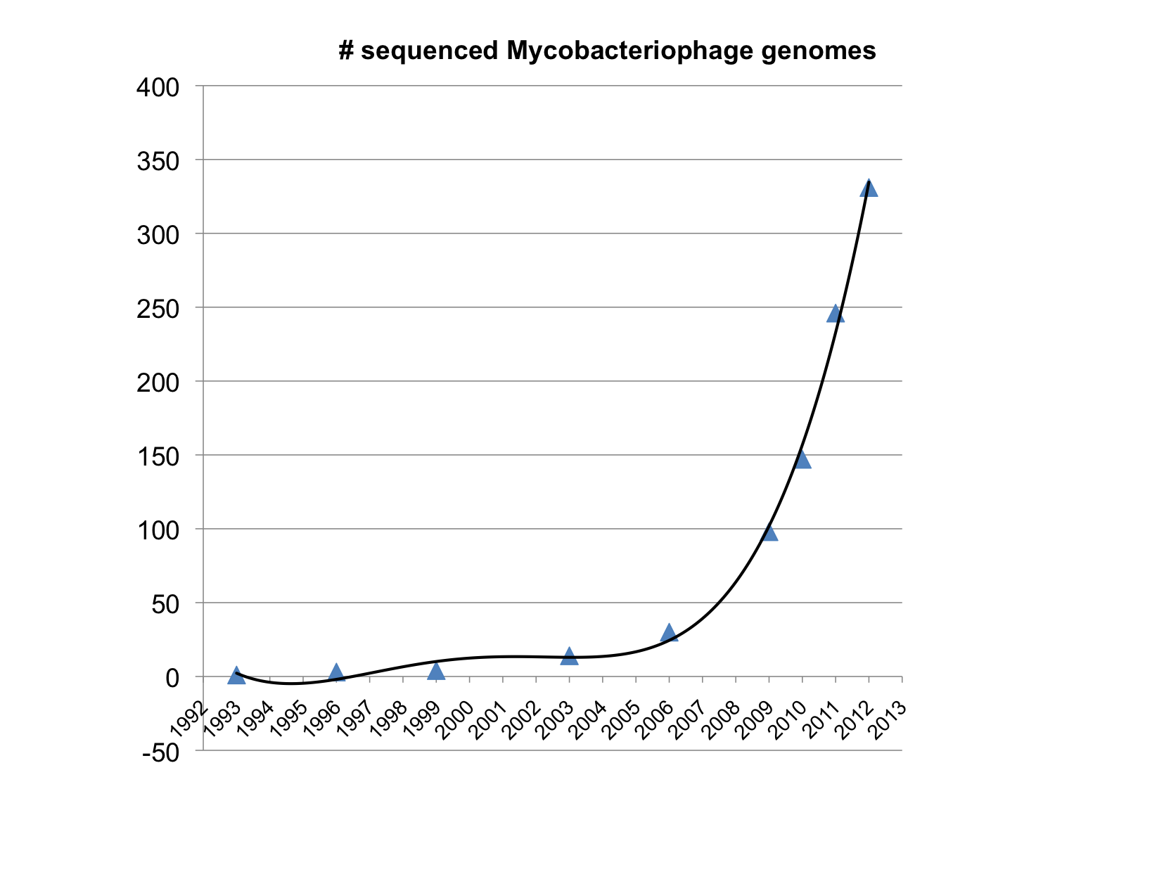
Largely because of PHIRE and SEA-PHAGES…

Slide 67
DNA Sequencing over Time
from The Economist
Notes:
Amazing growth in info and concurrent drop in price.
Story about 1 base thesis.
Now 1/1000 cent per base.

Slide 68
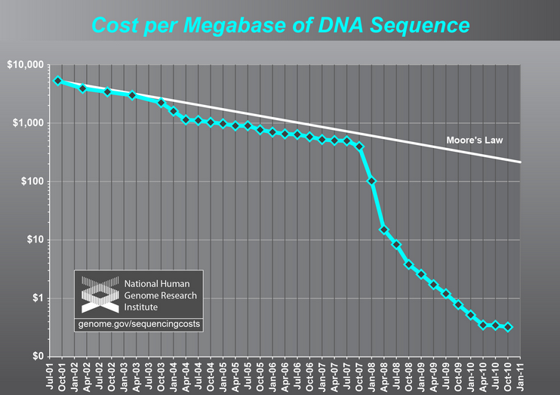

Slide 69
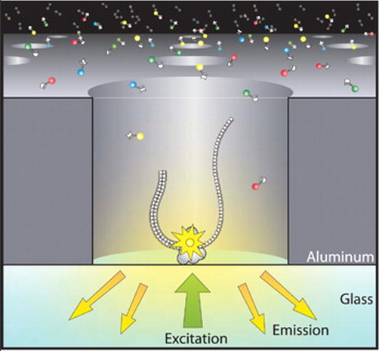
Single Molecule Sequencing

Slide 70
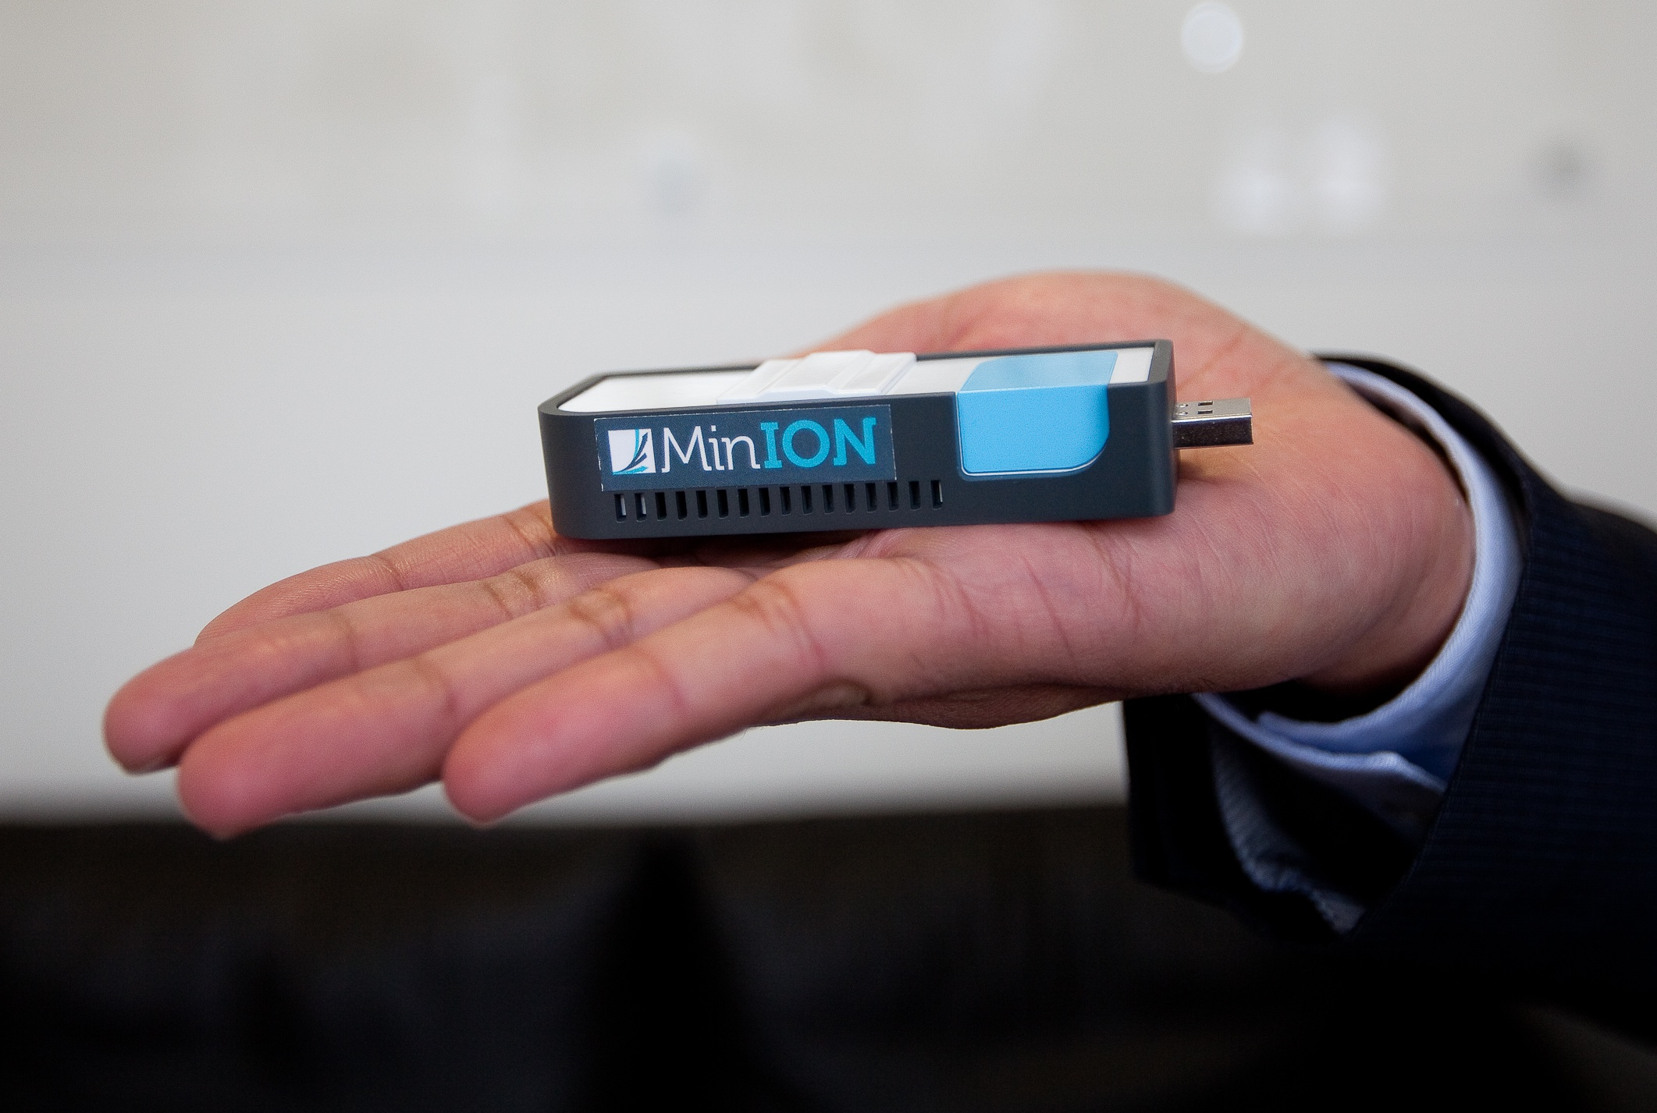
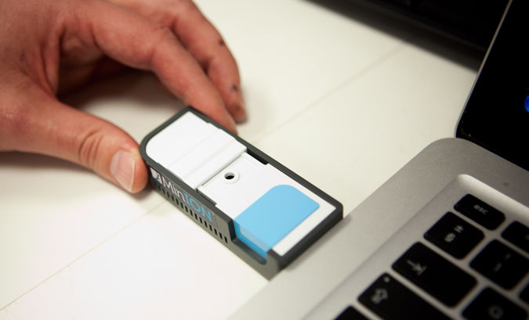

Slide 71
“The MinION has been used to successfully read the genome of a lambda bacteriophage, which has 48,500-ish base pairs, twice during one pass. That's impressive, because reading 100,000 base pairs during a single DNA capture has never been managed before using traditional sequencing techniques.
The operational life of the MinION is only about six hours, but during that time it can read more than 150 million base pairs. That's somewhat short of the larger human chromosomes (which contain up to 250 million base pairs), but Oxford Nanopore has also introduced GridION -- a platform where multiple cartridges can be clustered together. The company reckon that a 20-node GridION setup can sequence a complete human genome in just 15 minutes.”
—Wired

Slide 73
Epilogue
So should we really still be sequencing more mycobacteriophage genomes? We have 250+…

Slide 74
Chimps vs. Humans
At the DNA level…
> 95% similar
Cluster A vs. Cluster B Mycobacteriophages
< 50% similar
…but that’s just one pair of clusters, how many are there?

Slide 75
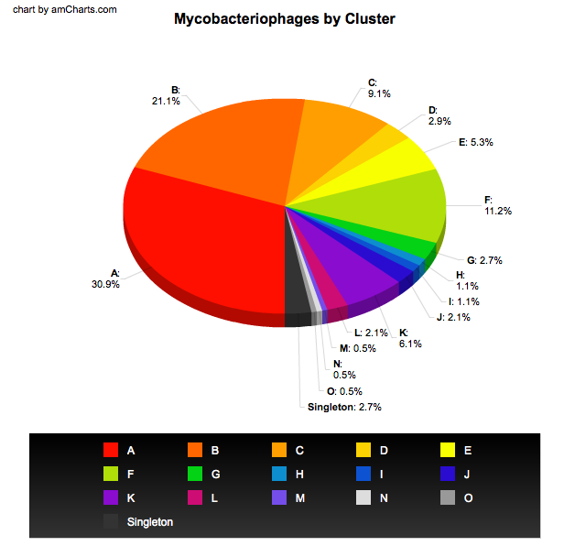
DNA Sequencing over Time
from The Economist
Notes:
Amazing growth in info and concurrent drop in price.
Story about 1 base thesis.
Now 1/1000 cent per base.

Slide 76
Comparing Different Technologies
Sanger Sequencing
Advantages | Disadvantages
Lowest error rate Long read length (~750 bp) Can target a primer | High cost per base Long time to generate data Need for cloning Amount of data per run

Slide 77
Comparing Different Technologies
454 Sequencing
Advantages | Disadvantages
Low error rate Medium read length (~400-600 bp) | Relatively high cost per base Must run at large scale Medium/high startup costs

Slide 78
Comparing Different Technologies
Ion Torrent Sequencing
Advantages | Disadvantages
Low startup costs Scalable (10 – 1000 Mb of data per run) Medium/low cost per base Low error rate Fast runs (<3 hours) | New, developing technology Cost not as low as Illumina Read lengths only ~100-200 bp so far

Slide 79
Comparing Different Technologies
Illumina Sequencing
Advantages | Disadvantages
Low error rate Lowest cost per base Tons of data | Must run at very large scale Short read length (50-75 bp) Runs take multiple days High startup costs De Novo assembly difficult

Slide 80
Comparing Different Technologies
PacBio Sequencing
Advantages | Disadvantages
Can use single molecule as template Potential for very long reads (several kb+) | High error rate (~10-15%) Medium/high cost per base High startup costs

