Slide 1
Bacteriophage Gene Functions
Welkin Pope
SEA-PHAGES In Silico Workshop, 2014

Slide 2
Anaya
Virion structural and assembly genes, i.e. those encoding proteins that are either components of virion particles or assist in their formation. These include genes encoding the terminase, portal, capsid maturation protease, scaffolding protein, major capsid protein, head to tail connectors, major tail subunit, tail assembly chaperones, tape measure protein, and minor tail proteins.
Genes involved in phage DNA replication. These include DNA polymerase, DNA primase, DNA helicase, nucleotide metabolism genes, and ssDNA binding proteins.
Genes involved in life cycle regulation. These include various regulators such as repressors and activators, integrases, recombination directionality factors, etc.
Genes involved in lysis, including endolysins (referred to as Lysin A in the mycobacteriophages), Lysin B, and Holins.
Other well-characterized genes, including transcription factors, toxin/anti-toxin systems, peptidases, phosphatases, host gene homologues, methylases, nucleases, and DNA binding proteins, among others.

Slide 3
Structural genes

Slide 5
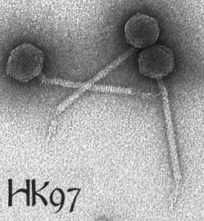
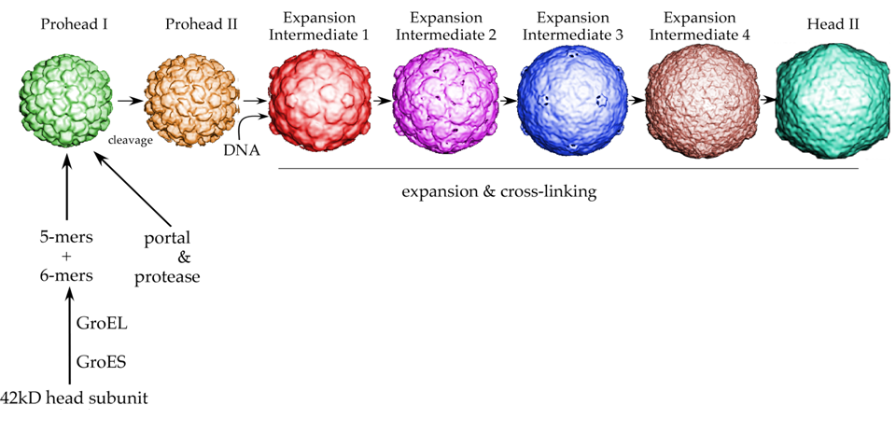
Bacteriophage HK97
(gp3)
(gp4)
(gp5, mcp)
Conway, Duda, and Hendrix

Slide 6
Bob Duda

Slide 7
Functional Assignments
BLAST GenBank
Conserved Domains
HHPred
Synteny
Using the Hatfull maps
BLAST Phagesdb
Phamerator

Slide 8
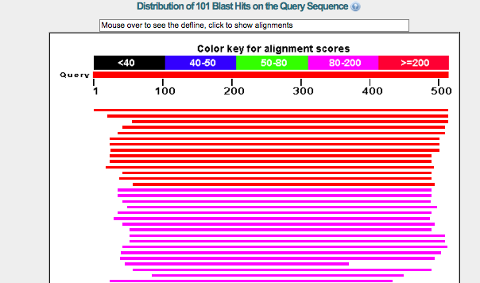

Slide 9
Conserved Domain Database

Slide 10
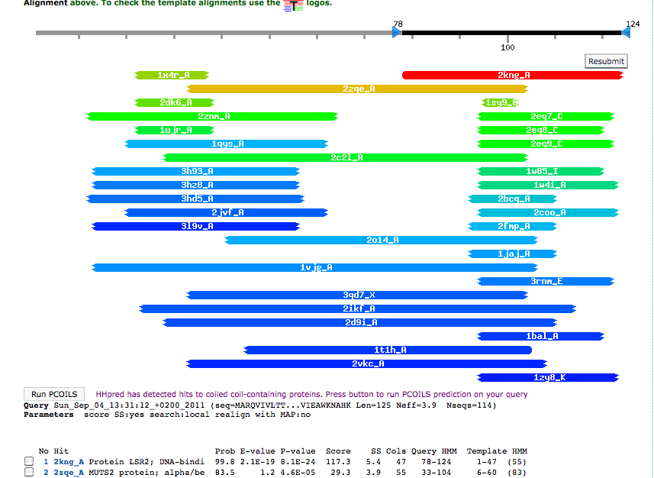
HHPred

Slide 11
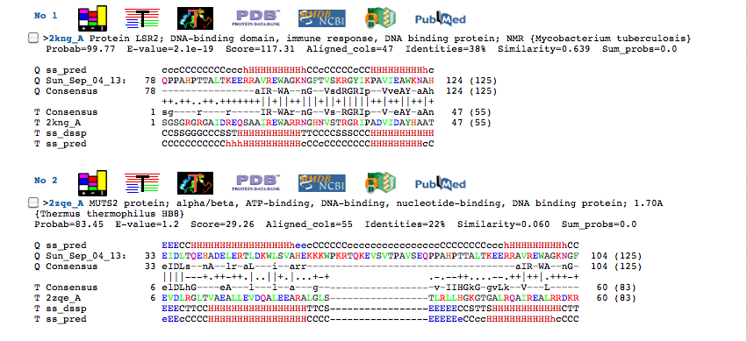

Slide 12
Synteny
Phage gene order is *somewhat* conserved
Terminase → Portal → Capsid Maturation Protease → Scaffolding → Major Capsid Subunit → Major Tail Subunit → Tail Assembly Chaperones → Tape measure → Minor Tail Proteins
Lysis (lysins, holins)
Integration cassette
DNA metabolism/Replication

Slide 13
Phagesdb

Slide 14
Phamerator

Slide 16
Assigning Functions and function sources in your Annotation File
First: Phamerator/Phagesdb. Include phagename and gene number.
Most of these will be supported by HHpred and BLAST on NCBI.
Second: If you find a new function NOT in Phamerator/Phagesdb or in conflict with the Phamerator/Phagesdb assignment, include in your notes:
HHpred, Include probability score and approximate % of match length.
Or --
BLASTp pn NCBI. Include e value, species/phagename, and approximate % of match length.
Finally: Include any other support you would like to. (Run TMHMM on a putative holin, and find two transmembrane domains? Write it down! Find one unlabeled gene between the portal and the major capsid protein? Sounds like a good candidate for the capsid maturation protease, assigned via synteny!)

