Slide 1
Predicting Genes in Mycobacteriophages
December 10, 2013
D. Jacobs-Sera

Slide 2
It is all about finding the patterns…
Since the beginning of time, woman (being human) has tried to make order and sense out of her surroundings. Gene annotation and analysis is just a primal instinct to make order.
Young children, as they prepare to enter school, are tested to see if they are ready by recognizing patterns, a form of making order.
1. Where will the dot appear in the 4th box?
Remember, everything you need to know, you learned in kindergarten….

Slide 3
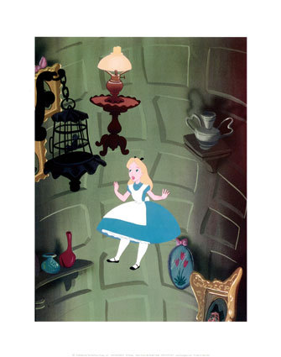
Make-Believe or Putative
Remember, you are working in the putative gene world. All gene predictions are made with the best evidence to date. Most of that evidence is computational (bioinformatic), not experimental. Tomorrow’s data may give us better evidence, but your prediction today is the best it can be … today! Make good predictions following a consistent approach. Let these predictions lead to experimentation that can provide the evidence to improve future predictions.

Slide 4
What is the universal format for a sequence?
How many ATCGS are in a typical
mycobacteriophage genome?
On average 70,000 base-pairs
Range 40,000 to 165,000 bps
FASTA

Slide 5
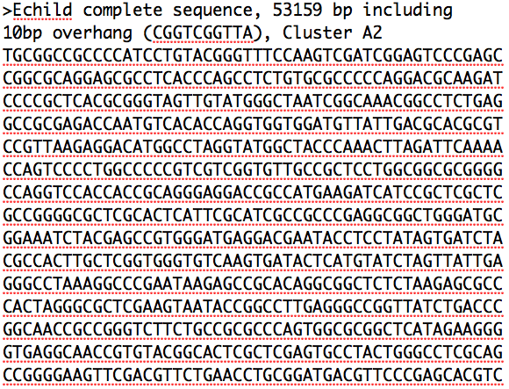

Slide 6
How do you make sense of the ATCGs?
Convert to genes
How do you convert ATCGs to Genes?
Codons
Code for Amino Acids, Starts, Stops

Slide 7
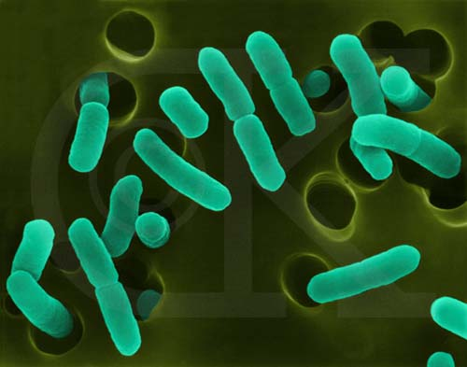
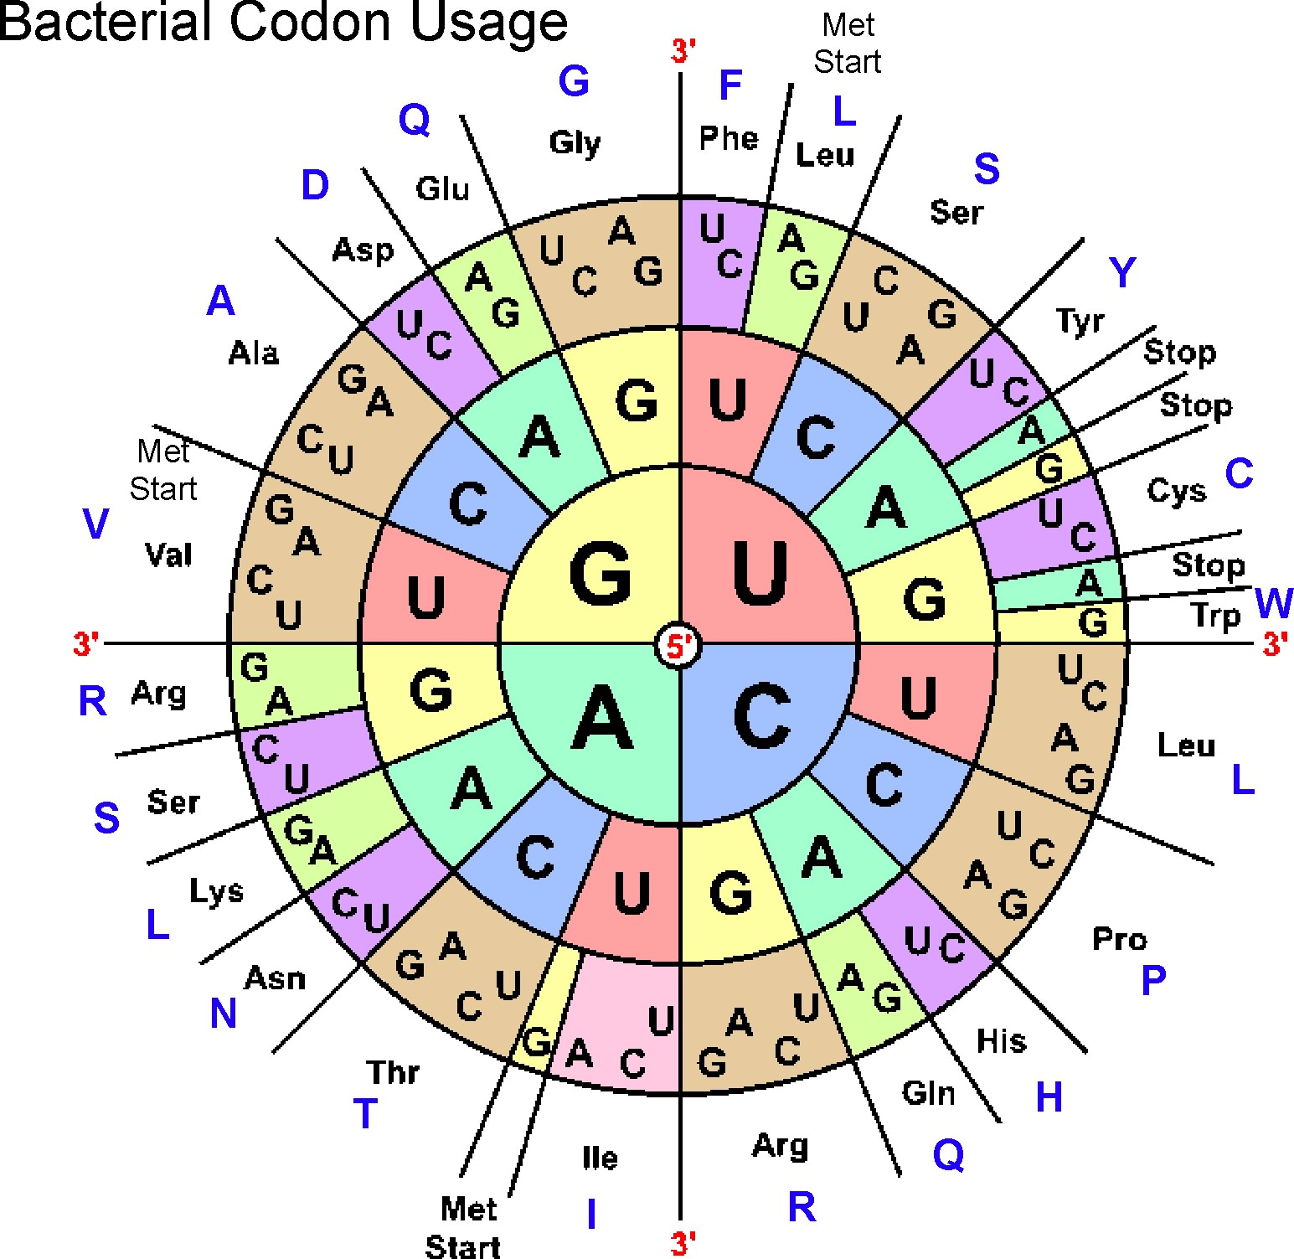
Phages use the Bacterial
Plastic code (NCBI: Table 11)
3 starts
ATG (methionine)
GTG (valine)
TTG (leucine)
3 stops (TAA, TAG, TGA)
Space in-between: Open Reading Frame -- ORF
www.cen.ulaval.ca

Slide 8
ATGGACCTCTCGCCC
ATG GAC CTC TCG CCC
TGG ACC TCT CGC ….
GGA CCT CTC GCC ….
If there are 3 choices (frames) in the forward direction,
how many are in the reverse direction?

Slide 9
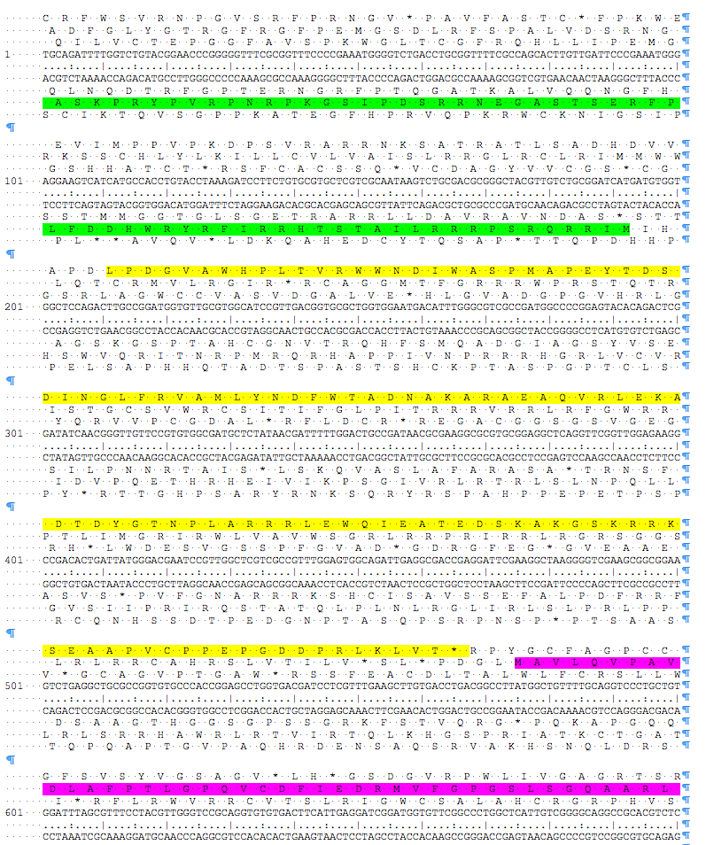
Six Frame Translations

Slide 10
We use 2 programs, Glimmer and GeneMark, to identify coding potential.
We can use Phamerator output for quick visual representation of gene and nucleotide similarity
We can:
Add a gene
Delete a gene
Change a gene start
What is the supporting data?

Slide 11
Other features found in
Mycobacteriophage genomes
tRNAs
tmRNAs
AttP sites
Terminators
Frame shifts
…

Slide 12
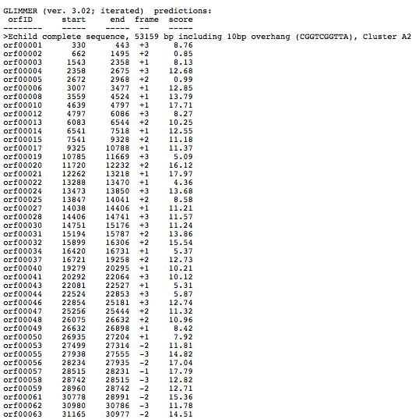
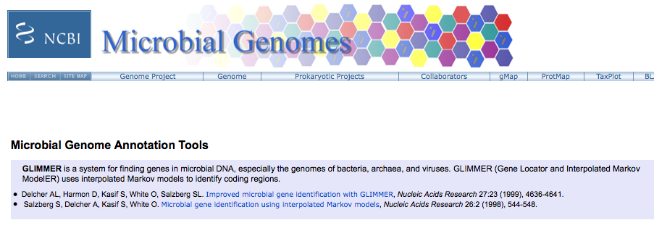

Slide 13
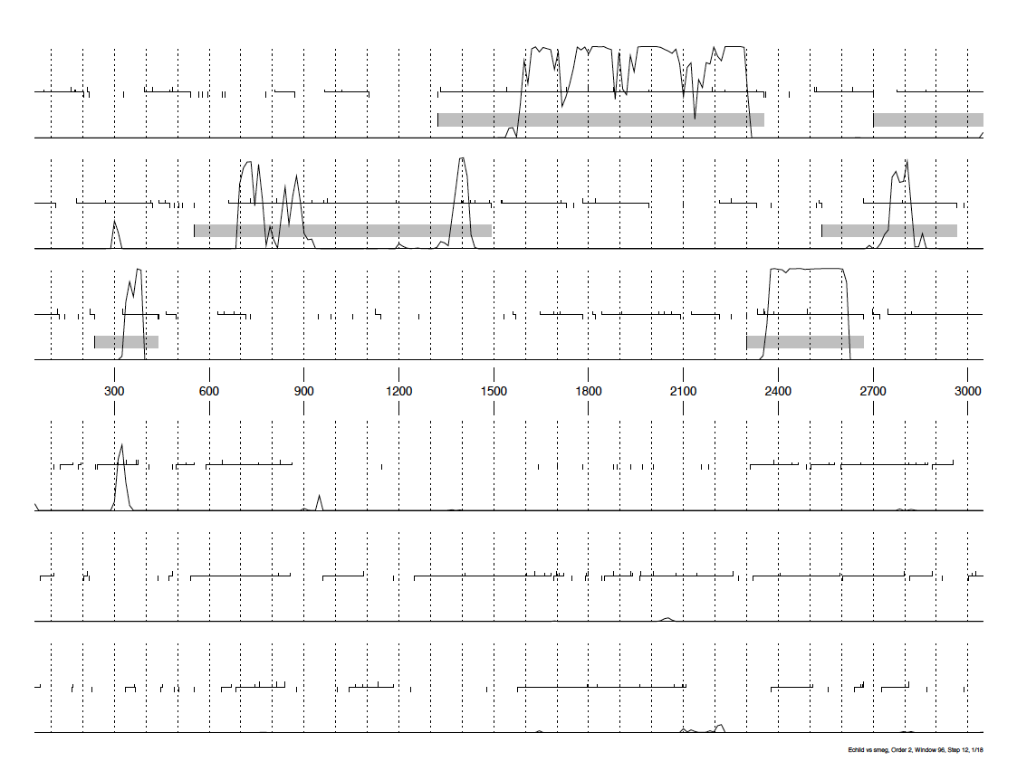
GeneMark Output (trained on M. smegmatis)

Slide 14
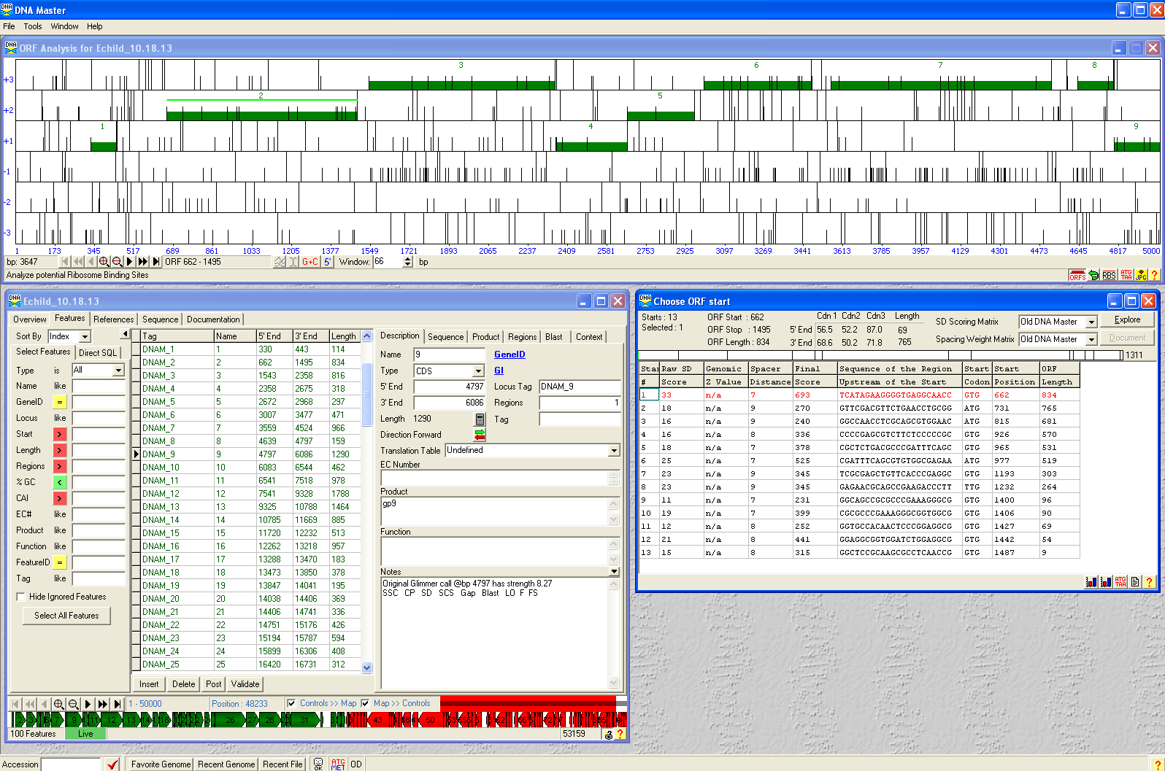

Slide 15
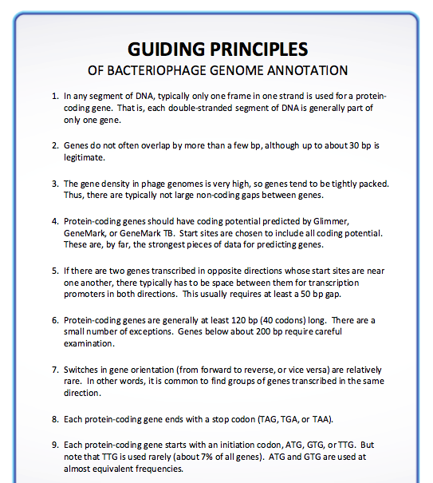
p. 60 -61

Slide 16
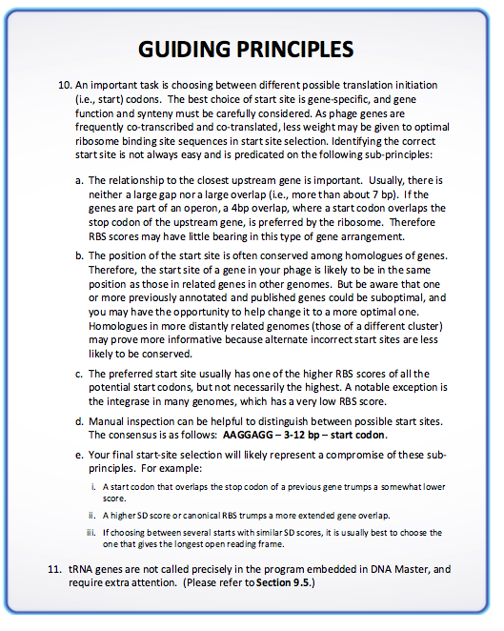

Slide 17
Comparisons with what we already know
Phamerator comparisons
BLAST comparisons
At NCBI
At phagesDB

Slide 18
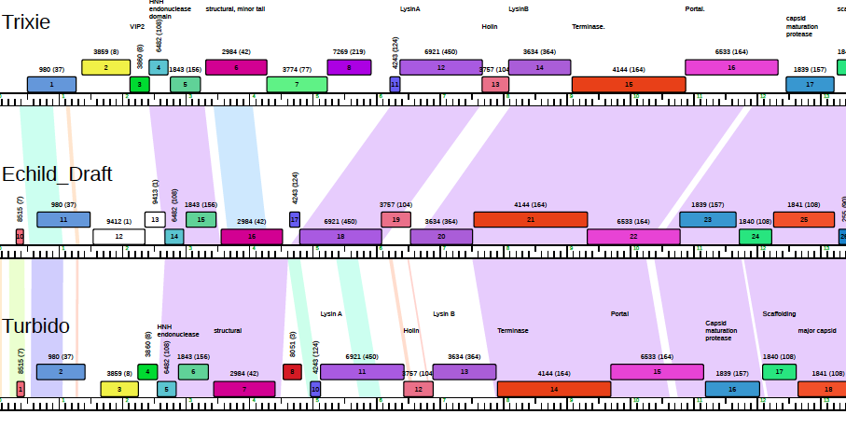
Phamerator map

Slide 19
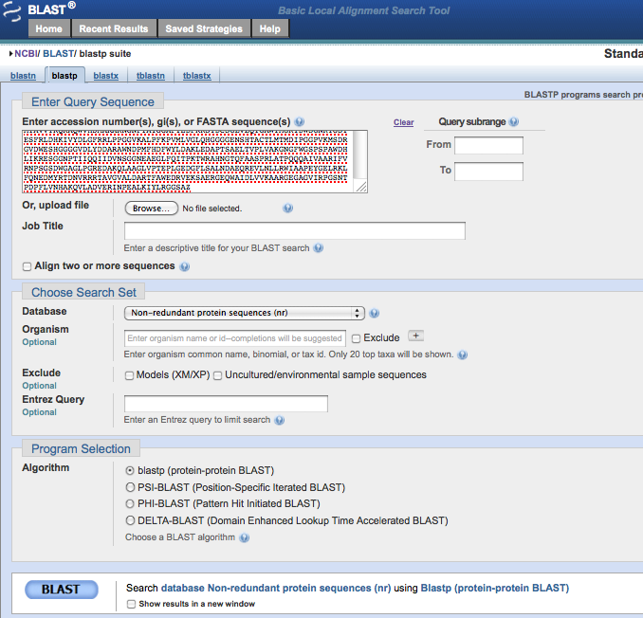
Blast Comparisons

Slide 20
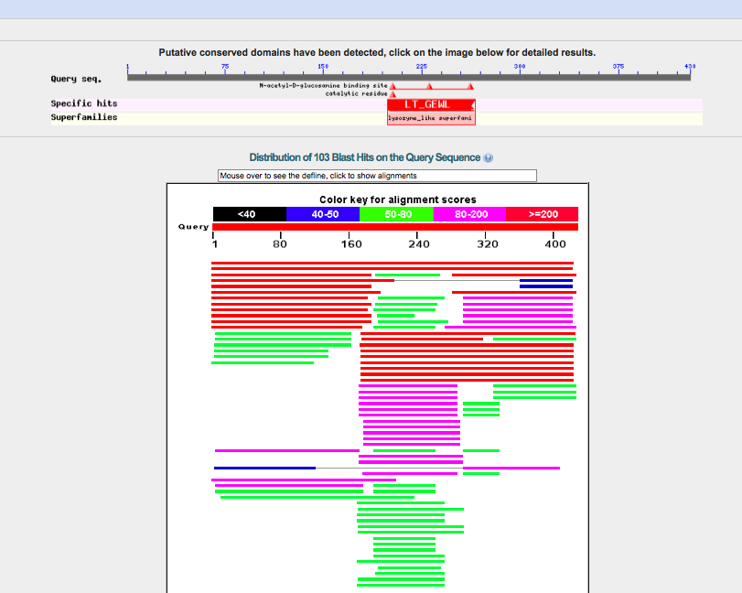

Slide 21
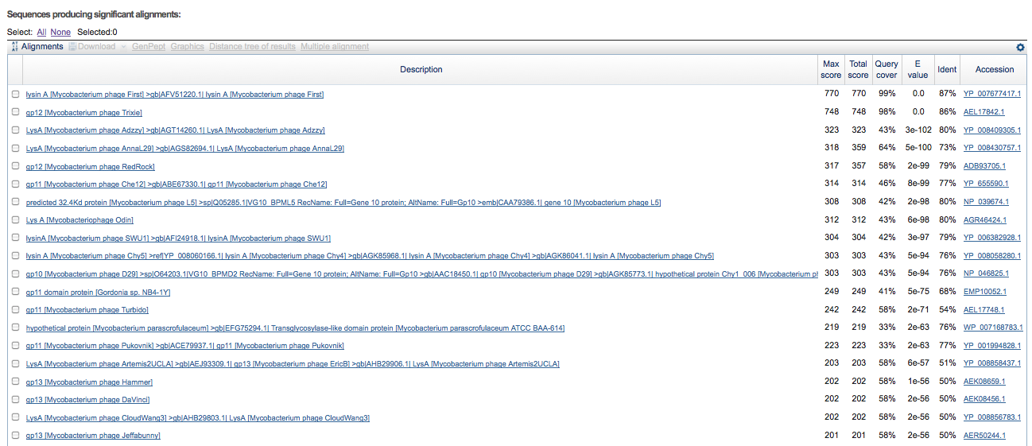

Slide 22
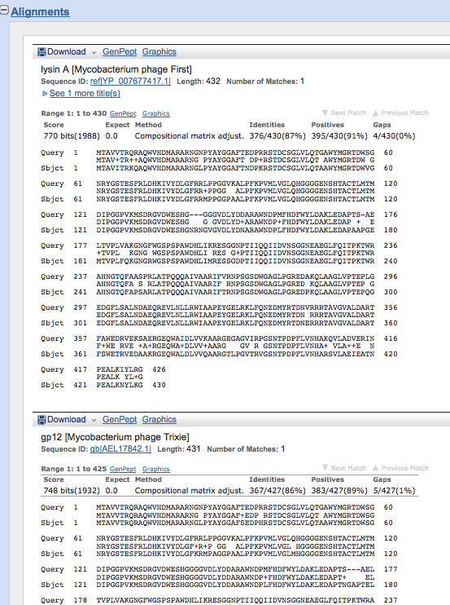

Slide 23
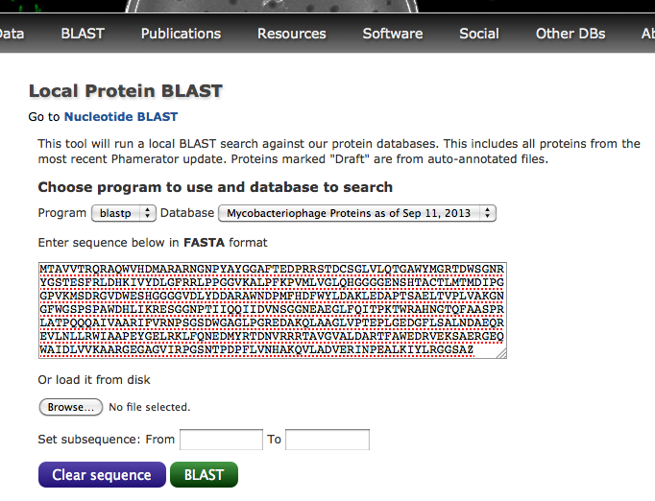

Slide 24
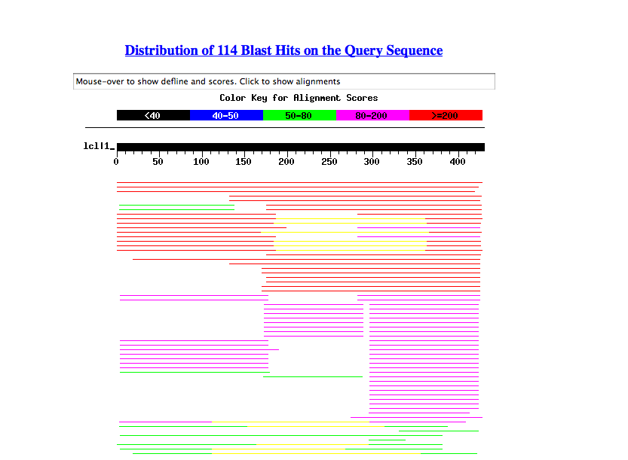

Slide 25
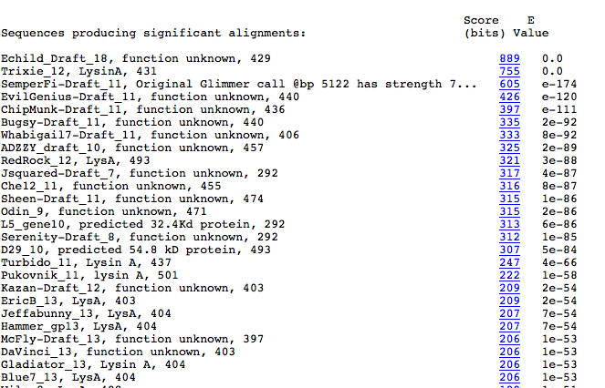

Slide 26
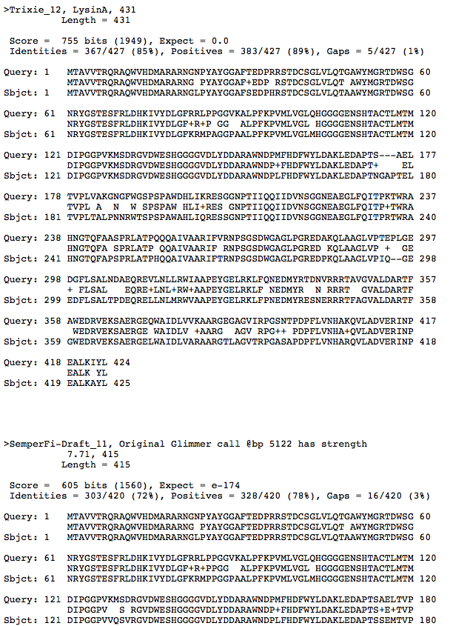

Slide 27
Things to do often:
Save .dnam5 file often
Save .dnam5 file as a new name. (Then don’t save the old named one.)

Slide 28
