Slide 1
Predicting Genes in Mycobacteriophages
December 8, 2014
2014 In Silico Workshop Training
D. Jacobs-Sera

Slide 2
It is all about finding the patterns…
Since the beginning of time, woman (being human) has tried to make order and sense out of her surroundings. Gene annotation and analysis is just a primal instinct to make order.
Young children, as they prepare to enter school, are tested to see if they are ready by recognizing patterns, a form of making order.
1. Where will the dot appear in the 4th box?
Remember, everything you need to know, you learned in kindergarten….

Slide 3
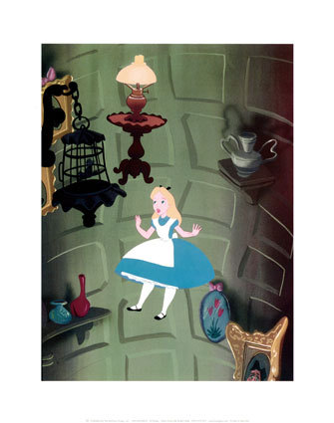
Make-Believe or Putative
Remember, you are working in the putative gene world. All gene predictions are made with the best evidence to date. Most of that evidence is computational (bioinformatic), not experimental. Tomorrow’s data may give us better evidence, but your prediction today is the best it can be … today! Make good predictions following a consistent approach. Let these predictions lead to experimentation that can provide the evidence to improve future predictions.

Slide 4
What is the universal format for a sequence?
How many ATCGS are in a typical
mycobacteriophage genome?
On average 70,000 base-pairs
Range 40,000 to 165,000 bps
FASTA

Slide 5
How many bacteriophage genome sequences are in GenBank?
1800+
How many mycobacteriophage genomes
are sequenced?
694
How many mycobacteriophage genomes
are published?
Tricky Question
Number in GenBank: 422
Number announced: ~301
Number in an additional publication: pending!

Slide 6
What is the universal format for a sequence?
How many ATCGS are in a typical
mycobacteriophage genome?
On average 70,000 base-pairs
Range 40,000 to 165,000 bps
FASTA

Slide 7
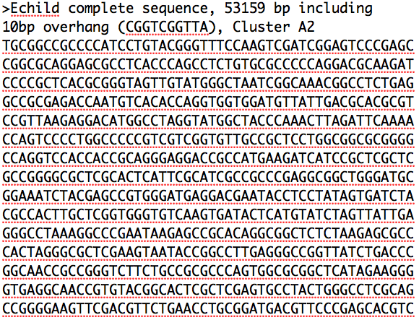

Slide 8
How do you make sense of the ATCGs?
Convert to genes
How do you convert ATCGs to Genes?
Codons
Code for Amino Acids, Starts, Stops

Slide 9
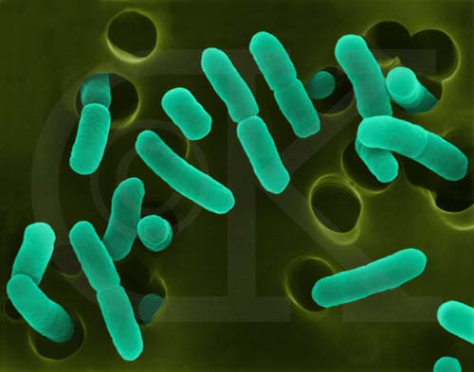
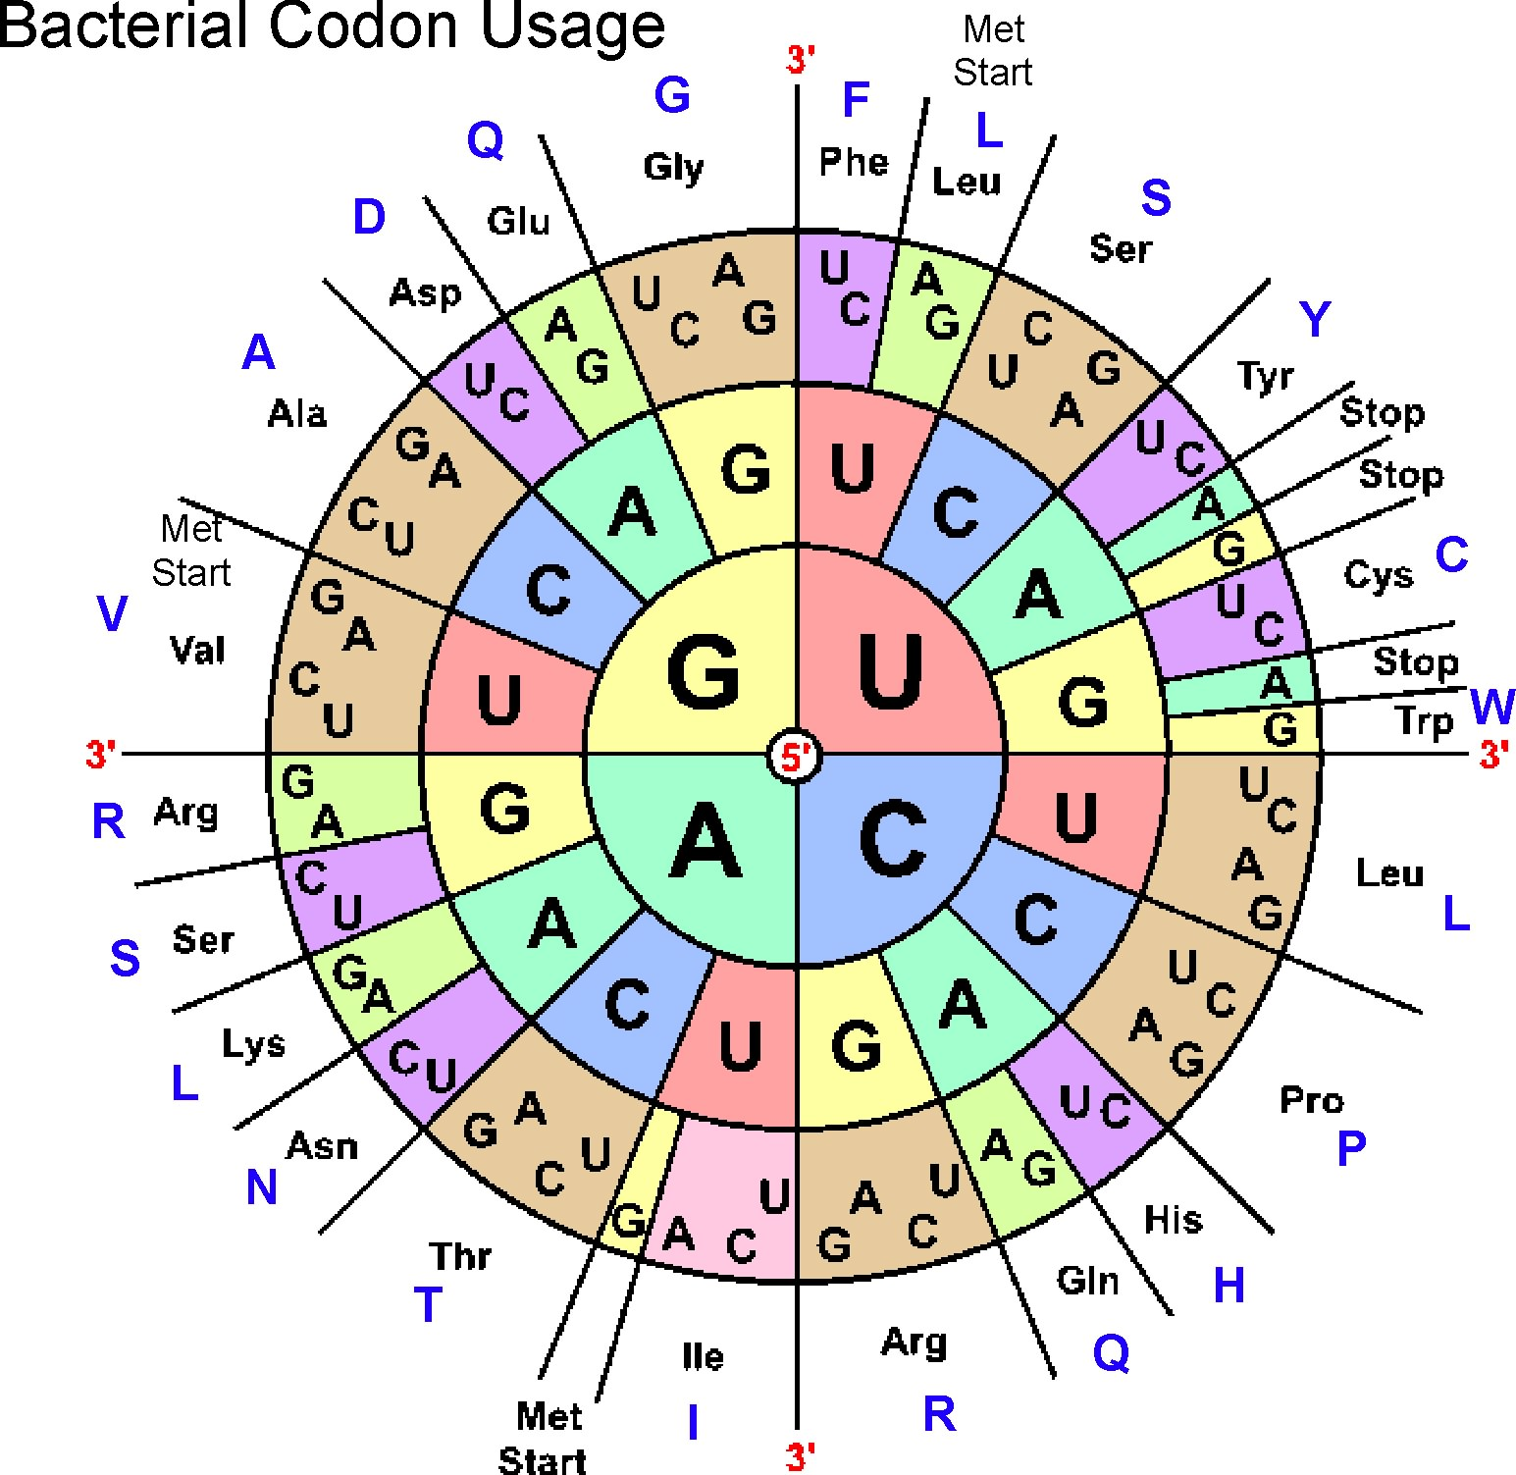
Phages use the Bacterial
Plastic code (NCBI: Table 11)
3 starts
    ATG (methionine)
    GTG (valine)
    TTG (leucine)
      3 stops (TAA, TAG, TGA)
      Space in-between: Open Reading Frame -- ORF
www.cen.ulaval.ca

Slide 10
ATGGACCTCTCGCCC
ATG GAC CTC TCG CCC
TGG ACC TCT CGC ….
GGA CCT CTC GCC ….
If there are 3 choices (frames) in the forward direction,
how many are in the reverse direction?

Slide 11
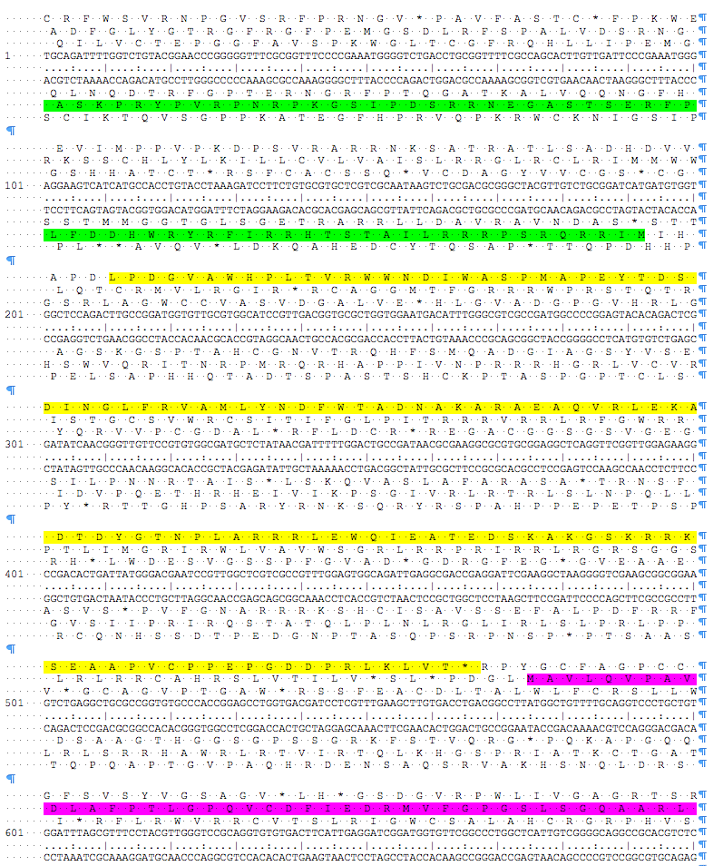
Six Frame Translations

Slide 12
Glimmer and GeneMark
Use Hidden Markov Models to identify coding potential
Use a sample of the genome
Identify longest ORFS in that sample
Calculate patterns in the nucleotides:
    2 at a time, 4 at a time
Concept: Each organism has a codon usage ‘preference’. Bottom line: Codon usage is always skewed.

Slide 13
Codon Usage
Notes:
Normalized synonymous codon usage (NSCU) for M. smegmatis and five phage genomes. An NSCU value of 1.0 is assigned to the most commonly used codon for each amino acid, and the abundances of other codons are given relative to it. The most commonly used codon for each of the 18 amino acids using more than one codon is shown in green. Blue is codons the correspond to tRNAS of smeg that are not commonly used. Red are the codons that differ from smeg

Slide 14
Gene Evaluations
We use 2 programs, Glimmer and GeneMark, to identify coding potential.
We use Phamerator output for a visual representation of gene and nucleotide similarity
As we evaluate, we can:
  Add a gene
  Delete a gene
  Change a gene start
We are always looking for the supporting data?

Slide 15
Other features found in
Mycobacteriophage genomes
tRNAs ✓
tmRNAs
AttP sites
Terminators
Frame shifts ✓
…

Slide 16
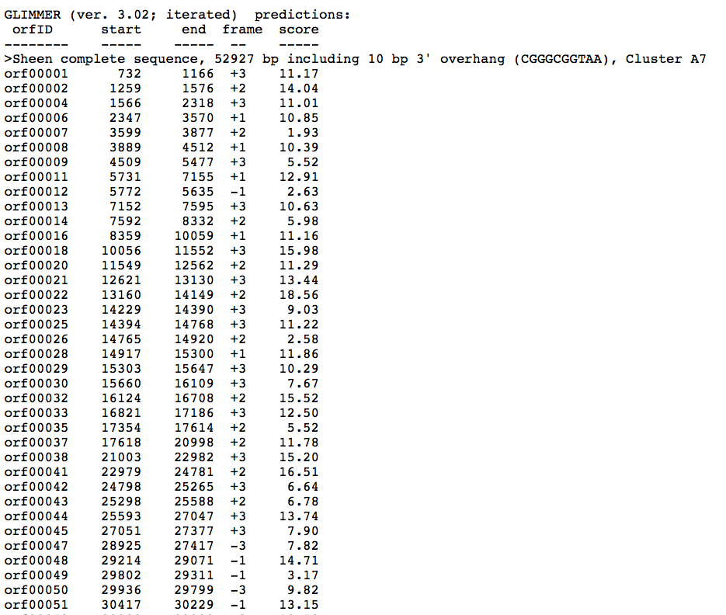
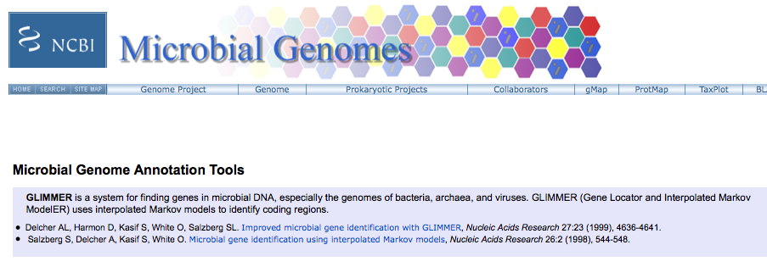
GLIMMER
http://www.ncbi.nlm.nih.gov/genomes/MICROBES/glimmer_3.cgi

Slide 17
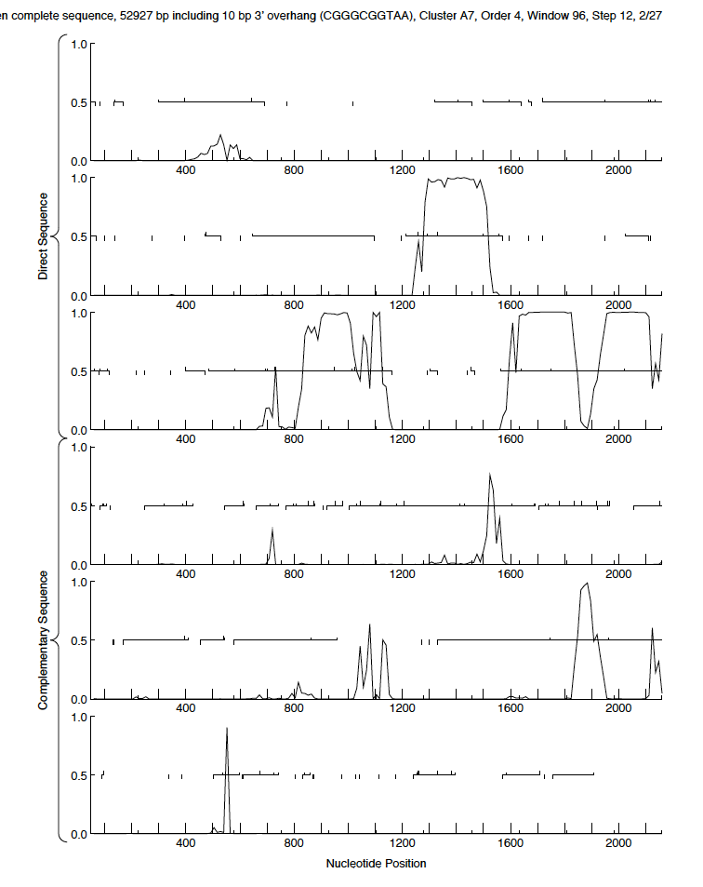
GeneMark Output
(trained on
M. tuberculosis)

Slide 18
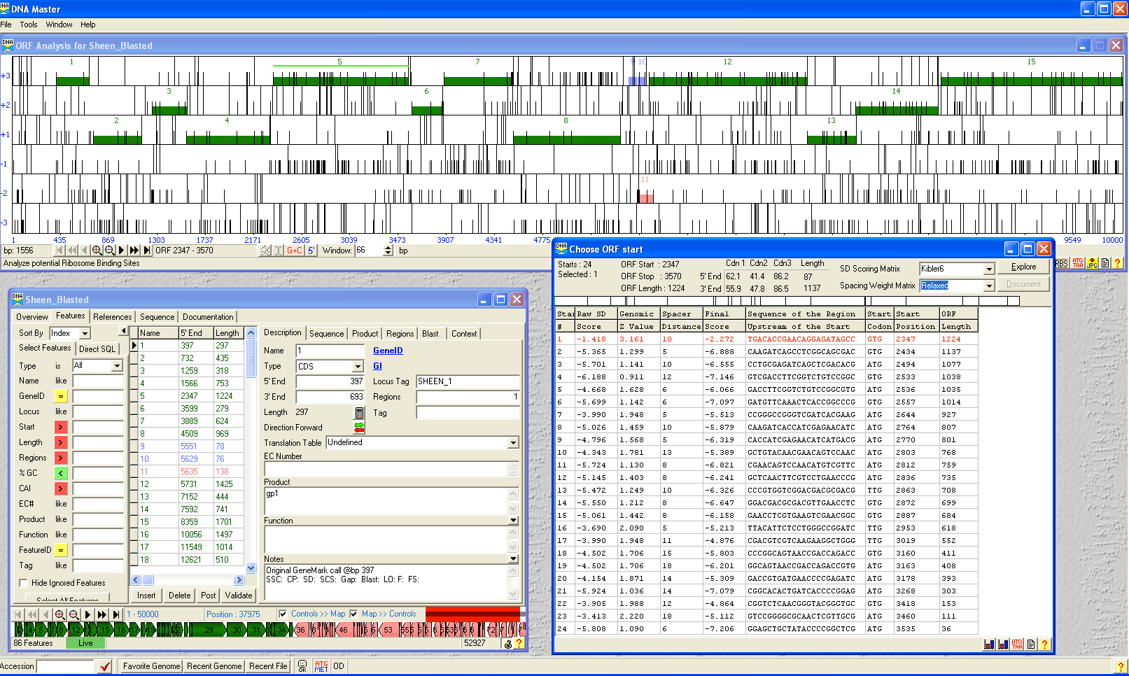

Slide 19
p. 64 -65

Slide 21
Comparisons with what we already know
Phamerator comparisons
BLAST comparisons
    At NCBI
    At phagesDB

Slide 22
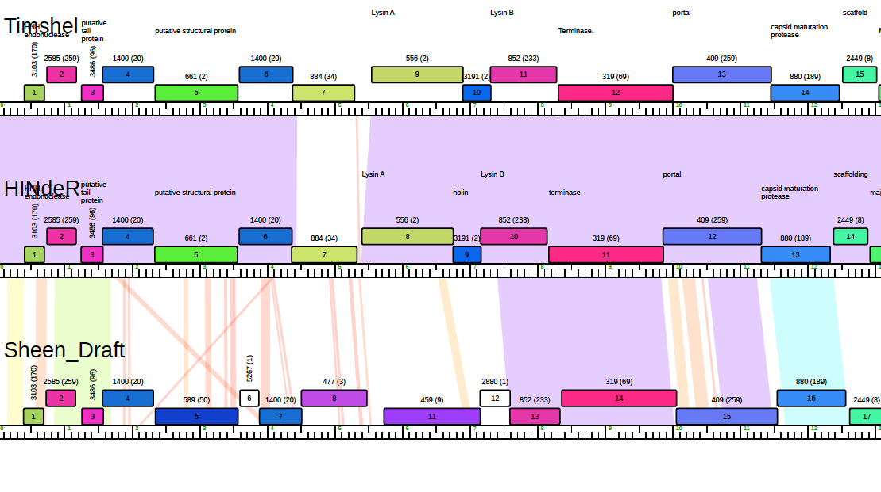
Phamerator map

Slide 23
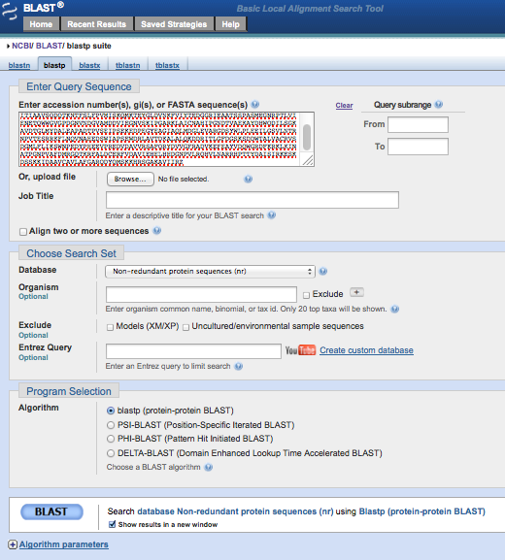
Blast Comparisons

Slide 24
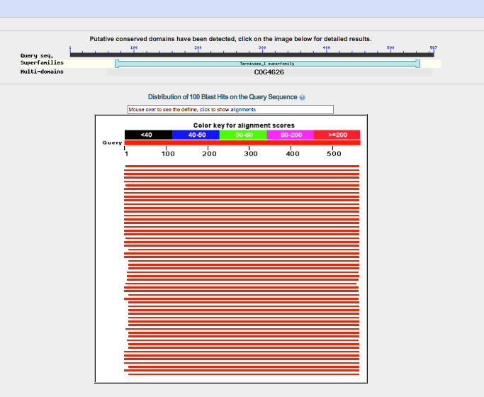

Slide 25
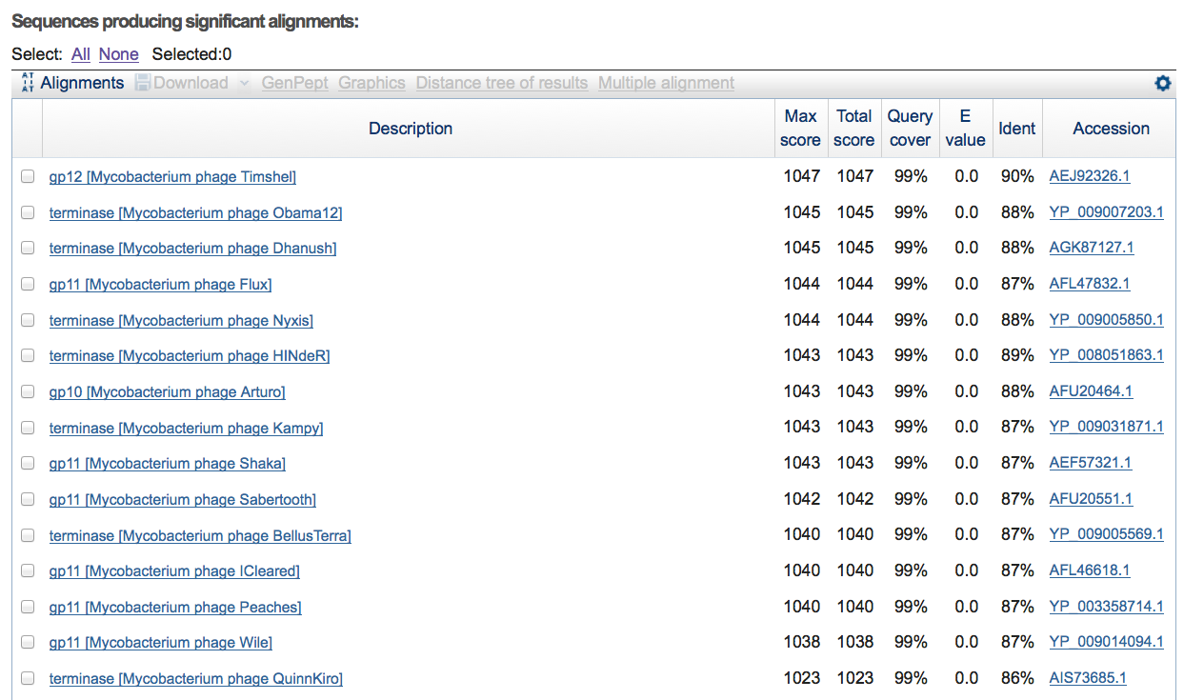

Slide 26
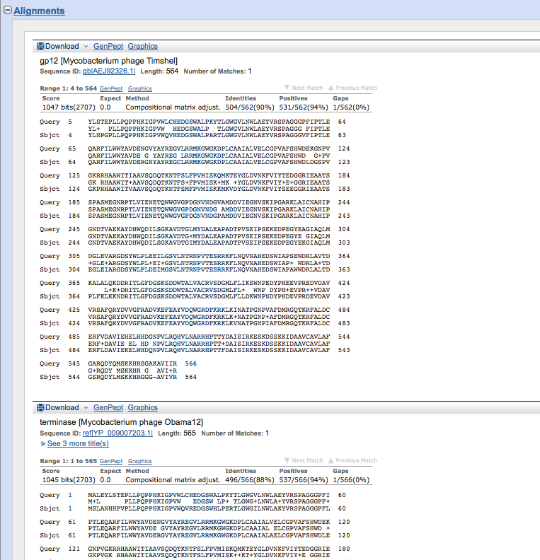

Slide 27
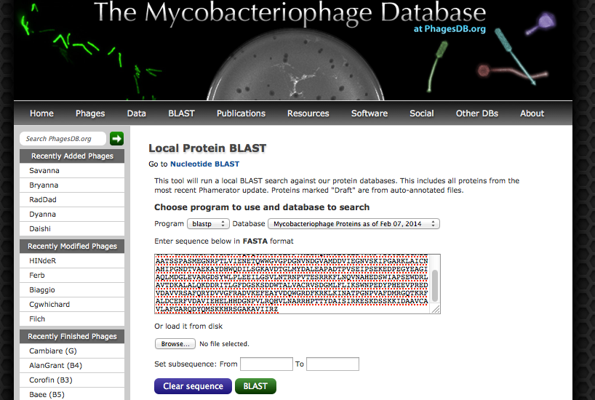

Slide 28
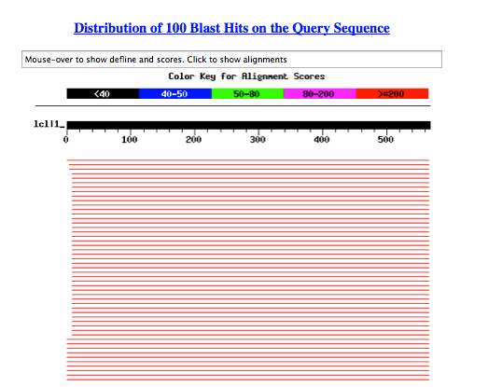

Slide 29
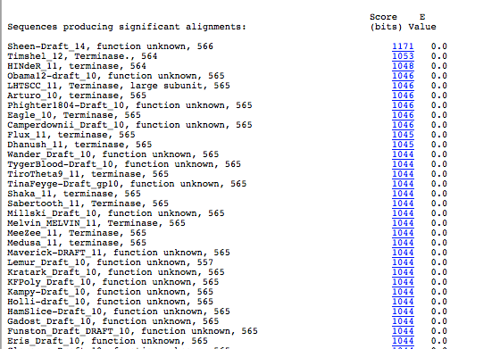

Slide 30
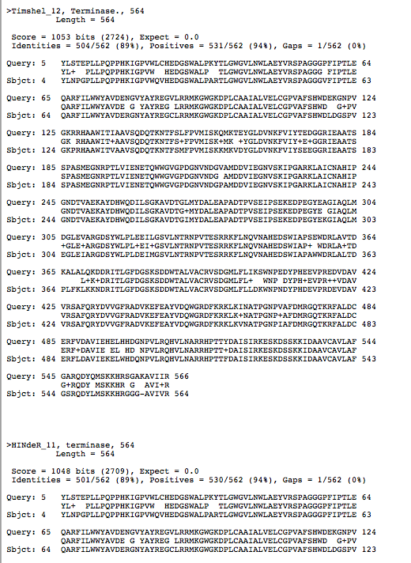

Slide 31
Things to do often:
Save .dnam5 file often
Save .dnam5 file as a new name. (Then don’t save the old named one.)

Slide 32




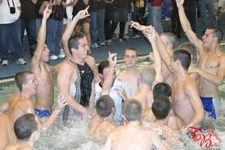

Slide 33
SEA-PHAGES
In-Silico Workshop
December 8, 2014
Getting Started

Slide 34
Let’s get started!
Gather Data
Basic DNA Master functions
Gene Assignments
Functional Assignments

Slide 35
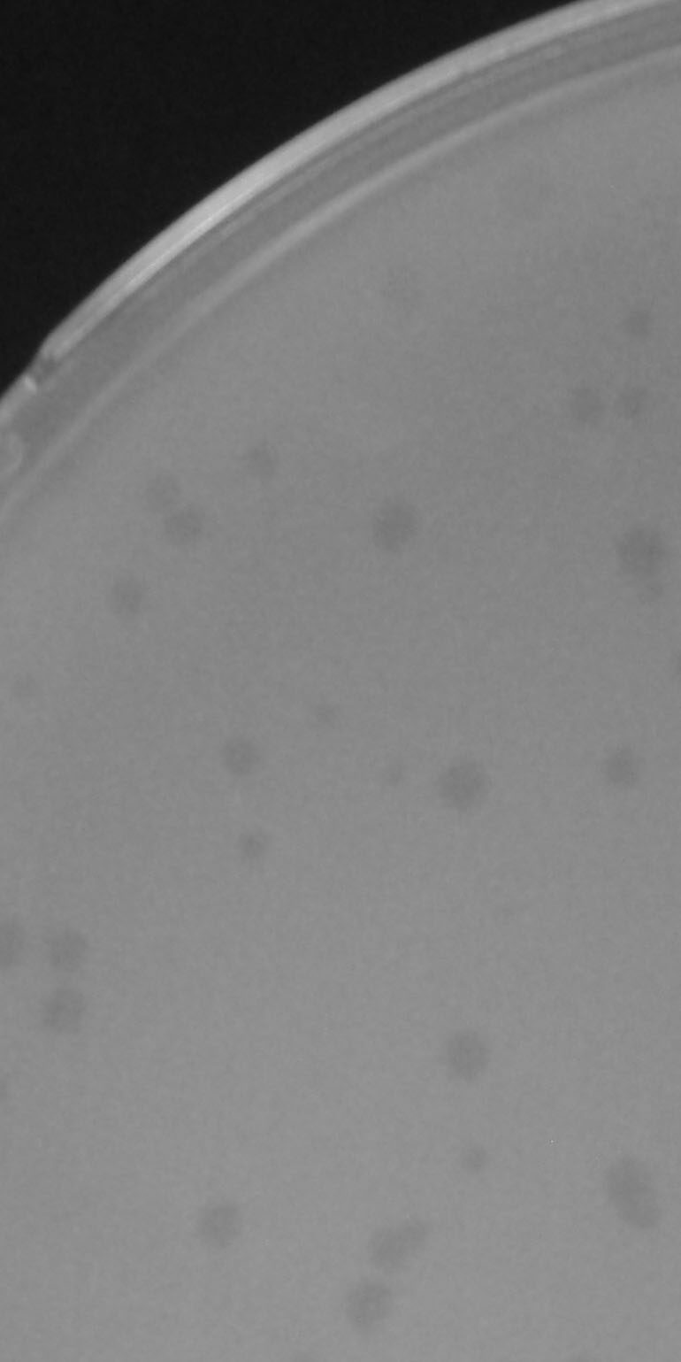
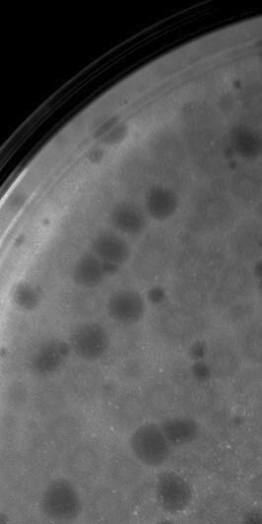
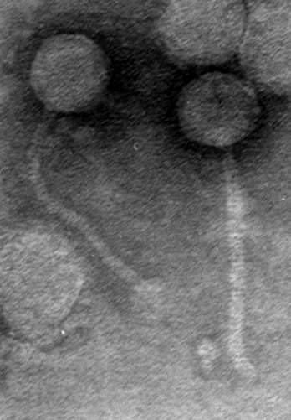
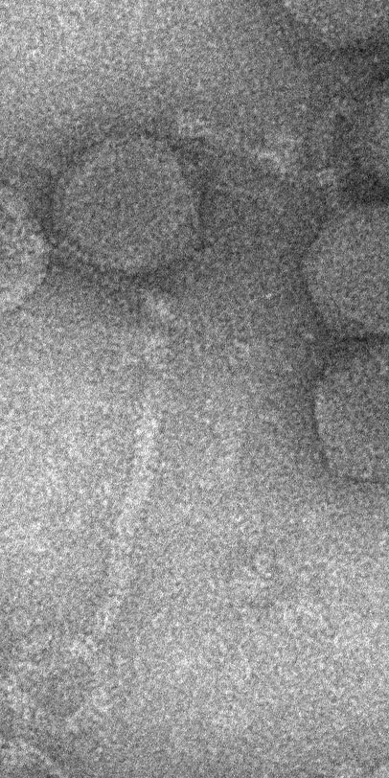
Annotation of Sheen
Found in Fort Kent, ME
by Devon Cote & Zach Daigle
Sheen
Timshel
Timshel
HINdeR
Genome Length: 52927
Defined physical ends, 10 bp overhang
GC content 63.4%

Slide 36
Gathering Data
Obtain your genome (phagesdb.org)
Use DNA Master to obtain Glimmer, GeneMark, and tRNA (Aragorn) data
Obtain GeneMark data on web (trained on M. smeg)
BLAST genome
Phamerator data

