Slide 1
CandC Final Annotation
Evidence

Slide 2
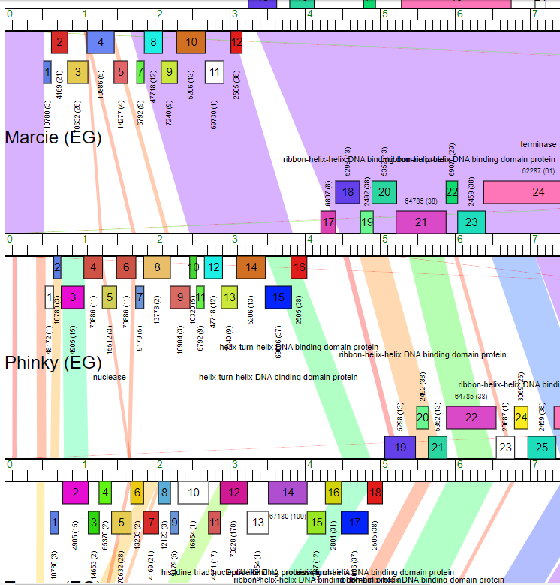
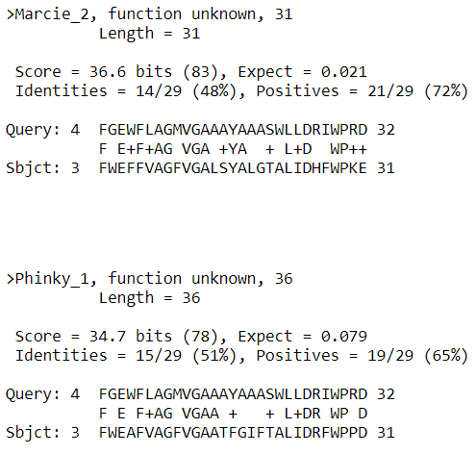
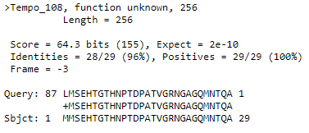
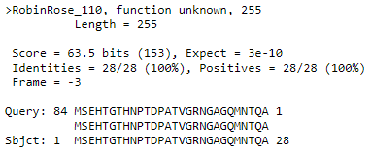
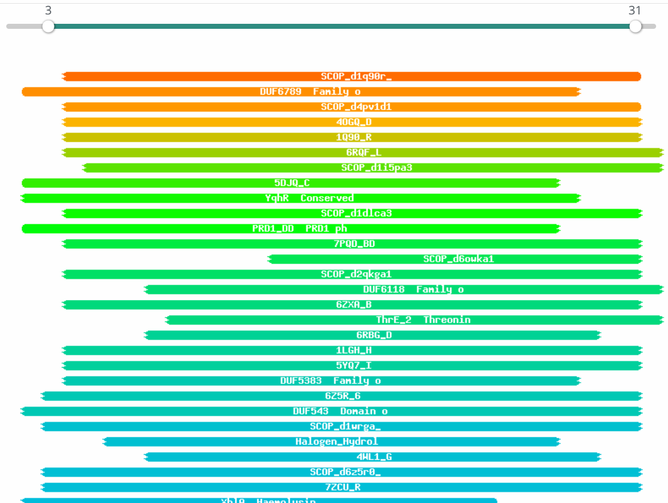
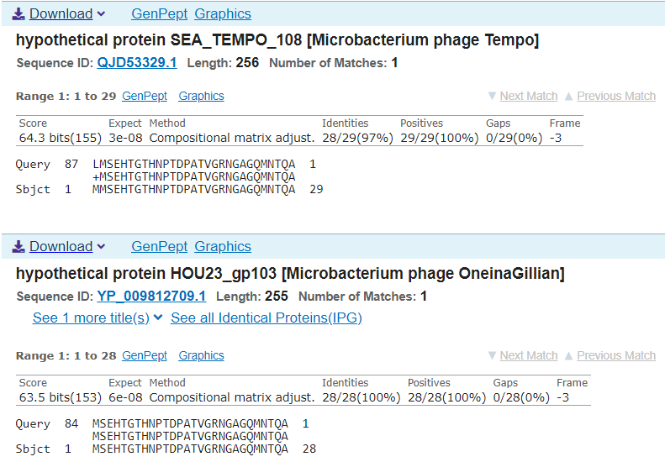
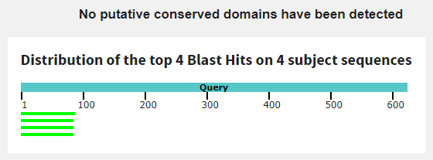
Gene #1 This gene needs to be deleted. Start: 620 Stop: 522
*Highlight start if changed from original call*
1. Is it a gene? No
Gene originally called by: Genemark
Coding potential: Yes, throughout most of the gene.
Other organisms have it? Only two
Marcie and Phinky have some similarities.
Gap investigation: No significant similarities in genes.
2. Where does it start? Close to predicted start
RBS info: Second best, z = 1.807, final = -5.103
Coding potential is close to predicted start, but there is not really any coding potential.
BLAST alignments:
Phagesdb: Marcie, Phinky, 4:3, e-value: 0.021, 0.079
NCBI: No alignments
Starterator: Most called start
Gap: 3 bp gap
Gap is too small, so no coding potential.
3. What is its function?
Final Function Decided: NKF
Must be from approved function list: https://docs.google.com/spreadsheets/d/1FNcTlsU41iI1U8Jq0Yd-YqwJDUa089AInNnULL-K9hE/edit#gid=0
Synteny: Same pham and positional similarity as Marcie_2, downstream from nuclease, and Phiky_1, downstream from histidine triad nucleotide binding protein; both are upstream from genes with no know function.
BLAST Results: Phagesdb, Marcie_2, function unknown, e = 0.021; NCBI, none.
HHPRED results: No significant hits, because E values are too high.
TGCCTGAGTGTTCATCTGTCCTGCTCCGTTCCGTCCGACCGTGGCCGGAT
CTGTGGGGTTGTGAGTGCCGGTGTGTTCCGACAT
CAATCACATTACCGGTTTGAATCGGTATGTCAAGCCCTGATCCAAATCAACCTGGGTTGATTGATC
CGGACCCCCCTACCCCCGCGGAATCGGCCGGCGGGGCTGTCTGTCACCCC
GGTCCCCCACGAATCGCCTGGATGCTTCCCCCAGAAATAGCGTCATACAT
TATGGGATATCCCCAGGGTTATCCACAGGATGAAGCGAGCGGAGCGAAGC
GGGAGCGAGTCTCATCCGGGAGTCGAACTAGCTTCAGAACGCTCCGCTCC
GCTGGCGCTCGCTCGCTCCTGGATGCCCGGGAGGAATGGAGAGAGAAAAC
TGGCCGATAGAAACCGACCCCTGTATCTACTATGTGGTCACCCGGTGACC
TTCTCGAGGTGCACGAGAAGCCCCGTGAGAAGTGCTTCTCGAGAAGCCGA
GAAGATCACCCGGTGACCTTCTCAATCGCGGGGCCAGATGCGATCGAGGA
GCCAGGATGCCGCTGCATAGGCGGCAGCGCCGACCATTCCAGCCAGGAAC
CACTCGCCGAAGTTATCCAC
Date Reviewed: 4/20/23
Notes:
Secondary Annotator Notes: Check each piece of evidence provided and confirm whether your interpretation supports that of the primary annotator:
Secondary Annotator #1 Name:
Secondary Annotator #2 Name:

Slide 3
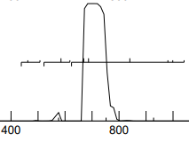
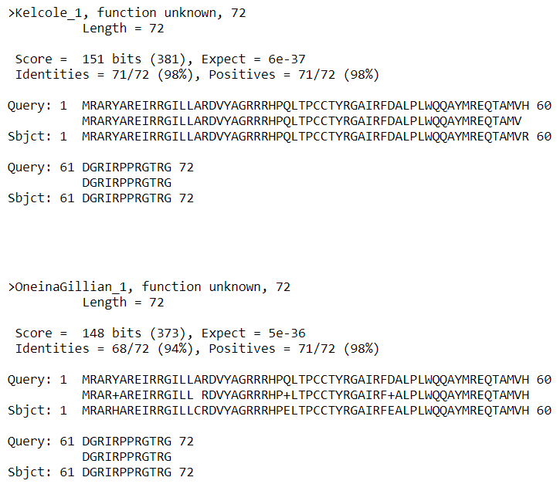
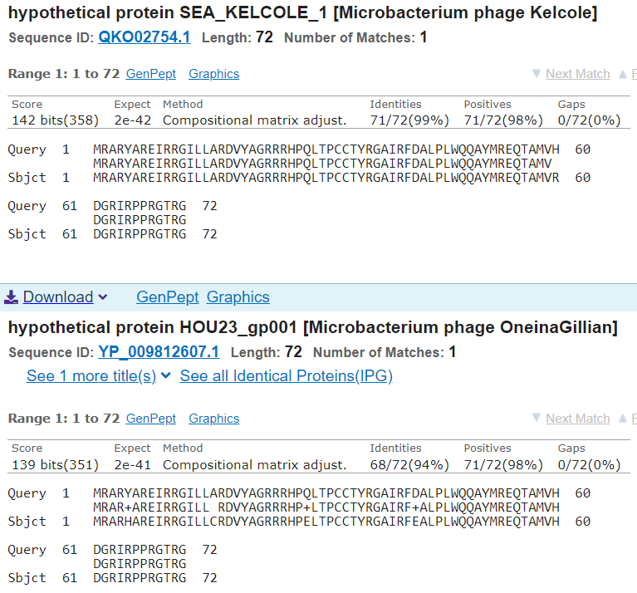
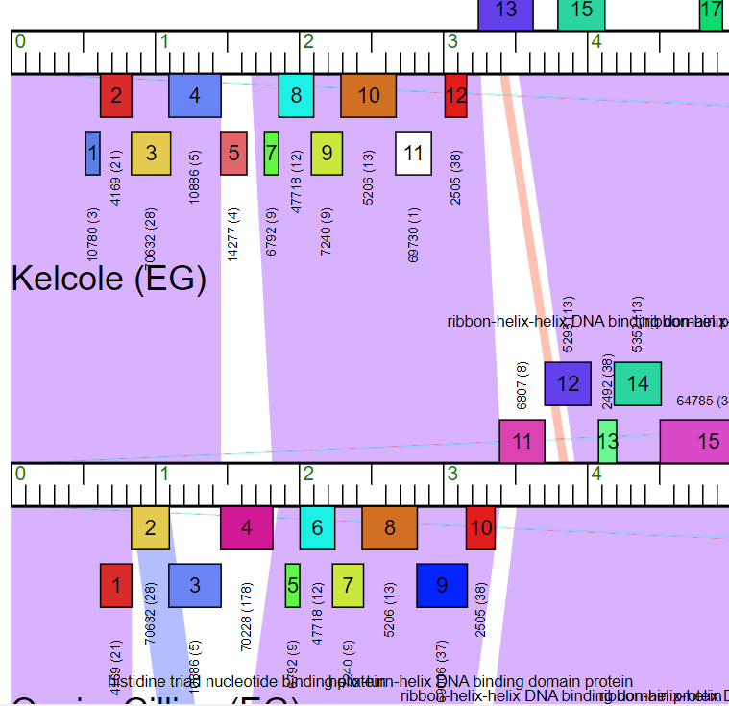
Gene #2 Start: 842 Stop: 624
*Highlight start if changed from original call*
1. Is it a gene? Yes
Gene originally called by (delete incorrect): Both
Coding potential: Yes, but not over the entire coding region.
Other organisms have it? Yes
Kelcole and OneinaGillian have high similarities.
2. Where does it start? At predicted start
Coding potential kind of aligns with predicted start
RBS info: best, z = 2.455, final = -3.667
BLAST alignments:
NCBI: Kelcole, OneinaGillian, 1:1, e value: 2e-42, 2e-41
Phagesdb: Kelcole, OneinaGillian, 1:1, e-value: 6e-37, 5e-36
Starterator: Yes, and called 100% of time when present. Can’t be seen because is the second phage on Track 1 (it is after Romm).
Gap: -4 bp overlap, no gap
3. What is its function?
Final Function Decided: NKF
Must be from approved function list: https://docs.google.com/spreadsheets/d/1FNcTlsU41iI1U8Jq0Yd-YqwJDUa089AInNnULL-K9hE/edit#gid=0
Synteny: Same pham and positional similarity as Kelcole_1, downstream from histidine triad nucleotide binding protein and OneinaGillian_1, downstream from helix-turn-helix DNA binding protein; all upstream from genes with no know function.
BLAST Results: Phagesdb, Kelcole_1, function unknown, e = 6e-37; NCBI, Kelcole_1, function unknown, e = 2e-42.
HHPRED results: No significant hits; they’re all below 56%.
Date Reviewed: 4/20/23
Notes:
Secondary Annotator Notes: Check each piece of evidence provided and confirm whether your interpretation supports that of the primary annotator:
Secondary Annotator #1 Name:
Secondary Annotator #2 Name:

Slide 4
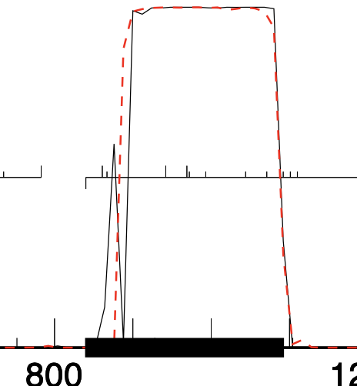
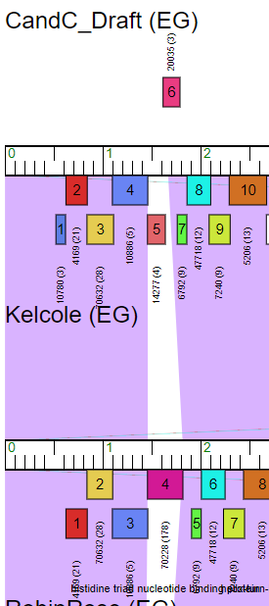
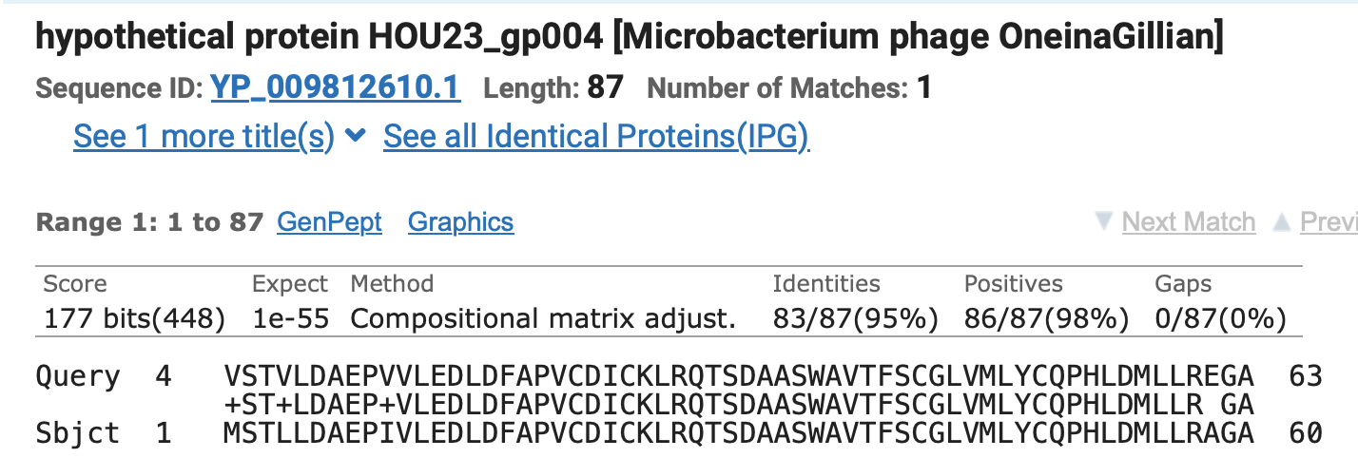
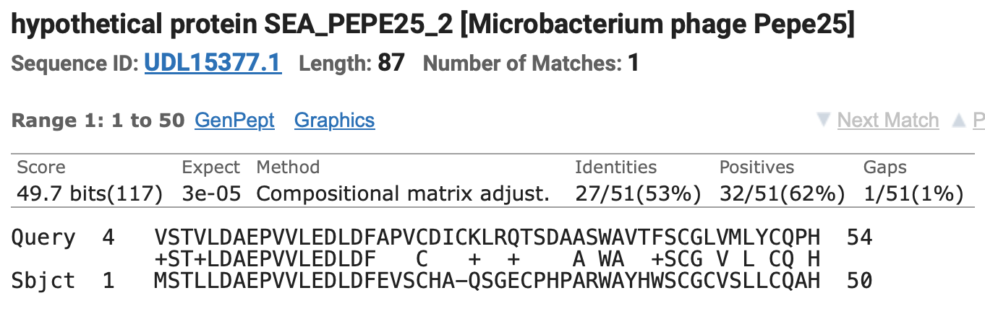
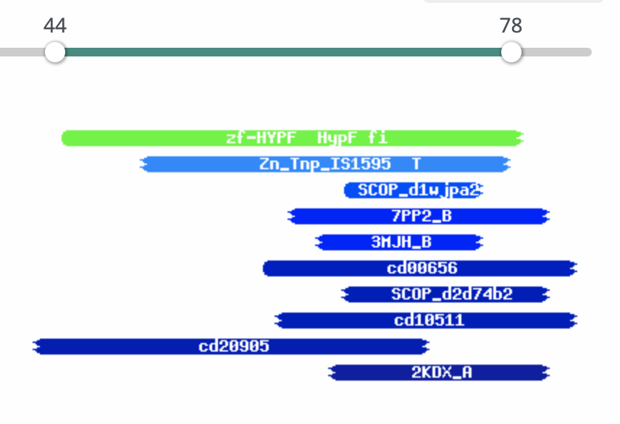
Gene #3 Start: 1,102 Stop: 839
*Highlight start if changed from original call*
1. Is it a gene? Yes
Gene originally called by: Both, however, Glimmer calls the start at 1,111 and GeneMark calls the start at 1,093
Coding potential: Yes, coding potential aligns with GeneMark call.
Other organisms have it? Yes, RobinRose and Kelcole are the most similar
2. Where does it start? 1,102
Coding potential does not align with predicted start
RBS info: Best, z=1.397, final=-4.436
BLAST alignments:
PhagesDB: Kelcole, RobinRose, 4:1, e-values: 2e-45, 2e-45
NCBI: OneInAGillian, Pepe25, 4:1, e-values: 1e-55, 3e-05
Starterator: No, and only called 20% of the time when present, which means the GeneMark start is most likely the right one. The most called start is 1,111
Gap: 5 bp gap, too small for any coding potential.
New gap -4bp
3. What is its function?
Final Function Decided: No Known Function
Must be from approved function list: https://docs.google.com/spreadsheets/d/1FNcTlsU41iI1U8Jq0Yd-YqwJDUa089AInNnULL-K9hE/edit#gid=0
Synteny: Same pham (70362) and positional similarity as RobinRose_3 and Kelcole_2, both up and downstream from genes with no known function.
BLAST Results: RobinRose_3, NKF, PhagesDB, e=2e-45/Pepe25, NKF, NCBI, e=3e-05
HHPRED results: No significant hits, all hits under 80% prob.
Date Reviewed: 4/20/23
Notes:
Secondary Annotator Notes: Check each piece of evidence provided and confirm whether your interpretation supports that of the primary annotator:
Secondary Annotator #1 Name:
Secondary Annotator #2 Name:

Slide 5
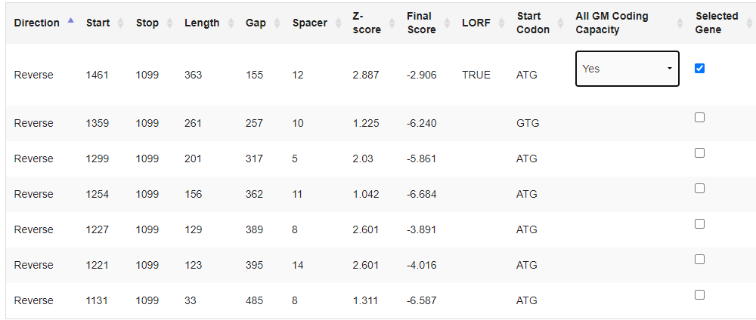
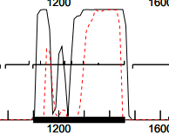
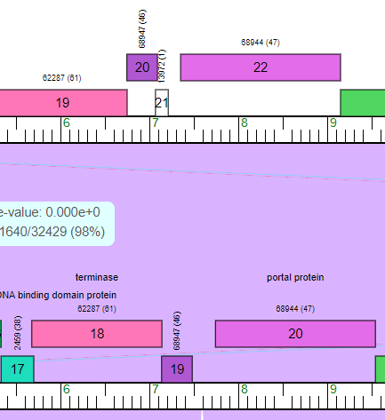
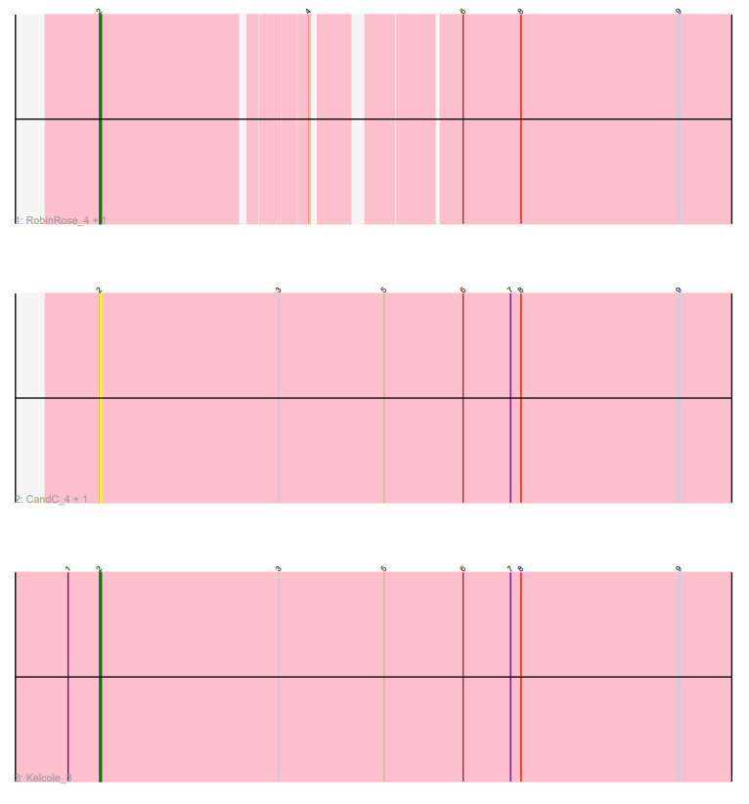
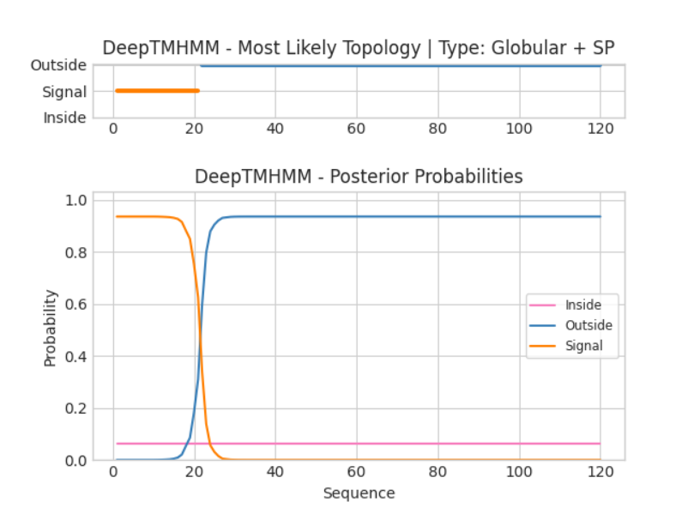
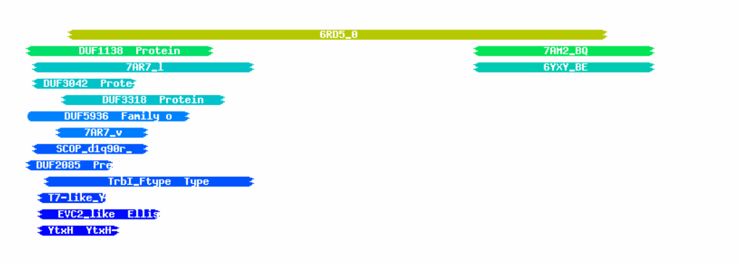
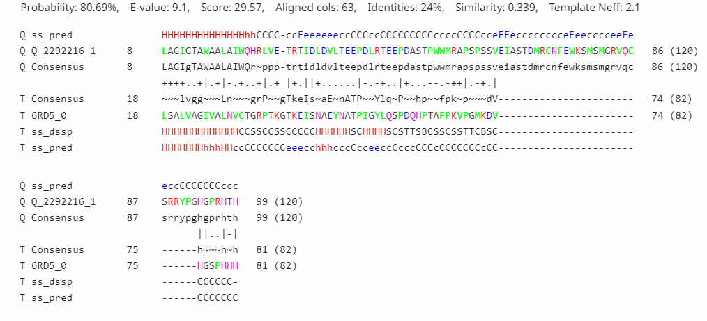
Gene #4 Start:1461 Stop:1099
*Highlight start if changed from original call*
1. Is it a gene? Reverse
Gene originally called by: Both
Yes entire gene
kelcole and RobinRose high similarity
NCBI Blast:
PhagesDB Blast:
2. Where does it start?
RBS info: best- z= 2.887, final=-2.906
coding potential aligns with predicted start
BLAST alignments:
NBCI: Kelcole, Evalue:2.5e-82, 1:1; RobinRose, Evalue: 8.2e-46, 1:1
PhagesDB: Kelcole, Evalue: 6e-69, 1:1; RobinRose, Evalue: 9e-40, 1:1
Starterator: Most called start
Gap:155 bp gap
large gap, check this gene
3. What is its function?
Final Function Decided: NKF
Must be from approved function list: https://docs.google.com/spreadsheets/d/1FNcTlsU41iI1U8Jq0Yd-YqwJDUa089AInNnULL-K9hE/edit#gid=0
Synteny •same pham and positional similarity as Kelcole_19, terminase upstream
BLAST Results: Tempo_20, function unknown, phagesdb, e = 2e-06, Phage RobinRose, hypothetical protien, nbci
HHPRED results: One significant hit- 6RD5_0, prob= 80.69, E= 9.1,
Date Reviewed: 4/20/23
Notes:
Secondary Annotator Notes: Check each piece of evidence provided and confirm whether your interpretation supports that of the primary annotator:
Secondary Annotator #1 Name:
Secondary Annotator #2 Name:

Slide 6
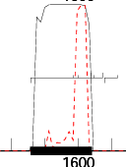
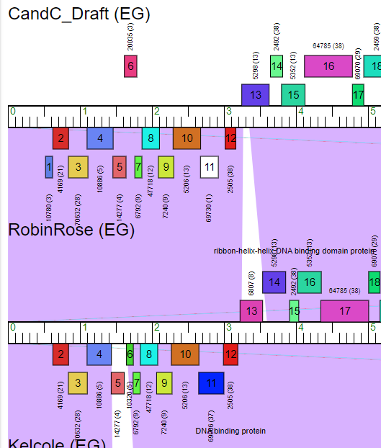
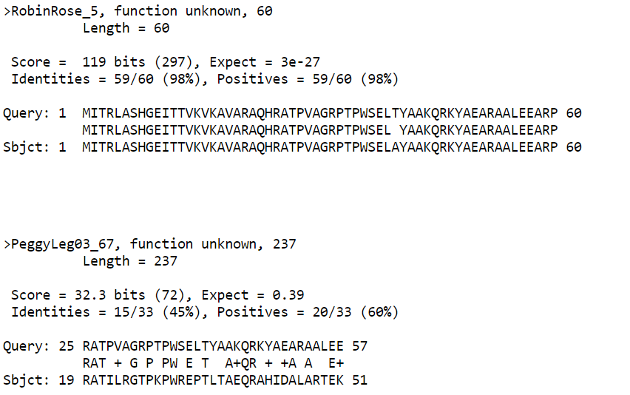
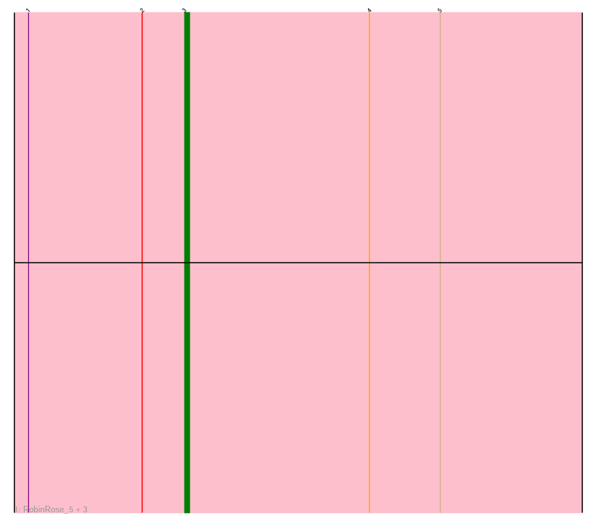
Gene #5 Start: 1640 Stop: 1458 (= gene #6 on PECAAN)
*Highlight start if changed from original call*
1. Is it a gene? Yes
Gene originally called by: Both
Coding potential: Yes
Other organisms have it? Yes
RobinRose has high similarities and PeggyLeg has a few similarities.
2. Where does it start? At a different start (predicted by Phagesdb)
RBS info: Best, z= 1.309, Final= -6.063
Coding potential does not with predicted start
BLAST alignments:
Phagesdb: RobinRose, PeggyLeg, 1:1, e-value: 3e-27, 0.39
NCBI: Only RobinRose, 1:1, e value: 1e-32
Starterator: Most called start (on Track 3 with RobinRose)
Gap: 121 bp gap
Small gap, so light coding potential.
3. What is its function?
Final Function Decided: NKF
Must be from approved function list: https://docs.google.com/spreadsheets/d/1FNcTlsU41iI1U8Jq0Yd-YqwJDUa089AInNnULL-K9hE/edit#gid=0
Synteny: Same pham and positional similarity as RobinRose_5, downstream from helix-turn-helix DNA binding domain protein and upstream from genes with no know function.
BLAST Results: Phagesdb, RobinRose_5, function unknown, e = 3e-27; NCBI, RobinRose_5, function unknown, e = 1e-32.
HHPRED results: No significant hits; they’re all below 57%.
Date Reviewed: 4/20/23
Notes:
Secondary Annotator Notes: Check each piece of evidence provided and confirm whether your interpretation supports that of the primary annotator:
Secondary Annotator #1 Name:
Secondary Annotator #2 Name:

Slide 7
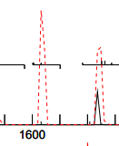
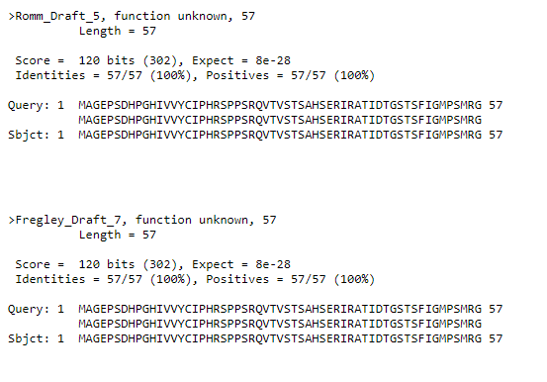
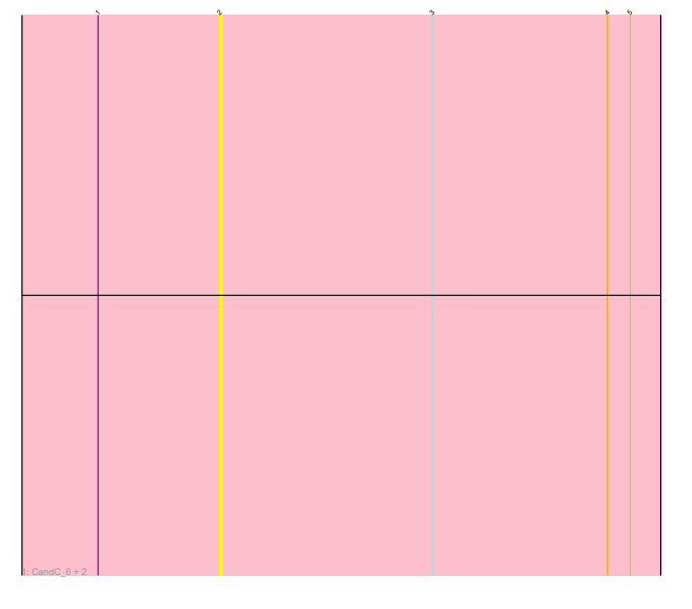
Gene #6 Start: Should Delete. Stop:
*Highlight start if changed from original call*
1. Is it a gene? No support for this being a gene
Gene originally called by (delete incorrect):
Both
Coding potential: No coding potential
Only drafts, no similarities
Phagesdb:
NCBI:
2. Where does it start?
RBS info: z= 1.309 final score= -6.063
BLAST alignments: Only drafts in the local blast alignments, In the NCBI, no alignments found.
Starterator: No other alignments, called 100% of time when present.
Gap: 183 bp gap
Large gap, coding potential should be looked into
3. What is its function?
No evidence for this being a gene, therefore no function will be needed or known.
Final Function Decided: ______________
Must be from approved function list: https://docs.google.com/spreadsheets/d/1FNcTlsU41iI1U8Jq0Yd-YqwJDUa089AInNnULL-K9hE/edit#gid=0
Synteny <Insert phamerator image, upstream of ___, downstream of ____, example phage names
BLAST Results: <Local and NCBI function results, include phage names, e values, etc.; Image of output
HHPRED results: <List phages, function, Score, image of output list>
Date Reviewed: 4/20/23
Notes:
Secondary Annotator Notes: Check each piece of evidence provided and confirm whether your interpretation supports that of the primary annotator:
Secondary Annotator #1 Name:
Secondary Annotator #2 Name:

Slide 8
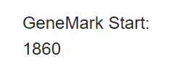
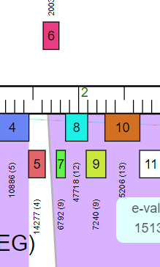
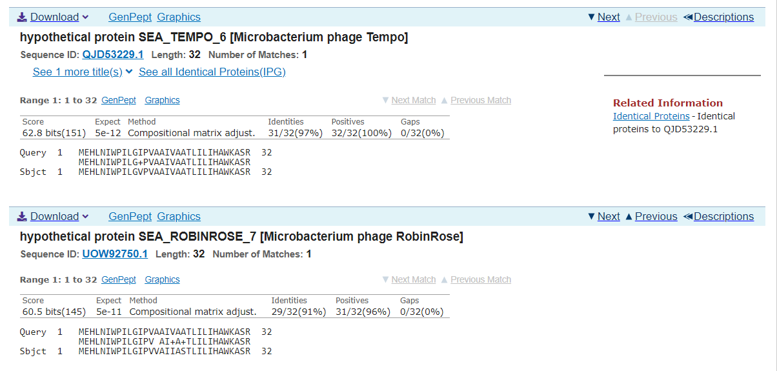
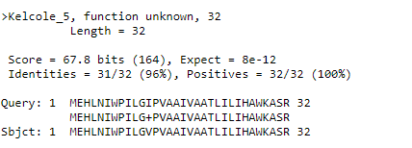
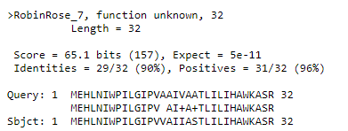
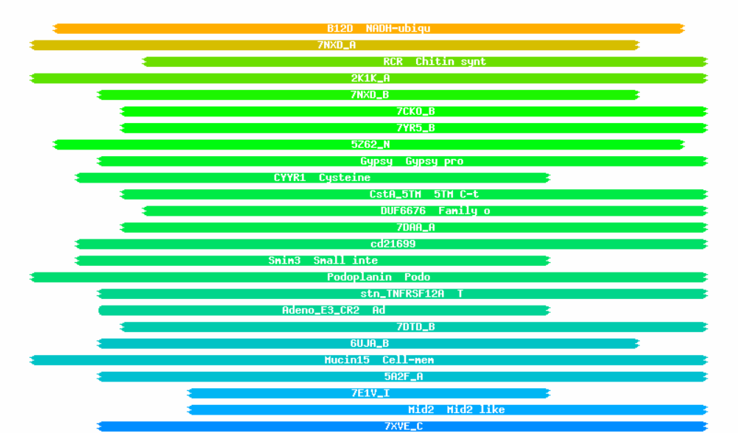
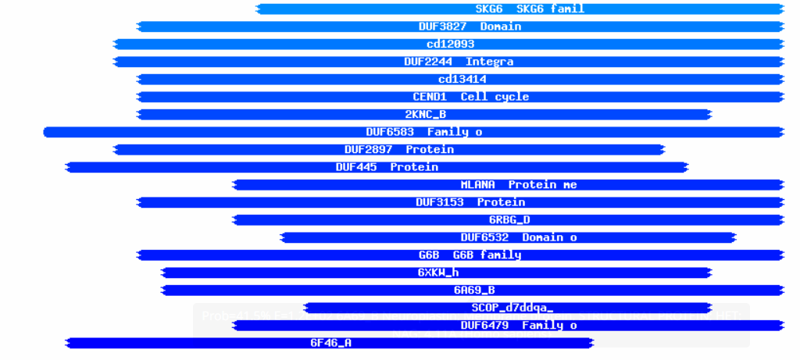
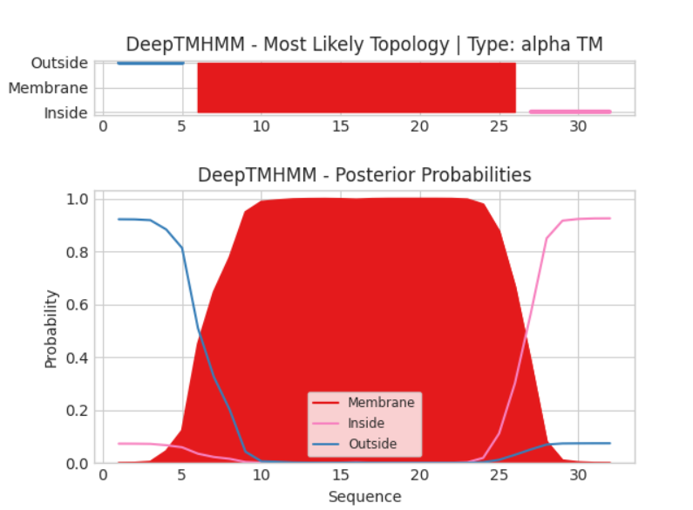
Gene #7 Start: 1860 Stop: 1762
*Highlight start if changed from original call*
1. Is it a gene? Reverse
Gene originally called by: Genemark
Coding potential: Yes entire gene
Tempo,Kelcole, and RobinRose, high similarity
NBCI Blast:
PhagesDB Blast:
2. Where does it start?
RBS info: z= 2.723, final= -3.109
coding potential aligns with predicted start
BLAST alignments:
NCBI: Tempo, Evalue:4.9e-12, 1:1; RobinRose, Evalue:4.8e-11, 1:1
PhagesDB: Tempo, Evalue: 8e-12, 1:1; Kelcole, Evalue: 8e-12, 1:1
Starterator: Most called start
Gap: 1 bp gap
If gap – is there coding potential there? Check for missing genes!
3. What is its function?
Final Function Decided: Membrane protein
Must be from approved function list: https://docs.google.com/spreadsheets/d/1FNcTlsU41iI1U8Jq0Yd-YqwJDUa089AInNnULL-K9hE/edit#gid=0
Synteny Same pham as Kecole_5and RobinRose_7, upstream of NKF, downstream of NKF
BLAST Results: Kelcole_5, function unknown, e= 8e-12,phagesdb; Phage RobinRose, hypothetical protein, nbci
HHPRED results: No significant hits-PF06522.14, prob= 85.26, E= 4.1
Date Reviewed: 4/20/23
Notes:
Secondary Annotator Notes: Check each piece of evidence provided and confirm whether your interpretation supports that of the primary annotator:
Secondary Annotator #1 Name:
Secondary Annotator #2 Name:

Slide 9
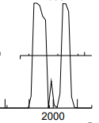
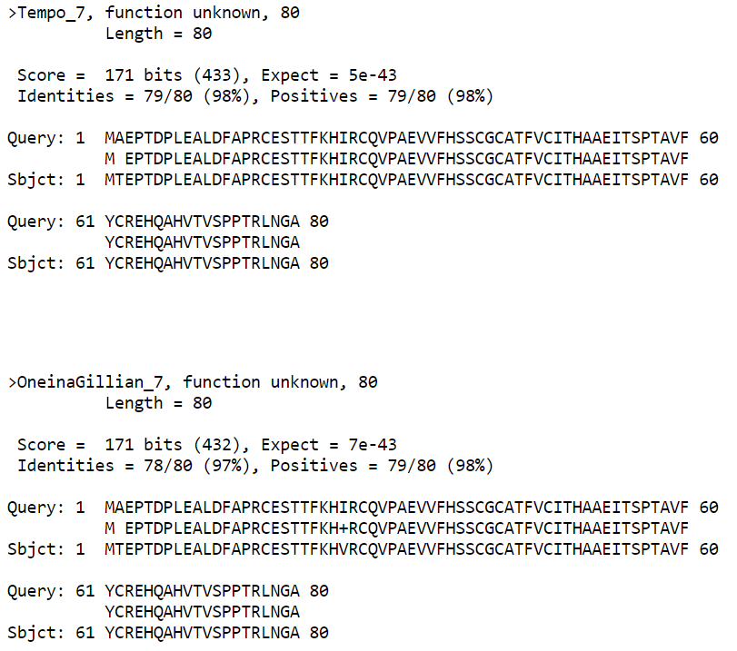
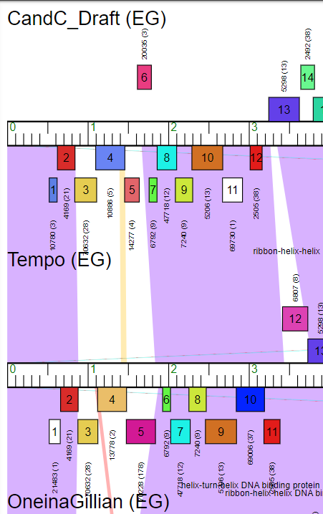
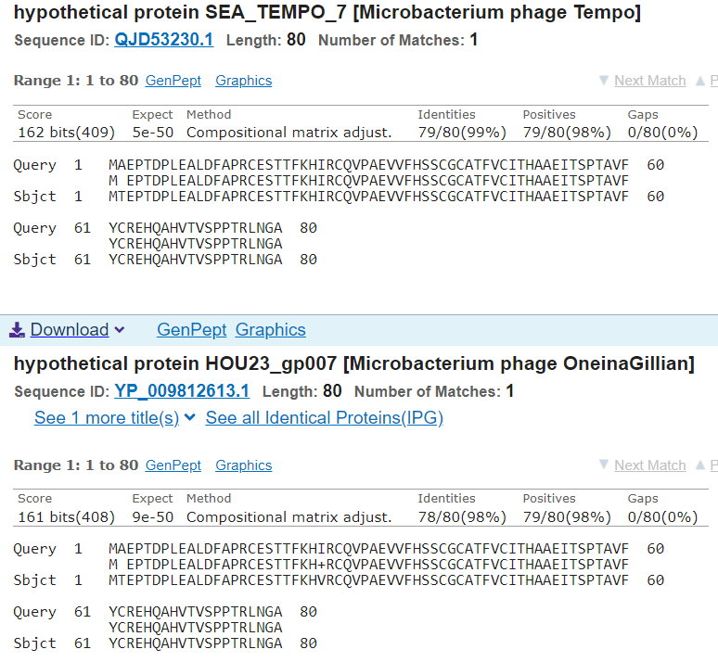
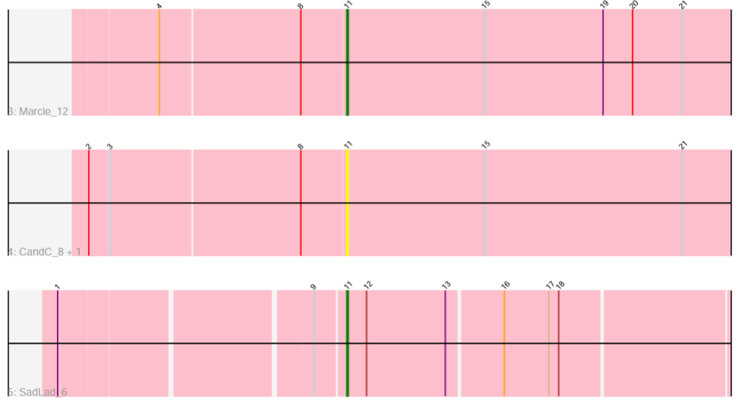
Gene #8 Start: 2104 Stop: 1862
*Highlight start if changed from original call*
1. Is it a gene? Yes
Gene originally called by: Both
Coding potential: Yes, except for in the mid region of the gene.
Other organisms have it? Yes
Tempo and OneinaGillian have high similarities.
2. Where does it start? At predicted start
RBS info: Best, z = 2.786, final = -3.327
Coding potential aligns with predicted start
BLAST alignments:
Phagesdb: Tempo, OneinaGillian, 1:1, e-value: 5e-43, 7e-43
NCBI: Tempo, OneinaGillian, 1:1, e-value: 5e-50, 9e-50
Starterator: Most called start
Gap: -17 bp gap
Gap is too small, so no coding potential.
3. What is its function?
Final Function Decided: NKF
Must be from approved function list: https://docs.google.com/spreadsheets/d/1FNcTlsU41iI1U8Jq0Yd-YqwJDUa089AInNnULL-K9hE/edit#gid=0
Synteny: Same pham and close positional similarity as Tempo_7, upstream from histidine triad nucleotide binding protein and OneinaGillian_7, upstream from genes with no know function; both are downstream from helix-turn-helix DNA binding protein.
BLAST Results: Phagesdb, Tempo_7, function unknown, e = 5e-43; NCBI, Tempo_7, function unknown, e = 5e-50.
HHPRED results: No significant hits; they’re all below 34%.
Date Reviewed: 4/20/23
Notes:
Secondary Annotator Notes: Check each piece of evidence provided and confirm whether your interpretation supports that of the primary annotator:
Secondary Annotator #1 Name:
Secondary Annotator #2 Name:

Slide 10
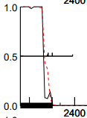
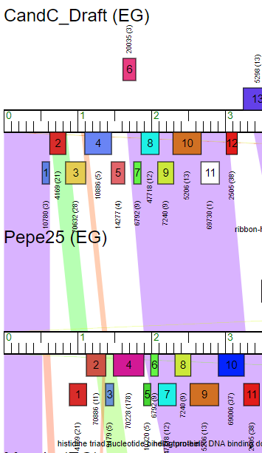
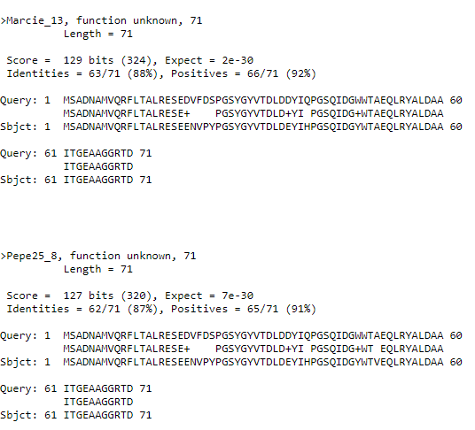
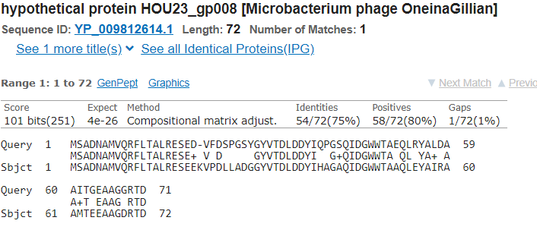
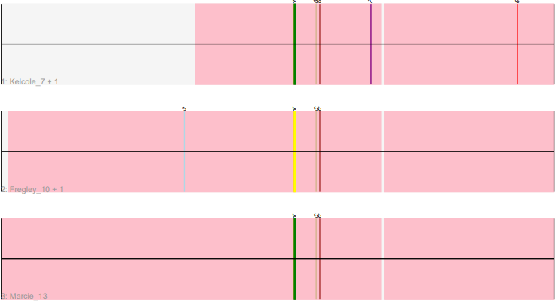
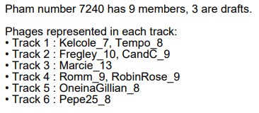
Gene #9 Start: 2,303 Stop: 2,088
*Highlight start if changed from original call*
1. Is it a gene? Yes
Gene originally called by: Both
Coding potential: Yes, aligns almost exactly with prediction
Other organisms have it Yes
Marcie and Pepe25 have high similarities
2. Where does it start? 2,303
Coding potential aligns with predicted start.
RBS info: Best, z=3.041, final=-2.505
BLAST alignments:
PhagesDB: Marcie, Pepe25, 1:1, e-value: 2e-30, 7e-30
NCBI: OneInAGillian, Tempo, 1:1, e-value: 4e-26, 6e-21
Starterator: Yes, most annotated start is 4. CandC is located on Track 2, second to Fregley.
Gap: -11 bp overlap, no gap
3. What is its function?
Final Function Decided: No Known Function
Must be from approved function list: https://docs.google.com/spreadsheets/d/1FNcTlsU41iI1U8Jq0Yd-YqwJDUa089AInNnULL-K9hE/edit#gid=0
Synteny: Same pham and positional similarity as Pepe25_8, both upstream and downstream from genes with no known function
BLAST Results: Marcie_13, NKF, PhagesDB, e=2e-30/OneInAGillian, NKF, NCBI, e=4e-26
HHPRED results: No significant hits, all have a prob under 75%, and e-values above 4.5
Date Reviewed: 4/20/23
Notes:
Secondary Annotator Notes: Check each piece of evidence provided and confirm whether your interpretation supports that of the primary annotator:
Secondary Annotator #1 Name:
Secondary Annotator #2 Name:

Slide 11
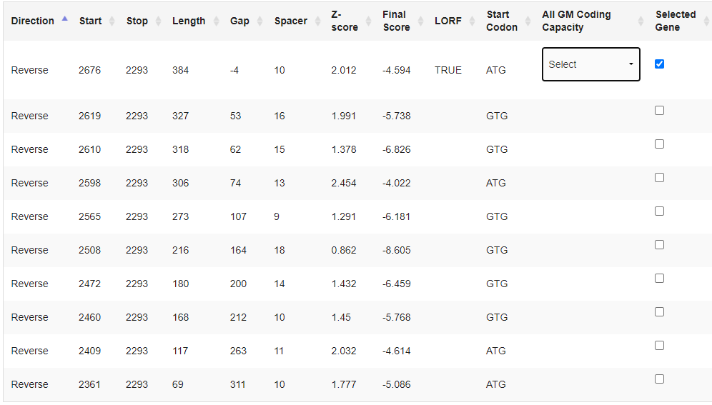
Gene #10 Start:2676 Stop: 2293
*Highlight start if changed from original call*
1. Is it a gene?
Gene originally called by: Both
Coding potential: Yes entire gene
RobinRose, OneinaGillian, high similarity
NBCI Blast:
PhagesDB Blast:
2. Where does it start?
RBS info: z= 2.012, final=-4.594; not best- best: z=2.454, final= -4.022
BLAST alignments:
NCBI Blast: RobinRose- Evalue:9e-85, 1:1; OneinaGillian- Evalue: 7.5e-83, 1:1
PhagesDB Blast: RobinRose- Evalue: 9e-75, 1:1; OneinaGillian- Evalue: 3e-73, 1:1
Starterator: Most called start
Gap: -4 bp gap
If gap – is there coding potential there? Check for missing genes!
3. What is its function?
Final Function Decided: NKF
Must be from approved function list: https://docs.google.com/spreadsheets/d/1FNcTlsU41iI1U8Jq0Yd-YqwJDUa089AInNnULL-K9hE/edit#gid=0
Synteny Same pham as Kelcole_8 and RobinRose_10,, upstream of NKF, downstream of NKF
BLAST Results: Kelcole_8, unknown function, e= 2e-72, phagesdb; Phage RobinRose, hypothetical protein, e= 9e-85, nbci
HHPRED results: One significant hit- 3U52_E, prob= 62.51, e= 25
Date Reviewed: 4/20/23
Notes:
Secondary Annotator Notes: Check each piece of evidence provided and confirm whether your interpretation supports that of the primary annotator:
Secondary Annotator #1 Name:
Secondary Annotator #2 Name:

Slide 12
Gene #11 Start: 3023 Stop: 2673
*Highlight start if changed from original call*
1. Is it a gene? Yes
Gene originally called by: Both
Coding potential: Yes, except for a few sections.
Other organisms have it? Yes
RobinRose and Kelcole have high similarities.
2. Where does it start? Earlier than at the predicted start (3023)
RBS info: Second best, z = 2.07, final = -4.536
Coding potential does not align with predicted start
BLAST alignments:
Phagesdb: RobinRose, Kelcole, 1: 35, e-value: 3e-41, 3e-41. 1:1 alignment for new start.
NCBI: Kelcole, Marcie, 1: 35, e-value: 5e-51, 1e-49. 1:1 alignment for new start.
Starterator: Orpham, no data
Gap: 94 bp gap
No coding potential in gap
3. What is its function?
Final Function Decided: Helix-turn-helix DNA binding domain protein
Must be from approved function list: https://docs.google.com/spreadsheets/d/1FNcTlsU41iI1U8Jq0Yd-YqwJDUa089AInNnULL-K9hE/edit#gid=0
Synteny: Not same pham, but similar position as RobinRose_11, upstream from DNA binding protein and downstream from ribbon-helix-helix-DNA binding domain protein, and Kelcole_9, upstream from histidine triad nucleotide binding protein-helix and downstream from DNA binding domain protein.
BLAST Results: Phagesdb, RobinRose_11, helix-turn-helix DNA binding domain protein, e = 3e-41; NCBI, Kelcole_9, helix-turn-helix DNA binding domain protein, e = 5e-51.
HHPRED results: Many significant hits, a.4.5.28 (A:), alpha protein, prob = 98.95, E = 6.2e-8, coverage = 142.
Date Reviewed: 4/20/23
Notes:
Secondary Annotator Notes: Check each piece of evidence provided and confirm whether your interpretation supports that of the primary annotator:
Secondary Annotator #1 Name:
Secondary Annotator #2 Name:

Slide 13
Gene #12 Start: 3,165 Stop: 3,016
*Highlight start if changed from original call*
1. Is it a gene? Yes
Gene originally called by: Both
Coding potential: Yes
Other organisms have it? Yes, Kelcole and RobinRose are very similar
2. Where does it start? 3,165
Coding potential aligns with predicted start
RBS info: Best, z=3.041, final=-2.794
BLAST alignments:
PhagesDB: RobinRose, Kelcole, 1:1, e-value: 1e-22, 1e-22
NCBI: Tempo, OneInAGillian, 1:1, e-value: 1e-26, 6e-20
Starterator: No, and only called 15.8% of the time when present. Located on track 4 behind Fregley_13.
Gap: 81 bp gap, no coding potential.
3. What is its function?
Final Function Decided: Helix-Turn-Helix DNA Binding Domain
Must be from approved function list: https://docs.google.com/spreadsheets/d/1FNcTlsU41iI1U8Jq0Yd-YqwJDUa089AInNnULL-K9hE/edit#gid=0
Synteny: Same pham and positional similarity as Tempo_11 and Kelcole_10. Located upstream of genes with no known function, and downstream of Ribbon-Helix-Helix DNA Binding Domain Protein.
BLAST Results: Kelcole_10, Helix-Turn_Helix DNA Binding Domain Protein, PhagesDB, e=1e-22/Tempo, Helix-Turn-Helix DNA Binding Domain Protein, NCBI, e=1e-26.
HHPRED results: Many significant hits, top 2. 1) a.6.1.5, DNA Binding Protein, prob=99.19%, e=3.4e-10, coverage=140%??? 2) Putative DNA-binding protein, DNA Binding Protein, prob=98.94%, e=1.3e-8, coverage=145%??
Date Reviewed: 4/20/23
Notes:
Secondary Annotator Notes: Check each piece of evidence provided and confirm whether your interpretation supports that of the primary annotator:
Secondary Annotator #1 Name:
Secondary Annotator #2 Name:

Slide 14
Gene #13 Start: 3247 Stop: 3627
*Highlight start if changed from original call*
1. Is it a gene? Forward
Gene originally called by: Both
Coding potential: Yes entire gene
Tempo, RobinRose, Kelcole, high similarity
NBCI Blast:
PhagesDB Blast:
2. Where does it start?
RBS info: z=2.088, final=--5.087; not best- best: z=2.909, final= –2.780
BLAST alignments:
NBCI Blast: Tempo- Evalue: 2e-72, 1:1
PhagesDB Blast: Tempo- Evalue: 2e-69, 1:1
Starterator: Not the most called start
Gap: 81 bp gap
Large gap
3. What is its function?
Final Function Decided: NKF
Must be from approved function list: https://docs.google.com/spreadsheets/d/1FNcTlsU41iI1U8Jq0Yd-YqwJDUa089AInNnULL-K9hE/edit#gid=0
Synteny same pham as RobinRose_14 and Tempo_13, upstream of ribbon-helix-helix and DNA binding domain proteinA
BLAST Results: RobinRose_14, e= 5e-24 , function unknown, phagesdb; Phage Tempo, hypothetical protein, e= 7e-28 , nbci
HHPRED results: No significant hits
Date Reviewed: 4/20/23
Notes:
Secondary Annotator Notes: Check each piece of evidence provided and confirm whether your interpretation supports that of the primary annotator:
Secondary Annotator #1 Name:
Secondary Annotator #2 Name:

Slide 15
Gene #14 Start: 3645 Stop: 3815 *Highlight start if changed from original call*
1. Is it a gene? Yes
Gene originally called by: Both, but Glimmer is correct.
Coding potential: Yes
Other organisms have it? Yes
Marcie and Tempo have high similarities.
2. Where does it start? 3645
RBS info: Best, z = 2.698, final = -4.464
Coding potential kind of aligns with predicted start
BLAST alignments:
Phagesdb: Marcie, Tempo, 1:1, 1:15, e-value: 8e-26, 2e-17. Mostly 1:1 alignment for GeneMark start.
NCBI: Marcie, Tempo, 1:1, 1:15, e-value: 4e-31, 4e-20. Mostly 1:1 alignment for GeneMark start.
Starterator: Most called start (on Track 6 with Fregley)
Gap: 17 bp gap
Gap is too small, so no coding potential.
3. What is its function?
Final Function Decided: Ribbon-helix-helix DNA binding domain protein
Must be from approved function list: https://docs.google.com/spreadsheets/d/1FNcTlsU41iI1U8Jq0Yd-YqwJDUa089AInNnULL-K9hE/edit#gid=0
Synteny: Same pham and close positional similarity as Marcie_19 and Tempo_14; both are upstream from helix-turn-helix DNA binding domain protein and downstream from ribbon-helix-helix DNA binding domain protein.
BLAST Results: Phagesdb, Marcie_19, ribbon-helix-helix DNA binding domain protein, e = 8e-26; NCBI, Marcie_19, ribbon-helix-helix DNA binding domain protein, e = 4e-31.
HHPRED results: Many significant hits, Helicobacter pylori, repressor, transcriptional regulator, DNA-binding, ribbon-helix-helix, prob = 99.18, E = 8.8e-10, coverage = 66.
Date Reviewed: 4/20/23
Notes:
Secondary Annotator Notes: Check each piece of evidence provided and confirm whether your interpretation supports that of the primary annotator:
Secondary Annotator #1 Name: Start is probably 3645
Secondary Annotator #2 Name:

Slide 16
Gene #15 Start: 3,799 Stop: 4,125
*Highlight start if changed from original call*
1. Is it a gene? Yes
Gene originally called by: Both
Coding potential: Yes
Other organisms have it? Yes, Tempo and Kelcole are the most similar
2. Where does it start? 3,799
Coding potential aligns with predicted start
RBS info: Best, z=2.887, final=-2.828
BLAST alignments
PhagesDB: Tempo, Kelcole, 1:1, e-value: 3e-59, 3e-59
NCBI: Pepe25, 1:1, e-value: 1e-48
Starterator: Yes, most annotated start is 3. On Track 2 with Fregley.
Gap: -17 bp overlap, no gap
3. What is its function?
Final Function Decided: No Known Function
Must be from approved function list: https://docs.google.com/spreadsheets/d/1FNcTlsU41iI1U8Jq0Yd-YqwJDUa089AInNnULL-K9hE/edit#gid=0
Synteny: Same pham and positional similarity as Tempo_15 and Kelcole_14. Located upstream from Helix-Turn-Helix DNA Binding Domain, and downstream of Ribbon-Helix-Helix DNA Binding Domain.
BLAST Results: Tempo_15, NKF, PhagesDB, e=3e-59/Kelcole_14, NKF, PhagesDB, e=3e-59
HHPRED results: No significant hits, all under prob of 75%,
Date Reviewed: 4/20/23
Notes:
Secondary Annotator Notes: Check each piece of evidence provided and confirm whether your interpretation supports that of the primary annotator:
Secondary Annotator #1 Name:
Secondary Annotator #2 Name:

Slide 17
Gene #16 Start:4118 Stop:4783
*Highlight start if changed from original call*
1. Is it a gene? Forward
Gene originally called by: Both
Coding potential: Yes entire gene
Tempo high similarity
NBCI Blast:
PhagesDB Blast:
2. Where does it start?
RBS info: Fourth best z= 2.125, final= -4.419, second best score
BLAST alignments:
NBCI Blast: Tempo- Evalue:1.2e-158, 1:1
PhagesDB Blast: Tempo- Evalue: e-122, 1:1
Starterator: Not the most called start
Gap: -8 bp gap
If gap – is there coding potential there? Check for missing genes!
3. What is its function?
Final Function Decided: Dna Binding protein
Must be from approved function list: https://docs.google.com/spreadsheets/d/1FNcTlsU41iI1U8Jq0Yd-YqwJDUa089AInNnULL-K9hE/edit#gid=0
Synteny same pham as RobinRose_17 and Tempo_16, upstream of terminase, downstream of ribbon-helix-helix-DNA binding domain protein
BLAST Results: Tempo_16, e= e-122 , function unknown, phagesdb; Phage RobinRose, hypothetical protein, e= 2e-157, nbci
HHPRED results: Many significant hits- 2L0K_A, stage III sporulation protein D; spoIIID, NMR solution structure, DNA binding, bacillus subtilis, transcription factor, prob= 97.9, E= 0.00014, approx. coverage= ~42%
Date Reviewed: 4/20/23
Notes:
Secondary Annotator Notes: Check each piece of evidence provided and confirm whether your interpretation supports that of the primary annotator:
Secondary Annotator #1 Name:
Secondary Annotator #2 Name:

Slide 18
Gene #17 Start: 4783 Stop: 4941
*Highlight start if changed from original call*
1. Is it a gene? Yes
Gene originally called by: Both
Coding potential: Yes, except it is lower at the end.
Other organisms have it? Yes
Kelcole and RobinRose have high similarities.
2. Where does it start? At predicted start
RBS info: Best, z = 2.638, final = -3.285
Coding potential aligns with predicted start
BLAST alignments:
Phagesdb: Kelcole, RobinRose, 1:1, e-value: 4e-23, 1e-21
NCBI: Kelcole, RobinRose, 1:1, e-value: 2e-26, 1e-24
Starterator: Not most called start, but called 100% of time when present (is on Track 2 with Romm).
Gap: -1 bp gap
Gap is too small, so no coding potential.
3. What is its function?
Final Function Decided: NKF
Must be from approved function list: https://docs.google.com/spreadsheets/d/1FNcTlsU41iI1U8Jq0Yd-YqwJDUa089AInNnULL-K9hE/edit#gid=0
Synteny: Same pham and close positional similarity as Kelcole_16, upstream from helix-turn-helix DNA binding domain protein and downstream from terminase, and RobinRose_18, upstream from ribbon-helix-helix DNA binding domain protein and downstream from terminase.
BLAST Results: Phagesdb, Kelcole_16, function unknown, e = 4e-23; NCBI, Kelcole_16, function unknown, e = 2e-26.
HHPRED results: No significant hits; they’re all below 79%.
Date Reviewed: 4/20/23
Notes:
Secondary Annotator Notes: Check each piece of evidence provided and confirm whether your interpretation supports that of the primary annotator:
Secondary Annotator #1 Name:
Secondary Annotator #2 Name:

Slide 19
Gene #18 Start: 4,941 Stop: 5,309 *Highlight start if changed from original call*
1. Is it a gene? Yes
Gene originally called by: Both
Coding potential: Yes
Other organisms have it. Yes, RobinRose and Kelcole are the most similar.
2. Where does it start? 4,941
Coding potential aligns with predicted start
RBS info: Best, z=1.952, final=-5.372
BLAST alignments:
PhagesDB: RobinRose, Kelcole, 1:1, e-value: 2e-65, 2e-65
NCBI: OneInAGillian, Marcie 1:1, e-value: 7e-82, 2e-81
Starterator: Yes, most called start is 13
Gap: -1 bp overlap, no gap
3. What is its function?
Final Function Decided: Ribbon-Helix-Helix DNA Binding Domain protein
Must be from approved function list: https://docs.google.com/spreadsheets/d/1FNcTlsU41iI1U8Jq0Yd-YqwJDUa089AInNnULL-K9hE/edit#gid=0
Synteny: Same pham and positional similarity as Kelcole_16 and RobinRose_18. All are upstream of Ribbon-helix-helix binding domain protein, and downstream of terminase.
BLAST Results: Kelcole_17, DNA binding domain protein, PhagesDB, e-value: 2e-65/OneInAGillian, DNA binding domain protein, NCBI, e-value: 7e-82
HHPRED results: Over 30 significant hits, top 2: 1) Putative; Helicobacter pylori, DNA-binding, ribbon-helix-helix, prob=97.47%, e=0.0013, coverage~54% 2) NikA, Ribbon-Helix-Helix DNA Binding Domain, prob=97.1%, e=0.0041, coverage~42%
Date Reviewed: 4/20/23
Notes:
Secondary Annotator Notes: Check each piece of evidence provided and confirm whether your interpretation supports that of the primary annotator:
Secondary Annotator #1 Name:
Secondary Annotator #2 Name:

Slide 20
Gene #19 Start: 5287 Stop: 6750
*Highlight start if changed from original call*
1. Is it a gene? Forward
Gene originally called by: Both
Coding potential: Yes entire gene or not
Romm and OneinaGillion high similarity
NBCI Blast:
PhagesDB Blast:
2. Where does it start?
RBS info: z=2.375, final= -3.935- not best; best: z= 2.532, final= -3.858
BLAST alignments:
NBCI Blast: OneinaGillian- Evalue: 0, 1:1
PhagesDB Blast: Romm- Evalue: 0.0, 1:1
Starterator: Most called start
Gap: -23 bp gap
If gap – is there coding potential there? Check for missing genes!
3. What is its function?
Final Function Decided: Terminase
Must be from approved function list: https://docs.google.com/spreadsheets/d/1FNcTlsU41iI1U8Jq0Yd-YqwJDUa089AInNnULL-K9hE/edit#gid=0
Synteny same pham as OneinaGillian_19 and Tempo_19, upstream of terminase and downstream of ribbon-helix-helix DNA
BLAST Results: OneinaGillian_19, e= 0.0, terminase, phagesdb; Phage Tempo, terminase, e= 0.0 , nbci
HHPRED results: Many significant hits- 5OE8_A, prob= 100, E= 1.6e-32, approx. coverage= ~88%
Date Reviewed: 4/20/23
Notes:
Secondary Annotator Notes: Check each piece of evidence provided and confirm whether your interpretation supports that of the primary annotator:
Secondary Annotator #1 Name:
Secondary Annotator #2 Name:

Slide 21
Gene #20 Start: 6747 Stop: 7091
*Highlight start if changed from original call*
1. Is it a gene? Yes
Gene originally called by: Both
Coding potential: Yes
Other organisms have it: Yes
Tempo and RobinRose have high similarities.
2. Where does it start? At predicted start
Coding potential aligns with predicted start
RBS info: best, z = 2.679, final = -4.028
BLAST alignments:
NCBI: Tempo, OneinaGillian, 1:1, e value: 6e-72/2e-72
Phagesdb: RobinRose, Kelcole19, 1:1, e-value: 2e-68, 4e-69
Starterator: No, but called 100% of time when present
Gap: -4 bp overlap, no gap
3. What is its function?
Final Function Decided: Membrane Protein
Must be from approved function list: https://docs.google.com/spreadsheets/d/1FNcTlsU41iI1U8Jq0Yd-YqwJDUa089AInNnULL-K9hE/edit#gid=0
Synteny: Same pham and positional similarity as Tempo_20 and Kelcole_19; all immediately upstream of terminase and downstream of portal protein
BLAST Results: Tempo_20, function unknown, phagesdb, e = 2e-69; Phage Pepe25, membrane protein, e 1e-62, ncbi.
HHPRED results: One significant hit - •DUF1360, NKF, prob = 99.85, E=1.6e-20, approx. coverage ~86%, pfam
Membrane protein:
SOSUI - three primary regions
DeepTMHMM - three regions
Date Reviewed: 4/20/23
Notes:
Secondary Annotator Notes: Check each piece of evidence provided and confirm whether your interpretation supports that of the primary annotator:
Secondary Annotator #1 Name: Frank Vereline.
Is it a gene? Evidence shows good coding potential and other phages having this gene-agree with primary.
Where does it start? Evidence shows start aligns with best RBS, many 1:1 Blast alignments, starterator supports start call.
Conclusion: Predicted start is correct.
Secondary Annotator #2 Name:

Slide 22
Gene #21 This gene needs to be deleted. *Highlight start if changed from original call* (Called Start: 7069 Stop: 7212)
1. Is it a gene? No
Gene originally called by: Glimmer
Coding potential: No
Other organisms have it? No
2. Where does it start? No start
RBS info: Second best, z = 1.442, final = -5.927
No coding potential; does not aligns with predicted start
BLAST alignments: No other organisms or alignments
Starterator: Orpham, no data
Gap: -23 bp gap
Gap is too small, so no coding potential.
3. What is its function?
Final Function Decided: NKF
Must be from approved function list: https://docs.google.com/spreadsheets/d/1FNcTlsU41iI1U8Jq0Yd-YqwJDUa089AInNnULL-K9hE/edit#gid=0
Synteny: Not the same pham as any other gene, but positional similarity as Kelcole_19 and RobinRose_21.
BLAST Results: Phagesdb, none; NCBI, none.
HHPRED results: No significant hits; they’re all below 49%.
Date Reviewed: 4/20/23
Notes:
Secondary Annotator Notes: Check each piece of evidence provided and confirm whether your interpretation supports that of the primary annotator:
Secondary Annotator #1 Name:
Secondary Annotator #2 Name:

Slide 23
Gene #22 Start: 7,351 Stop: 9,150 *Highlight start if changed from original call*
1. Is it a gene? Yes
Gene originally called by: Both
Coding potential: Yes
Other organisms have it? Yes, OneInAGillian are the most similar
2. Where does it start? 7,351
Coding potential aligns with predicted start
RBS info: RBS Info: Best, z=2.719, final=-3.197
BLAST alignments
PhagesDB: OneInAGillian, Tempo, 1:1, e-values: 0.0, 0.0
NCBI: RobinRose, Marcie, 1:1, e-values: 0.0, 0.0
Starterator: Yes, most called start is 5
Gap: There is a gap of 138 bp, there is a possibility for coding potential, as gene 22 on CandC is in a different location from gene 22 on similar phages OneInAGillian and Tempo.
3. What is its function?
Final Function Decided: Portal Protein
Must be from approved function list: https://docs.google.com/spreadsheets/d/1FNcTlsU41iI1U8Jq0Yd-YqwJDUa089AInNnULL-K9hE/edit#gid=0
Synteny: Same pham and positional similarity as OneInAGillian_21 and RobinRose_23. Immediately downstream of Capsid Morphogenesis Protein, upstream of Terminase.
BLAST Results: OneInAGillian_21, Portal Protein, PhagesDB, e=0.0/RobinRose_23, Portal Protein, NCBI, e=0.0.
HHPRED results: 13 significant hits, top 2. 1) Phage Portal Protein, Portal Protein, prob=99.94%, e=3.1e-23, coverage=66% 2) Phage_Portal, Portal Protein, prob=99.91%, e=1.7e-21, coverage=55%
Date Reviewed: 4/20/23
Notes:
Secondary Annotator Notes: Check each piece of evidence provided and confirm whether your interpretation supports that of the primary annotator:
Secondary Annotator #1 Name:
Secondary Annotator #2 Name:

Slide 24
Gene #23 Start: 9150 Stop: 12302 *Highlight start if changed from original call*
1. Is it a gene? Yes
Gene originally called by: Both
Coding potential: Weak coding potential at the start, but strong at the end.
Other organisms have it? Yes
Tempo and OneinaGillian have high similarities.
2. Where does it start? At predicted start
RBS info: Second best, z = 2.413, final = -3.836
Coding potential aligns with predicted start
https://blast.ncbi.nlm.nih.gov/Blast.cgi
BLAST alignments: NCBI: OneinaGillian, Tempo, 1:1, e value: 0.0/0.0
Phagesdb: OneinaGillian, Tempo, 1:1, e-value: 0.0, 0.0
NCBI BLAST
Starterator: No, but called 100% of time when present
Gap: -1 bp gap
There is no coding potential because the gap is so small.
3. What is its function?
Final Function Decided: Capsid maturation protease
Must be from approved function list: https://docs.google.com/spreadsheets/d/1FNcTlsU41iI1U8Jq0Yd-YqwJDUa089AInNnULL-K9hE/edit#gid=0
Synteny: Same pham and positional similarity as OneinaGillian_22, which is a capsid morphogenesis protein, and Tempo_22, which is capsid maturation protease and MuF-like fusion protein. They are both upstream from portal protein and downstream from major capsid hexamer protein
BLAST Results: Phagesdb, OneinaGillian_22, capsid morphogenesis protein, e = 0.0; NCBI, OneinaGillian, head maturation protease, e = 0.0.
HHPRED results: One significant hit, Phage_Mu_F, Phage Mu protein F like protein, prob = 97.75, E = 0.00023, coverage = 107.
Date Reviewed: 4/20/23
Notes:
Secondary Annotator Notes: Check each piece of evidence provided and confirm whether your interpretation supports that of the primary annotator:
Secondary Annotator #1 Name:Justin I-PhageB
Evidence shows that the gene has good coding potential and aligns with other data provided by different databases. The start aligns with best OneInAGillion and Tempo, many 1:1 genes.
Secondary Annotator #2 Name: Chloe
Evidence points to this being a gene, other organisms have it, it’s called by both at the same start, and has relatively good coding potential towards the end of the gene. However, still needs blast data and staterator image inserted.

Slide 25
Gene #24 Start: 12,305 Stop: 12,469
*Highlight start if changed from original call*
1. Is it a gene? Yes
Gene originally called by: Both
Coding potential: Yes, but not the entire gene has it
Other organisms have it: Yes, OneInAGillian and Tempo have high similarities
2. Where does it start? 12,469
Coding potential aligns with predicted start
RBS info: Best, Z=3.041, Final=-2.523
BLAST alignments:
PhagesDB: OneInAGillian, Tempo, 1:1, e-value: 2e-25, 5e-25
NCBI: Marcie, RobinRose, 1:1, e-value: 5e-29, 6e-29
Starterator: Yes, most called start is 3
Gap: 2 bp gap, no coding potential because gap is so small
3. What is its function?
Final Function Decided: NKF
Must be from approved function list: https://docs.google.com/spreadsheets/d/1FNcTlsU41iI1U8Jq0Yd-YqwJDUa089AInNnULL-K9hE/edit#gid=0
Synteny: Same pham and positional similarity as RobinRose_25 and Tempo_23. Located directly upstream of Capsid Maturation Protease, and directly downstream of Major Capsid Protein.
BLAST Results: RobinRose_25, NKF, NCBI, e=6e-29/Tempo_23, NKF, PhagesDB, e=5e-25.
HHPRED results: 1 significant hit. Uncharacterized protein yaiA, Protein Structure???, prob=91.74%, e=1.1, coverage=1.31???
Date Reviewed: 4/20/23
Notes:
Secondary Annotator Notes: Check each piece of evidence provided and confirm whether your interpretation supports that of the primary annotator:
Secondary Annotator #1 Name: Chloe
Evidence points to this being a gene. The gene is originally called by both at the same start, it also has coding potential in certain sections of this gene, other organisms have this gene, coding potential aligns with the predicted start, it is the most called start in the staterator image, and the alignments have a 1:1 ratio as well. Overall this seems to be a gene.
Secondary Annotator #2 Name: Emma
Evidence supports this being a gene shown above. It is called by both at the same start and it is found in other organisms which are OneInAGillion and Tempo. These have high similarities as well. The alignments have a 1:1 ratio which is supportive evidence. The e-values are also similar in both BLAST Alignments. Therefore there is good evidence supporting that this is a gene.

Slide 26
Gene #25 Start:12598 Stop: 14376 *Highlight start if changed from original call*
1. Is it a gene?
Gene originally called by (delete incorrect):
Both
Coding potential: yes
Other organisms have it?
Local Blast
NIH Blast
2. Where does it start?
RBS info: best, z= 2.455, final= -3.808
BLAST alignments: yes, 1:1
Local BlastKelcole_23, major capsid hexamer protein
NCBI Blast, RobinRose, 0
Starterator:Not the most called start but called 100% of the time when present
Gap: no CP
3. What is its function?
Final Function Decided: Major capsid hexamer protein
Must be from approved function list: https://docs.google.com/spreadsheets/d/1FNcTlsU41iI1U8Jq0Yd-YqwJDUa089AInNnULL-K9hE/edit#gid=0
Synteny Same pham and positional similarity as tempo and RobinRose downstream of capsid maturation protease and upstream of phosphoesterase or NKF
BLAST Results:Major capsid hexamer protien
Local Blast, Kelcole_23, major capsid hexamer protein
NCBI Blast, RobinRose, 0
Not the correct pham for major capsid hexamer protein
HHPRED results:No significant hits
Date Reviewed: 4/25/23
Note: There is also evidence of iit being a major capsid hexamer protein.
Notes:
Secondary Annotator Notes: Check each piece of evidence provided and confirm whether your interpretation supports that of the primary annotator:
Secondary Annotator #1 Name: Emma
There is good evidence that supports this is a gene. It is originally called on by both glimmerstart and genemark start. The coding potential is very high, therefore it is correct that the genemark is correct. The BLAST alignments also show a 1:1 ratio indicating that they started at the same location which is strong evidence that this is a gene.
Secondary Annotator #2 Name: Leah
The evidence for this gene is very well presented, both started off at 12958 and ended at 14376 which is very good. The coding potential was interpreted correctly and it is obvious that it's coding potential is good. As for the gap which you were unsure of, the gap is 128 according to Pecaan. Other than that all the information looks correct :)

Slide 27
Gene #26 Start: 14442 Stop: 15179
*Highlight start if changed from original call*
1. Is it a gene? Yes
Gene originally called by (delete incorrect):
Glimmer
Coding potential: Yes there is good coding potential
Other organisms have it?
Local Blast
NCBI Blast
2. Where does it start?At predicted start
Coding Potential aligns with predicted start
RBS info: Best Z=3.121 Final= -2.627
<See DNA Master/PECAAN, report Kibler score, Karlin Score, Z score>
BLAST alignments: Yes 1:1
Local Blast: Tempo,RobinRose - e-137/ e-137
NCBI blast : tempo, Marcie- 3e-172 /2e-156
Starterator: Yes this is the most called start for this gene
Gap: There is a 66bp gap and no overlap
3. What is its function?
Final Function Decided: NKF
Must be from approved function list: https://docs.google.com/spreadsheets/d/1FNcTlsU41iI1U8Jq0Yd-YqwJDUa089AInNnULL-K9hE/edit#gid=0
Synteny Same pham and positional similarity as tempo and RobinRose both upstream of head-to-tail adapter and downstream of major capsid protein
BLAST Results:
Local Blast: Tempo,RobinRose - e-137/ e-137
NCBI blast : tempo, Marcie- 3e-172 /2e-156
HHPRED results: No Significant hits
Date Reviewed: 4/25/23
Notes:
Secondary Annotator Notes: Check each piece of evidence provided and confirm whether your interpretation supports that of the primary annotator:
Secondary Annotator #1 Name: Sophia Crandall. Is it a gene? Evidence shows good coding potential and other phages having this gene.- agree with primary. Where does is start? Evidence shows start aligns with RBS, many 1:1 blast assignments.
Secondary Annotator #2 Name: wesley tender. This is good evidence that this i sa gene. genestart starts at 14442 and glimmermark starts at 14443. they are very close to the same start. I agree with primary, alignments line up, and there is excellent coding potential.

Slide 28
Gene #27 Start: 15,190 Stop: 15,651
*Highlight start if changed from original call*
1. Is it a gene?
Gene originally called by:
Both
Coding potential: Yes entire gene
Phagesdb: Tempo, E: 2e-74
NCBI: Marcie, E:9e-77, Percent Identity: 81.05%
2. Where does it start?
RBS info: best: z=3.286, final:-1.931
coding potential aligns with predicted start, best scores
BLAST alignments: Phagesdb: OneInAGillion, e-value: and Phagesdb:Tempo, 1:1, e-value: 5e-91/4e-91
Starterator: Called most annotate start.
Gap: 10 bp gap
3. What is its function?
Final Function Decided: NKF
Must be from approved function list: https://docs.google.com/spreadsheets/d/1FNcTlsU41iI1U8Jq0Yd-YqwJDUa089AInNnULL-K9hE/edit#gid=0
Synteny same pham as Kelcole_25 and OneinaGillian_26, upstream of major tail protein, downstream of major capsid hexamer protein
BLAST Results: OneinaGillian_26, e= 2e-74 , function unknown, phagesdb; Phage Tempo, hypothetical protein, e=4e-91 , nbci
HHPRED results: No significant hits
Date Reviewed: 4/20/23
Notes:
Secondary Annotator Notes: Check each piece of evidence provided and confirm whether your interpretation supports that of the primary annotator:
Secondary Annotator #1 Name: Ariyanna Phillips
Is it a gene? Yes this evidence shows good coding potential as well as other phage having this gene as well. Agree with Primary. Where does it start? Evidence shows that start is aligned with best RBS, there are many 1:1 blast alignments, and startarator shows every gene in this pham beginning at this called start. Agree with Primary.
Secondary Annotator #2 Name: Justin I PhageB-
Is it a Gene? Evidence shows that it has good coding potential along with other genes within other phages. Where does it start? The start aligned best with RBS, many 1:1 alignments and the starterator shows every gene in pharmerator blast at start. Agree with primary

Slide 29
Gene #28 Start:15681 Stop:16622 *Highlight start if changed from original call*
1. Is it a gene?
Gene originally called by: Both
Coding potential: Yes entire gene
Tempo, OneInAGillion, and Marcie have high similarity.
2. Where does it start?
RBS info: best: z= 2.374, final= -3.837
coding potential aligns with predicted start
BLAST alignments: NCBI Tempo, OneInAGillion, 1:1, e-value: 0.0/ e-value: 0.0
PhagesDB: RobinRose, Kelcole, 1:1, e-value: 0.0/ e-value: 0.0
Starterator: No
Gap: 29 bp gap
If gap – is there coding potential there? Check for missing genes!
3. What is its function?
Final Function Decided: major tail protein
Must be from approved function list: https://docs.google.com/spreadsheets/d/1FNcTlsU41iI1U8Jq0Yd-YqwJDUa089AInNnULL-K9hE/edit#gid=0
Synteny same pham as Kelcole_26 and OneinaGillian_27, upstream of major capsid hexamer protein, downstream of major tail protein
BLAST Results: Kelcole_26, e= 0.0 , major tail protein, phagesdb; Phage OneinaGillian, major tail protein, e=0.0 , nbci
HHPRED results: No significant hits
Date Reviewed: 4/20/23
Notes:
Secondary Annotator Notes: Check each piece of evidence provided and confirm whether your interpretation supports that of the primary annotator:
Secondary Annotator #1 Name: Frank Vereline
Is it a gene? Evidence points to good coding potential, and several other phages have this gene.
Where does it start? Evidence shows start with best RBS, and it has many 1:1 Blast alignments. Starterator also supports start call.
Conclusion: Predicted start is correct
Secondary Annotator #2 Name: Jenna Collins
Is it a gene? Evidence shows good coding potential and other phages having this gene. Agree with primary annotator. Where does it start? Evidence shows start aligns with best RBS and numerous 1:1 blast alignments. Starterator supports a different call- but all phages with this start call it, so evidence is in favor of the predicted start. Conclusion: predicted start is correct

Slide 30
Gene #29 Start:16746 Stop:17549 *Highlight start if changed from original call*
1. Is it a gene?
Gene originally called by (delete incorrect):
Both
Coding potential: <yes, entire gene>
Other organisms have it?
Kelcole_27 and Tempo_28, high similarity
2. Where does it start?
RBS info:Best Z-score:2.787,Final:-2.974
BLAST alignments: <Tempo, Kelcole 1:1 e-value: e-152 both>
NCBI- Tempo, RobinRose 1:1 e-value e-152 and e-151:
Starterator: <Not most called start, but called 100% when present> CandC track 1
Gap: 123bp gap
3. What is its function?
Final Function Decided: No known function
Must be from approved function list: https://docs.google.com/spreadsheets/d/1FNcTlsU41iI1U8Jq0Yd-YqwJDUa089AInNnULL-K9hE/edit#gid=0
Synteny Robinrose and Tempo come from same pharm and have the same position.Downstream of major tail protein.
BLAST Results:
HHPRED results:No significant hits
Date Reviewed: 4/25/23
Notes:
Secondary Annotator Notes: Check each piece of evidence provided and confirm whether your interpretation supports that of the primary annotator:
Secondary Annotator #1 Name: Ariyanna Phillips
Is it a gene? This gene shows good coding potential and many phages also have this gene. Agree with Primary. Where does it start? Evidence aligns this start with the best RBS as well as having many 1:1 blast ratios both locally and in the NCBI database. While the startarator shows this is not the most annotated start site amongst this pham it is called 100% of the time it is present. Agree with primary.
Secondary Annotator #2 Name: Emma Rabideau
is it a gene?: evidence shows there is good coding potential, multiple phages have this gene
where does it start? evidence show this aligns with the best RBS and have many blast alignments. starterator says this is not the most annotated start but all within the pham have it present. all in all, agree with primary

Slide 31
Gene #30 Start:17594 Stop:19153 *Highlight start if changed from original call*
1. Is it a gene?
Gene originally called by (delete incorrect):
Both
Coding potential: <Yes, entire gene>
Other organisms have it?
Tempo_29 and RobinRose_31 high similarity
2. Where does it start?
RBS info:Best Z score:2.392, Final:-3.800
BLAST alignments:Tempo_29,Romm_draft,Robin Rose
NCBI Clast: Tempo, Marcie, OneInAGillion 1:1 e-value 0.0
Starterator: CandC Track 7 (not most annotated start called 94.4% of time)
Gap: -1bp
3. What is its function?
Final Function Decided: Phosphoesterase
Must be from approved function list: https://docs.google.com/spreadsheets/d/1FNcTlsU41iI1U8Jq0Yd-YqwJDUa089AInNnULL-K9hE/edit#gid=0
Synteny Marcie and tempo come from the same pharm and share the same position.Downstream of major capsid hexamer protein and upstream of major tai;l protein.
BLAST Results
HHPRED results: Significant hits top 2OTD 99.97 probability. function for top hit is phosphoesterase.
Date Reviewed: 4/25/23
Notes:
Secondary Annotator Notes: Check each piece of evidence provided and confirm whether your interpretation supports that of the primary annotator:
Secondary Annotator #1 Name: Ariyanna Phillips
Is it a gene? This gene shows good coding potential, as well as many other phages having this gene. Agree with Primary. Where does it start? Evidence aligns start with best RBS, however the images shown for the blast alignments are incorrect and no annotation can be made about them. The starterator data shows genes in this pham agree with the start site predicted. Agree with Primary.
When correct blast data was looked up there are many 1:1 blast ratios both locally and in NCIB.
Secondary Annotator #2 Name: Jenna Collins
Is it a gene? Evidence shows good coding potential since the curve is flat and other phages having this gene. I agree with the primary. Where does it start? Evidence shows start aligns with best RBS, many 1:1 blast alignments, starterator supports a different call- but all phages with this start call it, so evidence is in favor of predicted start. Conclusion: predicted start is correct.

Slide 32
Gene #31 Start: 19,185 Stop: 20,030 *Highlight start if changed from original call*
1. Is it a gene? Yes
Gene originally called by (delete incorrect):
Both
Coding potential: Has good coding potential except for in the middle
Other organisms have it? yes
phagesdb: Tempo, E:-167
NCBI: RobinRose, E:0.0, Percent Identity: 98.58%
2. Where does it start? At predicted start
RBS info: best, z=3.121, final= -2..627
<See DNA Master/PECAAN, report Kibler score, Karlin Score, Z score>
BLAST alignments: <Include whether 1:1, names of two phages, e scores>
,Kelcole29, 1:1 e-value: e-167
Tempo 30, 1:1- e-value: e-167
Starterator: Not most called start (track 162 candc), but called 100% of the time whnen present.
Gap: 31
3. What is its function?
Final Function Decided: head-to-tail adaptor (doesn’t meet HHPRED requirements, but is called by local & NCBI blasts. Is also in same Pham as the phages called by those blasts).
Must be from approved function list https://docs.google.com/spreadsheets/d/1FNcTlsU41iI1U8Jq0Yd-YqwJDUa089AInNnULL-K9hE/edit#gid=0
Synteny: gene 31 is in the same phama as gene 33 63891. Gene 31 is upstream of tail assembly chaperone and downstream of head to tail adaptor.
BLAST Results:
Local Blast: Tempo, head to tail adaptor, e value e-167/ Kelcole, head to tail adaptor, e value e-167
NCBI blast: tempo, head to tail adaptor, e value 0.0/ Robinrose, head to tail adaptor, e value 0.0
HHPRED results: Warm colors indicate hits and similarities. The probability is 99.38 and the evalue is 9.2e-11
Date Reviewed: 4/25/23
Notes:
Secondary Annotator Notes: Check each piece of evidence provided and confirm whether your interpretation supports that of the primary annotator:
Secondary Annotator #1 Name: Justin I PhageB
Is it a gene? While the gene shows ok coding potential, only a few phages that share the gene. I do not agree with primary that it is a gene. Evidence of this is a lack of many 1:1 blast ratios in both the local blast and the NCBI database. There is no evidence to prove it is called 100% of the time.Disagree with primary
Secondary Annotator #2 Name:

Slide 33
Gene #32 Start: 20,015 Stop: 20,527 * Note: final annotation calls 20,030 start *Highlight start if changed from original call*
1. Is it a gene? Yes
Gene originally called by (delete incorrect):
Both
Coding potential: Gene has good coding potential
Other organisms have it? Yes
Tempo and RobinRose
2. Where does it start? At 20,015, because it matches the coding potential start better and has a better Z score.
:RBS info: second best, z=2.108, final= -4.456
BLAST alignments: all alignments are 1:1, except RobinRose, which is a 1:6 alignment with the predicted start, but a 1:1 alignment with the changed start.
Local Blast: Tempo, unknown function, e value 6e-92/ Robinrose, function unknown, e value 2e-91
NCBI Blast: all are hypothetical
Starterator: Most called start
Gap: -1
3. What is its function?
Final Function Decided: No known function
Must be from approved function list: https://docs.google.com/spreadsheets/d/1FNcTlsU41iI1U8Jq0Yd-YqwJDUa089AInNnULL-K9hE/edit#gid=0
Synteny: Gene 32 is in the same pham as Kelcole, pham number 65899. gene 32 is upstream of phosphoesterase and downstream of tail assembly chaperone
BLAST Results:
Local Blast: Tempo, function unknown, evalue 6e-92/ RobinRose, function unknown, e value 2e-91
NCBI blast: all hypothetical proteins
HHPRED results: There are no significant hits or similarities. The probability is 17.25 amd the e value 150….. Probability is really low and e value is high.
Date Reviewed: 4/25/23
Notes:
Secondary Annotator Notes: Check each piece of evidence provided and confirm whether your interpretation supports that of the primary annotator:
Secondary Annotator #1 Name: Justin I Phage B-
Is it a gene? While this has a good gene potential, it is a forward gene as seen on the chart. There is only one other phage that shares the that gene though. Agree with primary. Where does it start? Evidence aligns with RBS. While there are not many blast alignments it seems that tempo is the phage with the most similarity. I cannot tell if it is a 1:1 ratio of gene elements so I conclude that it is not a gen. Disagree with primary.
Secondary Annotator #2 Name:

Slide 34
Gene #33 Start: 20527 Stop: 20922
*Highlight start if changed from original call*
1. Is it a gene? Forward
Gene originally called by: Both
Coding potential: Yes entire gene
OneinaGillian high similarity
NBCI Blast:
PhagesDB Blast:
2. Where does it start?
RBS info: z=2.965, final=-2.742
BLAST alignments:
NBCI Blast: OneinaGillian- Evalue:2.9e-89 1:1
PhagesDB Blast: OneinaGillian- Evalue:1e-71, 1:1
Starterator: Not most called start
Gap: -1 bp gap
If gap – is there coding potential there? Check for missing genes!
3. What is its function?
Final Function Decided: Minor capsid protein
Must be from approved function list: https://docs.google.com/spreadsheets/d/1FNcTlsU41iI1U8Jq0Yd-YqwJDUa089AInNnULL-K9hE/edit#gid=0
Synteny same pham as OneinaGillian_32 and RobinRose_34, upstream of tail assembly chaperone, downstream of head-to-tail adapter
BLAST Results: OneinaGillian_34, e= 1e-71 , function unknown, phagesdb; Phage RobinRose, hypothetical protein, e= 6e-86 , nbci
HHPRED results: One significant hit- PF11114.11, minor capsid protein, prob= 99.39, E= 8.7e-12, approx. coverage= 80%
Date Reviewed: 4/27/23
Notes:
Secondary Annotator Notes: Check each piece of evidence provided and confirm whether your interpretation supports that of the primary annotator:
Secondary Annotator #1 Name:
Secondary Annotator #2 Name:

Slide 35
Gene #34 Start: 20958 Stop: 21392
*Highlight start if changed from original call*
1. Is it a gene? Yes
Gene originally called by : Both
Coding potential: Yes, except at the end.
Other organisms have it? Yes
Tempo and RobinRose have high similarities.
2. Where does it start? At predicted start
RBS info: Best, z = 3.041, final = -2.443
Coding potential aligns with predicted start
BLAST alignments:
Phagesdb: Tempo, RobinRose, 1:1, e-value: 4e-77, 4e-77
NCBI: Tempo, OneinaGillian, 1:1, e-value: 3e-98, 2e-97
Starterator: Not most called start, but called 100% of time when present.
Gap: 35 bp gap
Gap is too small, so no coding potential.
3. What is its function?
Final Function Decided: Tail assembly chaperone
Must be from approved function list: https://docs.google.com/spreadsheets/d/1FNcTlsU41iI1U8Jq0Yd-YqwJDUa089AInNnULL-K9hE/edit#gid=0
Synteny: Same pham and positional similarity as Tempo_33 and RobinRose_37, which are both tail assembly chaperones, upstream from head-to-tail adaptor, and downstream from tape measure protein.
BLAST Results: Phagesdb, Tempo_33, tail assembly chaperone, e = 4e-77; NCBI, Tempo, tail assembly chaperone, e = 3e-98.
HHPRED results: No significant hits, because the E values are too high: Phage_TAC_10, Phage Tail Assembly Chaperone, prob=96.51%, e=0.05, coverage=57%
Notes:
Secondary Annotator Notes: Check each piece of evidence provided and confirm whether your interpretation supports that of the primary annotator:
Secondary Annotator #1 Name:
Secondary Annotator #2 Name:

Slide 36
Gene #35 Start: PTFS-21,356 Stop: 21577 *Highlight start if changed from original call*PTFS, second part
1. Is it a gene? No
Gene originally called by: Glimmer
Coding potential: No coding potential
Tempo and RobinRose have similarities
NCBI Blast:
PhagesDB Blast:
2. Where does it start?
RBS info: The best start hit is 21440 but the numbers we have gotten so far show that this might not be a gene.
BLAST alignments: NBCI: Tempo- Evalue: 1e-22, 1:162 ratio, PhagesDB: RobinRose- Evalue: 2e-20, 1:162 ratio
Starterator: Most called start
Gap: 138 bp gap
3. What is its function?
Final Function Decided: tail assembly chaperone
Must be from approved function list: https://docs.google.com/spreadsheets/d/1FNcTlsU41iI1U8Jq0Yd-YqwJDUa089AInNnULL-K9hE/edit#gid=0
Synteny: upstream of tail assembly chaperone and tape measure protein , downstream of head-to-tail adapter
BLAST Results: PhagesDb:Romm_Draft36 function unknown, Fregley_Draft35 function unknown
NCBI: Sea_Marcie39 hypothetical protein
HHPRED results: The scale is pretty large but the probability for Domain Function Unknown is the highest.
Date Reviewed: 4/27/23
Notes:
Secondary Annotator Notes: Check each piece of evidence provided and confirm whether your interpretation supports that of the primary annotator:
Secondary Annotator #1 Name:
Secondary Annotator #2 Name:

Slide 37
Gene #36 Start: 21593 Stop: 24604 *Highlight start if changed from original call*
1. Is it a gene? Yes
Gene originally called by: Both
Coding potential: Yes, stronger at the beginning.
Other organisms have it? Yes
Tempo and RobinRose have high similarities.
2. Where does it start? At predicted start
RBS info: Best, z = 2.965, final = -2.664
Coding potential aligns with predicted start
BLAST alignments:
Phagesdb: Tempo, RobinRose, 1:1, e-value: 0.0, 0.0
NCBI: Tempo, RobinRose, 1:1, e-value: 0.0, 0.0
Starterator: Not most called start, but called 100% of time when present.
Gap: 15 bp gap
Gap is too small, so no coding potential.
3. What is its function?
Final Function Decided: Tape measure protein
Must be from approved function list: https://docs.google.com/spreadsheets/d/1FNcTlsU41iI1U8Jq0Yd-YqwJDUa089AInNnULL-K9hE/edit#gid=0
Synteny: Same pham and positional similarity as Tempo_35 and RobinRose_37, which are both tape measure proteins, upstream from tail assembly chaperone, and downstream from minor tail protein.
BLAST Results: Phagesdb, Tempo_35, tape measure protein, e = 0.0; NCBI, Tempo, tape measure protein, e = 0.0.
HHPRED results: Many significant hits, gp57, phage tail tip, tape measure protein, prob = 99.57, E = 1.4e-7, coverage = 1154.
Date Reviewed: 4/27/23
Notes:
Secondary Annotator Notes: Check each piece of evidence provided and confirm whether your interpretation supports that of the primary annotator:
Secondary Annotator #1 Name:
Secondary Annotator #2 Name:

Slide 38
Gene #37 Start: 24,614 Stop: 26,587
*Highlight start if changed from original call*
1. Is it a gene? Yes
Gene originally called by: Both
Coding potential: Yes
Other organisms have it? Yes, Tempo and RobinRose are the most similar.
2. Where does it start? 26,587
Coding potential aligns with predicted start
RBS info: Best, z=2.14, final=-4.326
BLAST alignments:
PhagesDB: Tempo, RobinRose, 1:1, e-values: 0.0, 0.0
NCBI: Kelcole, OneInaGillian, 1:1, e-values: 0.0, 0.0
Starterator: Does not have most annotated start
Gap: 9 bp gap, but no coding potential because gap is too small
3. What is its function?
Final Function Decided: Minor Tail Protein
Must be from approved function list: https://docs.google.com/spreadsheets/d/1FNcTlsU41iI1U8Jq0Yd-YqwJDUa089AInNnULL-K9hE/edit#gid=0
Synteny: Same pham and positional similarity as Kelcole_35 and OneInAGillian_36. Immediately upstream of Tape Measure Protein, and immediately downstream of Minor Tail Protein.
BLAST Results: Kelcole_35, Minor Tail Protein, NCBI, e=0.0/OneInAGillian_36, Minor Tail Protein, NCBI, e=0.0
HHPRED results: Dozens of significant hits, top 2. 1)Endo-1,4-beta-xylanase, Minor Tail Protein, prob=99.78%, e=1.2e-15, coverage=51% 2)ENDO-ALPHA-ACETYLGALACTOSAMINIDASE, Minor Tail Protein, prob=99.39%, e=9.4e-10, coverage=170%??
Date Reviewed: 4/27/23
Notes:
Secondary Annotator Notes: Check each piece of evidence provided and confirm whether your interpretation supports that of the primary annotator:
Secondary Annotator #1 Name:
Secondary Annotator #2 Name:

Slide 39
Gene #38 Start: 26607 Stop: 29528
*Highlight start if changed from original call*
1. Is it a gene?
Gene originally called by: Both
Coding potential: Yes entire gene
Tempo high similarity
NBCI Blast:
PhagesDB Blast:
2. Where does it start?
RBS info: z=2.723, final=-3.171
BLAST alignments:
NBCI Blast: Tempo- Evalue: 0.0, 1:1
PhagesDB Blast: Tempo- Evalue: 0, 1:1
Starterator: Most called start
Gap: 19 bp gap
If gap – is there coding potential there? Check for missing genes!
3. What is its function?
Final Function Decided: minor tail protein
Must be from approved function list: https://docs.google.com/spreadsheets/d/1FNcTlsU41iI1U8Jq0Yd-YqwJDUa089AInNnULL-K9hE/edit#gid=0
Synteny same pham as Tempo_37 and RobinRose_39, upstream of minor tail protein, downstream of minor tail protein
BLAST Results: RobinRose_39, e= 0.0 , minor tail protein, phagesdb; Phage Tempo, minor tail protein, e= 0.0 , nbci
HHPRED results: One significant hit- 3L5H_A , interleukin-6 receptor subunit beta; ig-like FNIII, cell membrane, disulfide bond, glycoprotein, immunoglobulin domain, prob= 99.89, E= 5.3e-18, approx. coverage= 61%
Date Reviewed: 4/27/23
Notes:
Secondary Annotator Notes: Check each piece of evidence provided and confirm whether your interpretation supports that of the primary annotator:
Secondary Annotator #1 Name:
Secondary Annotator #2 Name:

Slide 40
Gene #39 Start: 29528 Stop: 30676
*Highlight start if changed from original call*
1. Is it a gene? Yes
Gene originally called by: Both, but Glimmer is correct.
Coding potential: Yes, stronger at the end.
Other organisms have it? Yes
Tempo and Kelcole have high similarities.
2. Where does it start? At predicted start
RBS info: Best, z = 2.649, final = -3.262
Coding potential aligns with predicted start
BLAST alignments:
Phagesdb: Tempo, Kelcole, 1:1, e-value: 0.0, 0.0
NCBI: Tempo, OneinaGillian, 1:1, e-value: 0.0, 0.0
Starterator: Most called start (Staterator was recently updated).
Gap: -1bp gsp
Gap is too small, so no coding potential.
3. What is its function?
Final Function Decided: Minor tail protein
Must be from approved function list: https://docs.google.com/spreadsheets/d/1FNcTlsU41iI1U8Jq0Yd-YqwJDUa089AInNnULL-K9hE/edit#gid=0
Synteny: Same pham and positional similarity as Tempo_38 and Kelcole_37, which are both minor tail proteins, upstream from minor tail protein, and downstream from lysin A.
BLAST Results: Phagesdb, Tempo_38, minor tail protein, e = 0.0; NCBI, Tempo, minor tail proteins, e = 0.0.
HHPRED results: Many significant hits, Sipho_Gp37, Siphovirus ReqiPepy6 Gp37-like protein, prob = 99.87, E = 4.3e-19, coverage = 343.
Date Reviewed: 4/27/23
Notes:
Secondary Annotator Notes: Check each piece of evidence provided and confirm whether your interpretation supports that of the primary annotator:
Secondary Annotator #1 Name:
Secondary Annotator #2 Name:

Slide 41
Gene #40 Start: 30,678 Stop: 31466
*Highlight start if changed from original call*
1. Is it a gene? Yes
Gene originally called by: Both
Coding potential: Yes
Other organisms have it? Yes, Kelcole and Tempo are the most similar.
2. Where does it start? 30,678
Coding potential aligns with predicted start
RBS info: Best, z=2.887, final=-3.293
BLAST alignments:
PhagesDB: Kelcole, Tempo, 1:1, e-values: e-149, e-149
NCBI: RobinRose, OneInAGillian, 1:1, e-values: 3e-179, 4e-178
Starterator: Yes, most called start is 6
Gap: 1 bp gap, which is too small for any coding potential
3. What is its function?
Final Function Decided: No Known Function
Must be from approved function list: https://docs.google.com/spreadsheets/d/1FNcTlsU41iI1U8Jq0Yd-YqwJDUa089AInNnULL-K9hE/edit#gid=0
Synteny: Same pham and positional similarity as Kelcole_38 and RobinRose_41. Immediately upstream of Minor Tail Protein, and downstream of genes with no known function.
BLAST Results: Kelcole_38, NKF, PhagesDB, e=e-149/RobinRose_41, NKF, NCBI, e=3e-179.
HHPRED results: No significant hits, all have a prob of 50% or under.
Date Reviewed: 4/27/23
Notes:
Secondary Annotator Notes: Check each piece of evidence provided and confirm whether your interpretation supports that of the primary annotator:
Secondary Annotator #1 Name:
Secondary Annotator #2 Name:

Slide 42
Gene #41 Start: 31476 Stop: 31745
*Highlight start if changed from original call*
1. Is it a gene?
Gene originally called by: Both, Glimmer first
Coding potential: No
Tempo high similarity
NBCI Blast:
PhagesDB Blast:
2. Where does it start?
RBS info: z=2.14, final=-4.326
BLAST alignments:
NCBI Blast: Tempo- Evalue: 0, 1:1
PhagesDB Blast: Tempo- Evalue: 0.0, 1:1
Starterator: Not most called start
Gap: 9 bp gap
If gap – is there coding potential there? Check for missing genes!
3. What is its function?
Final Function Decided: NKF
Must be from approved function list: https://docs.google.com/spreadsheets/d/1FNcTlsU41iI1U8Jq0Yd-YqwJDUa089AInNnULL-K9hE/edit#gid=0
Synteny same pham as Tempo_40 and OneinaGillian_40, upstream of lysin A, downstream of minor tail protein
BLAST Results: Tempo_40, e= 1e-44, function unkown, phagesdb; Phage OneinaGillian, hypothetical protein, e= 1e-53 , nbci
HHPRED results: No significant hits
Date Reviewed: 4/27/23
Notes:
Secondary Annotator Notes: Check each piece of evidence provided and confirm whether your interpretation supports that of the primary annotator:
Secondary Annotator #1 Name:
Secondary Annotator #2 Name:

Slide 43
Gene #42 Start: 31805 Stop: 32287
*Highlight start if changed from original call*
1. Is it a gene? Yes
Gene originally called by: Both
Coding potential: Yes
Other organisms have it? Yes
RobinRose and Tempo have high similarities.
2. Where does it start? At predicted start
RBS info: Best, z = 3.131, final = -2.906
Coding potential aligns with predicted start
BLAST alignments:
Phagesdb: RobinRose, Tempo, 1:1, e-value: 2e-83, 5e-83
NCBI: RobinRose, Tempo, 1:1, e-value: 8e-107, 3e-106
Starterator: Most called start
Gap: 59 bp gap
Gap is too small, so no coding potential.
3. What is its function?
Final Function Decided: NKF
Must be from approved function list: https://docs.google.com/spreadsheets/d/1FNcTlsU41iI1U8Jq0Yd-YqwJDUa089AInNnULL-K9hE/edit#gid=0
Synteny: Same pham and positional similarity as RobinRose_43, downstream from endolysin, and Tempo_41, downstream from lysin A; both are upstream from minor tail proteins.
BLAST Results: Phagesdb, RobinRose_43, function unknown, e = 2e-83; NCBI, RobinRose_43, function unknown, e = 8e-107.
HHPRED results: No significant hits, because E values are too high.
Date Reviewed: 4/27/23
Notes:
Secondary Annotator Notes: Check each piece of evidence provided and confirm whether your interpretation supports that of the primary annotator:
Secondary Annotator #1 Name:
Secondary Annotator #2 Name:

Slide 44
Gene #43 Start: 32,277 Stop: 32,465
*Highlight start if changed from original call*
1. Is it a gene? Yes
Gene originally called by: Both
Coding potential: Yes
Other organisms have it? Yes, Tempo and RobinRose are the most similar
2. Where does it start? 32,277
Coding potential aligns with predicted start
RBS info: Best, z=2.965. final=-3.254
BLAST alignments:
PhagesDB: Tempo, RobinRose, 1:1. e-values: 3e-29, 3e-29
NCBI: OneInAGillian, Marcie 1:1, e-values: 5e-37, 4e-33
Starterator: No, but called 100% of the time when present
Gap: -11 bp overlap, no gap.
3. What is its function?
Final Function Decided: No Known Function
Must be from approved function list: https://docs.google.com/spreadsheets/d/1FNcTlsU41iI1U8Jq0Yd-YqwJDUa089AInNnULL-K9hE/edit#gid=0
Synteny: Same pham and positional similarity as OneInAGillian_42 and Tempo_42. Located downstream of genes with no known function, and upstream of Lysin A.
BLAST Results: OneInAGillian_42, NKF, NCBI, e=5e-37/Tempo_42, NKF, PhagesDB, e=3e-29
HHPRED results: No significant hits, all have a prob under 70%.
Date Reviewed: 4/27/23
Notes:
Secondary Annotator Notes: Check each piece of evidence provided and confirm whether your interpretation supports that of the primary annotator:
Secondary Annotator #1 Name:
Secondary Annotator #2 Name:

Slide 45
Gene #44 Start: 32465 Stop: 33238
*Highlight start if changed from original call*
1. Is it a gene?
Gene originally called by: Both
Coding potential: Yes entire gene
RobinRose high similarity
NBCI Blast:
PhagesDB Blast:
2. Where does it start?
RBS info: z=2.377, final= -3.831
BLAST alignments:
NBCI Blast: RobinRose- Evalue: 0, 1:1
PhagesDB Blast: RobinRose- Evalue: e-144, 1:1
Starterator: Not most called start
Gap: -1 bp gap
If gap – is there coding potential there? Check for missing genes!
3. What is its function?
Final Function Decided: Membrane protein
Must be from approved function list: https://docs.google.com/spreadsheets/d/1FNcTlsU41iI1U8Jq0Yd-YqwJDUa089AInNnULL-K9hE/edit#gid=0
Synteny same pham as RobinRose_45 and Tempo_43, upstream of endolysin, downstream of minor tail protein
BLAST Results: RobinRose_45, e= e-144 , function unknown, phagesdb; Phage RobinRose, hypothetical protein, e= 4e-178 , nbci
HHPRED results: All results low- PF17272.5, prob= 87.91, E= 5, approx. coverage= ~29%
Date Reviewed: 4/27/23
Notes:
Secondary Annotator Notes: Check each piece of evidence provided and confirm whether your interpretation supports that of the primary annotator:
Secondary Annotator #1 Name:
Secondary Annotator #2 Name:

Slide 46
Gene #45 Start: 33231 Stop: 33323
*Highlight start if changed from original call*
1. Is it a gene? Yes
Gene originally called by: Genemark
Coding potential: Yes
Other organisms have it? Yes
Tempo and RobinRose have similarities.
2. Where does it start? At predicted start
RBS info: Best, z = 2.028, final = -4.624
No coding potential
BLAST alignments:
Phagesdb: Tempo, RobinRose, 1:1, e-value: 9e-11, 9e-11
NCBI: Tempo, OneinaGillian, 1:1, e-value: 1e-23, 2e-20
Starterator: Not most called start, but called 100% of time when present.
Gap: -8 bp gap
Gap is too small, so no coding potential.
3. What is its function?
Final Function Decided: NKF
Must be from approved function list: https://docs.google.com/spreadsheets/d/1FNcTlsU41iI1U8Jq0Yd-YqwJDUa089AInNnULL-K9hE/edit#gid=0
Synteny: Same pham and positional similarity as Temp_44, downstream from lysin A, and RobinRose_46, downstream from endolysin; both are upstream from minor tail proteins.
BLAST Results: Phagesdb, Tempo_44, function unknown, e = 9e-11; NCBI, Tempo_44, function unknown, e = 1e-23.
HHPRED results: No significant hits; they’re all below 33%.
Date Reviewed: 4/27/23
Notes:
Secondary Annotator Notes: Check each piece of evidence provided and confirm whether your interpretation supports that of the primary annotator:
Secondary Annotator #1 Name:
Secondary Annotator #2 Name:

Slide 47
Gene #46 Start: 33313 Stop: 34134
*Highlight start if changed from original call*
1. Is it a gene?
Gene originally called by (delete incorrect):
Both , Glimmer is favored
Coding potential:Coding potential yes
Other organisms have it?
Phagesdb: Robinrose, E: -162
NCBI: OneinaGillion, E: 0.0, Percent identity: 97.80%
2. Where does it start?
RBS info: z-score: 2.542 Final Score: -4.791
third best score
BLAST alignments: Phagesdb: robinrose, E-162 3:1
NCBI: Kelcole, E:0.0, 3:1
Starterator: Most annotates start, but not called it
Gap: -11 bp gap
If gap – is there coding potential there? Check for missing genes!
3. What is its function?
Final Function Decided: Endolysin
Must be from approved function list: https://docs.google.com/spreadsheets/d/1FNcTlsU41iI1U8Jq0Yd-YqwJDUa089AInNnULL-K9hE/edit#gid=0
Synteny CandC_46 gene in same pham as Tempo_45 and Kelcole_44. Function of Tempo_45 and Kelcole_44 is Lysin A.
BLAST Results: Phagesdb:RobinRose function endolysin
NCBI: OneinaGillion. membrane associated protein
HHPRED results: Multiple significant hits top hit probability: 98.46. Top hit description endolysin.
Date Reviewed: 4/27/23
Notes:
Secondary Annotator Notes: Check each piece of evidence provided and confirm whether your interpretation supports that of the primary annotator:
Secondary Annotator #1 Name:
Secondary Annotator #2 Name:

Slide 48
Gene #47 Start: 34693 Stop: 34426
*Highlight start if changed from original call*
1. Is it a gene? Not a gene
Gene originally called by: Genemark
Coding potential: No, not entire gene
Tempo, high similarity
NBCI Blast:
PhagesDB Blast:
2. Where does it start? 34,693 (new evidence included as well)
RBS info: z=1.458, final=-6.279, not best; best- z=1.976, final=-5.974
BLAST alignments:
NBCI Blast: Tempo- Evalue: 1.9e-33, 1:103
PhagesDB Blast: Tempo- Evalue: 3e-29, 1:103
Starterator:
Gap: -32 bp gap
Large gap
3. What is its function?
Final Function Decided: NKF
Must be from approved function list: https://docs.google.com/spreadsheets/d/1FNcTlsU41iI1U8Jq0Yd-YqwJDUa089AInNnULL-K9hE/edit#gid=0
Synteny same pham as Altheas_Draft_48, upstream of HNH NKF, downstream of lysin A
BLAST Results: Tempo_46, e= 3e-29 , function unknown, phagesdb; Phage OneinaGillian, hypothetical protein, e= 2e-33 , nbci
HHPRED results: Significant hit, prob= 98.39, E= 0.0000042, approx. coverage= ~%
Date Reviewed: 4/27/23
Notes:
Secondary Annotator Notes: Check each piece of evidence provided and confirm whether your interpretation supports that of the primary annotator:
Secondary Annotator #1 Name:
Secondary Annotator #2 Name:

Slide 49
Gene #48 This gene needs to be deleted. *Highlight start if changed from original call* Start: 34217 Stop: 34426 (Forward) for gene #48 on Phagesdb, but this is gene #47 on PECAAN.
1. Is it a gene? No
Gene originally called by: Glimmer
Coding potential: Only in some sections.
Other organisms have it? No
2. Where does it start? At predicted start
RBS info:
<See DNA Master/PECAAN, report Kibler score, Karlin Score, Z score>
BLAST alignments: <Include whether 1:1, names of two phages, e scores>
<Insert local blast data>
<Insert NCBI blast data>
Starterator: <Most called start or not?>
<Insert Starterator image>
Gap: <Record #bp between start of this gene and upstream gene stop>
If gap – is there coding potential there? Check for missing genes!
3. What is its function?
Final Function Decided: ______________
Must be from approved function list: https://docs.google.com/spreadsheets/d/1FNcTlsU41iI1U8Jq0Yd-YqwJDUa089AInNnULL-K9hE/edit#gid=0
Synteny <Insert phamerator image, upstream of ___, downstream of ____, example phage names
BLAST Results: <Local and NCBI function results, include phage names, e values, etc.; Image of output
HHPRED results: <List phages, function, Score, image of output list>
Date Reviewed: 4/27/23
Notes:
Secondary Annotator Notes: Check each piece of evidence provided and confirm whether your interpretation supports that of the primary annotator:
Secondary Annotator #1 Name:
Secondary Annotator #2 Name:

Slide 50
Gene # NEW GENE Start: 43,693 Stop: 34,199 Reverse
1. Is it a gene?
Gene originally called by: Not called
Coding potential: Self Genemark:
Other organisms have it?
Yes - But many not at the same start, or if 1:1 not super high similarity/with a large overlap with prior gene.
2. Where does it start? At predicted start
RBS info: Best, and includes all CP
BLAST alignments:High similarity to other but not 1:1, 1:1 alignments with lower similarity (still significant) to a group of other phages
Starterator:Pham only includes draft annotations.
Gap: -32
3. What is its function?
Final Function Decided:__NKF_________
Must be from approved function list: https://docs.google.com/spreadsheets/d/1FNcTlsU41iI1U8Jq0Yd-YqwJDUa089AInNnULL-K9hE/edit#gid=0
Synteny <Insert phamerator image, upstream of ___, downstream of ____, example phage names
BLAST Results: <Blast results all hypothetical protein
HHPRED results: <List phages, function, Score, image of output list>
Notes:
Secondary Annotator Notes: Check each piece of evidence provided and confirm whether your interpretation supports that of the primary annotator:
Secondary Annotator #1 Name:
Secondary Annotator #2 Name:

Slide 51
Gene #49 Start: 34991 Stop: 34662
*Highlight start if changed from original call*
1. Is it a gene? Reverse
Gene originally called by (delete incorrect):
Both Genemark is favored
Coding potential: yes, entire gene
Other organisms have it? similar to RobinRose and Kelcole
Phagesdb: RobinRose, E:2e-58 with 34997 start
Phagesdb: with 34991 start
NCBI: Kelcole, E:3e-73 percent identity: 98.2%. with 34997 start
NCBI: with 34991 start
2. Where does it start?
RBS info: z-score: 1.268 Final score: -6.211
Not best score
BLAST alignments: RobinRose, 1:1, e-value: 9e-74. OneInAGillion, 3:1, e-value: 6e-57. start 34997(LEFT).
start 34991 (RIGHT)
Starterator: Most annotated, but not called it start @34991 has 22 matches.
Gap: -10 bp gap
If gap – is there coding potential there? Check for missing genes!
3. What is its function?
Final Function Decided: NKF
Must be from approved function list: https://docs.google.com/spreadsheets/d/1FNcTlsU41iI1U8Jq0Yd-YqwJDUa089AInNnULL-K9hE/edit#gid=0
Synteny downstream of HNH endonuclease and upstream of lysin A in Tempo and Kelcole.
BLAST Results: Phagesdb: RobinRose function unknown
NCBI:Kelcole, hypothetical protein
HHPRED results: Multiple significant hits. Top hit probability: 91.29. Unknown protein as description
Date Reviewed: 5/2/23
Notes:
Secondary Annotator Notes: Check each piece of evidence provided and confirm whether your interpretation supports that of the primary annotator:
Secondary Annotator #1 Name:
Secondary Annotator #2 Name:

Slide 52
Gene #50 Start: 35164 Stop: 34988 *Highlight start if changed from original call*
1. Is it a gene?
Gene originally called by: Both
Coding potential: Yes, except at the end.
Tempo, high similarity
NCBI Blast:
PhagesDB Blast:
2. Where does it start?
RBS info: best, z=3.041, final= -2.584
BLAST alignments:
NBCI Blast: Tempo- Evalue: 9.6e-34, 1:1
PhagesDB Blast: Tempo- Evalue: 1e-27, 1:1
Starterator: Most called start
Gap: -4 bp gap
If gap – is there coding potential there? Check for missing genes!
3. What is its function?
Final Function Decided: NKF
Must be from approved function list: https://docs.google.com/spreadsheets/d/1FNcTlsU41iI1U8Jq0Yd-YqwJDUa089AInNnULL-K9hE/edit#gid=0
Synteny same pham as Tempo_48 and OneinaGillian_48, upstream of HNH endonuclease, downstream of endolysin
BLAST Results: Tempo_48, e= 1e-27 , function unknown, phagesdb; Phage OneinaGillian, hypothetical protein, e= 7e-04 , nbci
HHPRED results: All results low- 3C9P_A, prob= 88.24, E= 1.6, approx. coverage= ~%
Date Reviewed: 5/2/23
Notes:
Secondary Annotator Notes: Check each piece of evidence provided and confirm whether your interpretation supports that of the primary annotator:
Secondary Annotator #1 Name:
Secondary Annotator #2 Name:

Slide 53
Gene #51 Start: 35583 Stop: 35161 *Highlight start if changed from original call*
1. Is it a gene? Yes
Gene originally called by: Both
Coding potential: Yes
Other organisms have it? Yes
Tempo and RobinRose have similarities.
2. Where does it start? At predicted start
RBS info: Best, z = 2.618, final = -3.408
Coding potential aligns with predicted start
BLAST alignments:
Phagesdb: Tempo, RobinRose, 1:1, e-value: 4e-76, 4e-76
NCBI: Tempo, OneinaGillian, 1:1, e-value: 7e-97, 2e-96
Starterator: Most called start.
Gap: -1 bp gap
Gap is too small, so no coding potential.
3. What is its function?
Final Function Decided: NKF
Must be from approved function list: https://docs.google.com/spreadsheets/d/1FNcTlsU41iI1U8Jq0Yd-YqwJDUa089AInNnULL-K9hE/edit#gid=0
Synteny: Same pham and positional similarity as Tempo_49, upstream from lysin A and downstream from HNH endonuclease, and RobinRose_51, upstream from endolysin and downstream from RecA-like DNA recombinase.
BLAST Results: Phagesdb, Tempo_49, function unknown, e = 4e-76; NCBI, Tempo_49, function unknown, e = 7e-97.
HHPRED results: No significant hits, because E value is too high.
Date Reviewed: 5/2/23
Notes:
Secondary Annotator Notes: Check each piece of evidence provided and confirm whether your interpretation supports that of the primary annotator:
Secondary Annotator #1 Name:
Secondary Annotator #2 Name:

Slide 54
Gene #52 Start: 35,861 Stop: 35,583 *Highlight start if changed from original call*
1. Is it a gene? Yes
Gene originally called by: Both
Coding potential: Yes
Other organisms have it? Yes, RobinRose and Tempo are the most similar
2. Where does it start? 35,861
Coding potential aligns with predicted start
RBS info: Best, z=3.041, final=-2.523
BLAST alignments:
PhagesDB: RobinRose, Tempo, 1:1, e-values: 1e-45, 1e-39
NCBI: Marcie, Pepe25, 1:1, e-values: 1e-30, 2e-21
Starterator: Yes, most called start is 6
Gap: -4 bp overlap, no gap
3. What is its function?
Final Function Decided: No Known Function
Must be from approved function list: https://docs.google.com/spreadsheets/d/1FNcTlsU41iI1U8Jq0Yd-YqwJDUa089AInNnULL-K9hE/edit#gid=0
Synteny: Same pham and positional similarity as Marcie_55 and Tempo_50. Located upstream of genes with no known function and downstream of HNH Endonuclease.
BLAST Results: Marcie_55, NKF, NCBI, e=1e-30/Tempo_50, NKF, PhagesDB, e=1e-39
HHPRED results: No significant hits, all have a prob under 40%
Date Reviewed: 5/2/23
Notes:
Secondary Annotator Notes: Check each piece of evidence provided and confirm whether your interpretation supports that of the primary annotator:
Secondary Annotator #1 Name:
Secondary Annotator #2 Name:

Slide 55
Gene #53 Start: 36118 Stop: 35858 *Highlight start if changed from original call*
1. Is it a gene?
Gene originally called by: Both
Coding potential: Yes entire gene
Marcie, high similarity
NBCI Blast:
PhagesDB Blast:
2. Where does it start?
RBS info: bets, z=2.489, final=-3.660
BLAST alignments:
NBCI Blast: Marcie- Evalue: 2e-55, 1:1
PhagesDB Blast: Marcie- Evalue: 1e-44, 1:1
Starterator: Most called start
Gap: -1 bp gap
If gap – is there coding potential there? Check for missing genes!
3. What is its function?
Final Function Decided: NKF
Must be from approved function list: https://docs.google.com/spreadsheets/d/1FNcTlsU41iI1U8Jq0Yd-YqwJDUa089AInNnULL-K9hE/edit#gid=0
Synteny same pham as OneinaGillian_51 and RobinRose_53, upstream of endolysin, downstream of RecA-like DNA
BLAST Results: OneinaGillian_51, e= 3e-42 , function unknown, phagesdb; Phage RobinRose, hypothetical protein, e= 2e-52 , nbci
HHPRED results: No significant hits
Date Reviewed: 5/2/23
Notes:
Secondary Annotator Notes: Check each piece of evidence provided and confirm whether your interpretation supports that of the primary annotator:
Secondary Annotator #1 Name:
Secondary Annotator #2 Name:

Slide 56
Gene #54 Start: 36309 Stop: 36118 *Highlight start if changed from original call*
1. Is it a gene? Yes
Gene originally called by: Both
Coding potential: Yes
Other organisms have it? Yes
OneinaGillian and Tempo have high similarities.
2. Where does it start? At predicted start
RBS info: Best, z = 3.041, final = -2.523
Coding potential aligns with predicted start
BLAST alignments:
Phagesdb: OneinaGillian, Tempo, 1:1, e-value: 5e-30, 2e-29
NCBI: OneinaGillian, Tempo, 1:1, e-value: 2e-34, 7e-34
Starterator: Most called start
Gap: 20 bp gap
Gap is too small, so no coding potential.
3. What is its function?
Final Function Decided: NKF
Must be from approved function list: https://docs.google.com/spreadsheets/d/1FNcTlsU41iI1U8Jq0Yd-YqwJDUa089AInNnULL-K9hE/edit#gid=0
Synteny: Same pham and positional similarity as OneinaGillian_52 and Tempo_52, which are both upstream from lysin A and downstream from HNH endonuclease.
BLAST Results: Phagesdb, OneinaGillian_52, function unknown, e = 5e-30; NCBI, OneinaGillian, membrane protein, e = 2e-34.
HHPRED results: Few significant hits, Lysis_col, Lysis protein, prob = 97.51, E = 0.00058, coverage = 49.
Membrane protein:
SOSUI: One primary region.
DeepTMHMM: No regions.
Date Reviewed: 5/2/23
Notes:
Secondary Annotator Notes: Check each piece of evidence provided and confirm whether your interpretation supports that of the primary annotator:
Secondary Annotator #1 Name:
Secondary Annotator #2 Name:

Slide 57
Gene #55 Start: 36674 Stop: 36330 *Highlight start if changed from original call*
1. Is it a gene? Reverse Gene
Gene originally called by (delete incorrect):
Both
Coding potential: Yes entire Gene
Other organisms have it? Tempo and OneinaGillion have similarities
Phagesdb: Tempo, e-value: 7e-64.
NCBI: OneinaGillion, e-value: 7e-75, Percent Identity: 99.12%
2. Where does it start?
RBS info: z-score: 1.838 Final score: -5.037
Not best score, third best score
BLAST alignments: most are 1:1 ratio, not all
NCBI: Tempo, 1:1, e-value: 3e-75.
Phagesdb: RobinRose, 1:1, e-value: 2e-63
Starterator: Call most annotated start
Gap: -8 bp gap
If gap – is there coding potential there? Check for missing genes!
3. What is its function?
Final Function Decided: HNH endonuclease
Must be from approved function list: https://docs.google.com/spreadsheets/d/1FNcTlsU41iI1U8Jq0Yd-YqwJDUa089AInNnULL-K9hE/edit#gid=0
Synteny CandC on bottom, RobinRose on top, gene 55 both have same pham:65039. Positional similarities RobinRose_55 function: HNH endonuclease.
BLAST Results:
NCBI: Tempo, function: HNH endonuclease
Phagesdb: RobinRose &OneinAGillion function: HNH endocluease
HHPRED results: measure 22-99 lots of red. Many signifcatn hits, Top hit is SCOP_d4-gca2 probability: 98.25 evalue: .000013. function shown: endonuclease
Date Reviewed: 5/2/23
Notes:
Secondary Annotator Notes: Check each piece of evidence provided and confirm whether your interpretation supports that of the primary annotator:
Secondary Annotator #1 Name:
Secondary Annotator #2 Name:

Slide 58
Gene #56 Start: 36966 Stop: 36667 *Highlight start if changed from original call*
1. Is it a gene?
Gene originally called by: Both
Coding potential: Yes entire gene. This is the earliest start codon listed.
OneinaGillian, high similarity
NBCI Blast:
PhagesDB Blast:
2. Where does it start?
RBS info: not best, z=1.521, final=-6.272; best- z=2.125, final=-4.357
BLAST alignments:
NBCI Blast: OneinaGillian- Evalue: 8e-65, 1:1
PhagesDB Blast: OneinaGillian- Evalue: 3e-53
Starterator: Most called start
Gap: -1 bp gap
If gap – is there coding potential there? Check for missing genes!
3. What is its function?
Final Function Decided: NKF
Must be from approved function list: https://docs.google.com/spreadsheets/d/1FNcTlsU41iI1U8Jq0Yd-YqwJDUa089AInNnULL-K9hE/edit#gid=0
Synteny same pham as OneinaGillian_54 and RobinRose_56, upstream of RecA-like DNA, downstream of HNH endonuclease
BLAST Results: OneinaGillian_54, e= 3e-53 , function unknown, phagesdb; Phage RobinRose, RuvC-like resolvase, e= 3e-46 , nbci
HHPRED results: All results low- PF08772.14, prob= 79.34, E= 4.4, approx. coverage= ~73%
Date Reviewed: 5/2/23
Notes:
Secondary Annotator Notes: Check each piece of evidence provided and confirm whether your interpretation supports that of the primary annotator:
Secondary Annotator #1 Name:
Secondary Annotator #2 Name:

Slide 59
Gene #57 Start: 37433 Stop: 36966 *Highlight start if changed from original call*
1. Is it a gene? Yes
Gene originally called by: Both
Coding potential: Yes, except in the middle.
Other organisms have it? Yes
RobinRose and Tempo have similarities.
2. Where does it start? At predicted start
RBS info: Best, z = 2.887, final = -2.845
Coding potential aligns with predicted start
BLAST alignments:
Phagesdb: RobinRose, Tempo, 1:1, e-value: 4e-83, 6e-82
NCBI: RobinRose, Tempo, 1:1, e-value: 4e-107, 7e-106
Starterator: Most called start
Gap: -1 bp gap
Gap is too small, so no coding potential.
3. What is its function?
Final Function Decided: NKF
Must be from approved function list: https://docs.google.com/spreadsheets/d/1FNcTlsU41iI1U8Jq0Yd-YqwJDUa089AInNnULL-K9hE/edit#gid=0
Synteny: Same pham and positional similarity as RobinRose_57, upstream from DNA binding protein and downstream from HNH endonuclease, and Tempo_55, upstream from HNH endonuclease and downstream from DNA recombinase.
BLAST Results: Phagesdb, RobinRose_57, ssDNA binding protein, e = 4e-83; NCBI, RobinRose, ssDNA binding protein, e = 4e-107.
HHPRED results: No significant hits; they’re all below 53%.
Date Reviewed: 5/2/23
Note: RobinRose is the only phage to call its function ssDNA binding protein.
Notes:
Secondary Annotator Notes: Check each piece of evidence provided and confirm whether your interpretation supports that of the primary annotator:
Secondary Annotator #1 Name:
Secondary Annotator #2 Name:

Slide 60
Gene #58 Start: 37729 Stop: 37433 *Highlight start if changed from original call*
1. Is it a gene? Reverse Gene
Gene originally called by (delete incorrect):
Both Genemark is favored
Coding potential: Yes, entire gene
Other organisms have it?
phagesdb: Tempo, e-value: 1e-45
NCBI: RobinRose, e-value: 2e-55, Percent Identity: 98.84%
2. Where does it start?
RBS info: z-score: 2.531 Final score: -3.589
Not best score. 37729 has best scores.
BLAST alignments: All are not 1:1 ratio
NCBI:RobinRose, 1:14, e-value: 2e-55.
Phagesdb: Tempo, 1:13, e-value: 1e-45.
Starterator: CandC in track 77. Has most annotated start, but does not call it.
Gap: -1 bp gap
If gap – is there coding potential there? Check for missing genes!
3. What is its function?
Final Function Decided: NKF
Must be from approved function list: https://docs.google.com/spreadsheets/d/1FNcTlsU41iI1U8Jq0Yd-YqwJDUa089AInNnULL-K9hE/edit#gid=0
Synteny Same pham:71865 as RobinRose_58 and Tempo_56. Tempo and RobinRose downstream from HNH endonuclease.
BLAST Results: Phagesdb: Tempo, Robinrose function unknown
NCBI: RobinRose, Kelcole: hypothetical proteins
HHPRED results: 41-80 spread. Many significant hits over 80. Top hit, probability: 98.98 e-value: 1.3e-8. no evidence of membrane protein.
Date Reviewed: 5/2/23
Notes:
Secondary Annotator Notes: Check each piece of evidence provided and confirm whether your interpretation supports that of the primary annotator:
Secondary Annotator #1 Name:
Secondary Annotator #2 Name:

Slide 61
Gene #59 Start: 39618 Stop: 37729 *Highlight start if changed from original call*
1. Is it a gene?
Gene originally called by: Both
Coding potential: Yes entire gene
Tempo, high similarity
NBCI Blast:
PhagesDB Blast:
2. Where does it start?
RBS info: best, z=2.474, final=-3.709
BLAST alignments:
NBCI Blast: Tempo- Evalue: 0.0, 1:1
PhagesDB Blast: Tempo- Evalue: 0.0 1:1
Starterator: Does not have most called start
Gap: -1 bp gap
If gap – is there coding potential there? Check for missing genes!
3. What is its function?
Final Function Decided: Endonuclease Cas4
https://docs.google.com/spreadsheets/d/1FNcTlsU41iI1U8Jq0Yd-YqwJDUa089AInNnULL-K9hE/edit#gid=0
Synteny same pham as Tempo_57 and RobinRose_59, upstream of HNH endonuclease, downstream of HNH endonuclease and DNA binding protein
BLAST Results: Tempo_57, e= 0.0 , function unknown, phagesdb; Phage RobinRose, hypothetical protein, e= 0.0 , nbci
HHPRED results: Many significant hits- 4IC1_D, uncharacterized protein, prob= 99.33, e= 2.8e-10, approx. coverage= ~33%
Date Reviewed: 5/2/23
Notes:
Secondary Annotator Notes: Check each piece of evidence provided and confirm whether your interpretation supports that of the primary annotator:
Secondary Annotator #1 Name:
Secondary Annotator #2 Name:

Slide 62
Gene #60 Start: 39998 Stop: 39618 *Highlight start if changed from original call*
1. Is it a gene? Yes
Gene originally called by: Both
Coding potential: Yes
Other organisms have it? Yes
RobinRose and OneinaGillian have similarities.
2. Where does it start? At predicted start
RBS info: Best, z = 3.102, final = -3.222
Coding potential aligns with predicted start
BLAST alignments:
Phagesdb: RobinRose, OneinaGillian, 1:1, e-value: 3e-67, 3e-67
NCBI: OneinaGillian, Pepe25, 1:1, e-value: 7e-84, 5e-64
Starterator: Most called start
Gap: -1 bp gap
Gap is too small, so no coding potential.
3. What is its function?
Final Function Decided: NKF
Must be from approved function list: https://docs.google.com/spreadsheets/d/1FNcTlsU41iI1U8Jq0Yd-YqwJDUa089AInNnULL-K9hE/edit#gid=0
Synteny: Same pham and positional similarity as RobinRose_60, upstream from DNA binding protein and downstream from HNH endonuclease, and OneinaGillian_58, upstream from HNH endonuclease and downstream from DNA recombinase.
BLAST Results: Phagesdb, RobinRose_60, function unknown, e = 3e-67; NCBI, OneinaGillian, function unknown, e = 7e-84.
HHPRED results: No significant hits; they’re all below 71%.
Date Reviewed: 5/2/23
Notes:
Secondary Annotator Notes: Check each piece of evidence provided and confirm whether your interpretation supports that of the primary annotator:
Secondary Annotator #1 Name:
Secondary Annotator #2 Name:

Slide 63
Gene #61 Start: 40,798 Stop: 39,998 *Highlight start if changed from original call*
1. Is it a gene? Yes
Gene originally called by: Both
Coding potential: Yes
Other organisms have it? Yes, Tempo and Kelcole are the most similar.
2. Where does it start? 40,798
Coding potential aligns with predicted start.
RBS info: Best, z=3.041, final=-2.523
BLAST alignments:
PhagesDB: Tempo, Kelcole, 1:1, e-values: e-158, e-156
NCBI: OneInAGillian, Marcie, 1:1, e-values: 0.0, 0.0
Starterator: Yes, most called start is 8
Gap: -4 bp overlap, no gap
3. What is its function?
Final Function Decided: RecA-like DNA Recombinase
Must be from approved function list: https://docs.google.com/spreadsheets/d/1FNcTlsU41iI1U8Jq0Yd-YqwJDUa089AInNnULL-K9hE/edit#gid=0
Synteny: Same pham and positional similarity as OneInAGillian_59 and Tempo_59. Located upstream of genes with no known function, and downstream of HNH Endonuclease, also seemingly located on DNA Recombinase.
BLAST Results: OneInAGilliaan_59, DNA Repair Protein, NCBI, e=0.0/Tempo_59, DNA Recombinase, PhagesDB, e=e-158.
HHPRED results: 5 significant hits, top 2 hits: 1) Rad52_Rad22, Break Repair Protein, prob=99.91%, e=2.4e-22, coverage=58% 2) d.50.1.3 (A:), Recombinase, prob=99.9, e-=5.3e-22, coverage=69%.
Date Reviewed: 5/2/23
Notes:
Secondary Annotator Notes: Check each piece of evidence provided and confirm whether your interpretation supports that of the primary annotator:
Secondary Annotator #1 Name:
Secondary Annotator #2 Name:

Slide 64
Gene #62 Start: 41331 Stop: 40795 *Highlight start if changed from original call*
1. Is it a gene?
Gene originally called by: Both
Coding potential: Yes entire gene
Kelcole, high similarity
NBCI Blast:
PhagesDB Blast:
2. Where does it start?
RBS info: not best- z= 1.875, final= -5.232 final=best- z=2.887, final=-3.293
BLAST alignments:
NBCI Blast: Kelcole- Evalue: 5e-128, 1:1
PhagesDB Blast: Kelcole- Evalue: e-105, 1:1
Starterator: Most called start
Gap: -4 bp gap
If gap – is there coding potential there? Check for missing genes!
3. What is its function?
Final Function Decided: HNH endonuclease
Must be from approved function list: https://docs.google.com/spreadsheets/d/1FNcTlsU41iI1U8Jq0Yd-YqwJDUa089AInNnULL-K9hE/edit#gid=0
Synteny same pham as Kelcole_58 and OneinaGillian_60, upstream of DNA recombinase, downstream of HNH endonuclease
BLAST Results: Kelcole_58, e= e-105 , HNH endonuclease, phagesdb; Phage OneinaGillian, ssDNA binding protein, e= 2e-127 , nbci
HHPRED results: Many significant hits- PF05551.14, zinc-binding loop region of homing endonuclease, prob= 99.75, e= 7.2e-18, approx. coverage= ~66%
Date Reviewed: 5/2/23
Notes:
Secondary Annotator Notes: Check each piece of evidence provided and confirm whether your interpretation supports that of the primary annotator:
Secondary Annotator #1 Name:
Secondary Annotator #2 Name:

Slide 65
Gene #63 Start: 41891 Stop: 41328 *Highlight start if changed from original call*
1. Is it a gene? Yes
Gene originally called by: Both
Coding potential: Yes
Other organisms have it? Yes
Kelcole and Tempo have similarities.
2. Where does it start? At predicted start
RBS info: Second best, z = 2.028, final = -4.702
Coding potential aligns with predicted start
BLAST alignments:
Phagesdb: Kelcole, Tempo, 1:1, e-value: e-101, e-101
NCBI: Kelcole, OneinaGillian, 1:1, e-value: 2e-133, 6e-133
Starterator: Not most called start, but called 100.0% of time when present.
Gap: -4 bp gap
Gap is too small, so no coding potential.
3. What is its function?
Final Function Decided: RuvC-like resolvase
Must be from approved function list: https://docs.google.com/spreadsheets/d/1FNcTlsU41iI1U8Jq0Yd-YqwJDUa089AInNnULL-K9hE/edit#gid=0
Synteny: Same pham and positional similarity as Kelcole_59 and Tempo_61; both are upstream from HNH endonuclease and downstream from ssDNA-binding protein.
BLAST Results: Phagesdb, Kelcole_59, RuvC-like resolvase, e = e-101; NCBI, Kelcole, RuvC-like resolvase, e = 2e-133.
HHPRED results: Many significant hits, Crossover junction endodeoxyribonuclease RuvC; resolvase, Hydrolase; 1.28A {Thermus thermophilus} SCOP: c.55.3.6, prob = 99.94, E = 2.2e-24, coverage = 166.
Date Reviewed: 5/2/23
Notes:
Secondary Annotator Notes: Check each piece of evidence provided and confirm whether your interpretation supports that of the primary annotator:
Secondary Annotator #1 Name:
Secondary Annotator #2 Name:

Slide 66
Gene #64 Start: 42136 Stop: 41888 *Highlight start if changed from original call*
1. Is it a gene? Reverse Gene
Gene originally called by (delete incorrect):
Both
Coding potential:Yes, entire gene
Other organisms have it?
Phagesdb: Tempo, e-value: 6e-39
NCBI: Marcie, e-value: 5e-50, Percent Identity: 96.34%
2. Where does it start?
RBS info: z-score: 3.041 Final score: -2.523
Best score
BLAST alignments: Most are 1:1 ratio
Phagesdb: Tempo, 1:1, e-value: 6e-39.
NCBI: Marcie, 1:1, 5e-50
Starterator: Most called start
Gap: 132 bp gap
Large bp gap, more investigation required
38-78 HHPRED gap
3. What is its function?
Final Function Decided: NKF
Must be from approved function list: https://docs.google.com/spreadsheets/d/1FNcTlsU41iI1U8Jq0Yd-YqwJDUa089AInNnULL-K9hE/edit#gid=0
Synteny Same pham-71982 as Marcie_67 and Tempo_62. Immediately upstream of HNH endonuclease and downstream of ssDNA-binding protein
BLAST Results: Phagesdb: Tempo function unknown
NCBI: Marcie, hypothetical protein
HHPRED results: Two significant hits, Top hit- 7UAW_B, probability: 88.54, E=6.8. Classified as Viral Protein
Date Reviewed: 5/2/23
Notes:
Secondary Annotator Notes: Check each piece of evidence provided and confirm whether your interpretation supports that of the primary annotator:
Secondary Annotator #1 Name:
Secondary Annotator #2 Name:

Slide 67
Gene #65 Start: 42994 Stop: 42269 *Highlight start if changed from original call*
1. Is it a gene?
Gene originally called by: Both
Coding potential: Yes entire gene; furthest start listed
Marcie high similarity
NBCI Blast:
PhagesDB Blast:
2. Where does it start?
RBS info: best, z=2.14, final= -4.326
BLAST alignments:
NBCI Blast: Marcie- Evalue: 9e-156, 1:1
PhagesDB Blast: Marcie- Evalue: e-137, 1:1
Starterator: Most called start
Gap: -9 bp gap
If gap – is there coding potential there? Check for missing genes!
3. What is its function?
Final Function Decided: SSB protein
Must be from approved function list: https://docs.google.com/spreadsheets/d/1FNcTlsU41iI1U8Jq0Yd-YqwJDUa089AInNnULL-K9hE/edit#gid=0
Synteny same pham as Kelcole_62 and OneinaGillian_63, upstream of RuVC-like resolvassesDNA binding protein, downstream of DNA recombinase and HNH endonuclease
BLAST Results: Kelcole_62, e= e-135 , ssDNA- binding protein, phagesdb; Phage OneinaGillian, ssDNA binding protein, e= 5e-151 , nbci
HHPRED results: One good hit- 7F5Y_A, single-stranded DNA-binding protein, prob= 99.92, e= 9.2e-23, approx. coverage= ~69%
Date Reviewed: 5/2/23
Notes:
Secondary Annotator Notes: Check each piece of evidence provided and confirm whether your interpretation supports that of the primary annotator:
Secondary Annotator #1 Name:
Secondary Annotator #2 Name:

Slide 68
Gene #66 Start: 43192 Stop: 43004 *Highlight start if changed from original call*
1. Is it a gene? Yes
Gene originally called by: Both, but Glimmer is correct.
Coding potential: Yes
Other organisms have it? Yes
OneinaGillian and Tempo have high similarities.
2. Where does it start? At predicted start
RBS info: Third best, z = 1.833, final = -5.031
No coding potential
BLAST alignments:
Phagesdb: OneinaGillian, Tempo, 1:1, e-value: 2e-27, 3e-27
NCBI: OneinaGillian, Tempo, 1:1, e-value: 6e-35, 6e-35
Starterator: Most called start
Gap: -4 bp gap
Gap is too small, so no coding potential.
3. What is its function?
Final Function Decided: NKF
Must be from approved function list: https://docs.google.com/spreadsheets/d/1FNcTlsU41iI1U8Jq0Yd-YqwJDUa089AInNnULL-K9hE/edit#gid=0
Synteny: Same pham and positional similarity as OneinaGillian_64, upstream from RuvC-like resolvasess DNA binding protein and downstream from DNA primase, and Tempo_66, upstream from ssDNA-binding protein and downstream from DNA primase.
BLAST Results: Phagesdb, OneinaGillian_64, function unknown, e = 2e-27; NCBI, OneinaGillian, function unknown, e = 6e-35.
HHPRED results: No significant hits; they’re all below 82%.
Date Reviewed: 5/4/23
Notes:
Secondary Annotator Notes: Check each piece of evidence provided and confirm whether your interpretation supports that of the primary annotator:
Secondary Annotator #1 Name:
Secondary Annotator #2 Name:

Slide 69
Gene #67 Start: 43,419 Stop: 43,189 *Highlight start if changed from original call*
1. Is it a gene? Yes
Gene originally called by: Both
Coding potential: Yes
Other organisms have it? Yes, Tempo and OneInAGillian are the most similar.
2. Where does it start? 43,419
Coding potential aligns with predicted start
RBS info: Best, z=3.041, final=-2.523
BLAST alignments:
PhagesDB: Tempo, OneInAGillian, 1:1, e-values: 1e-37, 1e-37
NCBI: Kelcole, RobinRose, 1:1, e-values: 1e-45, 3e-39
Starterator: No, but called 100% of the time when present
Gap: 32 bp gap, but too small for any coding potential.
3. What is its function?
Final Function Decided: NKF
Must be from approved function list: https://docs.google.com/spreadsheets/d/1FNcTlsU41iI1U8Jq0Yd-YqwJDUa089AInNnULL-K9hE/edit#gid=0
Synteny: Same pham and positional similarity as OneInAGillian_65 and RobinRose_67. Located upstream and downstream of genes with no known function
BLAST Results: OneInAGillian_65, NKF, PhagesDB, e=1e-37/RobinRose_65, NKF, NCBI, 3e-39.
HHPRED results: No significant hits, the highest only reaches a prob of ~75%.
Date Reviewed: 5/4/23
Notes:
Secondary Annotator Notes: Check each piece of evidence provided and confirm whether your interpretation supports that of the primary annotator:
Secondary Annotator #1 Name:
Secondary Annotator #2 Name:

Slide 70
Gene #68 Start: 43763 Stop: 43452 *Highlight start if changed from original call*
1. Is it a gene?
Gene originally called by: Both
Coding potential: Yes entire gene
RobinRose high similarity
NBCI Blast:
PhagesDB Blast:
3. What is its function?
Final Function Decided: NKF
Must be from approved function list: https://docs.google.com/spreadsheets/d/1FNcTlsU41iI1U8Jq0Yd-YqwJDUa089AInNnULL-K9hE/edit#gid=0
Synteny same pham as Kelcole_66 and RobinRose_68, upstream of NKF, downstream of NKF
BLAST Results: Kelcole_66, e= 5e-52 , function unknown, phagesdb; Phage RobinRose, hypothetical protein, e= 9e-66 , nbci
HHPRED results: All results low- PF14277.9, prob= 91.92, E= 1.6, approx. coverage= ~
2. Where does it start?
RBS info: best; z= 2.238, final= -4.775
BLAST alignments:
NBCI Blast: RobinRose- Evalue: 9e-66, 1:1
PhagesDB Blast: RobinRose- Evalue: 3e-53, 1:1
Starterator: Most called start
Gap: 198 bp gap
Large gap
3. What is its function?
Final Function Decided: NKF
Must be from approved function list: https://docs.google.com/spreadsheets/d/1FNcTlsU41iI1U8Jq0Yd-YqwJDUa089AInNnULL-K9hE/edit#gid=0
Synteny same pham as Kelcole_66 and RobinRose_68, upstream of NKF, downstream of NKF
BLAST Results: Kelcole_66, e= 5e-52 , function unknown, phagesdb; Phage RobinRose, hypothetical protein, e= 9e-66 , nbci
HHPRED results:
Date Reviewed: 5/4/23
Notes:
Secondary Annotator Notes: Check each piece of evidence provided and confirm whether your interpretation supports that of the primary annotator:
Secondary Annotator #1 Name:
Secondary Annotator #2 Name:

Slide 71
Gene #69 Start: 44056 Stop: 43760 *Highlight start if changed from original call* Phagesdb: 43963 to 43760 (Reverse) = Gene #70 on PECAAN: 43962 to 44084 (Forward). However, the reverse is also true… gene #70 on Phagesdb = gene #69 on PECAAN.
1. Is it a gene? Yes
Gene originally called by: Both, but GeneMark is correct.
Coding potential: Yes for some sections, but weak for others.
Other organisms have it? Yes
Tempo and AluminumJesus have some similarities; Tempo and OneinaGillian for the changed start.
Gap investigation (for original start): No significant similarities in genes.
2. Where does it start? At 44056
RBS info: Sixth best, z = 1.389, final = -5.897
Coding potential does not align with predicted start, but with the changed start.
BLAST alignments:
Phagesdb: Tempo, AluminumJesus, 1:32, 1:27, e-value: 2e-35, 0.002; For changed start: Tempo, OneinaGillian, 1:1, e-value: 8e-52, 5e-17.
NCBI: Tempo, 1:32, e-value: 7e-43; For changed start: Tempo, OneinaGillian, 1:1, e-value: 3e-64, 7e-11.
Starterator: Orpham, no data.
Gap: 89 bp gap; gap for changed start is -4 bp.
Gap is too small, so no coding potential.
3. What is its function?
Final Function Decided: NKF
Must be from approved function list: https://docs.google.com/spreadsheets/d/1FNcTlsU41iI1U8Jq0Yd-YqwJDUa089AInNnULL-K9hE/edit#gid=0
Synteny: Not same pham, but somewhat close positional similarity as Tempo_69, upstream from ssDNA-binding protein and downstream DNA primase, and AluminumJesus_59, upstream from HNH endonuclease RuvC-like resolvase and downstream from helix-turn-helix DNA binding domain protein; Also, for changed start, OneinaGillian_67, upstream from HNH endonuclease and downstream from DNA primase.
BLAST Results: Phagesdb, Tempo_69, function unknown, e = 2e-35 (changed start e = 8e-52); NCBI, Tempo_69, function unknown, e = 7e-43 (changed start e = 3e-64).
HHPRED results: No significant hits; they’re all below 17% (for both the original and the changed start).
GCGTGCCACCGATGCCTCGACGCTGATCGACGCCTCG
GTCGCCAGGGGATACTCGGCTTCGGCTGCCGCCTTCGCCTCGTCCGCGAC
GCTCACGATGC
Note: the following annotations are according to gene #69 on Phagesdb, but gene #70 on PECAAN.
Date Reviewed: 5/4/23
Notes:
Secondary Annotator Notes: Check each piece of evidence provided and confirm whether your interpretation supports that of the primary annotator:
Secondary Annotator #1 Name:
Secondary Annotator #2 Name:

Slide 72
Gene #70 Delete gene. Start: 43963 Stop: 43760 *Highlight start if changed from original call* NOT ENOUGH EVIDENCE FOR THIS TO BE A GENE
1. Is it a gene? No
Gene originally called by:
Both Glimmer is favored
Coding potential: start lines up, not stop
Other organisms have it?
Phagesdb: no blast results
NCBI: no blast results
2. Where does it start?
RBS info: z-score: 1.389 Final score: -5.897
Not best score
BLAST alignments: Only CandCdraft, 1:1, e-value: 1e-14.
Starterator: There was no phamerator data
Gap: 89 bp gap
Large bp gap, more investigating required
3. What is its function?
Final Function Decided: Not a gene
Must be from approved function list: https://docs.google.com/spreadsheets/d/1FNcTlsU41iI1U8Jq0Yd-YqwJDUa089AInNnULL-K9hE/edit#gid=0
Synteny No Gene 70 found in CandC draft
BLAST Results: No Blast results
HHPRED results: One hit, probability: 16.97
Date Reviewed: 5/4/23
Notes:
Secondary Annotator Notes: Check each piece of evidence provided and confirm whether your interpretation supports that of the primary annotator:
Secondary Annotator #1 Name:
Secondary Annotator #2 Name:

Slide 73
Gene #71 Start: 44307 Stop: 44053
*Highlight start if changed from original call*
1. Is it a gene?
Gene originally called by: Both
Coding potential: Yes entire gene; furthest start listed
OneinaGillian high similarity
NBCI Blast:
PhagesDB Blast:
2. Where does it start?
RBS info: best; z= 2.31, final= -4.034
BLAST alignments:
NBCI Blast: OneinaGillian- Evalue: 5e-51, 1:1
PhagesDB Blast: OneinaGillian- Evalue: 8e-42, 1:1
Starterator: Most called start
Gap: -4 bp gap
If gap – is there coding potential there? Check for missing genes!
3. What is its function?
Final Function Decided: NKF
Must be from approved function list: https://docs.google.com/spreadsheets/d/1FNcTlsU41iI1U8Jq0Yd-YqwJDUa089AInNnULL-K9hE/edit#gid=0
Synteny Same pham as Kelcole_69 and OneinaGillian_68, upstream of NKF, downstream of DNA primase/helicase
BLAST Results: OneinaGillian_68, e= 8e-42 , function unknown, phagesdb; Phage Kelcole, hypothetical protein, e= 3e-44 , nbci
HHPRED results: No significant hits
Date Reviewed: 5/4/23
Notes:
Secondary Annotator Notes: Check each piece of evidence provided and confirm whether your interpretation supports that of the primary annotator:
Secondary Annotator #1 Name:
Secondary Annotator #2 Name:

Slide 74
Gene #72 Start: 44471 Stop: 44304 *Highlight start if changed from original call*
1. Is it a gene? Yes
Gene originally called by: Both
Coding potential: Yes
Other organisms have it? Yes
Tempo and OneinaGillian have high similarities.
2. Where does it start? At predicted start
RBS info: Best, z = 2.118, final = -4.513
Coding potential aligns with predicted start
BLAST alignments:
Phagesdb: Tempo, OneinaGillian, 1:1, e-value: 1e-24, 1e-24
NCBI: OneinaGillian, Pepe25, 1:1, e-value: 8e-30, 5e-23
Starterator: Most called start
Gap: -4 bp gap
Gap is too small, so no coding potential.
3. What is its function?
Final Function Decided: Membrane protein
Must be from approved function list: https://docs.google.com/spreadsheets/d/1FNcTlsU41iI1U8Jq0Yd-YqwJDUa089AInNnULL-K9hE/edit#gid=0
Synteny: Same pham and positional similarity as Tempo_71, upstream from ssDNA-binding protein and downstream from DNA primase, and OneinaGillian_69, upstream from RuvC-like resolvasess DNA binding protein and downstream from DNA primase.
BLAST Results: Phagesdb, Tempo_71, function unknown, e = 1e-24; NCBI, OneinaGillian, membrane protein, e = 8e-30.
HHPRED results: No significant hits; they’re all below 83%.
Membrane protein:
SOSUI: One primary region.
DeepTMHMM: One region.
Date Reviewed: 5/4/23
Notes:
Secondary Annotator Notes: Check each piece of evidence provided and confirm whether your interpretation supports that of the primary annotator:
Secondary Annotator #1 Name:
Secondary Annotator #2 Name:

Slide 75
Gene #73 Start: 44971 Stop: 44468 *Highlight start if changed from original call*
1. Is it a gene? Yes
Gene originally called by (delete incorrect):
Both
Coding potential: Yes entire gene
Other organisms have it?
Phagesdb:RobinRose E-2e-91
NCBI: OneinaGillion, E: 1e-114, Percent Identity: 99.4%
2. Where does it start?
RBS info: z-score: 3.041 Final score: -2.523
BLAST alignments: Phagesdb:RobinRose, 1:1, e-value: 2e-91.
NCBI: OneInAGillion, 1:1, e-value: 1e-114
Some alignments are 1:1 not most of them,
Starterator: Most annotated start
Gap: 310 bp gap
Large bp gap, more investigating required
HHPRED gap between 16-67
3. What is its function?
Final Function Decided: NKF
Must be from approved function list: https://docs.google.com/spreadsheets/d/1FNcTlsU41iI1U8Jq0Yd-YqwJDUa089AInNnULL-K9hE/edit#gid=0
Synteny same pham-6733 as OneinaGillion_70 and RobinRose_73. Upstream of HNH endonuclease and downstream of pham-2444.
BLAST Results: phagesdb: RobinRose function unknown
NCBI: OneinaGillion, hypothetical protein
HHPRED results: Four significant hits. Top hit-PF18954.3, probability: 91.18, E: 0.7.
Date Reviewed: 5/4/23
Notes:
Secondary Annotator Notes: Check each piece of evidence provided and confirm whether your interpretation supports that of the primary annotator:
Secondary Annotator #1 Name:
Secondary Annotator #2 Name:

Slide 76
Gene #74 Start: 47060 Stop: 45282 *Highlight start if changed from original call*
1. Is it a gene?
Gene originally called by: Both
Coding potential: Yes entire gene
Kelcole and RobinRose high similarity
NBCI Blast:
PhagesDB Blast:
2. Where does it start?
RBS info: not best; z= 1.714, final= -5.297- best; z= 2.853, final= -3.665
BLAST alignments:
NBCI Blast: Kelcole- Evalue: 0.0, 1:1
PhagesDB Blast: Kelcole- Evalue: 0.0, 1:1
Starterator: Most called start
Gap: 192 bp gap
Large gap
3. What is its function?
Final Function Decided: DNA primase/helicase
Must be from approved function list: https://docs.google.com/spreadsheets/d/1FNcTlsU41iI1U8Jq0Yd-YqwJDUa089AInNnULL-K9hE/edit#gid=0
Synteny Same pham as RobinRose_75 and OneinaGillian_72, upstream of NKF, downstream of DNA primase/helicase
BLAST Results: RobinRose_75, e= 0.0, DNA primase/helicase, phagesdb; Phage OneinaGillian, DNA primase/helicase, e= 0.0 , nbci
HHPRED results: Many significant hits, best hit- 6N7I_A, DNA primase/helicase, prob= 99.97, e=5.6e-29, approx. coverage= ~96%
Date Reviewed: 5/4/23
Notes:
Secondary Annotator Notes: Check each piece of evidence provided and confirm whether your interpretation supports that of the primary annotator:
Secondary Annotator #1 Name:
Secondary Annotator #2 Name:

Slide 77
Gene #75 Start: 47507 Stop: 47253 *Highlight start if changed from original call*
1. Is it a gene? Yes
Gene originally called by: Both
Coding potential: Yes
Other organisms have it? Yes
RobinRose and Kelcole have high similarities.
2. Where does it start? At predicted start
RBS info: Third best, z = 1.952, final = -4.800
Coding potential aligns with predicted start
BLAST alignments:
Phagesdb: RobinRose, Kelcole, 1:1, e-value: 5e-42, 2e-41
NCBI: RobinRose, Kelcole, 1:1, e-value: 1e-53, 8e-53
Starterator: Most called start
Gap: -4 bp gap
Gap is too small, so no coding potential.
3. What is its function?
Final Function Decided: NKF
Must be from approved function list: https://docs.google.com/spreadsheets/d/1FNcTlsU41iI1U8Jq0Yd-YqwJDUa089AInNnULL-K9hE/edit#gid=0
Synteny: Same pham and positional similarity as RobinRose_76, upstream from DNA primase/helicase and downstream from genes with no know function, and Kelcole_73, upstream from DNA primase/helicase and downstream from MazG-like nucleotide pyrophosphohydrolase.
BLAST Results: Phagesdb, RobinRose_76, function unknown, e = 5e-42; NCBI, RobinRose, function unknown, e = 1e-53.
HHPRED results: No significant hits; they’re all below 65%.
Date Reviewed: 5/4/23
Notes:
Secondary Annotator Notes: Check each piece of evidence provided and confirm whether your interpretation supports that of the primary annotator:
Secondary Annotator #1 Name:
Secondary Annotator #2 Name:

Slide 78
Gene #76 Start: 49,330 Stop: 47,504 *Highlight start if changed from original call*
1. Is it a gene? Yes
Gene originally called by: Both, however, Glimmer calls it at 49,420, and GeneMark calls it at 49,330. Genemarks call aligns with the coding potential, and with the starterator call, so I’m going to say that is the correct call.
Coding potential: Yes
Other organisms have it? Yes, Tempo and Kelcoloe are the most similar.
2. Where does it start? Unknown
Coding potential aligns with predicted GeneMark start.
RBS info: Best, z=2.944, final=-3.173
BLAST alignments:
PhagesDB: Tempo, Kelcole, 1:1, e-values: 0.0, 0.0
NCBI: RobinRose, 1:1, e-values: 0.0
Starterator: No, and only called 18.4% of the time when present. On track 13, second to Fregley.
Gap: 75 bp gap, seems to have lots of coding potential
3. What is its function?
Final Function Decided: NKF
Must be from approved function list: https://docs.google.com/spreadsheets/d/1FNcTlsU41iI1U8Jq0Yd-YqwJDUa089AInNnULL-K9hE/edit#gid=0
Synteny: Same pham and positional similarity as RobinRose_77 and Tempo_76. Located upstream of DNA Primase, and downstream of genes with no known function.
BLAST Results: RobinRose_77, Membrane Protein, NCBI, e=0.0/Tempo_76, NKF, PhagesDB, e=0.0.
HHPRED results: No significant hits. Cell Wall Surface Anchor Protein, prob=94.18%, e=0.1, coverage=60%. E-value is way too small to be significant.
Date Reviewed: 5/4/23
Notes:
Secondary Annotator Notes: Check each piece of evidence provided and confirm whether your interpretation supports that of the primary annotator:
Secondary Annotator #1 Name:
Secondary Annotator #2 Name:

Slide 79
Gene #77 Start: 49777 Stop: 49496 *Highlight start if changed from original call*
1. Is it a gene?
Gene originally called by: Both, favored by Glimmer
Coding potential: Yes entire gene
Tempo high similarity
NBCI Blast:
PhagesDB Blast:
2. Where does it start?
RBS info: best; z= 3.178, final= -2.297
BLAST alignments:
NBCI Blast: Tempo- Evalue: 8e-61, 1:1
PhagesDB Blast: Tempo- Evalue: 4e-47, 1:1
Starterator: Not most called start
Gap: -17 bp gap
If gap – is there coding potential there? Check for missing genes!
3. What is its function?
Final Function Decided: NKF
Must be from approved function list: https://docs.google.com/spreadsheets/d/1FNcTlsU41iI1U8Jq0Yd-YqwJDUa089AInNnULL-K9hE/edit#gid=0
Synteny Same pham as Tempo_77 and OneinaGillian_75 , upstream of NKF, downstream of NKF
BLAST Results: Tempo_77, e= 4e-47, function unknown, phagesdb; Phage OneinaGillian,, hypothetical protein, e= 3e-60, nbci
HHPRED results: No significant hits
v
Date Reviewed: 5/4/23
Notes:
Secondary Annotator Notes: Check each piece of evidence provided and confirm whether your interpretation supports that of the primary annotator:
Secondary Annotator #1 Name:
Secondary Annotator #2 Name:

Slide 80
Gene #78 Start: 50039 Stop: 49761 *Highlight start if changed from original call*
1. Is it a gene? Yes
Gene originally called by: GeneMark
Coding potential: Yes, but only in the start to mid section.
Other organisms have it? Yes
Tempo and RobinRose have high similarities.
2. Where does it start? At predicted start
RBS info: Fifth best, z = 1.829, final = -5.058
Coding potential aligns with the predicted start but not the predicted end.
BLAST alignments:
Phagesdb: Tempo, RobinRose, 1:1, e-value: 5e-49, 5e-49
NCBI: OneinaGillian, Marcie, 1:1, e-value: 3e-57, 5e-48
Starterator: Not the most called start, but called 100.0% of time when present (on Track 8 with Tempo).
Gap: -8 bp gap
Gap is too small, so no coding potential.
3. What is its function?
Final Function Decided: NKF
Must be from approved function list: https://docs.google.com/spreadsheets/d/1FNcTlsU41iI1U8Jq0Yd-YqwJDUa089AInNnULL-K9hE/edit#gid=0
Synteny: Same pham and positional similarity as Tempo_78, upstream from DNA primase and downstream from genes with no know function, and RobinRose_79, upstream from DNA primase/helicase and downstream from genes with no know function.
BLAST Results: Phagesdb, Tempo_78, function unknown, e = 5e-49; NCBI, OneinaGillian, function unknown, e = 3e-57.
HHPRED results: No significant hits; they’re all below 60%.
Date Reviewed: 5/4/23
Notes:
Secondary Annotator Notes: Check each piece of evidence provided and confirm whether your interpretation supports that of the primary annotator:
Secondary Annotator #1 Name:
Secondary Annotator #2 Name:

Slide 81
Gene #79 Start: 50,364 Stop: 50,032 *Highlight start if changed from original call*
1. Is it a gene? Yes
Gene originally called by: Both
Coding potential: Yes
Other organisms have it? Yes, Tempo and RobinRose are the most similar.
2. Where does it start? 50,364
Coding potential aligns with predicted start
RBS info: Best, z=1.987, final=-4.646
BLAST alignments:
PhagesDB: Tempo, RobinRose, 1:1, e-values: 8e-63, 8e-63
NCBI: Kelcole, 1:1, 3e-75
Starterator: Yes, the most annotated start is 1
Gap: -4 bp overlap, no gap
3. What is its function?
Final Function Decided: NKF
Must be from approved function list: https://docs.google.com/spreadsheets/d/1FNcTlsU41iI1U8Jq0Yd-YqwJDUa089AInNnULL-K9hE/edit#gid=0
Synteny: Same pham and positional similarity as Kelcole_77 and Tempo_79. Located upstream and downstream of genes with no known function.
BLAST Results: Kelcole_77, NKF, NCBI, e=3e-75/Tempo_79, NKF, PhagesDB, e=8e-63.
HHPRED results: No significant hits, all under a prob of 50%.
Date Reviewed: 5/4/23
Notes:
Secondary Annotator Notes: Check each piece of evidence provided and confirm whether your interpretation supports that of the primary annotator:
Secondary Annotator #1 Name:
Secondary Annotator #2 Name:

Slide 82
Gene #80 Start: 50822 Stop: 50361 *Highlight start if changed from original call*
1. Is it a gene?
Gene originally called by: Both
Coding potential: Yes entire gene
Tempo high similarity
NBCI Blast:
PhagesDB Blast:
2. Where does it start?
RBS info: best; z= 2.723, final= -3.250
BLAST alignments:
NBCI Blast: Tempo- Evalue: 7e-107, 1:1
PhagesDB Blast: Tempo- Evalue: 2e-86
Starterator: Most called start
Gap: -8 bp gap
If gap – is there coding potential there? Check for missing genes!
3. What is its function?
Final Function Decided: NKF
Must be from approved function list: https://docs.google.com/spreadsheets/d/1FNcTlsU41iI1U8Jq0Yd-YqwJDUa089AInNnULL-K9hE/edit#gid=0
Synteny Same pham as Tempo_80 and Kelcole_78, upstream of NKF, downstream of NKF
BLAST Results: Kelcole, e= 7e-86, function unknown, phagesdb; Phage Tempo, hypothetical protein, e= 7e107, nbci
HHPRED results: No significant hits
Date Reviewed: 5/4/23
Notes:
Secondary Annotator Notes: Check each piece of evidence provided and confirm whether your interpretation supports that of the primary annotator:
Secondary Annotator #1 Name:
Secondary Annotator #2 Name:

Slide 83
Gene #81 Start: 51141 Stop: 50815 *Highlight start if changed from original call*
1. Is it a gene? Yes
Gene originally called by: Both
Coding potential: Yes
Other organisms have it? Yes
Tempo and RobinRose have similarities.
2. Where does it start? At predicted start
RBS info: Fifth best, z = 1.922, final = -5.435
Coding potential aligns with predicted start
BLAST alignments:
Phagesdb: Tempo, RobinRose, 1:1, e-value: 2e-57, 2e-57
NCBI: RobinRose, Tempo, 1:1, e-value: 2e-71, 3e-71
Starterator: Most called start
Gap: -8 bp gap
Gap is too small, so no coding potential.
3. What is its function?
Final Function Decided: NKF
Must be from approved function list: https://docs.google.com/spreadsheets/d/1FNcTlsU41iI1U8Jq0Yd-YqwJDUa089AInNnULL-K9hE/edit#gid=0
Synteny: Same pham and positional similarity as Tempo_81, upstream from DNA primase and downstream from genes with no know function, and RobinRose_83, upstream from DNA primase/helicase and downstream from genes with no know function.
BLAST Results: Phagesdb, Tempo_81, function unknown, e = 2e-57; NCBI, RobinRose_83, function unknown, e = 2e-71.
HHPRED results: No significant hits; they’re all below 85%.
Date Reviewed: 5/4/23
Notes:
Secondary Annotator Notes: Check each piece of evidence provided and confirm whether your interpretation supports that of the primary annotator:
Secondary Annotator #1 Name:
Secondary Annotator #2 Name:

Slide 84
Gene #82 Start: 51412 Stop: 51134 *Highlight start if changed from original call*
1. Is it a gene? Yes
Gene originally called by (delete incorrect):
Both
Coding potential: Yes entire gene
Other organisms have it?
Phagesdb: OneinaGillion, E: 3e-42
NCBI: Tempo, E: 8e-30, percent identity: 90.22%
2. Where does it start?
RBS info: z-score: 3.041 Final score: -2.584
Best scores
BLAST alignments: NCBI: OneInAGIllion, 1:1, 6e-53. Phagesdb: Kelcole, 1:1, 3e-42
Starterator: Most annotated start
Gap: -4 bp gap
If gap – is there coding potential there? Check for missing genes!
3. What is its function?
Final Function Decided: NKF
Must be from approved function list: https://docs.google.com/spreadsheets/d/1FNcTlsU41iI1U8Jq0Yd-YqwJDUa089AInNnULL-K9hE/edit#gid=0
Synteny Same pham-69438 as OneinaGillion_79 and Tempo_82.downstream of MazG-like nucleotide pyrophosphohydrolase
BLAST Results:
Phagesdb: OneinaGillion, function unknown
NCBI: Tempo, hypothetical protein
HHPRED results, Evalues too high for significance Top hit-7AGW_B, probability: 87.87, E:2.4. Classified as transport protein.
Date Reviewed: 5/4/23
Notes:
Secondary Annotator Notes: Check each piece of evidence provided and confirm whether your interpretation supports that of the primary annotator:
Secondary Annotator #1 Name:
Secondary Annotator #2 Name:

Slide 85
Gene #83 Start: 51903 Stop: 51409 *Highlight start if changed from original call*
1. Is it a gene?
Gene originally called by: Both
Coding potential: Yes entire gene
Tempo high similarity
NBCI Blast:
PhagesDB Blast:
2. Where does it start?
RBS info: not best; z= 1.971, final= -4.742- best; z= 2.173, final= -4.608
BLAST alignments:
NBCI Blast: Tempo- Evalue: 5e-114, 1:1
PhagesDB Blast: Tempo- Evalue: 2e-94, 1:1
Starterator: Most called start
Gap: -8 bp gap
If gap – is there coding potential there? Check for missing genes!
3. What is its function?
Final Function Decided: NKF
Must be from approved function list: https://docs.google.com/spreadsheets/d/1FNcTlsU41iI1U8Jq0Yd-YqwJDUa089AInNnULL-K9hE/edit#gid=0
Synteny Same pham as Tempo_83 and RobinRose_85, upstream of NKF, downstream of NKF
BLAST Results: Tempo_83, e= 2e-94, function unknown, phagesdb; Phage RobinRose, hypothetical protein, e= 3e-113, nbci
HHPRED results: No significant hits
Date Reviewed: 5/4/23
Notes:
Secondary Annotator Notes: Check each piece of evidence provided and confirm whether your interpretation supports that of the primary annotator:
Secondary Annotator #1 Name:
Secondary Annotator #2 Name:

Slide 86
Gene #84 Start: 52207 Stop: 51896 *Highlight start if changed from original call*
1. Is it a gene? Yes
Gene originally called by: Both
Coding potential: Yes
Other organisms have it? Yes
RobinRose and Kelcole have similarities.
2. Where does it start? At predicted start
RBS info: Best, z = 2.454, final = -4.198
Coding potential aligns with predicted start
BLAST alignments:
Phagesdb: RobinRose, Kelcole, 1:1, e-value: 2e-54, 2e-54
NCBI: Kelcole, Tempo, 1:1, e-value: 3e-65, 3e-64
Starterator: Most called start
Gap: -8 bp gap
Gap is too small, so no coding potential.
3. What is its function?
Final Function Decided: NKF
Must be from approved function list: https://docs.google.com/spreadsheets/d/1FNcTlsU41iI1U8Jq0Yd-YqwJDUa089AInNnULL-K9hE/edit#gid=0
Synteny: Same pham and positional similarity as RobinRose_86, upstream from DNA primase/helicase and downstream from genes with no know function, and Kelcole_82, upstream from DNA primase/helicase and downstream from MazG-like nucleotide pyrophosphohydrolase.
BLAST Results: Phagesdb, RobinRose_86, function unknown, e = 2e-54; NCBI, Kelcole_82, function unknown, e = 3e-65.
HHPRED results: No significant hits; they’re all below 40%.
Date Reviewed: 5/4/23
Notes:
Secondary Annotator Notes: Check each piece of evidence provided and confirm whether your interpretation supports that of the primary annotator:
Secondary Annotator #1 Name:
Secondary Annotator #2 Name:

Slide 87
Gene #85 Start: 52463 Stop: 52200 *Highlight start if changed from original call*
1. Is it a gene? Yes
Gene originally called by (delete incorrect):
Both
Coding potential: Yes entire gene
Other organisms have it?
Phagesdb: Tempo, E: 1e-46
NCBI: RobinRose, E: 2e-57, Percent Identity: 98.85%
2. Where does it start?
RBS info: z-score: 2.638 Final score: -3.937
Best score
BLAST alignments: Phagesdb:Tempo, 1:1, 1e-57.
NCBI: RobinRose, 1:1, 2e-57.
some are 1:1 ratio, not all
Starterator: Most annotated start
Gap: -8 bp gap
If gap – is there coding potential there? Check for missing genes!
3. What is its function?
Final Function Decided: NKF
Must be from approved function list: https://docs.google.com/spreadsheets/d/1FNcTlsU41iI1U8Jq0Yd-YqwJDUa089AInNnULL-K9hE/edit#gid=0
Synteny Same pham-2398 as RobinRose_87 and Tempo_85. immediately upstream of pham-2467 and downstream of pham-69372. Upstream of MazG-like nucleotide pyrophosphohydrolase
BLAST Results: Phagesdb: Tempo, Function unknown
NCBI: RobinRose, hypothetical protein
HHPRED results: Few significant hits, Top hit- 1OAL_A, Probability: 87.91, E:3.7. States membrane protein. No evidence of membrane protein.
Date Reviewed: 5/4/23
Notes:
Secondary Annotator Notes: Check each piece of evidence provided and confirm whether your interpretation supports that of the primary annotator:
Secondary Annotator #1 Name:
Secondary Annotator #2 Name:

Slide 88
Gene #86 Start: 52728 Stop: 52456 *Highlight start if changed from original call*
1. Is it a gene?
Gene originally called by: Both
Coding potential: Yes entire gene
RobinRose high similarity
2. Where does it start?
RBS info: best, z= 2.418, final= -3.745
BLAST alignments:
NBCI Blast: RobinRose- Evalue: 5e-55, 1:1
PhagesDB Blast: RobinRose- Evalue: 2e-45, 1:1
Starterator: Most called start
Gap: -1 bp gap
If gap – is there coding potential there? Check for missing genes!
3. What is its function?
Final Function Decided: NKF
Must be from approved function list: https://docs.google.com/spreadsheets/d/1FNcTlsU41iI1U8Jq0Yd-YqwJDUa089AInNnULL-K9hE/edit#gid=0
Synteny Same pham as Tempo_86 and RobinRose_88, upstream of NKF, downstream of NKF
BLAST Results: Tempo_86, e= 2e-44, function unknown, phagesdb; Phage RobinRose, hypothetical protein, e= 5e-55, nbci
HHPRED results: No significant hits
Date Reviewed: 5/4/23
Notes:
Secondary Annotator Notes: Check each piece of evidence provided and confirm whether your interpretation supports that of the primary annotator:
Secondary Annotator #1 Name:
Secondary Annotator #2 Name:

Slide 89
Gene #87 Start: 53054 Stop: 52728 *Highlight start if changed from original call*
1. Is it a gene? Yes
Gene originally called by: Both
Coding potential: Yes
Other organisms have it? Yes
Kelcole and RobinRose have similarities.
2. Where does it start? At predicted start
RBS info: Best, z = 3.041, final = -2.523
Coding potential aligns with predicted start
BLAST alignments:
Phagesdb: Kelcole, RobinRose, 1:1, e-value: 2e-58, 2e-57
NCBI: Kelcole, RobinRose, 1:1, e-value: 4e-71, 1e-69
Starterator: Most called start
Gap: 24 bp gap
Gap is too small, so no coding potential.
3. What is its function?
Final Function Decided: NKF
Must be from approved function list: https://docs.google.com/spreadsheets/d/1FNcTlsU41iI1U8Jq0Yd-YqwJDUa089AInNnULL-K9hE/edit#gid=0
Synteny: Same pham and positional similarity as Kelcole_85, upstream from MazG-like nucleotide pyrophosphohydrolase and downstream from genes with no know function, and RobinRose_89, upstream from DNA primase/helicase and downstream from genes with no know function.
BLAST Results: Phagesdb, Kelcole_85, function unknown, e = 2e-58; NCBI, Kelcole_85, function unknown, e = 4e-71.
HHPRED results: No significant hits; they’re all below 53%.
Date Reviewed: 5/4/23
Notes:
Secondary Annotator Notes: Check each piece of evidence provided and confirm whether your interpretation supports that of the primary annotator:
Secondary Annotator #1 Name:
Secondary Annotator #2 Name:

Slide 90
Gene #88 Start: 53261 Stop: 53079 *Highlight start if changed from original call*
1. Is it a gene? Yes
Gene originally called by (delete incorrect):
Both
Coding potential:Yes entire gene
Other organisms have it?
Phagesdb: RobinRose, E: 5e-28
NCBI: Marcie, E:2e-32, percent identity- 96.67%
2. Where does it start?
RBS info: z-score: 2.107 Final Score: -4.536
best score
BLAST alignments:
Phagesdb: RobinRose, 1:1, 5e-28.
NCBI: Kelcole, 1:1, 2e-33
Starterator: Most annotated start
Gap: -4 bp gap
If gap – is there coding potential there? Check for missing genes!
3. What is its function?
Final Function Decided: NKF
Must be from approved function list: https://docs.google.com/spreadsheets/d/1FNcTlsU41iI1U8Jq0Yd-YqwJDUa089AInNnULL-K9hE/edit#gid=0
Synteny Same pham-7504 as Marcie_92 and RobinRose_90.Upstream of MazG-like nucleotide pyrophosphohydrolase
BLAST Results: Phagesdb: RobinRose, Function unknown
NCBI: Marcie, hypothetical protein
HHPRED results: No significant hits.
Date Reviewed: 5/4/23
Notes:
Secondary Annotator Notes: Check each piece of evidence provided and confirm whether your interpretation supports that of the primary annotator:
Secondary Annotator #1 Name:
Secondary Annotator #2 Name:

Slide 91
Gene #89 Start: 53620 Stop: 53258 *Highlight start if changed from original call*
1. Is it a gene?
Gene originally called by: Both
Coding potential: Yes entire gene
Kelcole high similarity
2. Where does it start?
RBS info: best, z= 2.723, final= -3.460
BLAST alignments:
NBCI Blast: Kelcole- Evalue: 7e-79, 1:1
PhagesDB Blast: Kelcole- Evalue: 4e-66, 1:1
Starterator: Most called start
Gap: -4 bp gap
3. What is its function?
Final Function Decided: NKF
Must be from approved function list: https://docs.google.com/spreadsheets/d/1FNcTlsU41iI1U8Jq0Yd-YqwJDUa089AInNnULL-K9hE/edit#gid=0
Synteny Same pham as Tempo_89 and Kelcole_87, upstream of NKF, downstream of NKF
BLAST Results: Kelcole_87, e= 4e-66, function unknown, phagesdb; Phage Tempo, hypothetical protein, e= 3e-36, nbci
HHPRED results: No significant hits
Date Reviewed: 5/4/23
Notes:
Secondary Annotator Notes: Check each piece of evidence provided and confirm whether your interpretation supports that of the primary annotator:
Secondary Annotator #1 Name:
Secondary Annotator #2 Name:

Slide 92
Gene #90 Start: 53946 Stop: 53617 *Highlight start if changed from original call*
1. Is it a gene? Yes
Gene originally called by: Both
Coding potential: Yes
Other organisms have it? Yes
Tempo and RobinRose have similarities.
2. Where does it start? At predicted start
RBS info: Second best, z = 1.473, final = -5.721
Coding potential aligns with predicted start
BLAST alignments:
Phagesdb: Tempo, RobinRose, 1:1, e-value: 1e-46, 1e-46
NCBI: Tempo, SadLad, 1:1, e-value: 1e-60, 2e-29
Starterator: Most called start
Gap: -4 bp gap
Gap is too small, so no coding potential.
3. What is its function?
Final Function Decided: NKF
Must be from approved function list: https://docs.google.com/spreadsheets/d/1FNcTlsU41iI1U8Jq0Yd-YqwJDUa089AInNnULL-K9hE/edit#gid=0
Synteny: Same pham and positional similarity as Tempo_90, upstream from DNA primase and downstream from genes with no know function, and RobinRose_92, upstream from DNA primase/helicase and downstream from genes with no know function.
BLAST Results: Phagesdb, Tempo_90, function unknown, e = 1e-46; NCBI, Tempo_90, function unknown, e = 1e-60.
HHPRED results: No significant hits, because the E value is too high.
Date Reviewed: 5/9/23
Notes:
Secondary Annotator Notes: Check each piece of evidence provided and confirm whether your interpretation supports that of the primary annotator:
Secondary Annotator #1 Name:
Secondary Annotator #2 Name:

Slide 93
Gene #91 Start: 54,338 Stop: 53,943 *Highlight start if changed from original call*
1. Is it a gene? Yes
Gene originally called by: Both
Coding potential: Yes
Other organisms have it? Yes, RobinRose and OneInAGillian are the most similar.
2. Where does it start? 54,338
Coding potential aligns with predicted start
RBS info: Best, z=3.275, final=-2.016
BLAST alignments:
PhagesDB: RobinRose, OneInAGillian, 1:1, e-values: 2e-71, 3e-61
NCBI: Pepe25, Tempo, 3:2, 1:1, e-values: 7e-77, 1e-76
Starterator: Yes, the most annotated start is 10.
Gap: -4 bp overlap, no gap
3. What is its function?
Final Function Decided: NKF
Must be from approved function list: https://docs.google.com/spreadsheets/d/1FNcTlsU41iI1U8Jq0Yd-YqwJDUa089AInNnULL-K9hE/edit#gid=0
Synteny: Same pham and positional similarity as Pepe25_86 and RobinRose_93. Located both up and downstream of genes with no known function. CandC at top.
BLAST Results: Pepe25_86, NKF, NCBI, e=7e-77/RobinRose_93, NKF, PhagesDB, e=2e-71.
HHPRED results: No significant hits, all under prob of 75%.
Date Reviewed: 5/9/23
Notes:
Secondary Annotator Notes: Check each piece of evidence provided and confirm whether your interpretation supports that of the primary annotator:
Secondary Annotator #1 Name:
Secondary Annotator #2 Name:

Slide 94
Gene #92 Start: 54736 Stop: 54335 *Highlight start if changed from original call*
1. Is it a gene?
Gene originally called by: Both
Coding potential: Yes entire gene
Tempo high similarity
Original
New
Original
New
2. Where does it start?
RBS info: For original start- not best, z= 1.981, final= -4.800
For changed start- best z-2.173 and best final–4.608
BLAST alignments:
NBCI Blast: Marcie- Evalue: 1e-78, 1:1, 61:61, 121:121
PhagesDB Blast: Tempo- Evalue: 6e-74, 1:1, 61:61, 121:121
New: Original:
Starterator: Most annotated start but doesn’t call it
Gap: -4 bp gap; original: -1 bp gap
If gap – is there coding potential there? Check for missing genes!
3. What is its function?
Final Function Decided: NKF
Must be from approved function list: https://docs.google.com/spreadsheets/d/1FNcTlsU41iI1U8Jq0Yd-YqwJDUa089AInNnULL-K9hE/edit#gid=0
Synteny Same pham as Kelcole_90 and Tempo_92, upstream of NKF, downstream of NKF
BLAST Results: Kelcole_90, e= 2e-73, function unknown, phagesdb; Phage Tempo, hypothetical protein, e= 2e-92, nbci
HHPRED results: All results low- PF18340.4, prob= 68.94, E= 25
Date Reviewed: 5/9/23
Notes:
Secondary Annotator Notes: Check each piece of evidence provided and confirm whether your interpretation supports that of the primary annotator:
Secondary Annotator #1 Name:
Secondary Annotator #2 Name:

Slide 95
Gene #93 Start: 55458 Stop: 54733 *Highlight start if changed from original call*
1. Is it a gene? Yes
Gene originally called by: Both
Coding potential: Yes
Other organisms have it? Yes
Kelcole and RobinRose have high similarities.
2. Where does it start? At predicted start
RBS info: Best, z = 3.041, final = -2.443
Coding potential aligns with predicted start
BLAST alignments:
Phagesdb: Kelcole, RobinRose, 1:1, e-value: e-139, e-133
NCBI: Kelcole, RobinRose, 1:1, e-value: 1e-167, 4e-160
Starterator: Most called start
Gap: 40 bp gap
Gap is too small, so no coding potential.
3. What is its function?
Final Function Decided: NKF
Must be from approved function list: https://docs.google.com/spreadsheets/d/1FNcTlsU41iI1U8Jq0Yd-YqwJDUa089AInNnULL-K9hE/edit#gid=0
Synteny: Same pham and positional similarity as Kelcole_91, upstream from MazG-like nucleotide pyrophosphohydrolase and downstream from genes with no know function, and RobinRose_94, upstream from DNA primase/helicase and downstream from genes with no know function.
BLAST Results: Phagesdb, Kelcole_91, function unknown, e = e-139; NCBI, Kelcole_91, function unknown, e = 1e-167.
HHPRED results: No significant hits; they’re all below 37%.
Date Reviewed: 5/9/23
Notes:
Secondary Annotator Notes: Check each piece of evidence provided and confirm whether your interpretation supports that of the primary annotator:
Secondary Annotator #1 Name:
Secondary Annotator #2 Name:

Slide 96
Gene #94 Start: 55,750 Stop: 55,499 *Highlight start if changed from original call*
1. Is it a gene? Yes
Gene originally called by: Both
Coding potential: Yes, but ends a little early.
Other organisms have it? Yes, Tempo and RobinRose are the most similar.
2. Where does it start? 55,750
Coding potential aligns with predicted start
RBS info: Best, z=1.991, final=-4.699
BLAST alignments:
PhagesDB: Tempo, RobinRose, 1:1, e-values: 4e-41, 4e-41
NCBI: OneInAGillian, Marcie, 1:1, e-values: 4e-53, 2e-49
Starterator: No, but called 100% of the time when present
Gap: -8 bp overlap, no gap
3. What is its function?
Final Function Decided: NKF
Must be from approved function list: https://docs.google.com/spreadsheets/d/1FNcTlsU41iI1U8Jq0Yd-YqwJDUa089AInNnULL-K9hE/edit#gid=0
Synteny: Same pham and positional similarity as OneInAGillian_90 and Tempo_94. Located both up and downstream from genes with no known function. CandC at the top.
BLAST Results: OneInAGillian_90, NKF, NCBI, e=4e-53/Tempo_94, NKF, PhagesDB, e=4e-41.
HHPRED results: No significant hits, all have a prob under 60%.
Date Reviewed: 5/9/23
Notes:
Secondary Annotator Notes: Check each piece of evidence provided and confirm whether your interpretation supports that of the primary annotator:
Secondary Annotator #1 Name:
Secondary Annotator #2 Name:

Slide 97
Gene #95 Start: 56045 Stop: 55743 *Highlight start if changed from original call*
1. Is it a gene?
Gene originally called by: Both
Coding potential: Yes entire gene
Fransoyer high similarity
Original
New: Fransoyer 3e-50
Orginal:
New:Fransoyer 1e-39
2. Where does it start?
RBS info: not best, z= 1.903, final= -4.902; best, z= 3.024, final= -2.559
BLAST alignments:
NBCI Blast: Fransoyer- Evalue: 4e-50, 3:1, 63:61
PhagesDB Blast: Fransoyer- Evalue: 9e-40, 3:1, 63:61
NEW:PhagesDB Blast Fransoyer 1:1 1e-39/Fransoyer 1:1 3e-50
Starterator: Most annotated start but do not call it
Gap: 68 bp gap
Updated:74bp gap
3. What is its function?
Final Function Decided: NKF
Must be from approved function list: https://docs.google.com/spreadsheets/d/1FNcTlsU41iI1U8Jq0Yd-YqwJDUa089AInNnULL-K9hE/edit#gid=0
Synteny Same pham as Fransoyer_86, upstream of NKF, downstream of NKF
BLAST Results: Fransoyer_86, e= 9e-40, function unknown, phagesdb; Phage Tempo, hypothetical protein, e= 4e-50, nbci
HHPRED results: All results low- 31WC_B, prob= 72.94, E= 10 (Original-right, New-left)
Located on the left is the updated coding potential on PECAAN.
Date Reviewed: 5/9/23
Notes:
Secondary Annotator Notes: Check each piece of evidence provided and confirm whether your interpretation supports that of the primary annotator:
Secondary Annotator #1 Name:
Secondary Annotator #2 Name:

Slide 98
Gene #96 Start: 56401 Stop: 56120 *Highlight start if changed from original call*
1. Is it a gene? Yes
Gene originally called by: Both
Coding potential: Yes
Other organisms have it? Yes
Marcie and Tempo have similarities.
2. Where does it start? At predicted start
RBS info: Second best, z = 2.887, final = -2.828
Coding potential aligns with predicted start
BLAST alignments:
Phagesdb: Marcie, Tempo, 1:1, e-value: 3e-46, 9e-43
NCBI: Marcie, Tempo, 1:1, e-value: 3e-56, 1e-51
Starterator: Not most called start, but called 100.0% of time when present (the most called start does not exist on this gene).
Gap: 83 bp gap
Gap is too small, so no coding potential.
3. What is its function?
Final Function Decided: NKF
Must be from approved function list: https://docs.google.com/spreadsheets/d/1FNcTlsU41iI1U8Jq0Yd-YqwJDUa089AInNnULL-K9hE/edit#gid=0
Synteny: Same pham and positional similarity as Marcie_99, upstream from MazG-like nucleotide pyrophosphohydrolase and downstream from genes with no know function, and Tempo_96, upstream from DNA primase and downstream from genes with no know function.
BLAST Results: Phagesdb, Marcie_99, function unknown, e = 3e-46; NCBI, Marcie_99, function unknown, e = 3e-56.
HHPRED results: No significant hits; they’re all below 78%.
Date Reviewed: 5/9/23
Notes:
Secondary Annotator Notes: Check each piece of evidence provided and confirm whether your interpretation supports that of the primary annotator:
Secondary Annotator #1 Name:
Secondary Annotator #2 Name:

Slide 99
Gene #97 Start: 56,661 Stop: 56,485 *Highlight start if changed from original call*
1. Is it a gene? Yes
Gene originally called by: Both
Coding potential: Yes; furthest start listed.
Other organisms have it? Yes, Tempo and RobinRose are the most similar.
2. Where does it start? 56,661
Coding potential aligns with predicted start
RBS info: Best, z=3.041, final=-2.584
BLAST alignments:
PhagesDB: Tempo, RobinRose, 1:1, e-values: 4e-25, 4e-25
NCBI: OneInAGillian, RubyRalph, 1:1, e-values: 8e-30, 3e-26
Starterator: Yes, most annotated start is 3. CandC is on track 3 with Tempo, RobinRose and OneInAGillian.
Gap: –4 bp overlap, no gap
3. What is its function?
Final Function Decided: NKF
Must be from approved function list: https://docs.google.com/spreadsheets/d/1FNcTlsU41iI1U8Jq0Yd-YqwJDUa089AInNnULL-K9hE/edit#gid=0
Synteny: Same pham and positional similarity as RubyRalph_88 and Tempo_97. Located both upstream and downstream of genes with no known function. CandC is at the top. Its hard to see but in dark blue.
BLAST Results: RubyRalph_88, NKF, NCBI, e=3e-26/Tempo_97, NKF, PhagesDB, e=4e-25.
HHPRED results: No significant hits, all have a prob ~65% or under.
Date Reviewed: 5/9/23
Notes:
Secondary Annotator Notes: Check each piece of evidence provided and confirm whether your interpretation supports that of the primary annotator:
Secondary Annotator #1 Name:
Secondary Annotator #2 Name:

Slide 100
Gene #98 Start: 57143 Stop: 56658 *Highlight start if changed from original call*
1. Is it a gene?
Gene originally called by: Both, favored Glimmer
Coding potential: Yes entire gene
Tempo high similarity
2. Where does it start?
RBS info: best, z= 3.199, final= -2.640
BLAST alignments:
NBCI Blast: Tempo- Evalue: 4e-108, 1:1, 61:61, 121:121
PhagesDB Blast: Tempo- Evalue: 5e-85, 1:1, 61;61, 121:121
Starterator: Most called start
Gap: 31 bp gap
If gap – is there coding potential there? Check for missing genes!
3. What is its function?
Final Function Decided: NKF
Must be from approved function list: https://docs.google.com/spreadsheets/d/1FNcTlsU41iI1U8Jq0Yd-YqwJDUa089AInNnULL-K9hE/edit#gid=0
Synteny Same pham as Kelcole_96 and Tempo_98, upstream of NKF, downstream of NKW
BLAST Results: Kelcole_96, e= 5e-85, function unknown, phagesdb; Phage Tempo, hypothetical protein, e= 4e-108, nbci
HHPRED results: All results low- PF09848.12, prob= 22.62, E= 110
Date Reviewed: 5/9/23
Notes:
Secondary Annotator Notes: Check each piece of evidence provided and confirm whether your interpretation supports that of the primary annotator:
Secondary Annotator #1 Name:
Secondary Annotator #2 Name:

Slide 101
Gene #99 Start: 58704 Stop: 57175 *Highlight start if changed from original call*
1. Is it a gene? Yes
Gene originally called by: Both
Coding potential: Yes
Other organisms have it? Yes
Tempo and Kelcole have high similarities.
2. Where does it start? At predicted start
RBS info: Best, z = 2.82, final = -3.256
Coding potential king of aligns with predicted start and end
BLAST alignments:
Phagesdb: Tempo, Kelcole, 1:1, e-value: 0.0, 0.0
NCBI: Tempo, Kelcole, 1:1, e-value: 0.0, 0.0
Starterator: Most called start
Gap: 101 bp gap
No CP
3. What is its function?
Final Function Decided: NKF
Must be from approved function list: https://docs.google.com/spreadsheets/d/1FNcTlsU41iI1U8Jq0Yd-YqwJDUa089AInNnULL-K9hE/edit#gid=0
Synteny: Same pham and positional similarity as Tempo_99, upstream from DNA primase and downstream from genes with no know function, and Kelcole_97, upstream from MazG-like nucleotide pyrophosphohydrolase and downstream from genes with no know function.
BLAST Results: Phagesdb, Tempo_99, function unknown, e = 0.0; NCBI, Tempo_99, function unknown, e = 0.0.
HHPRED results: No significant hits; they’re all below 79%.
Date Reviewed: 5/9/23
Notes:
Secondary Annotator Notes: Check each piece of evidence provided and confirm whether your interpretation supports that of the primary annotator:
Secondary Annotator #1 Name:
Secondary Annotator #2 Name:

Slide 102
Gene #100 Start: 59,240 Stop: 58,806 *Highlight start if changed from original call*
1. Is it a gene? Yes
Gene originally called by: Both
Coding potential: Yes
Other organisms have it? Yes, Kelcole and OneInAGillian are the most similar.
2. Where does it start? 59,240
Coding potential aligns with predicted start
RBS info: Best, z=3.041, final=-2.584
BLAST alignments:
PhagesDB: Kelcole, OneInAGillian, 1:1, e-values: 3e-79, 2e-77
NCBI: Marcie, Tempo, 1:1. e-values: 4e-72, 8e-71
Starterator: Yes, the most annotated start is 6
Gap: -4 bp overlap, no gap
3. What is its function?
Final Function Decided: NKF
Must be from approved function list: https://docs.google.com/spreadsheets/d/1FNcTlsU41iI1U8Jq0Yd-YqwJDUa089AInNnULL-K9hE/edit#gid=0
Synteny: Same pham and positional similarity as Kelcole_98 and Marcie_103. Located up and downstream from genes with no known function. CandC is at the top.
BLAST Results: Kelcole_98, NKF, PhagesDB, e=3e-79/Marcie_103, NKF, NCBI, e=4e-72.
HHPRED results: No significant hits.
Date Reviewed: 5/9/23
Notes:
Secondary Annotator Notes: Check each piece of evidence provided and confirm whether your interpretation supports that of the primary annotator:
Secondary Annotator #1 Name:
Secondary Annotator #2 Name:

Slide 103
Gene #101 Start: 59428 Stop: 59273 *Highlight start if changed from original call*
1. Is it a gene?
Gene originally called by: Both
Coding potential: yes entire gene
OneinaGillian high similarity
2. Where does it start?
RBS info: bes, z= 3.041, final= -2.443
BLAST alignments:
NBCI Blast: OneinaGillian- Evlaue: 7e-36, 1:1, 61:61
PhagesDB Blast: OneinaGillian- Evalue: 1e-29, 1:1, 61:61
Starterator: Not most called start, but called 100% of the time when present.
Gap: 23 bp gap
If gap – is there coding potential there? Check for missing genes!
3. What is its function?
Final Function Decided: NKF
Must be from approved function list: https://docs.google.com/spreadsheets/d/1FNcTlsU41iI1U8Jq0Yd-YqwJDUa089AInNnULL-K9hE/edit#gid=0
Synteny Same pham as OneinaGillian_97 and Tempo_101, upstream of NKF, downstream of NKF
BLAST Results: Tempo_101, e= 3e-29, function unknown, phagesdb; Phage OneinaGillian, hypothetical protein, e= 7e-36, nbci
HHPRED results: All results low-PF12737.10, prob= 84.55, E=5.1
Date Reviewed: 5/9/23
Notes:
Secondary Annotator Notes: Check each piece of evidence provided and confirm whether your interpretation supports that of the primary annotator:
Secondary Annotator #1 Name:
Secondary Annotator #2 Name:

Slide 104
Gene #102 This gene needs to be deleted. Start: 59748 Stop: 59452 *Highlight start if changed from original call*
1. Is it a gene? No
Gene originally called by: Both
Coding potential: Yes
Other organisms have it? Yes?
phagesdb - low e values
NCBI - 1 significant hit to a bacteria
2. Where does it start? At predicted start
RBS info: Best, z = 2.028, final = -4.702
Coding potential aligns with predicted start
BLAST alignments:
Phagesdb: Beuffert, Blueeyedbeauty, 1:299, 1:285, e-value: 0.002, 0.005
NCBI: Salmonella enterica, 1: 7, e-value: 2e-20
Starterator: Orpham, no data
Gap: -4 bp gap
Gap is too small, so no coding potential.
3. What is its function?
Final Function Decided: NKF
Must be from approved function list: https://docs.google.com/spreadsheets/d/1FNcTlsU41iI1U8Jq0Yd-YqwJDUa089AInNnULL-K9hE/edit#gid=0
Synteny: Unique pham; Cannot compare this gene to others from different phages, because the ones listed below are not included in Phamerator.
BLAST Results: Phagesdb, Beuffert_21, function unknown, e = 0.002; NCBI, Salmonella enterica, function unknown, e = 2e-20.
HHPRED results: No significant hits; they’re all below 51%.
Date Reviewed: 5/9/23
Notes:
Secondary Annotator Notes: Check each piece of evidence provided and confirm whether your interpretation supports that of the primary annotator:
Secondary Annotator #1 Name:
Secondary Annotator #2 Name:

Slide 105
Gene #103 Start: 60,173 Stop: 59,745 *Highlight start if changed from original call*
1. Is it a gene?
Gene originally called by: Both
Coding potential: Yes
Other organisms have it? Yes, Marcie and Tempo are the most similar
2. Where does it start?
Coding potential aligns with predicted start
RBS info: Best, z=2.723, final=-3.109
BLAST alignments:
PhagesDB: Marcie, Tempo, 1:1, 3:2, e-values: 9e-59, 5e-52
NCBI: RobinRose, Kelcole, 3:2, e-values: 8e-65, 2e-64
Starterator: Yes, most annotated start is 7
Gap: 36 bp gap, too small for any coding potential
3. What is its function?
Final Function Decided: NKF
Must be from approved function list: https://docs.google.com/spreadsheets/d/1FNcTlsU41iI1U8Jq0Yd-YqwJDUa089AInNnULL-K9hE/edit#gid=0
Synteny: Same pham and positional similarity as Marcie_105 and RobinRose_104. Located both up and downstream of genes with no known function.
BLAST Results: Marcie_105, NKF, PhagesDB, e=9e-59/RobinRose_104, NKF, NCBI, e=8e-65.
HHPRED results: No significant hits, all under 90%
Note: The alignments are a little off (Marcie has the only 1:1 alignment), but Starterator is updating. There are inconsistencies in the BLAST results as well.
Date Reviewed: 5/9/23
Notes:
Secondary Annotator Notes: Check each piece of evidence provided and confirm whether your interpretation supports that of the primary annotator:
Secondary Annotator #1 Name:
Secondary Annotator #2 Name:

Slide 106
Gene #104 Start: 60359 Stop: 60210 *Highlight start if changed from original call*
1. Is it a gene?
Gene originally called by: Both
Coding potential: Yes entire gene
RobinRose high similarity
2. Where does it start?
RBS info: best, z= 2.708, final= -3.139
BLAST alignments:
NBCI Blast: RobinRose- Evalue: 1e-23, 1:1
PhagesDB Blast: RobinRose- Evalue: 3e-22, 1:1
Starterator: Most annotated start
Gap: 36 bp gap
If gap – is there coding potential there? Check for missing genes!
3. What is its function?
Final Function Decided: NKF
Must be from approved function list: https://docs.google.com/spreadsheets/d/1FNcTlsU41iI1U8Jq0Yd-YqwJDUa089AInNnULL-K9hE/edit#gid=0
Synteny Same pham as RobinRose_105, upstream of NKF, downstream of NKF
BLAST Results: RobinRose_105, e= 3e-20, function unknown, phagesdb; Phage RobinRose, hypothetical protein, e= 1e-23, nbci
HHPRED results: All results low- PF10670.12, prob= 77.15, E= 11
Date Reviewed: 5/9/23
Notes:
Secondary Annotator Notes: Check each piece of evidence provided and confirm whether your interpretation supports that of the primary annotator:
Secondary Annotator #1 Name:
Secondary Annotator #2 Name:

Slide 107
Gene #105 Start: 60668 Stop: 60396 *Highlight start if changed from original call*
1. Is it a gene? Yes
Gene originally called by: Both
Coding potential: Yes.
Other organisms have it? Yes
Tempo and RobinRose have similarities.
2. Where does it start? At predicted start
RBS info: Best, z = 2.289, final = -4.155
Coding potential aligns with predicted start
BLAST alignments:
Phagesdb: Tempo, RobinRose, 1:1, e-value: 1e-47, 1e-46
NCBI: Tempo, RobinRose, 1:1, e-value: 1e-57, 5e-57
Starterator: Most called start
Gap: -4 bp gap
Gap is too small, so no coding potential.
3. What is its function?
Final Function Decided: NKF
Must be from approved function list: https://docs.google.com/spreadsheets/d/1FNcTlsU41iI1U8Jq0Yd-YqwJDUa089AInNnULL-K9hE/edit#gid=0
Synteny: Same pham and positional similarity as Tempo_104, upstream from DNA primase and downstream from genes with no know function, and RobinRose_106, upstream from DNA primase/helicase and downstream from genes with no know function.
BLAST Results: Phagesdb, Tempo_104, function unknown, e = 1e-47; NCBI, Tempo_104, function unknown, e = 1e-57.
HHPRED results: No significant hits; they’re all below 70%.
Date Reviewed: 5/9/23
Notes:
Secondary Annotator Notes: Check each piece of evidence provided and confirm whether your interpretation supports that of the primary annotator:
Secondary Annotator #1 Name:
Secondary Annotator #2 Name:

Slide 108
Gene # 106 Start: 60,778 Stop: 60,665 *Highlight start if changed from original call*
1. Is it a gene? Yes
Gene originally called by: Glimmer
Coding potential Some, but none at the end.
Other organisms have it? Yes, Tempo and RobinRose are the most similar.
3. What is its function?
Final Function Decided: NKF
Must be from approved function list: https://docs.google.com/spreadsheets/d/1FNcTlsU41iI1U8Jq0Yd-YqwJDUa089AInNnULL-K9hE/edit#gid=0
Synteny: Same pham and positional similarity as Pepe25_101 and Tempo_105. Located both upstream and downstream of genes with no known function.
BLAST Results: Pepe25_101, NKF, NCBI, e=1e-08/Tempo_105, NKF, PhagesDB, e=6e-15.
HHPRED results: No significant hits, all under a prob of 75%
2. Where does it start? 60,778
Coding potential aligns with predicted start (but not with the predicted end).
RBS info: Best, z=2.708, final=-3.200
BLAST alignments:
PhagesDB: Tempo, RobinRose, 1:1, e-values: 6e-15, 6e-15
NCBI: Marcie, Pepe25, 1:1, e-values: 8e-14, 1e-08
Starterator: Yes, most annotated start is 5
Gap: -4 bp overlap, no gap
Date Reviewed: 5/9/23
Notes:
Secondary Annotator Notes: Check each piece of evidence provided and confirm whether your interpretation supports that of the primary annotator:
Secondary Annotator #1 Name:
Secondary Annotator #2 Name:

Slide 109
Gene # 107 Start: 61008 Stop: 60775 *Highlight start if changed from original call*
1. Is it a gene?
Gene originally called by: Both
Coding potential: Yes
Tempo high similarity
2. Where does it start?
RBS info: not best, z= 1.545, final= -5.711; best, z= 2.454 final= -4.022
BLAST alignments:
NBCI Blast: Tempo- Evalue: 2e-48, 1:1, 61:61
PhagesDB Blast: Tempo- Evalue: 2e-39, 1:1, 61:61
Starterator: Most called start
Gap: -4 bp gap
If gap – is there coding potential there? Check for missing genes!
3. What is its function?
Final Function Decided: NKF
Must be from approved function list: https://docs.google.com/spreadsheets/d/1FNcTlsU41iI1U8Jq0Yd-YqwJDUa089AInNnULL-K9hE/edit#gid=0
Synteny Same pham as Kelcole_4 and OneinaGillian_101, upstream of NKF, downstream of NKF
BLAST Results: Kelcole_104, e= 2e-39, function unknown, phagesdb; Phage OneinaGillian,, hypothetical protien, e= 1e-47, nbci
HHPRED results: All results low- PF19353.2, prob= 82.49, E= 18
Date Reviewed: 5/9/23
Notes:
Secondary Annotator Notes: Check each piece of evidence provided and confirm whether your interpretation supports that of the primary annotator:
Secondary Annotator #1 Name:
Secondary Annotator #2 Name:

Slide 110
Gene # 108 Start: 61,232 Stop: 61,005 *Highlight start if changed from original call*
1. Is it a gene? Yes
Gene originally called by: Both
Coding potential: Yes, but not in the middle section.
Other organisms have it? Yes, OneInAGillian and Marcie are the most similar.
2. Where does it start? 61,232
Coding potential aligns with predicted start
RBS info: Best, z=2.13, final=-4.347
BLAST alignments:
PhagesDB: OneInAGillian, Marcie, 1:1, e-values: 2e-35, 1e-28
NCBI: Pepe25, OneInAGillian 1:1, e-value: 5e-15, 1e-43
Starterator: Yes, the most called start is 7. CandC is on Track 3 with RobinRose.
Gap: 225 bp gap. Of all the similar phages, OneInAGillian and Kelcole do not have a gene 108, Marcie and RobinRose have a gene 108, but there is no gap between it and gene 109, however, the gap from gene 108 to 109 on CandC is large enough for some coding potential.
3. What is its function?
Final Function Decided: NKF
Must be from approved function list: https://docs.google.com/spreadsheets/d/1FNcTlsU41iI1U8Jq0Yd-YqwJDUa089AInNnULL-K9hE/edit#gid=0
Synteny: Same pham and positional similarity as OneInAGillian_102 and Pepe25_103. Located both up and downstream of genes with no known function.
BLAST Results: OneInAGillian_102, NKF, PhagesDB, 2e-35/Pepe25_103, NKF, NCBI, e=5e-15.
HHPRED results: No significant hits, all under prob of 40%
Date Reviewed: 5/9/23
Notes:
Secondary Annotator Notes: Check each piece of evidence provided and confirm whether your interpretation supports that of the primary annotator:
Secondary Annotator #1 Name:
Secondary Annotator #2 Name:

Slide 111
Gene # 109 Start: 62156 Stop: 61458 *Highlight start if changed from original call*
1. Is it a gene?
Gene originally called by: Both, favored GeneMark
Coding potential: Yes entire gene
RobinRose high similarity
NCBI Orginial blasts:
NCBI New blasts:
Phages Original blasts:
Phages New blasts:
2. Where does it start?
RBS info: Original- not best, z= 2.117, final= -4.726
Changed start- best, z= 2.723, final= -3.250
BLAST alignments:
NBCI Blast: Original: RobinRose, Kelcole, 1:1, 5e-176, 6e-176; New: Kelcole, RobinRose, 1:24, 2e-156, 7e-156.
PhagesDB Blast: Original: RobinRose, Kelcole, 1:1, e-135, e-135; New: Kelcole, RobinRose, 1:24, e-121, e-120.
Starterator: Most annotated but does not call it
Gap: no bp gap listed
3. What is its function?
Final Function Decided: NKF
Must be from approved function list: https://docs.google.com/spreadsheets/d/1FNcTlsU41iI1U8Jq0Yd-YqwJDUa089AInNnULL-K9hE/edit#gid=0
Synteny same pham as RobinRose_110 and OneinaGillian_103, upstream of NKF, downstream of NKF
BLAST Results: OneinaGillian_103, e= e-134 function unknown, phagesdb; Phage RobinRose, hypothetical protien, e= 5e-176, nbci
HHPRED results: No significant hits- 7UAW_A, prob= 52.49, E= 180
Original
NEW:
Note: The changed start matches the coding potential start better and has a higher Z score. However, the alignments from the blast results are worse with the changed start than with the original start.
Date Reviewed: 5/9/23
Notes:
Secondary Annotator Notes: Check each piece of evidence provided and confirm whether your interpretation supports that of the primary annotator:
Secondary Annotator #1 Name:
Secondary Annotator #2 Name:

Slide 112
tRNA check - end result: No tRNAs called
tRNA scanSE:
Aragorn

