Slide 1
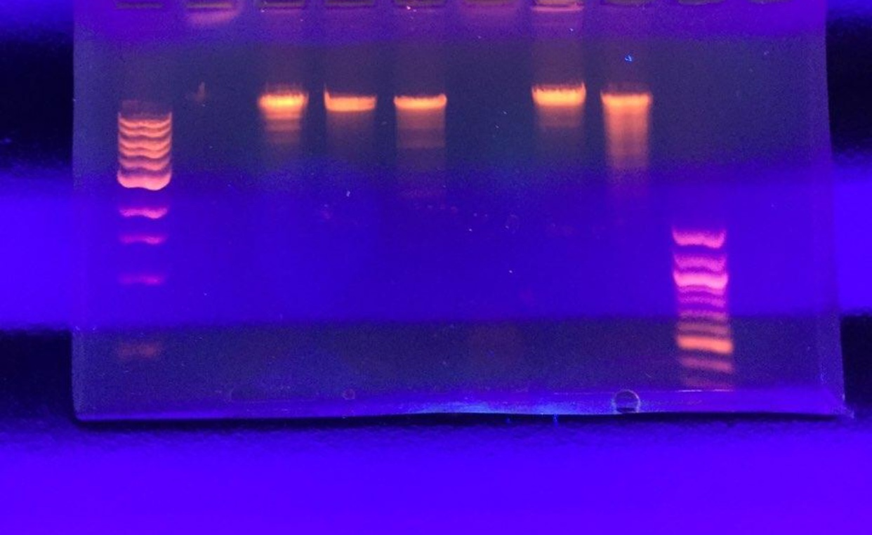
Cla I
Uncut DNA
Bam HI
Eco RI
Hind III
Hae III
Ladder
Sal I
bp
10,000
6,000
5,000
3,000
2,000
1,500
1,000
500

