Slide 1
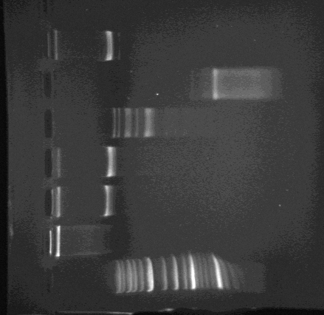
HindIV
10kb
6kb
HaeIII
0.8kb
0.1kb
EcoR
8kb
0.6kb
ClaI
10kb
BamHI
10kb
Uncut DNA
DNA ladder

