Slide 1
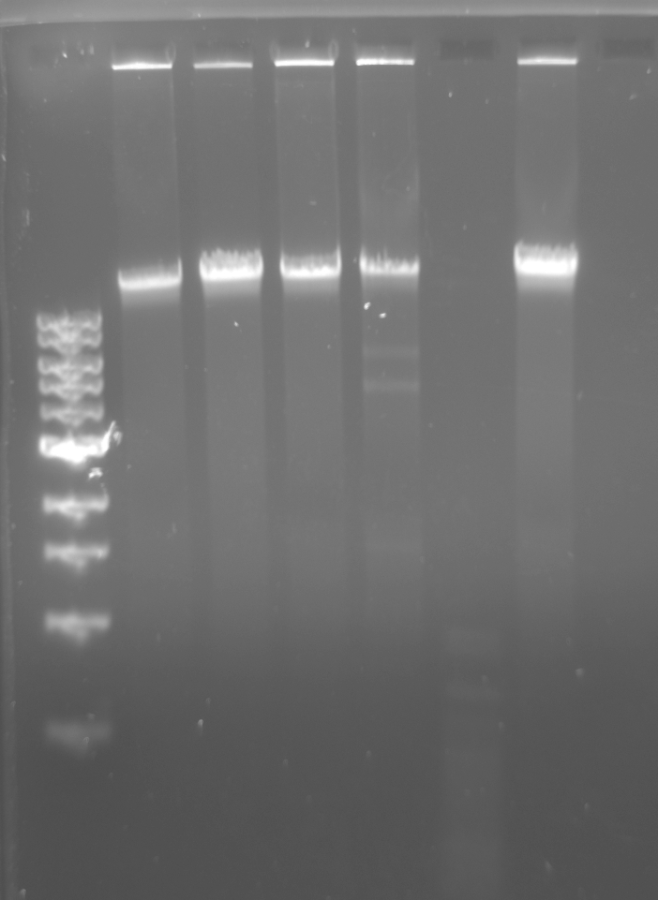
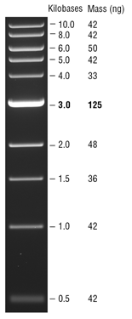
Control
BamHI
ClaI
EcoRI
HaeIII
HindIII
DNA Ladder

Slide 2
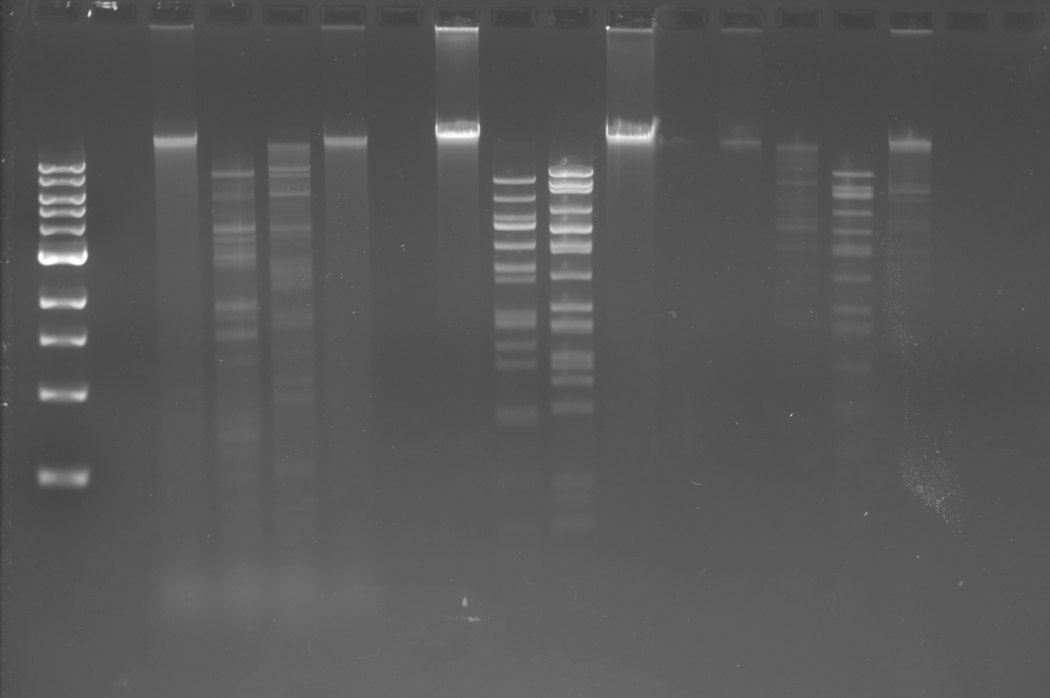
1
2
3
4
DNA Ladder
1. Control
2. AhdI
3. BstXI
4. DraIII-HF

