Slide 1
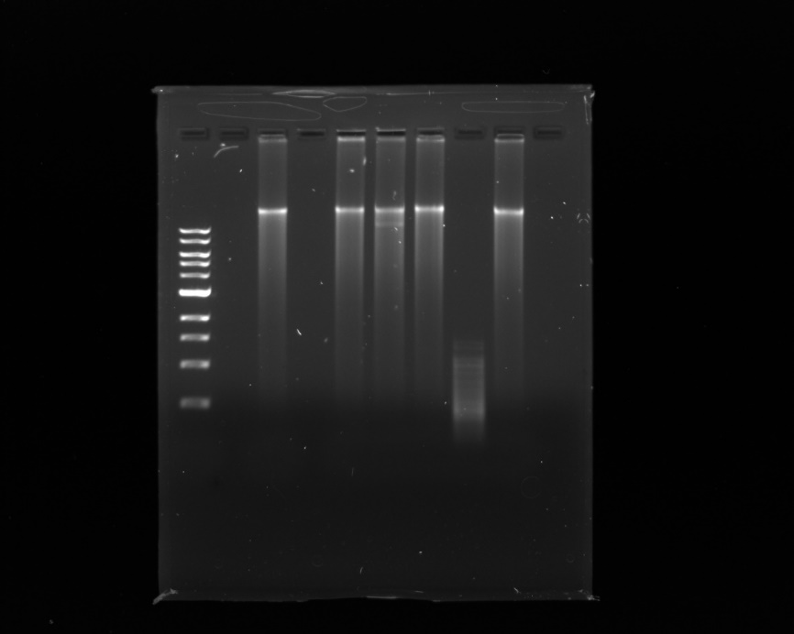
0.5 kb
Kb Ladder
Undigested DNA
BamHI
HindIII
EcoRI
HaeIII
ClaI
10.0 kb
8.0 kb
6.0 kb
5.0 kb
4.0 kb
3.0 kb
2.0 kb
1.5 kb
1.0 kb

