Slide 1
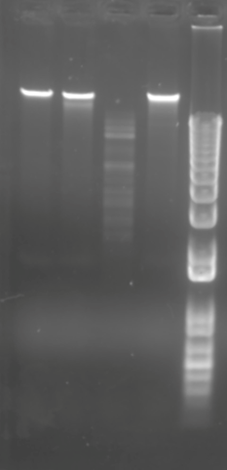
3-30-21
Phage Labelle
Julia Iacovella
4-12-21
Phage Labelle
Julia Iacovella
Ladder
Undigested
BamHI
ClaI
EcoRI
Haelll
HindIII

