Slide 1
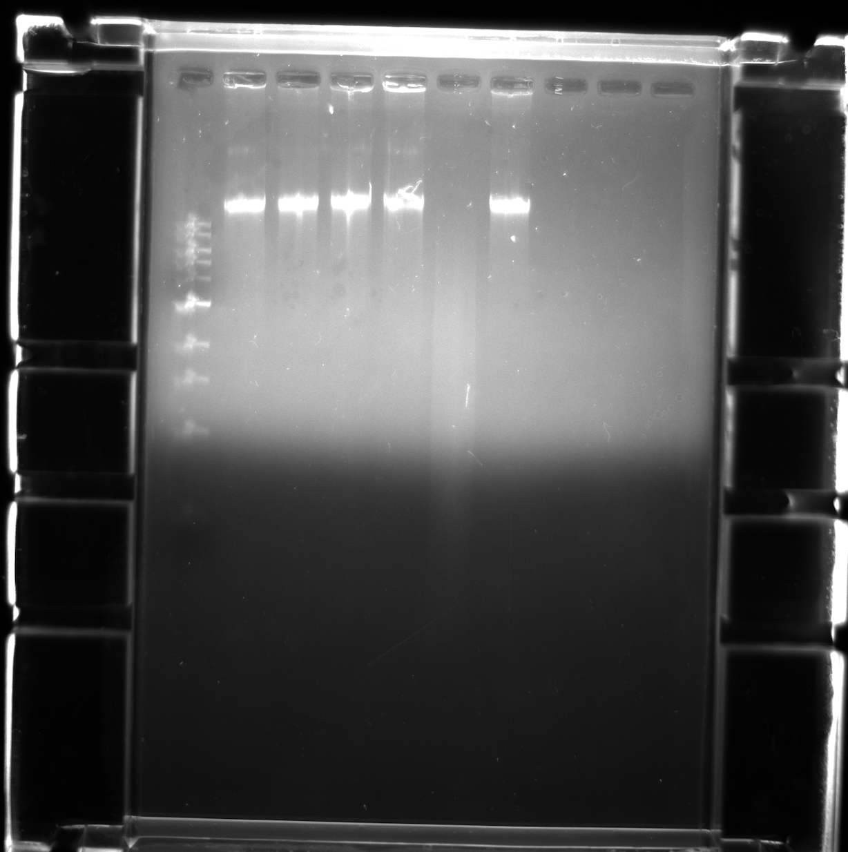
ClaI
HaeIII
HindIII
Ladder
BamHI
EcoRI
Control
10.0kb-
3 kb-
1.0kb-

