Slide 1
Mordor
Kori Montgomery, Sonya Layton and Dr. Lee Hughes
A Streptomyces xanthochromogenes phage…

Slide 2
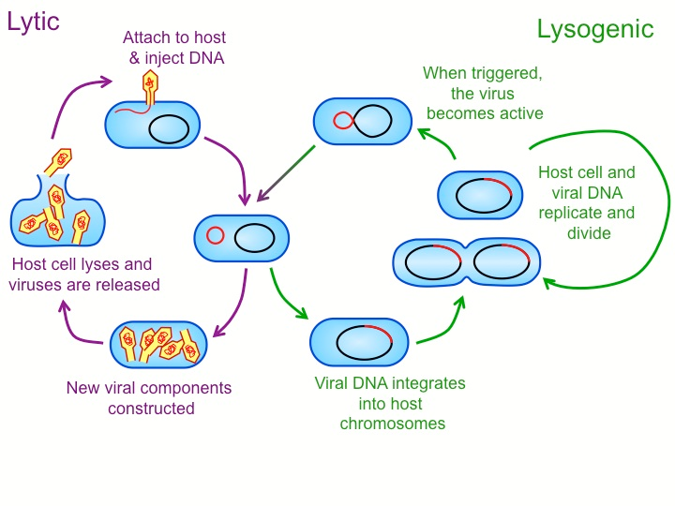
The Bacteriophage
The dictionary definition of bacteriophage is, any group of viruses that infect specific bacteria, usually causing their disintegration of dissolution.
Bacteriophages play a significant role in the world's carbon cycle.
Bacteriophages have two life cycles.

Slide 3
Phage Information
Phage:
Soil Sample 3:
Name for experiments: Traditions
The soil sample was wet/damp, really dark and had big grains.
Location: 502 North Texas Blvd. Denton, TX
Latitude: 33.2105
Longitude: -97.1558
Date: September 11, 2016
Time: 7:15 p.m.
Temperature: 82ﹾ F
We used Streptomyces xanthochromogenes for all the experiments to isolate the phage.

Slide 4
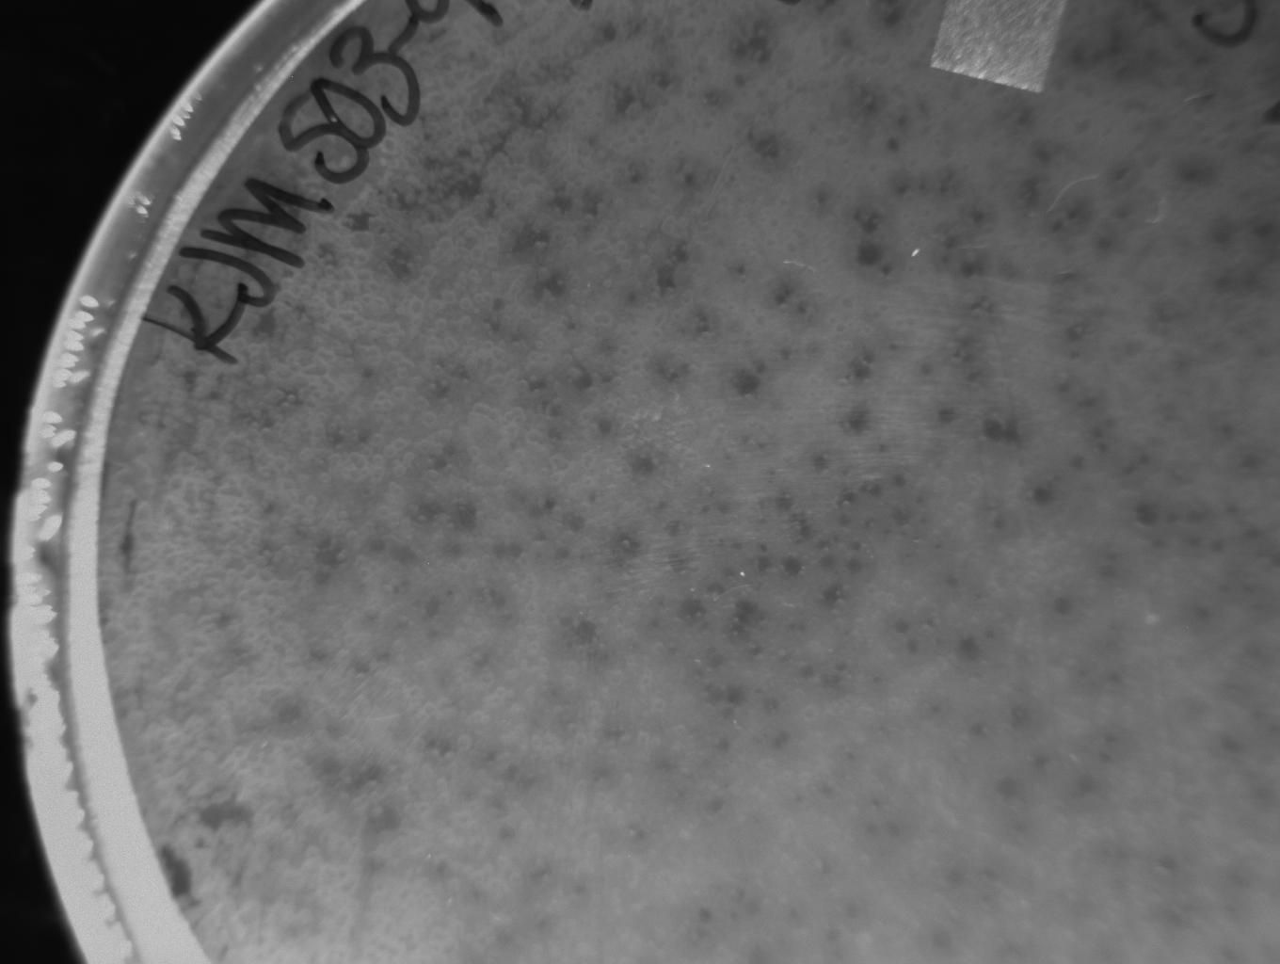
Individual Plaques
In this picture of my plate, you can see many individual plaques.
They are consistently very tiny, about 1 mm in diameter.
The plaques were always really clear, not cloudy.

Slide 5
MTL
I repeated the Phage titer 4 times before getting my MTL.
The titer of my MTL is:$8.0 ×{10}^{8}{pfu}/{μl}$

Slide 6
MPI “-5”
Volume of my diluted MTL needed for MPI:
9.04 μl for the 1X tubes
20 μl for the 2x tubes
1X plates flooded

Slide 7

HTL Spot Titer
$$\frac{2pfu}{5μl}×\frac{1000μl}{1μl}×{10}^{6}=4×{10}^{8}{pfu}/{μl}$$

Slide 8
DNA Information:
The concentration of my DNA is 108.9 ng/μl.
260/280 ratio: 1.81
The volume is 98 μl.
Total Yield: 49.83 μg

Slide 9
Restrictions Math
$\frac{500ng}{108.9{ng}/{μl}}×6.5=29.8ml of DNA$
13 μl of Cut smart
80.7 μl mol H₂O
Tube 2: 4.59 μl of DNA
13.41 μl mol H₂O
I followed the procedure exactly from the Streptomyces lab manual.

Slide 10
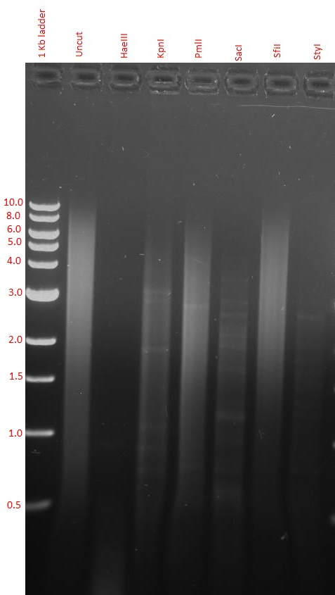
Gel Restrictions
When comparing my gel with other gels, I found mine is completely unique. The Uncut DNA band as you can see there is not a clear seen band because the chromosomes were broken when getting my DNA

Slide 11
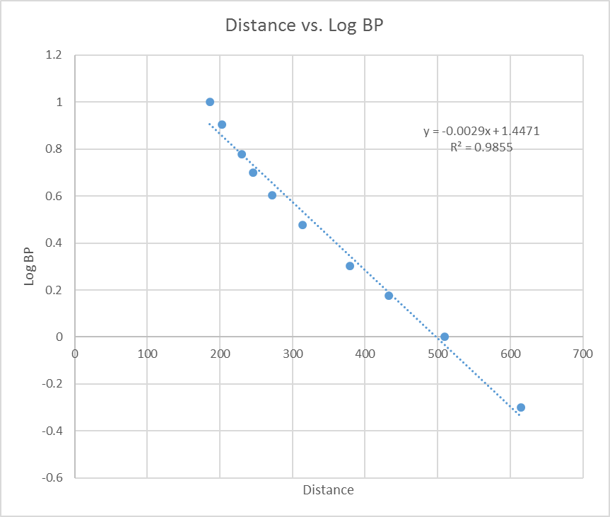
Genome
While I was able to calculate the genome length the results were not a good enough number.

Slide 12
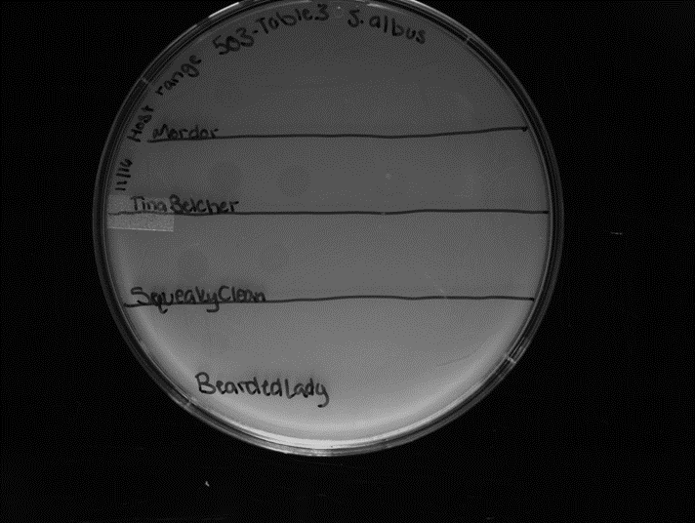
Host Range
Species | “+” or “-”
S. albus | -
S. venezuelae | -
S. virginiae | -
S. azureus | -
S. griseus | -

Slide 13
Conclusion
There are not any phages sequenced yet with Streptomyces xanthochromogenes. I hope that my phage will be one of the first to be sequenced.

