Slide 1
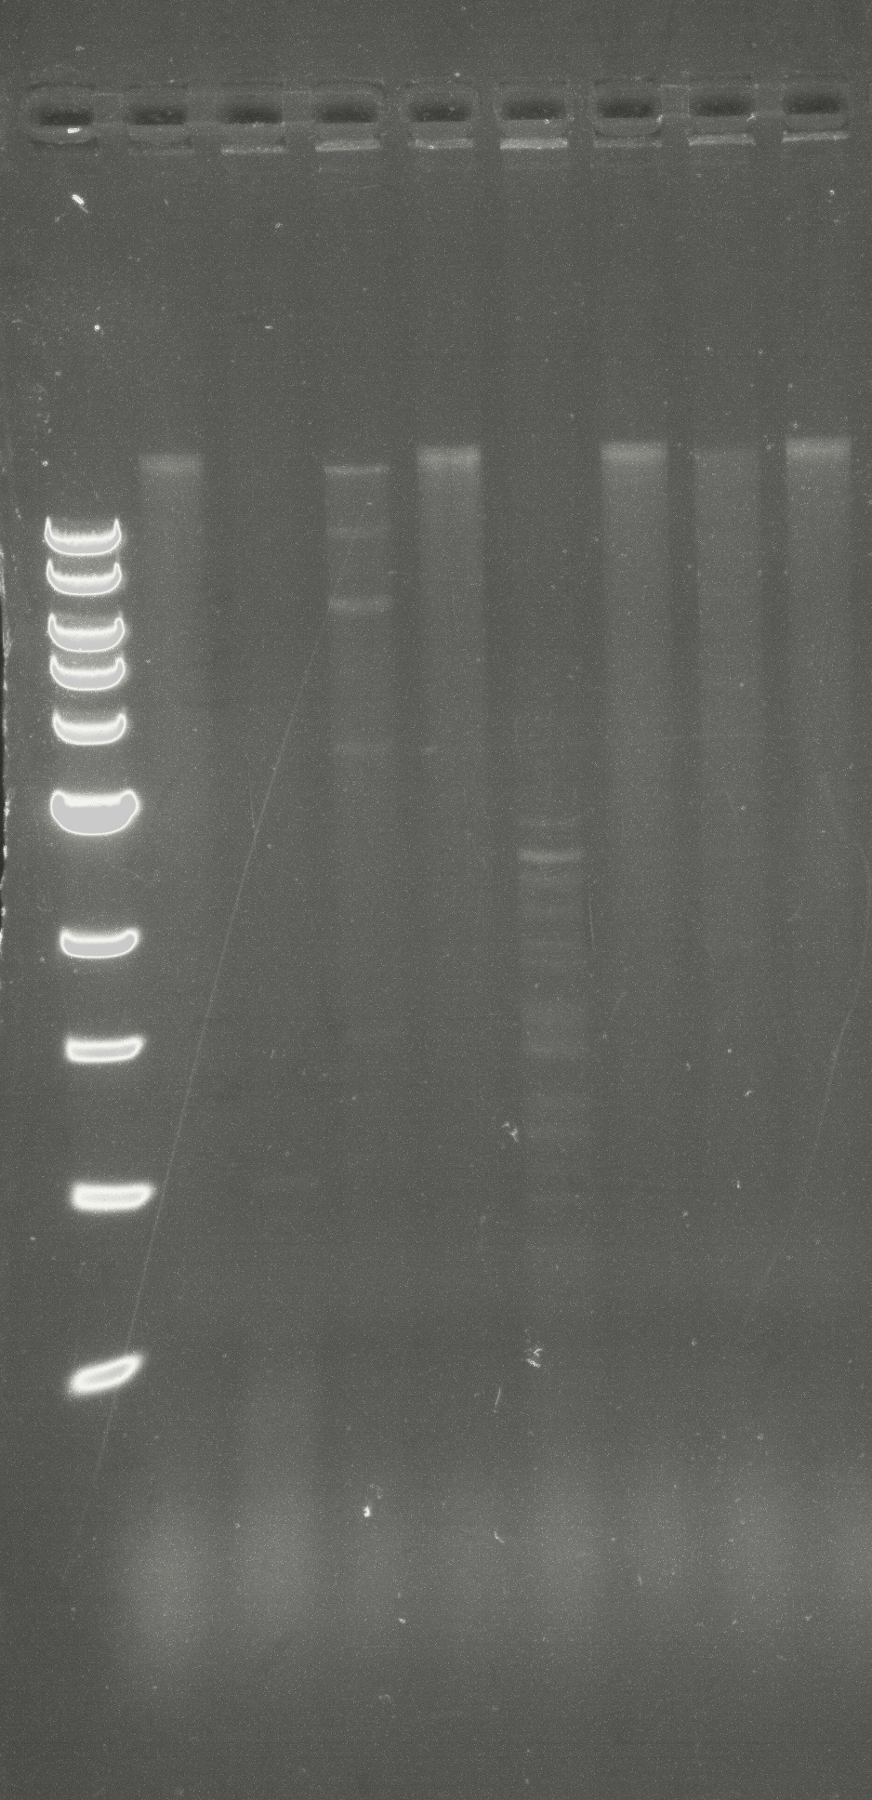
1 kb ladder
Uncut DNA
HaeIII
KpnI
PmlI
SacI
SfiI
StyI
Raijin
Streptomyces baarnensis
MseI
10 kbp
8 kbp
6 kbp
5 kbp
4 kbp
3 kbp
2 kbp
1.5 kbp
1 kbp
0.5 kbp

