Slide 1
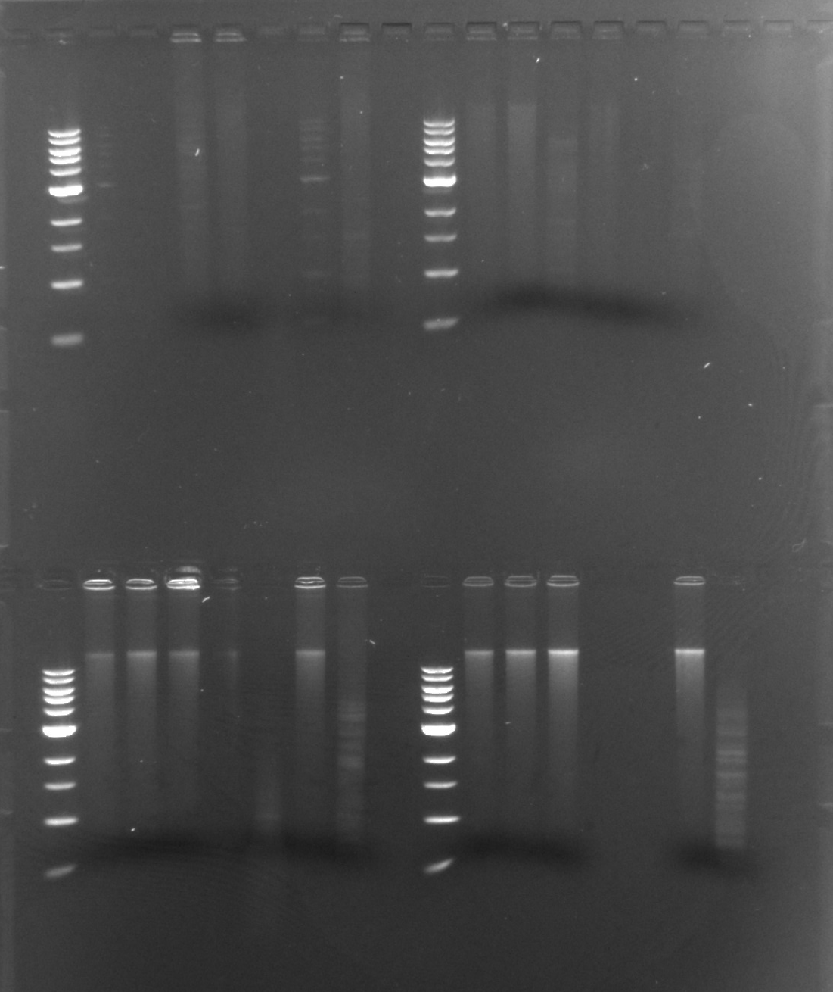
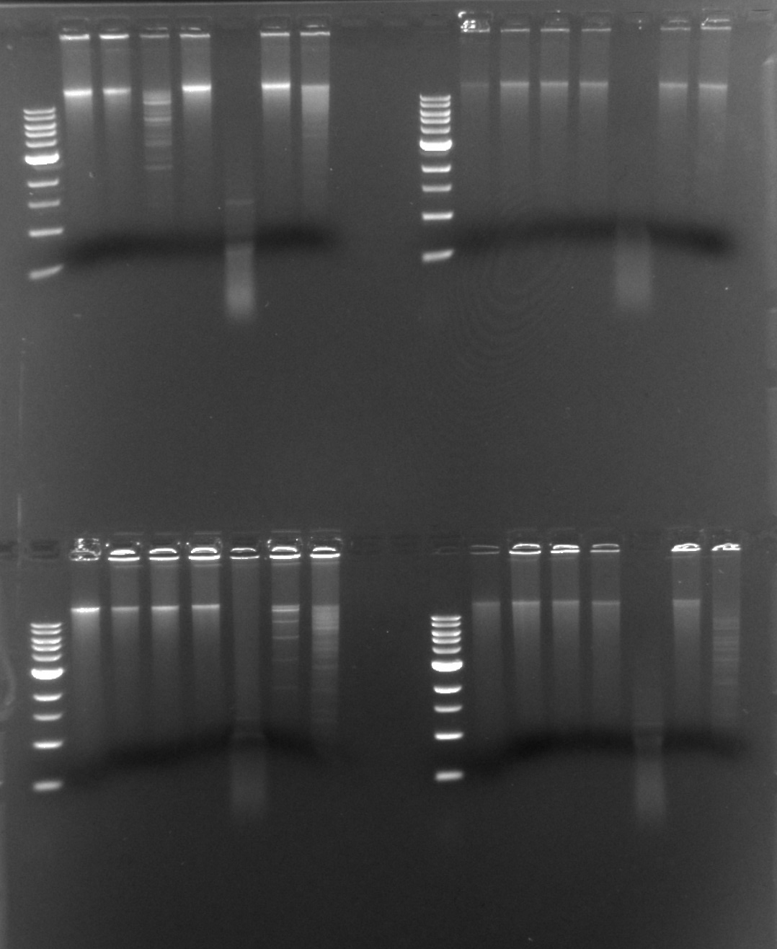
Gel 1
Gel 2
Ladder
Uncut
BamHI
ClaI
EcoRI
HaeIII
HindIII
Ladder
HindIII
SalI
Ladder
Uncut
BamHI
ClaI
EcoRI
HaeIII
HindIII
Ladder
Uncut
BamHI
ClaI
EcoRI
HaeIII
HindIII
Uncut
BamHI
ClaI
EcoRI
HaeIII
SalI
SalI
SalI
JEMP
ASCB
CLEP
DSCO
Ladder
Uncut
BamHI
EcoRI
HaeIII
HindIII
Ladder
BamHI
EcoRI
HindIII
Ladder
Uncut
BamHI
ClaI
EcoRI
HaeIII
HindIII
Ladder
Uncut
BamHI
ClaI
EcoRI
HaeIII
HindIII
ClaI
SalI
Uncut
ClaI
HaeIII
SalI
SalI
SalI
LRAP
BLAP
SHAF
KBAG

