Slide 1
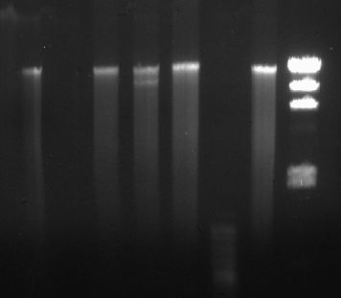
23,130 BP
9,416 BP
6,557 BP
4,361 BP
2,322 BP
2,027 BP

