Slide 1
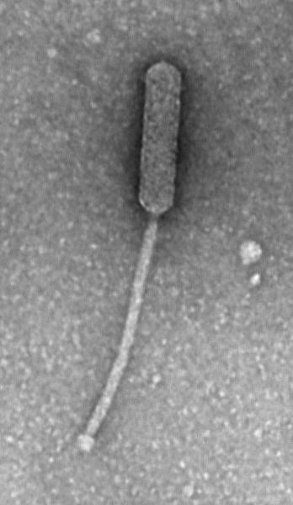
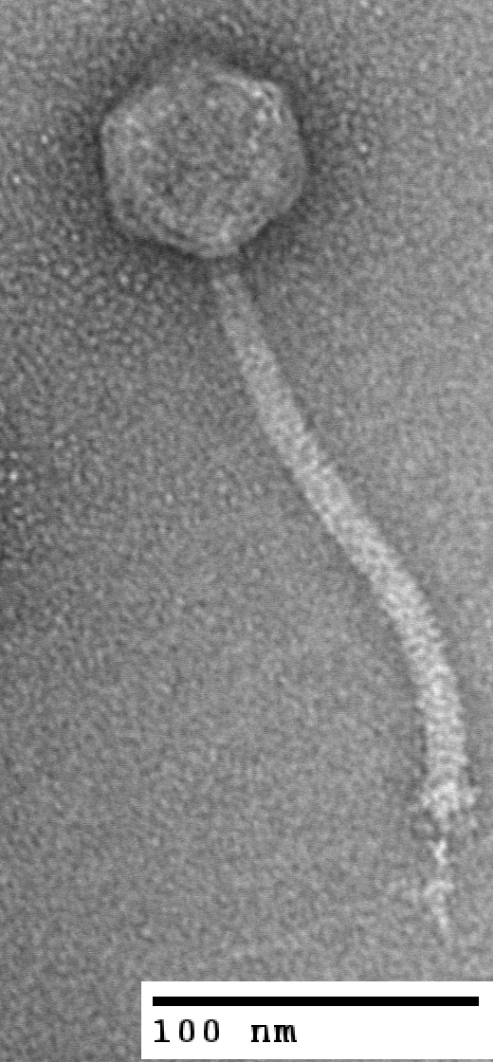
Finishing Phage Genomes
How to identify circularly permuted genomes, physical ends, 3’ overhangs, terminal repeats, and nicks.

Slide 2
Circularly Permuted Genomes
Some phages have circularly permuted genomes. This means a linear concatamer of phage DNA is synthesized, used to fill a phage head, then cut when the head is full. Generally, one head will fit more than 100% of a genome, say, 103-110%. This ensures that wherever the DNA is cut, at least one working copy of each gene is present.
The remaining part of the concatamer goes on to fill a new head, is cut, etc.
Think of it like the complete genome of a phage was the alphabet…
Complete genome of phage “AlphaCirc” with 26 “genes” (A through Z):
ABCDEFGHIJKLMNOPQRSTUVWXYZ

Slide 3
Circularly Permuted Genomes
First, a long concatamer of the genome is synthesized:
ABCDEFGHIJKLMNOPQRSTUVWXYZABCDEFGHIJKLMNOPQRSTUVWXYZABCDEFGHIJKLMNOPQRSTUVWXYZABCDEFGHIJKLMNOPQRS
Next, that concatamer is packaged into a phage head until the head is full:
ABCDEFGHIJKLMNOPQRSTUVWXYZABCDEFGHIJKLMNOPQRSTUVWXYZABCDEFGHIJKLMNOPQRSTUVWXYZABCDEFGHIJKLMNOPQRS
Then the concatamer is cut:
CDEFGHIJKLMNOPQRSTUVWXYZABCDEFGHIJKLMNOPQRSTUVWXYZABCDEFGHIJKLMNOPQRS
ABCDEFGHIJKLMNOPQRSTUVWXYZAB
CDEFGHIJKLMNOPQRSTUVWXYZABCDEFGHIJKLMNOPQRSTUVWXYZABCDEFGHIJKLMNOPQRS
And packaging begins again with a new head:
CDEFGHIJKLMNOPQRSTUVWXYZABCDEFGHIJKLMNOPQRSTUVWXYZABCDEFGHIJKLMNOPQRS
And cutting:
CDEFGHIJKLMNOPQRSTUVWXYZABCD
EFGHIJKLMNOPQRSTUVWXYZABCDEFGHIJKLMNOPQRS
EFGHIJKLMNOPQRSTUVWXYZABCDEFGHIJKLMNOPQRS
Until…

Slide 4
Circularly Permuted Genomes
…an entire series of heads have had DNA packaged:
ABCDEFGHIJKLMNOPQRSTUVWXYZAB
CDEFGHIJKLMNOPQRSTUVWXYZABCD
GHIJKLMNOPQRSTUVWXYZABCDEFGH
EFGHIJKLMNOPQRSTUVWXYZABCDEF
MNOPQRSTUVWXYZABCDEFGHIJKLMN
KLMNOPQRSTUVWXYZABCDEFGHIJKL
IJKLMNOPQRSTUVWXYZABCDEFGHIJ
Note that:
each new phage does have a complete complement of genes (A→Z, plus 2 duplicates)
there are ends within each individual phage, but the ends are not conserved among particles
So what does this mean for finishing genomes?

Slide 5
Circularly Permuted Genomes
A phage with a circularly permuted genome will not have any defined ends. No primers walks will result in the “glorious A” typical of physical ends.
No clone/read build up at ends will occur.
All reads will assemble into a large contig with sequence match at the “ends.”
Assembly View of a Finished, Circularly Permuted Phage (Troll4)
Green lines are clone/read coverage depth.
Purple lines show paired reads (F/R) from clones across the ends.
Orange line shows the location of sequence matches.

Slide 6
Circularly Permuted Genomes
We can tell this phage is circularly permuted because there is strong clone and read coverage throughout, and overlap at the ends. As long as we’ve checked for weak areas throughout the contig and verified the overlap as high enough quality, this phage is considered finished.
Keep in mind that the “ends” we see here are not real ends, only an artifact of consed, which cannot show DNA in a circle and so chooses a breaking point.
Assembly View of a Finished, Circularly Permuted Phage (Troll4)
Green lines are clone/read coverage depth.
Purple lines show paired reads (F/R) from clones across the ends.
Orange line shows the location of sequence matches.

Slide 7
Physical Ends
Some phages package their DNA differently. In these phages, the DNA molecule that is packaged always has the same start and end positions:
ABCDEFGHIJKLMNOPQRSTUVWXYZ
ABCDEFGHIJKLMNOPQRSTUVWXYZ
ABCDEFGHIJKLMNOPQRSTUVWXYZ
ABCDEFGHIJKLMNOPQRSTUVWXYZ
ABCDEFGHIJKLMNOPQRSTUVWXYZ
These phages have “physical ends,” meaning the left end and right end of each particle is the same, unlike circularly permuted phages.
So what does this mean for finishing genomes?

Slide 8
Physical Ends
ABCDEFGHIJKLMNOPQRSTUVWXYZ
ABCDEFGHIJKLMNOPQRSTUVWXYZ
ABCDEFGHIJKLMNOPQRSTUVWXYZ
ABCDEFGHIJKLMNOPQRSTUVWXYZ
ABCDEFGHIJKLMNOPQRSTUVWXYZ
In sequencing data, physical ends can be identified in two basic ways:
A build-up of clones/reads with identical start positions.
Primer walks into the end that terminate in a “glorious A” (an artificial, strong base added to physical ends by sequencing polymerase).
Let’s see what each method looks like in raw data form…

Slide 9
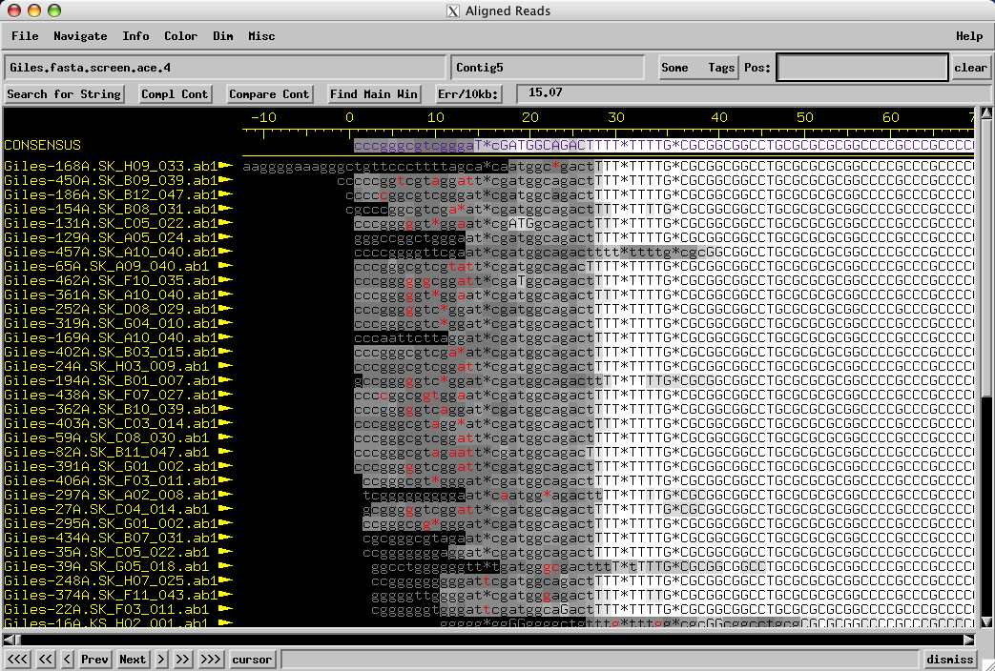
Physical Ends
Finding a potential physical end from a build-up of clones.
A screenshot of the Aligned Reads view from consed, from the phage Giles.
Note that many clones start having high quality (Q>20) sequence from almost the exact same base. This would be extremely unlikely by chance, so this is likely a physical end.

Slide 10
Physical Ends
Finding a potential physical end from a build-up of clones.
Assembly View from phage Giles
Looking at the assembly view of that same phage, we see several important things:
No orange line indicating overlap at the ends.
No purple clones linking the ends.
A higher than average amount of coverage at each end (green line).

Slide 11
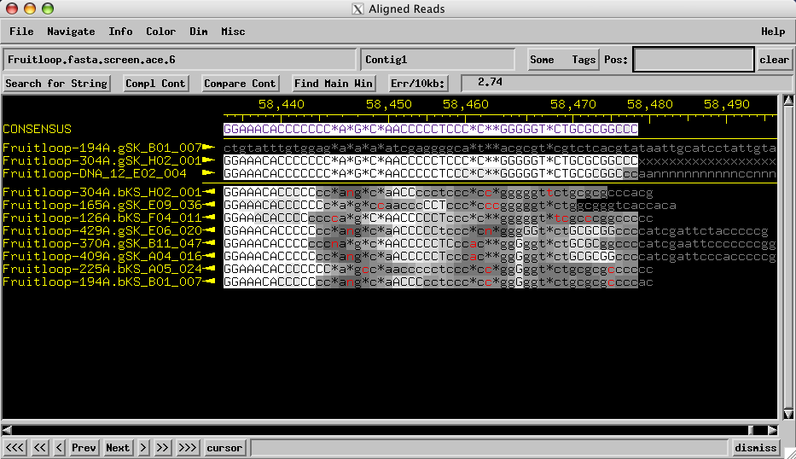
Physical Ends
Finding a potential physical end from a build-up of clones.
Another screenshot of the Aligned Reads view from consed, this time the phage Fruitloop.
The build-up may not always be as profound, but even 4 clones that start at the same position are unlikely by chance, and should arouse suspicions.

Slide 12
Physical Ends
Verifying a physical end with a primer walk.
Another screenshot of the Aligned Reads view from consed, this time the phage Fruitloop.
This is a primer walk using primer 12 and genomic DNA as the template.
To verify that you truly have a physical end, and to pinpoint the precise base where the genome ends, a primer walk toward the end is necessary. The sequencing polymerase will add a single false A nucleotide if it reaches the end of a piece of DNA.

Slide 13
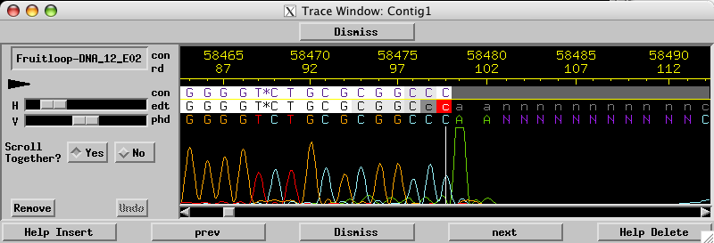
Physical Ends
Verifying a physical end with a primer walk.
This is a primer walk using primer 12 and genomic DNA as the template.
This is the chromatogram of that primer walk. Notice that the sequence has high quality with clear peaks, reaches a “glorious A” peak at the end, and then dies out. This is very strong evidence that this is a physical end, and since the glorious A is not real, we can call the last few bases of the genome: …TGCGCGGCCC
To verify that you truly have a physical end, and to pinpoint the precise base where the genome ends, a primer walk toward the end is necessary. The sequencing polymerase will add a single false A nucleotide if it reaches the end of a piece of DNA.

Slide 14
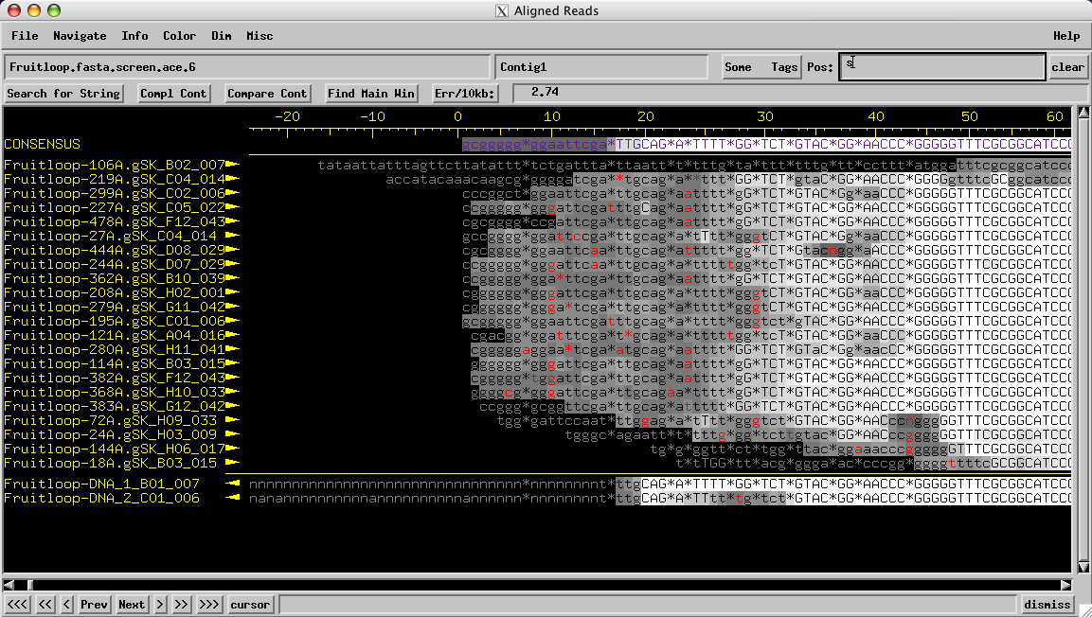
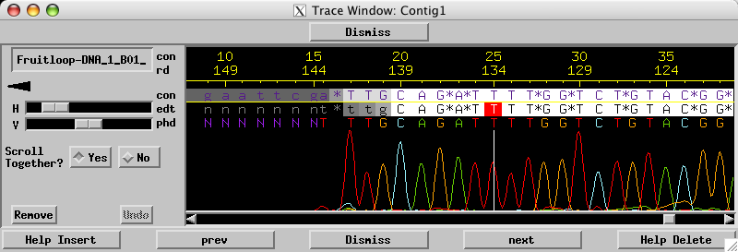
Physical Ends
Verifying a physical end with a primer walk.
At the other end of the genome, things work much the same. Just remember that the “glorious A” will now be a “glorious T” since the chromatogram is reverse complemented.
Again, remembering the final T is false, we can call the start of the genome: TGCAGATTT…

Slide 15
Physical Ends
Done?
So we know both ends precisely, the genome has acceptable coverage throughout (at least one high quality read on each strand in all locations), so is it finished?
Not quite. Most Mycobacterium phages that have physical ends also have a short (4-14bp) 3’ sticky-end overhang. We’d like to know the length and sequence of this overhang to consider the phage completely finished.
It would be nice to simply primer walk into this overhang and get the sequence that way. Why doesn’t that work?

Slide 16
3’ Overhangs
Here’s what we know about the end of the Fruitloop genome (assuming some 3’ overhang):
5’
3’
T G C G C G G C C C ? ? ? ? ? ? ? ? ? ?
A C G C G C C G G G
3’
5’
A primer heading towards the end of the genome will always use the bottom strand as template:
5’
3’
T G C G C G G C C C ? ? ? ? ? ? ? ? ? ?
T G C G C G G C C C A
A C G C G C C G G G
3’
5’
Note that the glorious A is added, but that we still have not been enlightened about the overhang sequence at all. So how do we figure out the overhang sequence?
The answer is that we ligate some genomic DNA:
5’
3’
T G C G C G G C C C ? ? ? ? ? ? ? ? ? ?
A C G T C T A A A A
? ? ? ? ? ? ? ? ? ? T G C A G A T T T T
A C G C G C C G G G
3’
5’
The sticky 3’ overhangs from each end align, ligase covalently bonds them, and now we have a continuous template on which we can run the same primer!

Slide 17
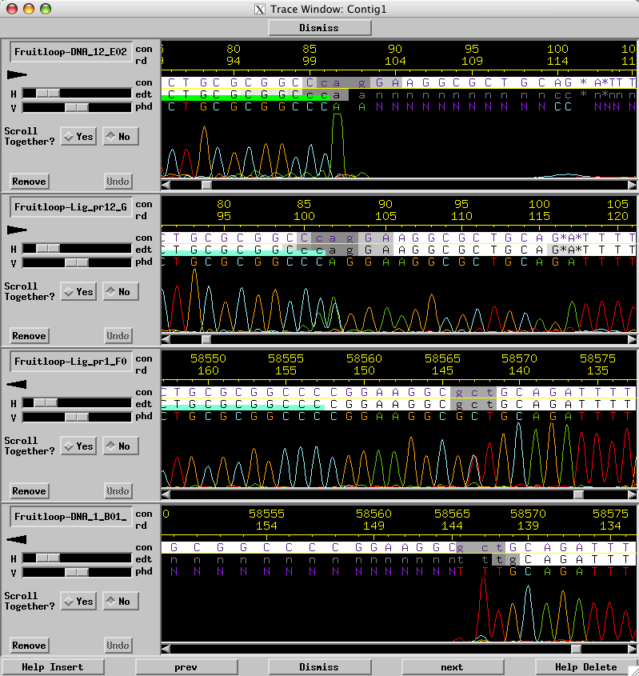
3’ Overhangs
Before ligating our genomic DNA, primer walks at the ends died at the “glorious A” (or “glorious T”), now they can reveal the overhang sequence.
We knew the right end of the genome was:
…TGCGCGGCCC
Now with primer walks on ligated DNA we can call the 3’ overhang between the two:
CGGAAGGCGC
And the left end of the genome was:
TGCAGATTT…

Slide 18
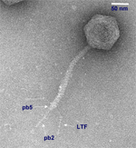
Terminally Repetitive Genomes
So some genomes are circularly permuted, and some have physical ends with overhangs. There are also terminally repetitive genomes, where the ends are consistent, but more than one full copy of the genome is packaged.
ABCDEFGHIJKLMNOPQRSTUVWXYZAB
ABCDEFGHIJKLMNOPQRSTUVWXYZAB
ABCDEFGHIJKLMNOPQRSTUVWXYZAB
ABCDEFGHIJKLMNOPQRSTUVWXYZAB
ABCDEFGHIJKLMNOPQRSTUVWXYZAB
Note that:
each phage particle has duplicates of section AB of the genome
each phage particle has the same ends
T5 is an E. coli phage that has a terminally repetitive genome. The total genome length is about 122 kb, but the first and last 10 kb are 100% identical.
Awesome is a T5-like phage finished at PBI.

Slide 19
Terminally Repetitive Genomes
The easiest way to identify a terminally repetitive genome is by a BLAST search that matches a known terminally repetitive genome. Another possible way is to look for an unusually defined section of double coverage in the data.
ABCDEFGHIJKLMNOPQRSTUVWXYZAB
ABCDEFGHIJKLMNOPQRSTUVWXYZAB
ABCDEFGHIJKLMNOPQRSTUVWXYZAB
ABCDEFGHIJKLMNOPQRSTUVWXYZAB
ABCDEFGHIJKLMNOPQRSTUVWXYZAB
Assembly View of Phage Awesome Genome
The red circle identifies a contiguous area of unusually high coverage. Notice that the true physical ends (on either side of “AB” in the phage particles) are somewhere within the contig, since the assembly software combines the AB section from both ends.
ABCDEFGHIJKLMNOPQRSTUVWXYZAB
ABCDEFGHIJKLMNOPQRSTUVWXYZAB

Slide 20
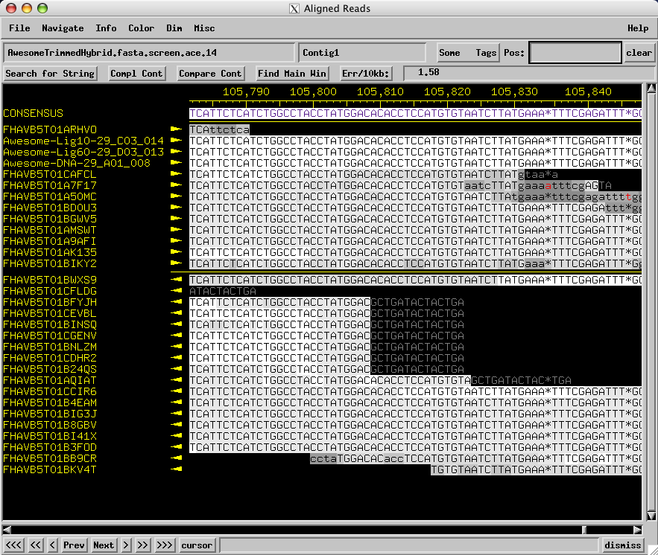
Terminally Repetitive Genomes
You may also see a build-up of clones/reads at the edges of the double coverage area, within the contig.
Suspicious build-up of reads, only this time it’s not at the end of a contig.
Area of detail.
Assembly View of Phage Awesome Genome

Slide 21
Terminally Repetitive Genomes
To confirm that this is really a terminal repeat, and to find the precise base where the repeat begins and ends, primer walks are again necessary.
Terminal Repeat
Complete Awesome Genome
Terminal Repeat
We want to design primers as though walking into physical ends.
These would normally give us glorious As and define the precise ends, but…
…each primer now has a secondary binding site.
This means when running these primers, we will get sequence from two areas of the genome. The reads from each binding site will be identical within the terminal repeat. When the end of the terminal repeat is reached, half the signal will end in a glorious A (like the yellow primer on the right) and the other half will continue into unique sequence (like the yellow primer on the left).
Thus, to find the ends of the terminal repeat (and genome), we look for primer walks with a glorious A, but that continue along after it at ~½ the signal strength.

Slide 22
Terminally Repetitive Genomes
Here is the chromatogram from Awesome that comes from running the equivalent of the yellow primer below.
Terminal Repeat
Complete Awesome Genome
Terminal Repeat
We can see the glorious A at base 105809 of the contig, and the purple lines show the drop of about ½ in average signal strength.

Slide 23
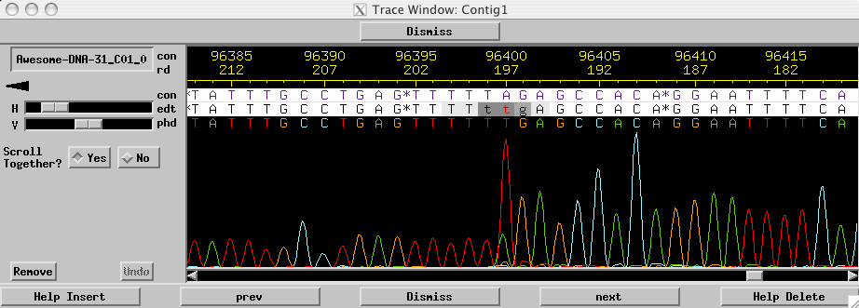
Terminally Repetitive Genomes
And the equivalent of the red primer below, from Awesome.
Terminal Repeat
Complete Awesome Genome
Terminal Repeat
Now we can call both ends of the terminal repeat (and genome).

Slide 24
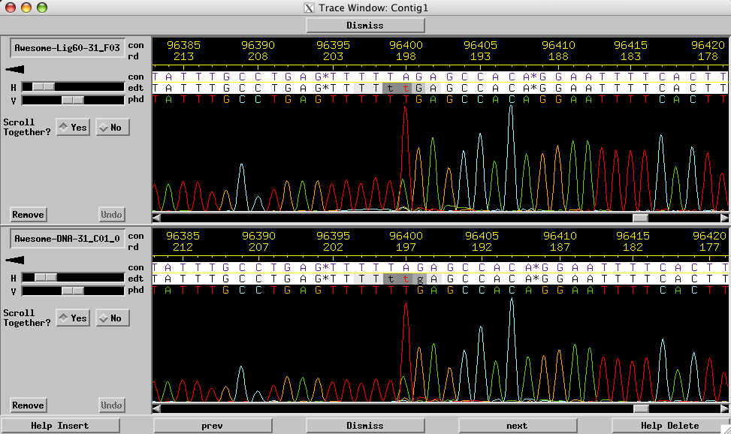
Terminally Repetitive Genomes
One important note, whose relevance will become clear. If we treat genomic DNA from this type of phage with ligase, the chromatogram is unchanged.

Slide 25
DNA Nicks
One other feature of some genomes (such as Awesome and T5) is the presence of nicks in the DNA. Nicks are present in one strand only, in the same place of the genome each time. Some nicks are “minor” (meaning a small percentage of DNA molecules possess the nick) and these are unlikely to show up in sequencing data. Others are “major” (most of the DNA molecules possess the nick) and these are likely to show up in the DNA.
5’
3’
T G C G C G G C C C G T C T A G C A
A C G T C T A A A A
C A G A T C G T T G C A G A T T T T
A C G C G C C G G G
3’
5’
Nick
So how do nicks show up in sequencing data?

Slide 26
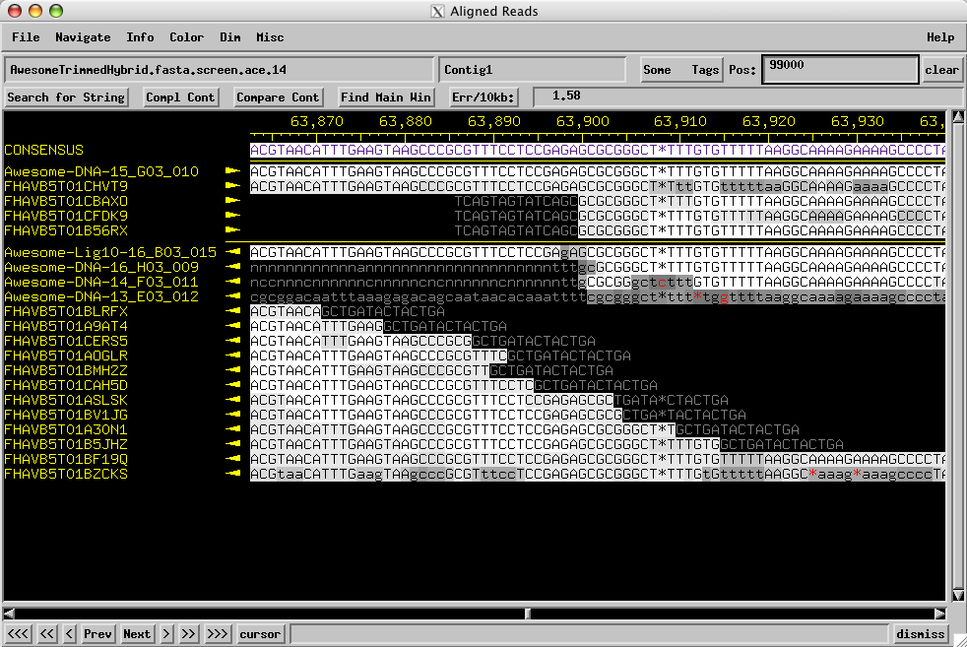
DNA Nicks
In an assembly, major nicks will appear as a build up of clones on one strand, and a “smear” of clustered clones on the other strand. This is because of the way DNA is sheared and repaired for library construction.
The red circle shows the build-up of clones. The purple line shows the “smear” on the opposite strand.

Slide 27
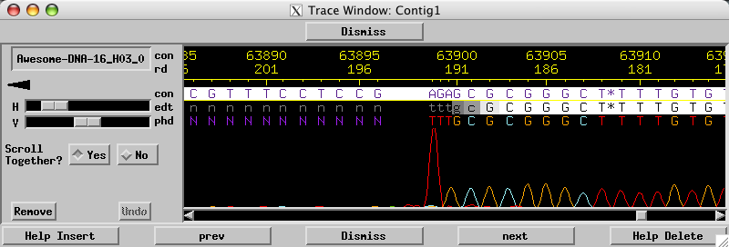
DNA Nicks
Again, primer walks are needed to verify the nick. Primer walks on one strand will be unaffected (those that use the non-nick strand as template), and walks on the other strand will die suddenly with a glorious A.
Non-nick strand as template.
Nick strand
as template.

Slide 28
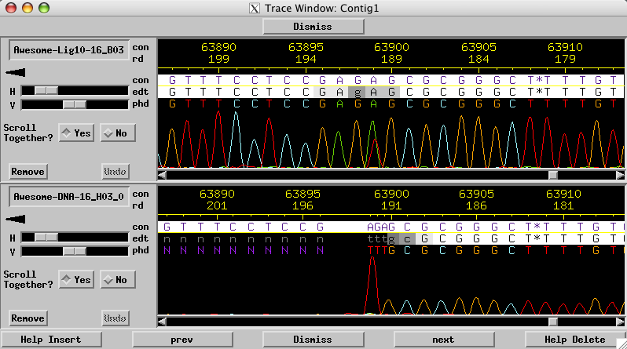
DNA Nicks
If a nick is present in only 50% of DNA molecules, it will look almost identical to an end of a terminally repetitive genome. The easiest way to distinguish them is to treat the DNA with ligase, which will repair a nick, but not (remember from earlier!) an end.
The same primer on ligated and unligated DNA. It’s repaired, so must be a nick, not an end!

