Slide 1
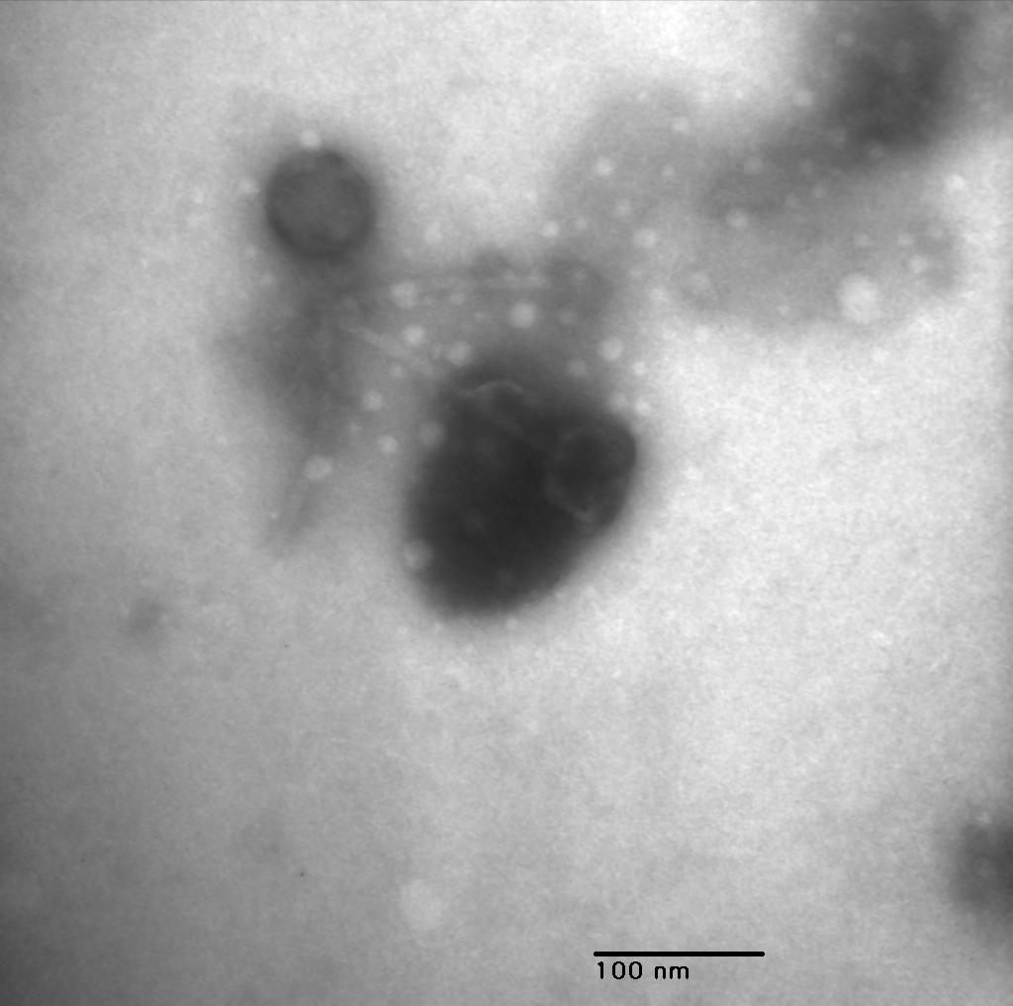
AH #1 150,000 X

Slide 2
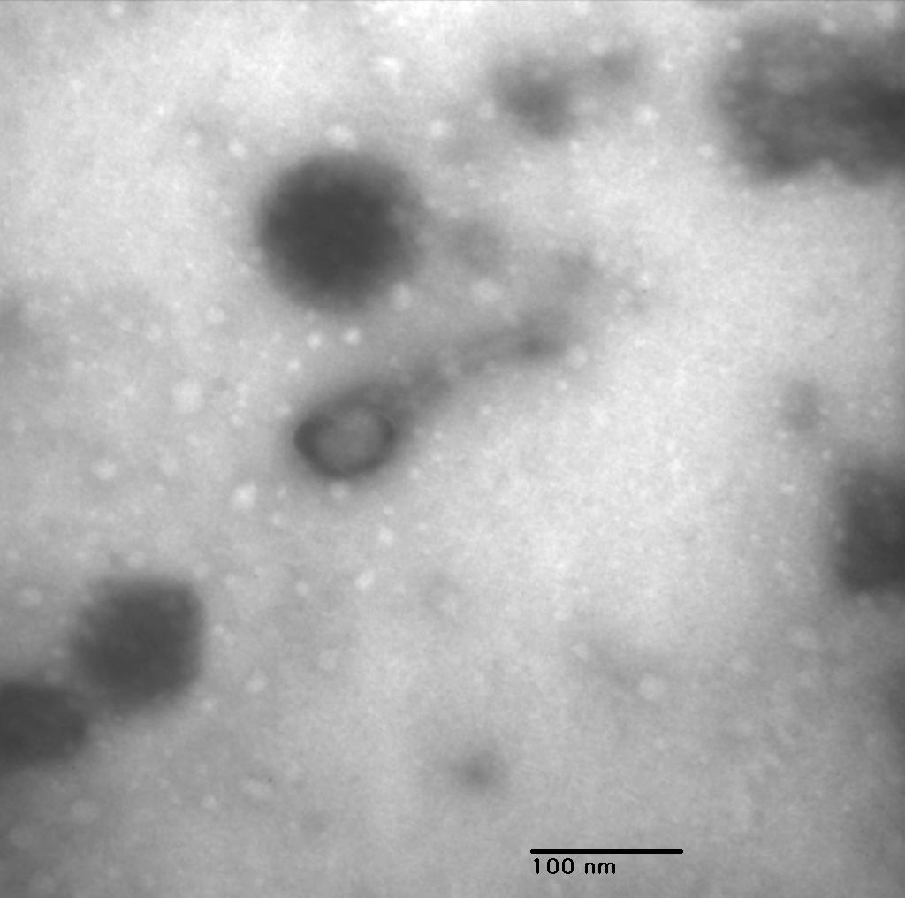
AH #2 100,000 X

Slide 3
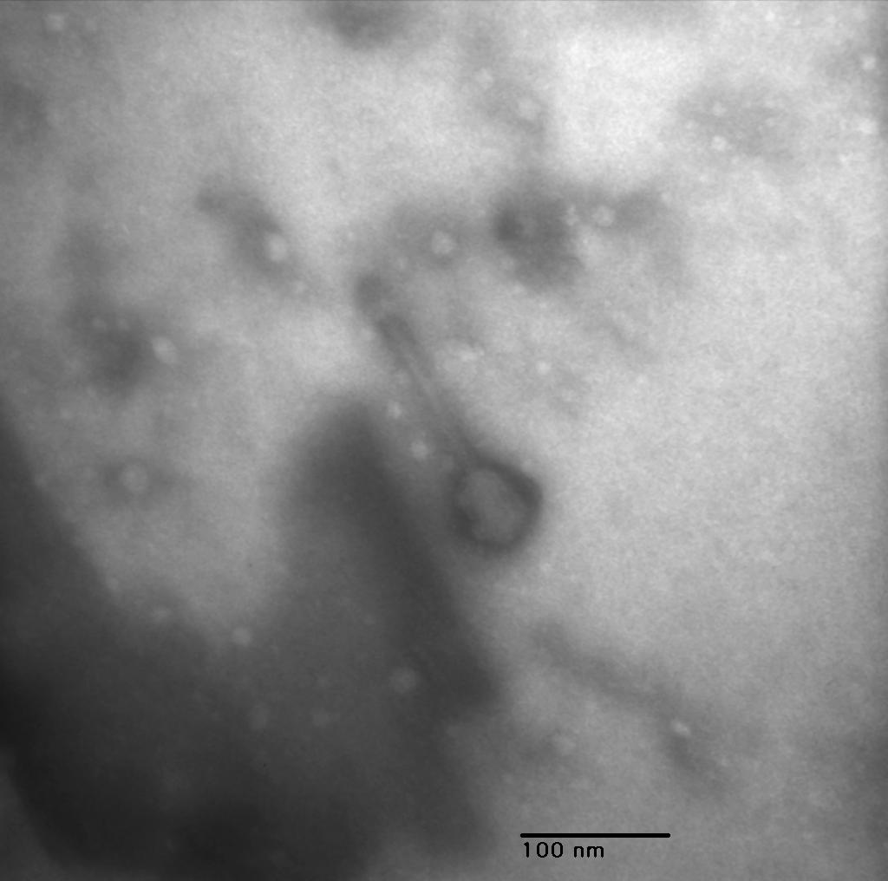
AH #3 150,000 X

Slide 4
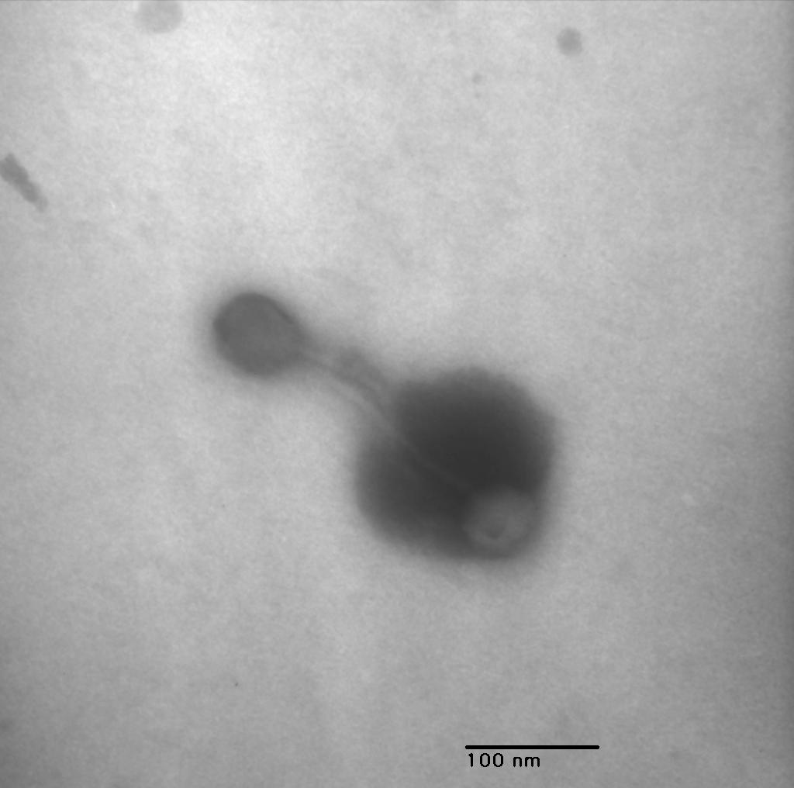
AH #4 150,000 X

Slide 5
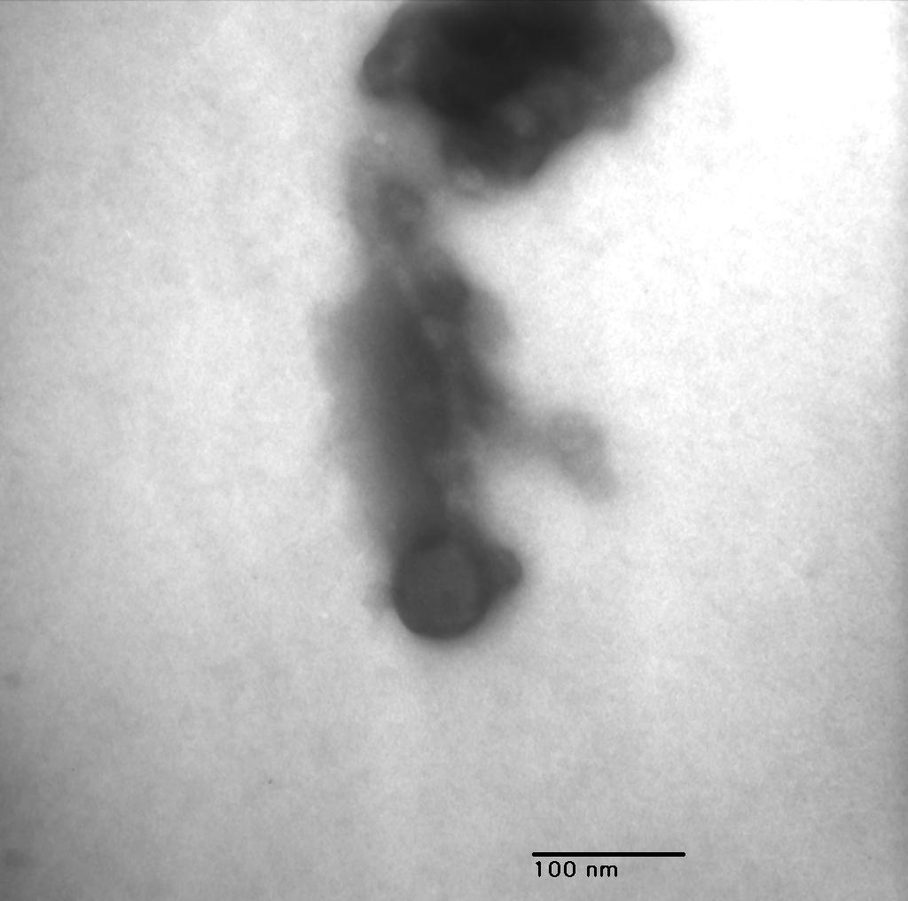
AH #5 150,000 X

Slide 6
Carl the Phage’s Modeling Portfolio

