Slide 1
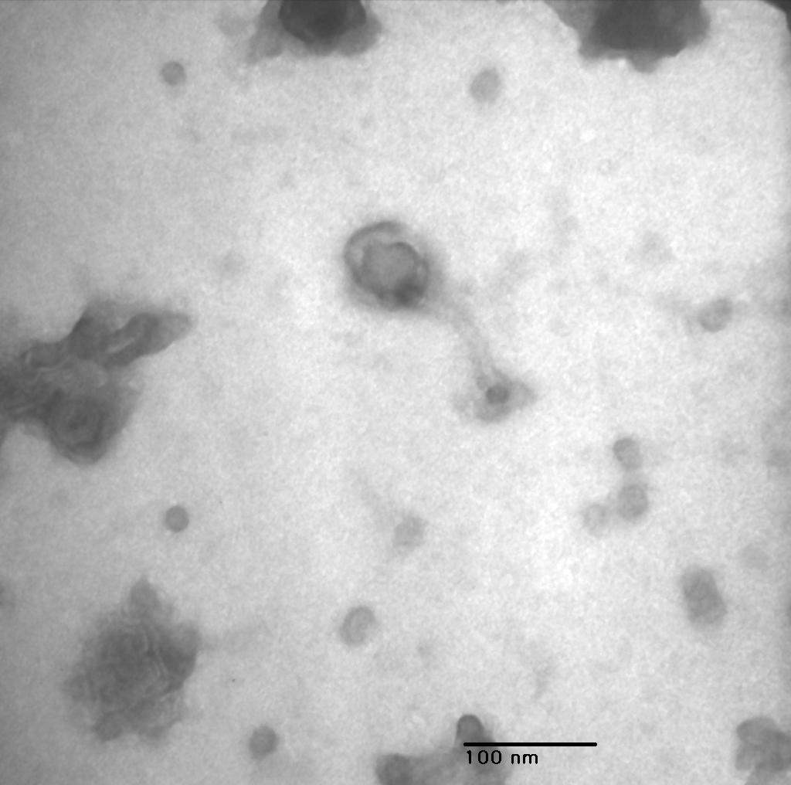
CNC 1, 150,000x

