Slide 1
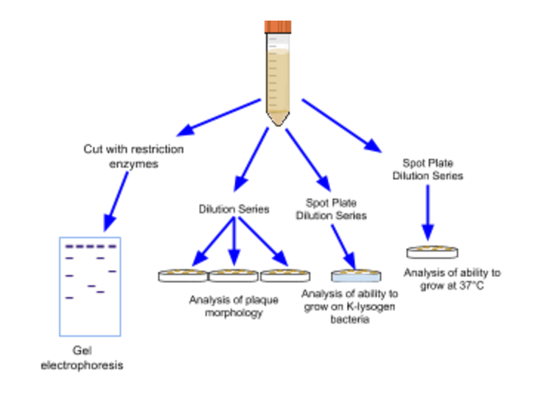
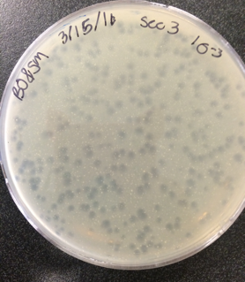
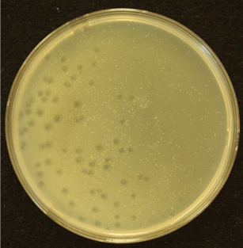
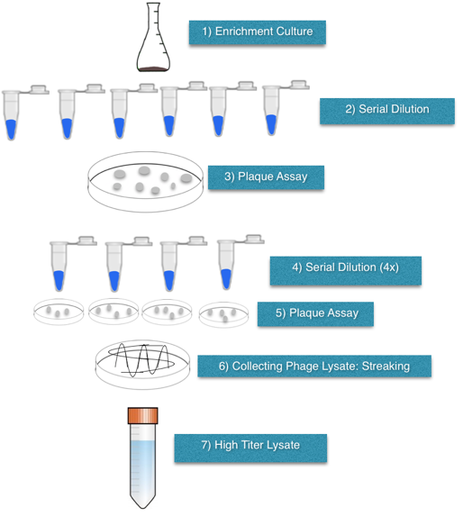
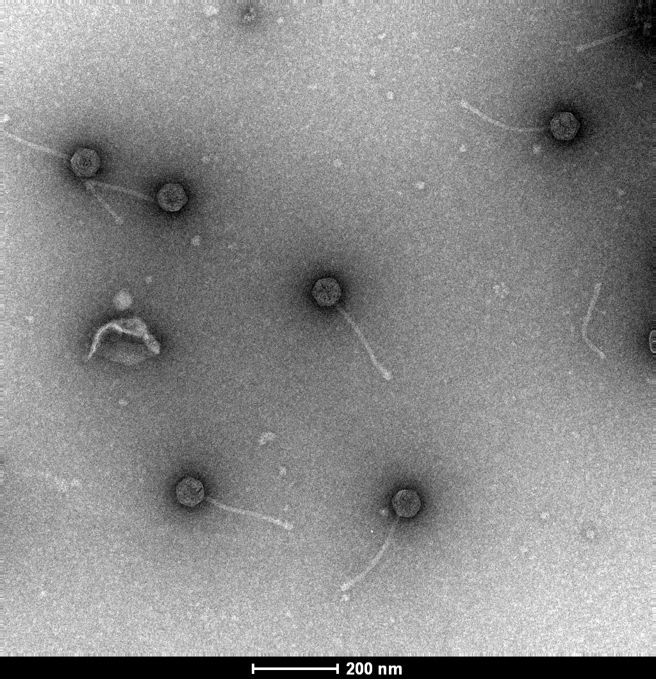
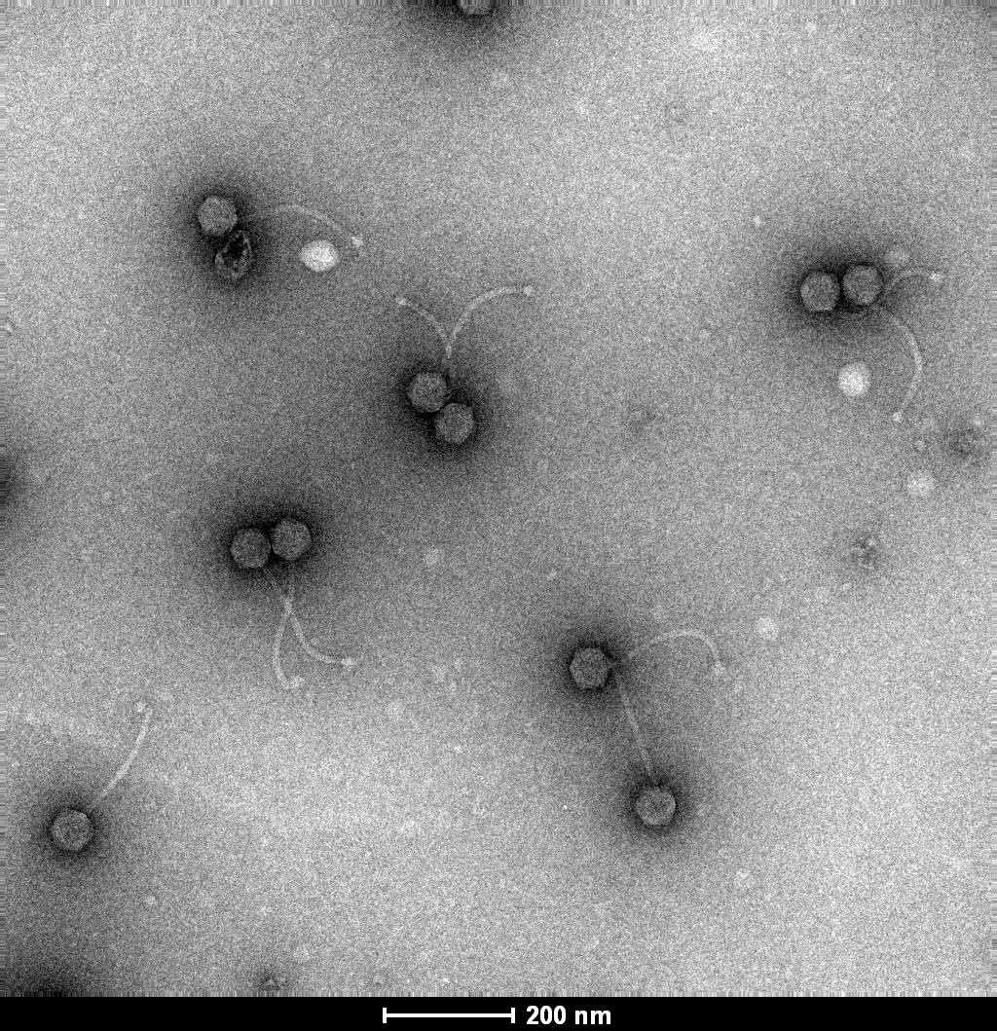
The Distinct Properties of an Isolated Bacteriophage
Simeon Menso, Briana Ofilas, and Helen Smith-Flores
Department of Biology, Gonzaga University, Spokane, WA 99258
INTRODUCTION
Bacteriophage (often shorten to “phage”) are parasites specific to bacteria. Phages are viruses, ranging in size from 100 to 200 nm. As viruses, they are not susceptible to antibiotics. (Gonzaga University, 2013). Felix d’Herelle, one of the discovering scientists of Bacteriophage, named them phages in reference to “eaters of bacteria.” (Zimmer 2003) There are two types of phages (lytic and temperate). Lytic phages form clear plaques whereas temperate phages form cloudy plaques. Phages are an important aspect of the ubiquitous world of science around us. Phages can survive in almost any environment and are estimated to be the most abundant life-form on Earth. (Gonzaga University,2013). Scientists have discovered over 10 trillion different phages in the ocean with over 1.8 million genes. Phages are also an important medical discovery as they now serve as an alternative to antibiotics. Because of this, phage research has gained important ground in labs around the world. It is now our opportunity to add integral data to this newfound research field.
Specific to our research, we utilized mycobacterium smegmatis as the host for our phage. The source of the soil sample was the outer surface of Lake Arthur, near Jundt Art Museum. Our goal is to isolate a newly discovered phage from the outside environment and to the phage database by gathering its DNA characteristics and morphology.
Methods (cont..)
Series II: Phage Analysis
1.We then set up our high-titer lysate for plaque morphology examination through the use of serial dilution.
2. Next we created a spot-plate serial dilution; developed a bacterial lawn for our phage which is incubated at 37C, our intention is to determine if our phage could grow at room temperature.
3. After, we tested our phage to determine if it could infect a K-lysogen bacteria. We wanted to know if our phage belonged to the K-cluster of Bacteriophages because a phage of one cluster cannot infect a bacteria that has already been infected by a phage of that same cluster.
4. We then used our high-titer lysate to isolate the phage’s DNA. We cut the DNA with different restricted enzymes and used gel electrophoresis to determine the specific enzymes that cut the phage’s DNA at certain locations.
RESULTS
Comparison of Plaque Morphology
Figure 1:Phage Simbra, dilution (a) compared to Phage Waddles (b)
The plaque morphology of Phage Simbra (a) (2mm diameter) is larger than that of Phage Waddles (b) (1mm diameter).Like Phage Waddles (b), Phage Simbra’s morphology are largely circular and clear. The plaques also are very evenly spread out and isolated. We grew the Simbra phage for 5 days.
Transmission electron microscopy (TEM) of Phages
Head:240nm Tail:80nm Head:240nm Tail:80nm
Figure 2: Phage Simbra (c), TEM, compared to Phage Kimtree (d)
The total diameter of Phage Simbra (c) is 320nm whereas the total diameter of Phage Kimtree (d) is approximately 216.6nm. Phage Simbra (c) is significantly larger than Phage Kimtree (d). This shows Phage Simbra’s (c) tape measure gene is different than that of Phage Kimtree (d). Even though both phages look similar in shape and size, the genomic makeup is different.
RESULTS (cont…)
Growth of Phage at RT and 37C
Figure 4: In this data table our goal was to determine if our phage can grow on the K-Lysogen m.smeg lawn or a positive control 37C environment. Our goal was to determine if Phage Simbra belonged to the K-cluster. Our first spot plate was grown at room temperature on a bacterial lawn consisting K-lysogen M.smegmatis (bacteria which had already been infected with a K-cluster bacteriophage). The second spot plate was grown on 4-day M.smegmatis at body temperature, 37°C. The third plate was our positive control which was grown at room temperature on a 4-day M.smegmatis lawn. As you can see on the chart above, because we didn’t have any growth on our lysogen KI plate, it determines we are in the K cluster. Simbra Phage cannot superinfect: meaning there was already an infected K phage present.
CONCLUSION
Plaque growth at 37 C
K1
Yes
F1
Yes
Simbra
Yes
Plaque growth on k-lysogen
K1
No
F1
No
Simbra
No
EXPERIMENTAL APPROACH
Series I: Isolation and Purification of Phage
1. We created an enrichment culture in order to grow bacteriophages and ultimately isolate a selected phage to examine.
2. We generated a plaque assay using M. smegmatis lawn in order to grow the phages present in our enrichment culture. Plaques ultimately develop on these lawns.
3. We selectively chose one plaque in order to isolate a single type of phage using two streaking protocols. We did this in order to be able to study one individual type of phage, using this one phage's DNA, morphology, and other characteristics to determine if it was unique from other previously discovered phages.
4. Our next step generated a heavy streak plate in order to collect our lysate. This lysate (high concentration of phage) will help us analyze our phage.
(a))
(b)
LITERATURE CITED
Zimmer, C. 2011. A Planet of Viruses. University of Chicago Press, Chicago, Illinois, pp. 33-40
Gonzaga University. 2013. Biology 105 Laboratory Phage Discovery Resource Guide: Phage Basics. Spokane, WA
Gonzaga University. 2013. Biology 105 Laboratory Phage Discovery Resource Guide: Phage Analysis. Spokane, WA.
Location: (47°39'58.5"N 117°24'20.9"W)
80 nm
240 nm
153.3nm
(c)
(d)
63.3nm
ACKNOWLEDGMENTS
We would like to thank Simon Menso, Joseph Wagner, Melissa Ching, and Kelly Borgerding for their Phages’ data.
We would also like to thank Dr. Smith-Flores and Austin for their assistance with isolating our distinct phage, Simbra, specifically pertaining to isolation experiments and protocols.
DNA Comparison of Restriction Enzymes

