Slide 1
Baine Genome Annotation

Slide 2
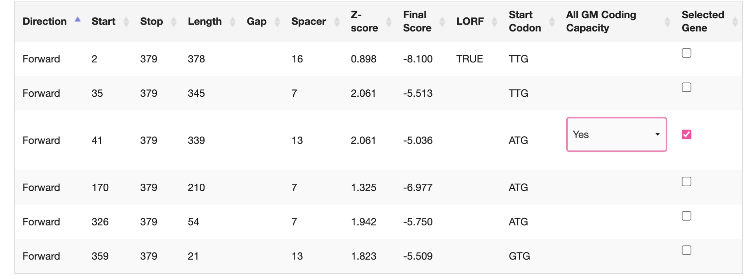
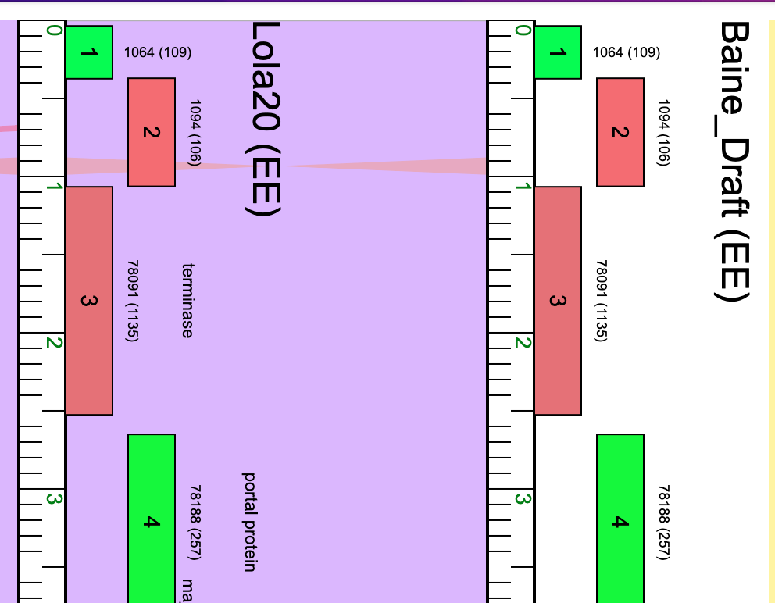
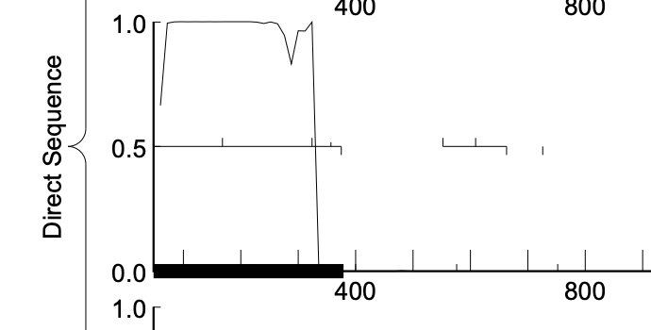
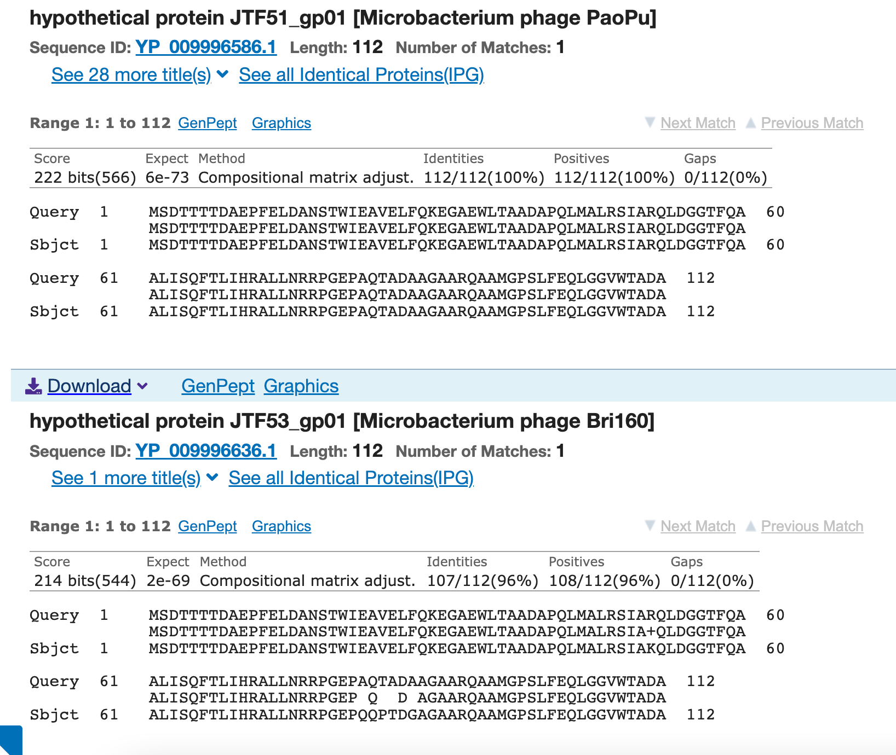
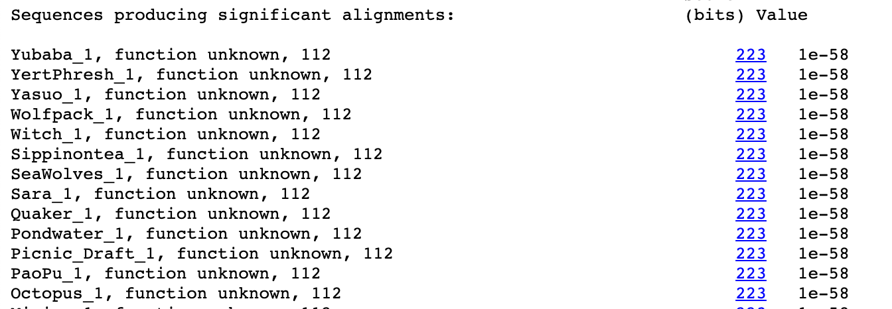
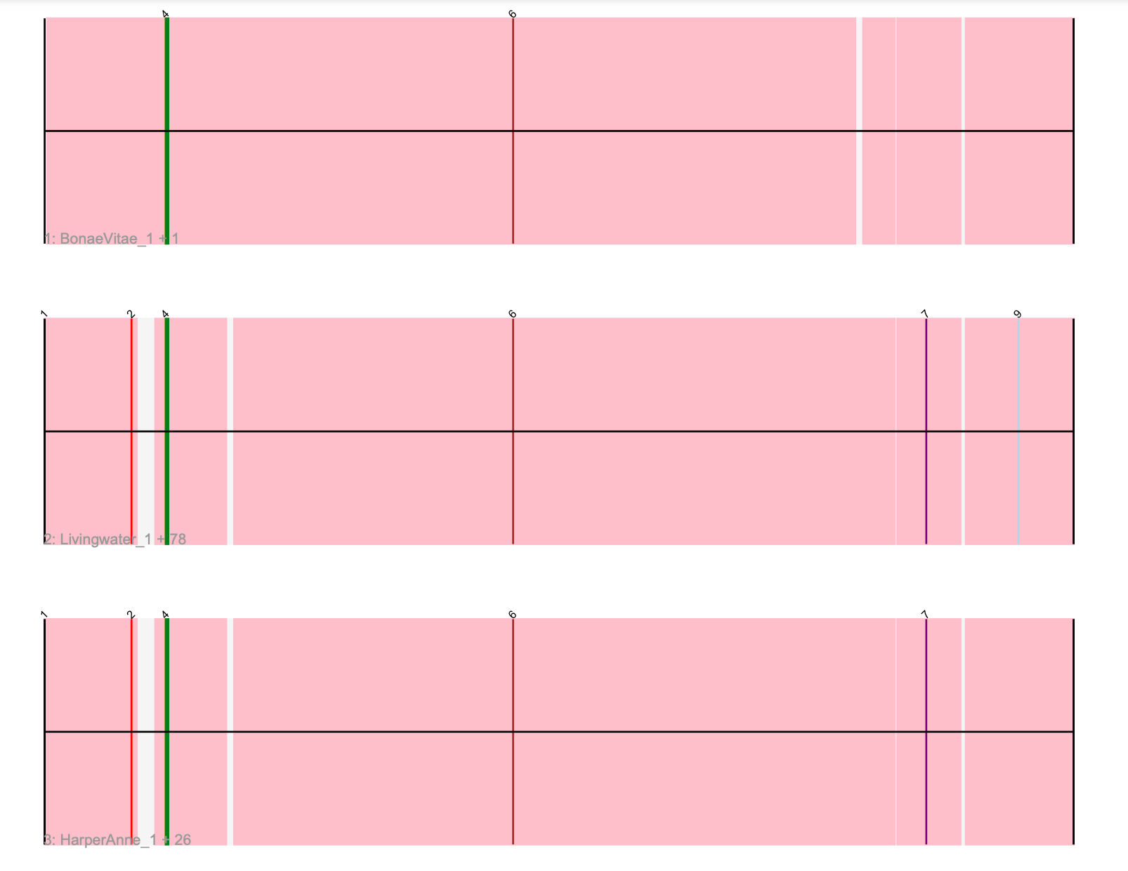
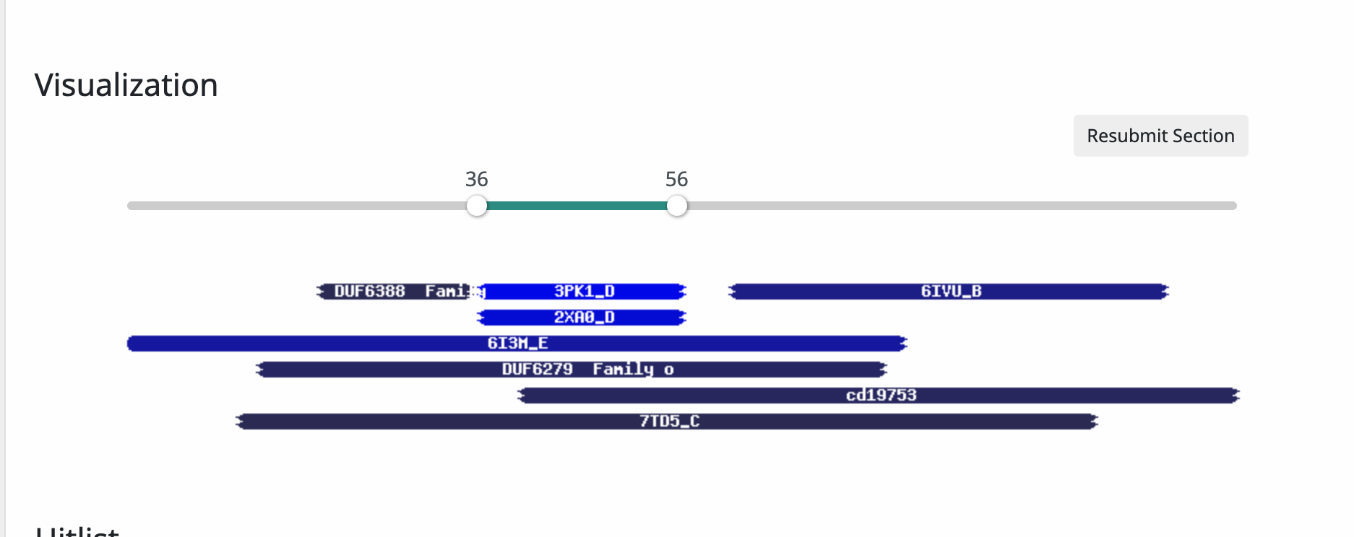
Gene #1 Start: 41 Stop: 379 *Highlight start if changed from original call*
1. Is it a gene?
Gene originally called by (delete incorrect):
Both
Coding potential: yes
Other organisms have it? Yes
2. Where does it start?
RBS info: Z score: 2.061 Final score: -5.036 Best z score
BLAST alignments: all alignments are 1:1
Local Blast: Yubaba, function unknown, e value 1e-58/ YertPhresh, function unknown, e value 1e-58
NCBI Blast: All are hypothetical
Starterator: track 2, most called
Gap: no gap
3. What is its function?
Final Function Decided: NKF
Must be from approved function list: https://docs.google.com/spreadsheets/d/1FNcTlsU41iI1U8Jq0Yd-YqwJDUa089AInNnULL-K9hE/edit#gid=0
Synteny: Gene 1 is in the same pham(1064) as Lola20 and is downstream of HNH endonuclease and upstream of NKF.
BLAST Results:
Local Blast: Yubaba, function unknown, e value 1e-58/ YertPhresh, function unknown, e value 1e-58
NCBI Blast: All are hypothetical
HHPRED results: Cool colors indicate very low hits and similarities. The best hit is 2XAO_D with the probability of 37.3%.
Any questions/uncertainties? Record them here for your secondary annotators:
Notes:
Secondary Annotator Notes: Check each piece of evidence provided and confirm whether your interpretation supports that of the primary annotator:
Secondary Annotator #1 Name:
Secondary Annotator #2 Name:

Slide 3
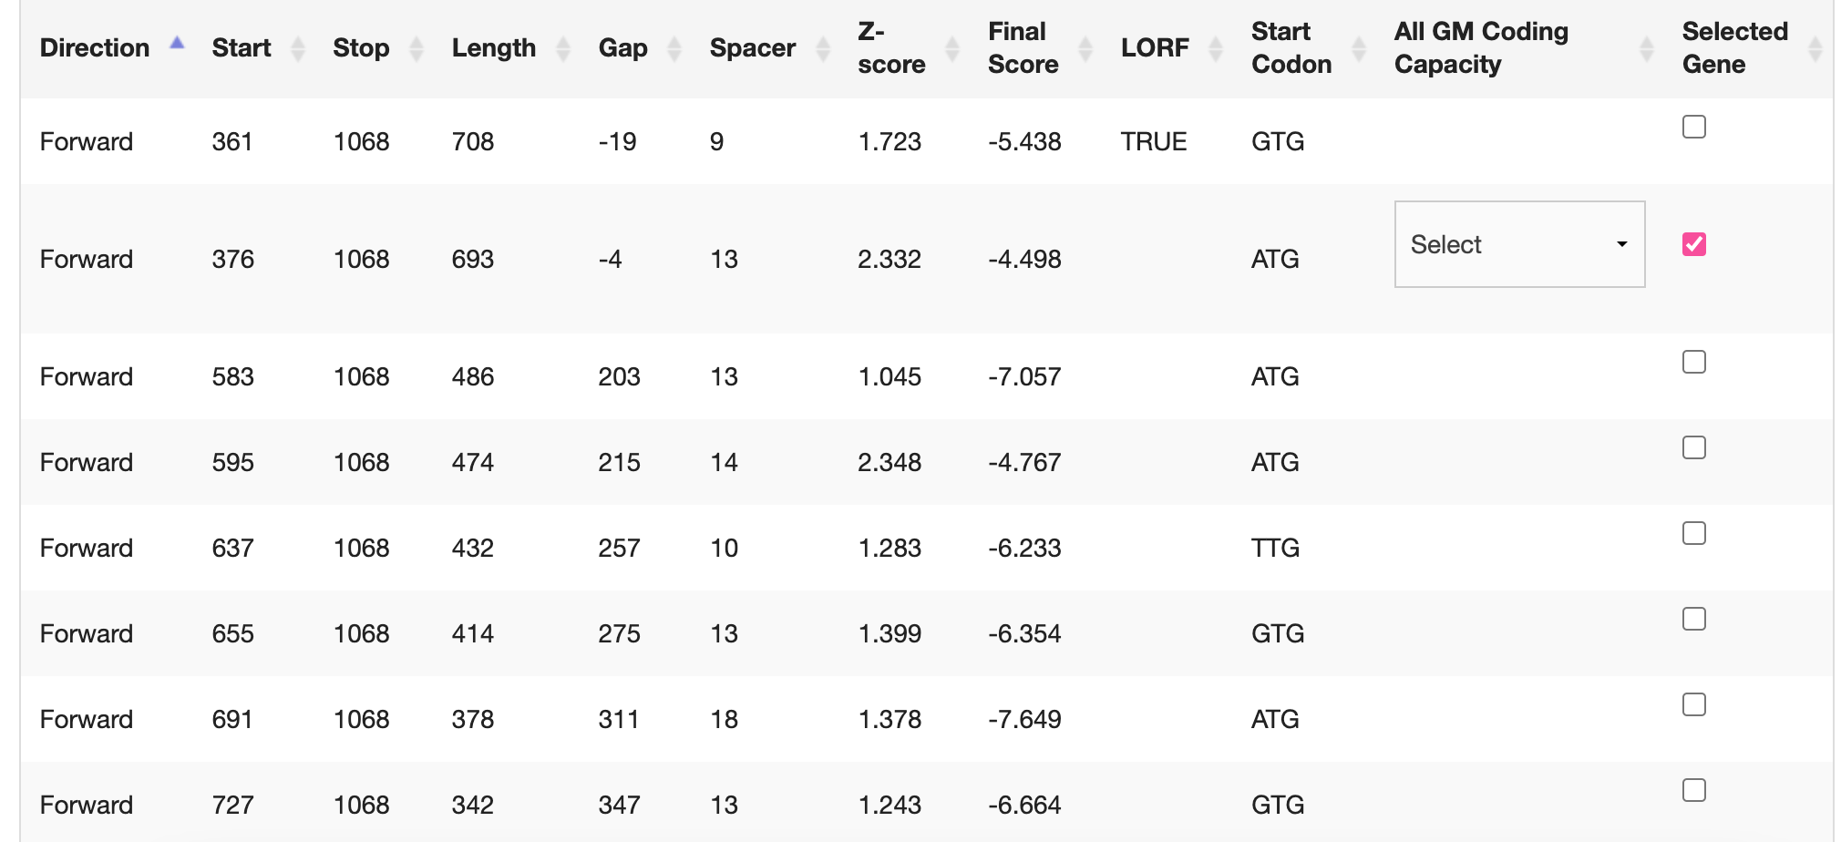
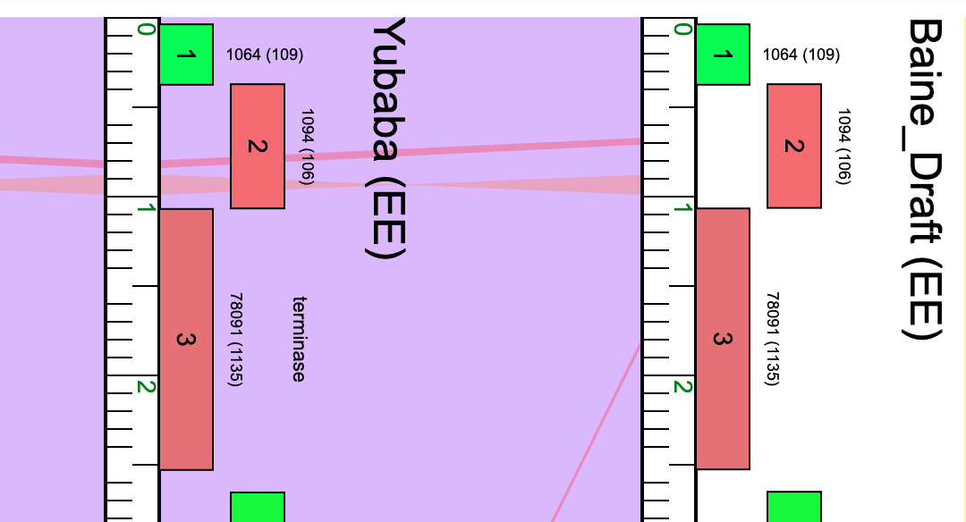
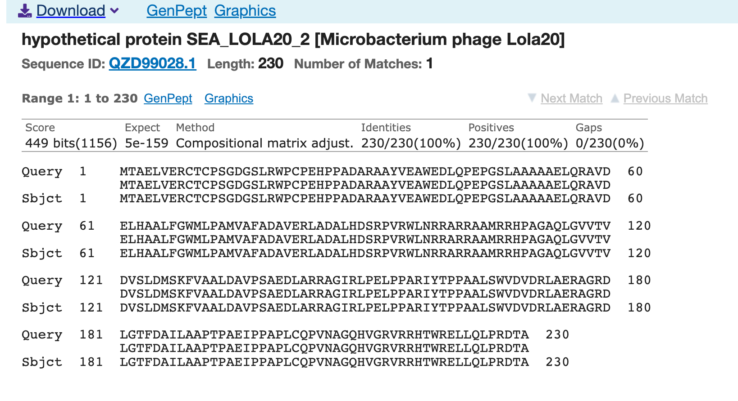
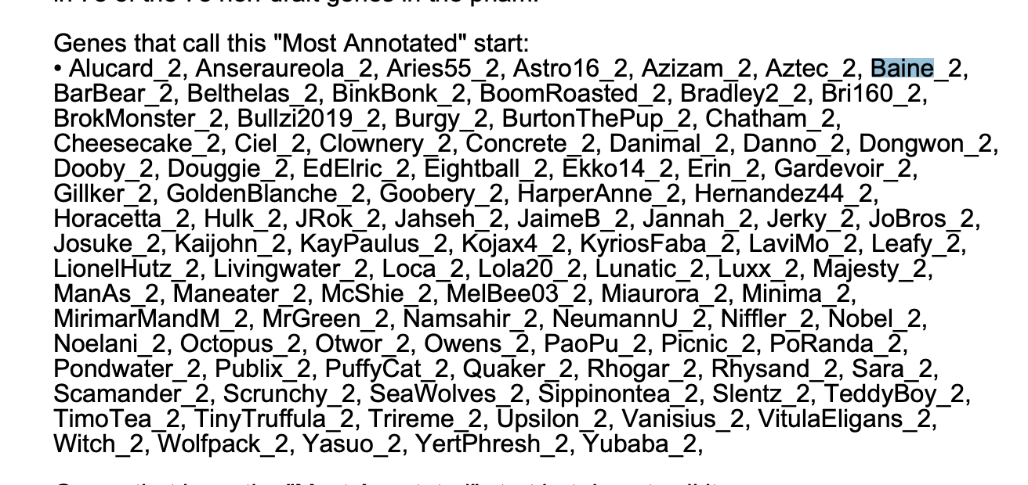
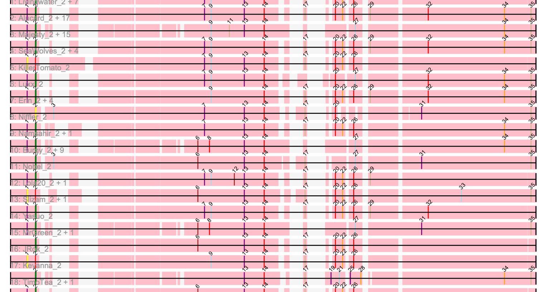
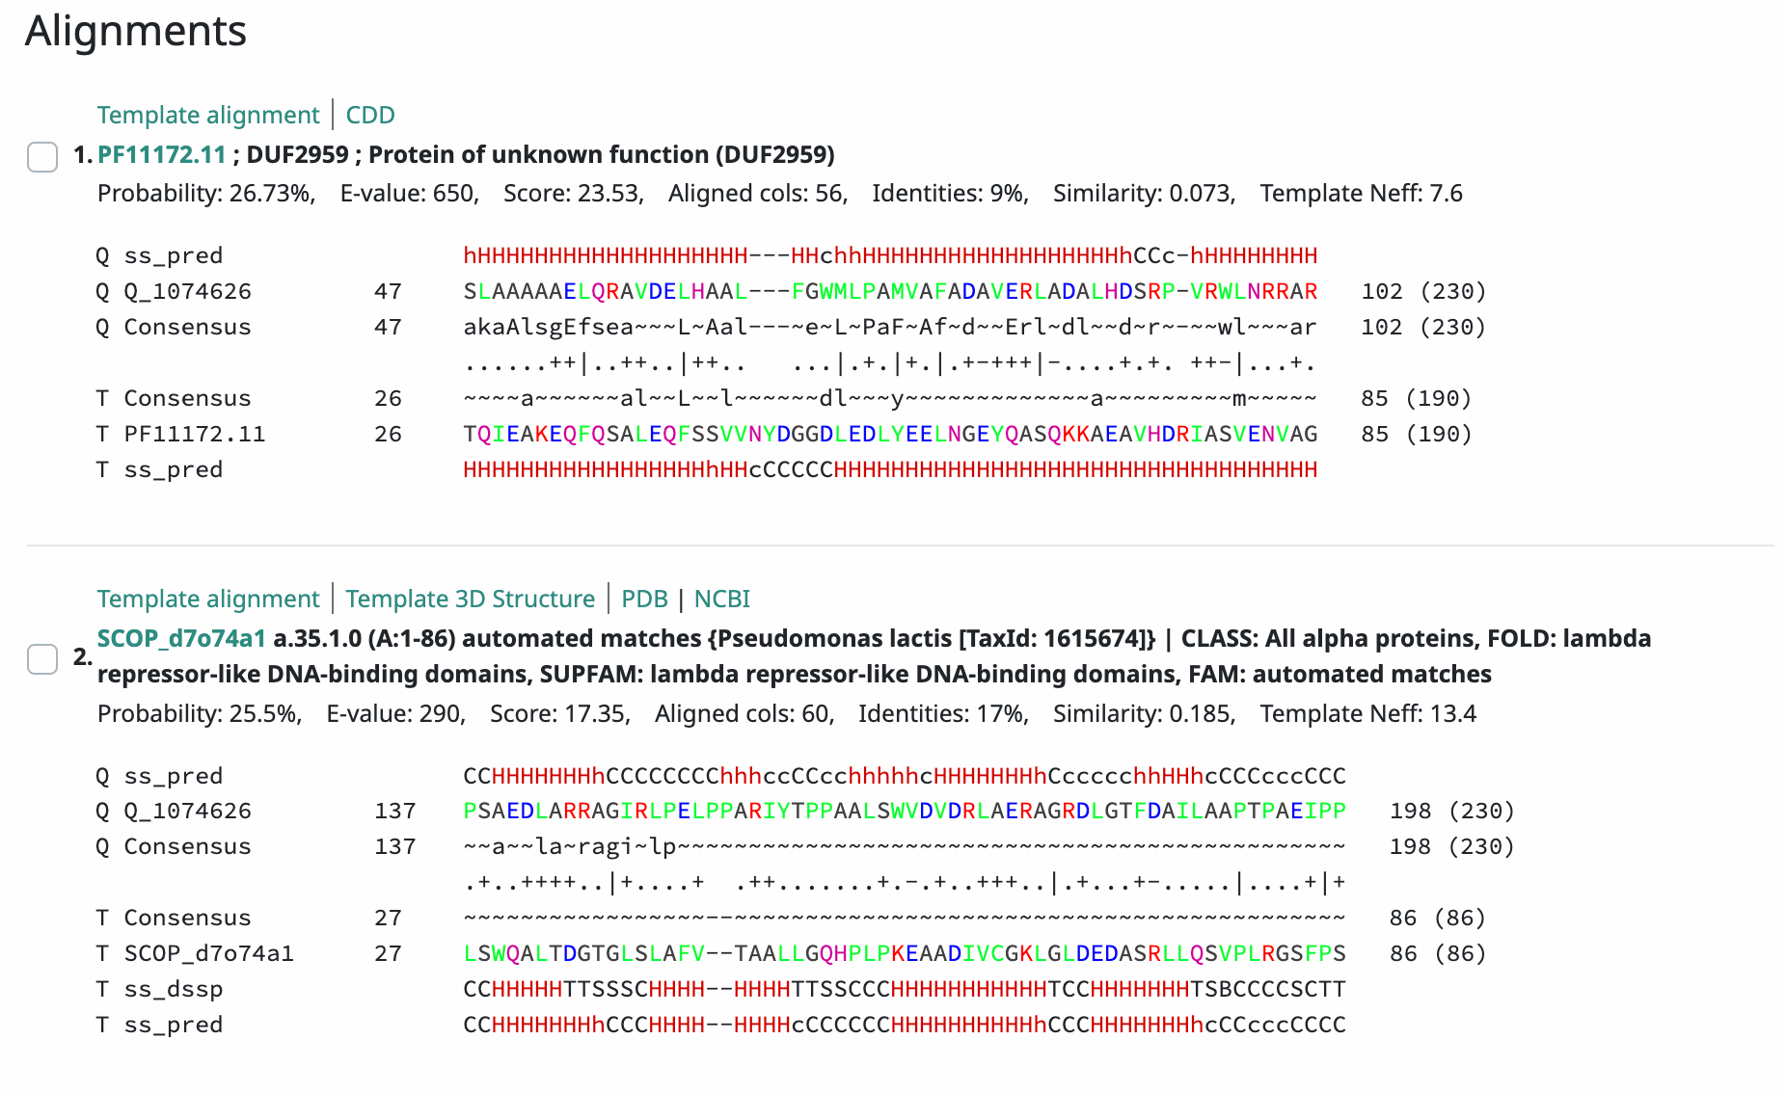
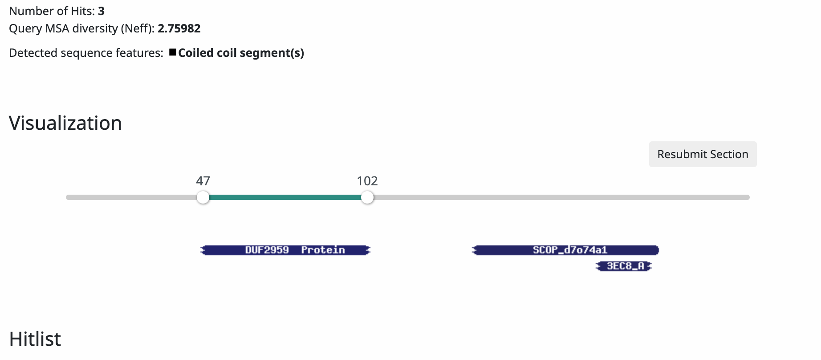
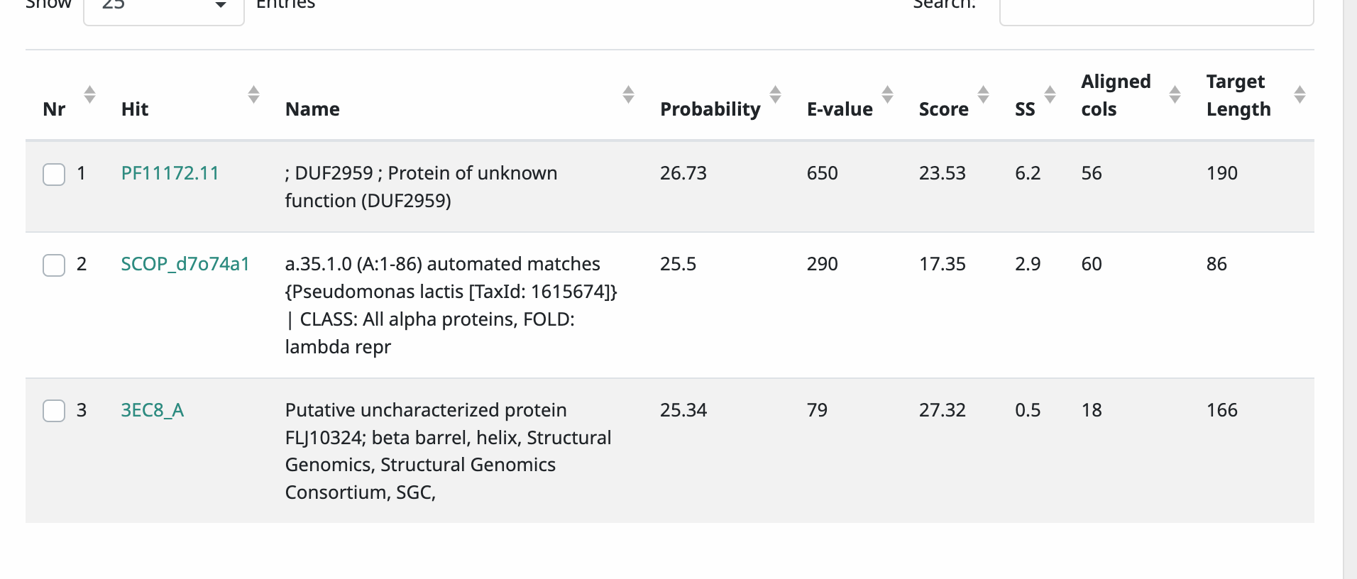
Gene #2 Start: 376 Stop: 1,068 *Highlight start if changed from original call*
1. Is it a gene?
Gene originally called by (delete incorrect):
Both
Coding potential: yes
Other organisms have it? Yes
2. Where does it start?
RBS info: Z score: 2.332 Final score: -4.498 2nd best z score
BLAST alignments: all alignments are 1:1
Local Blast: Lola, function unknown, e value e-132/ Yasuo, function unknown, e value e-132
NCBI Blast: all are hypothetical
Starterator: track 12 most called
Gap: -4
3. What is its function?
Final Function Decided: NKF
Must be from approved function list: https://docs.google.com/spreadsheets/d/1FNcTlsU41iI1U8Jq0Yd-YqwJDUa089AInNnULL-K9hE/edit#gid=0
Synteny: Gene 2 is in the same pham as, 1094, as Yubaba gene 2. Gene 2 is upstream of NKF and downstream of NKF.
BLAST Results:
Local Blast: Lola, function unknown, e value e-132/ Yasuo, function unknown, e value e-132
NCBI Blast: all are hypothetical
HHPRED results: Cool colors indicate very low similarities and low amount of hits, there were only 3 hits. All hits were below 25.3%
Any questions/uncertainties? Record them here for your secondary annotators:
Notes:
Secondary Annotator Notes: Check each piece of evidence provided and confirm whether your interpretation supports that of the primary annotator:
Secondary Annotator #1 Name:
Secondary Annotator #2 Name:

Slide 4
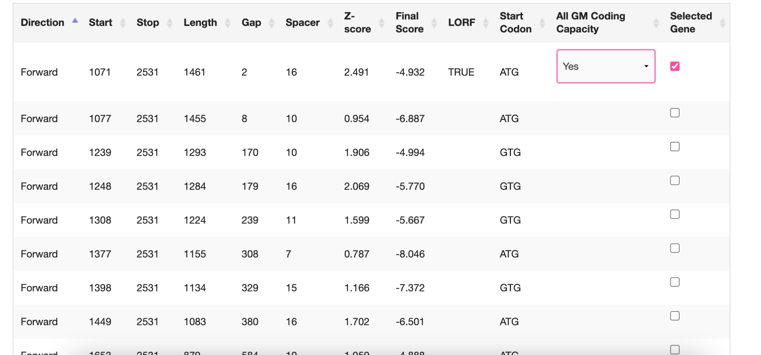
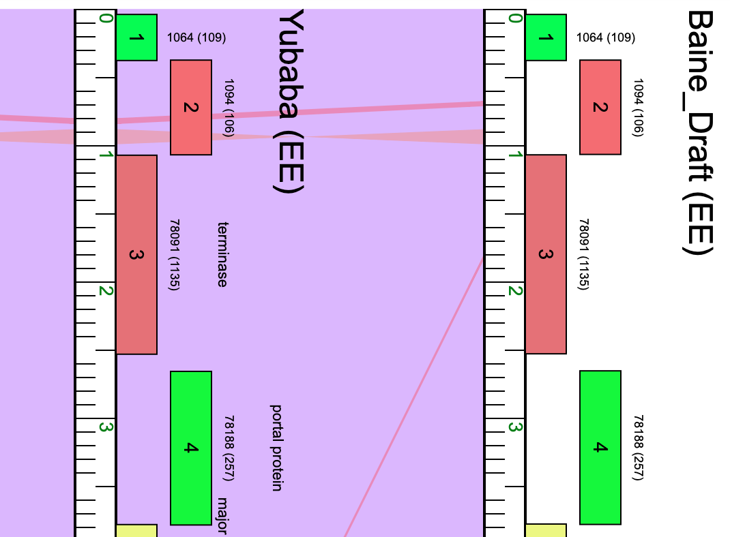
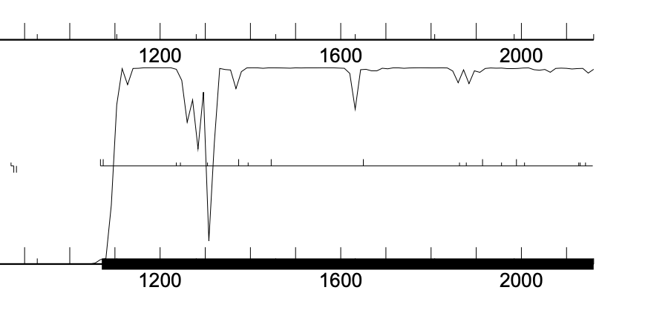
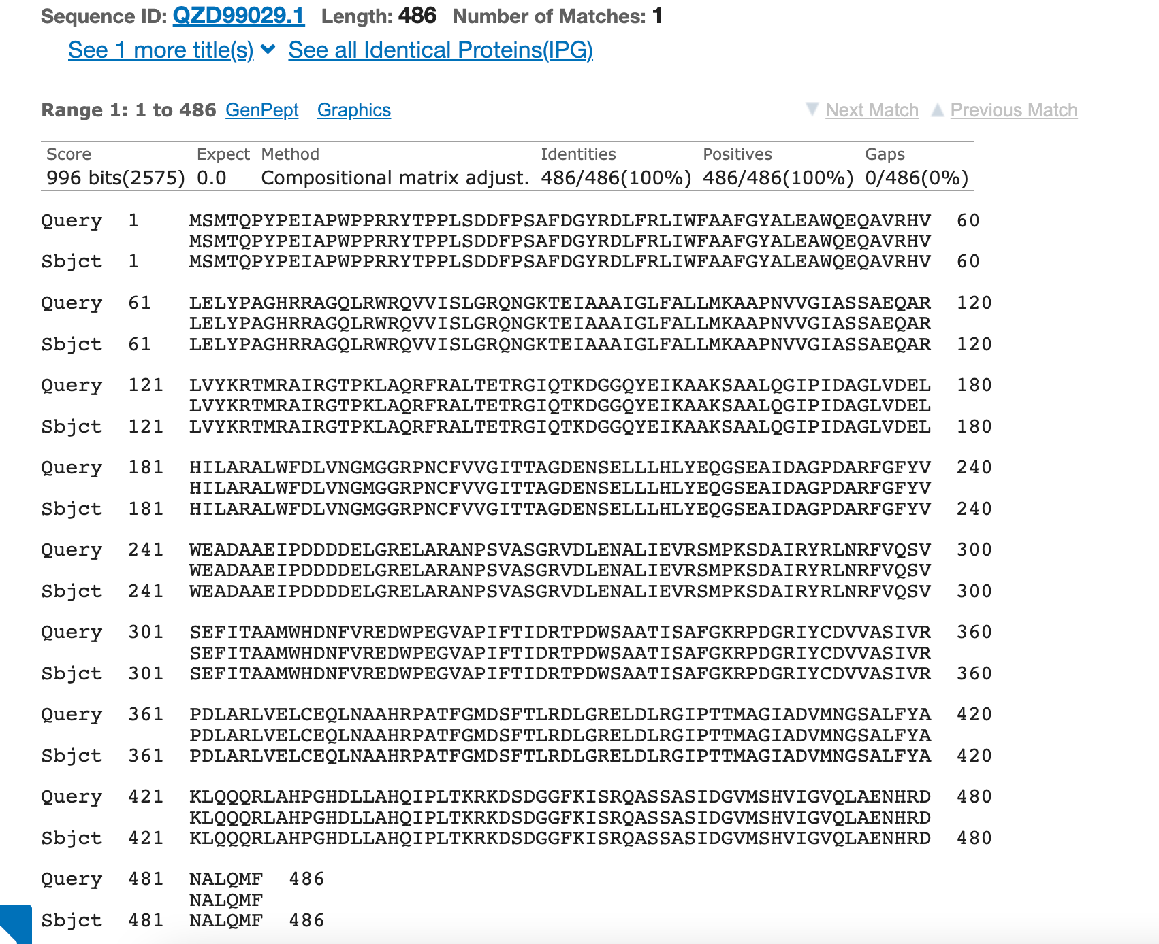
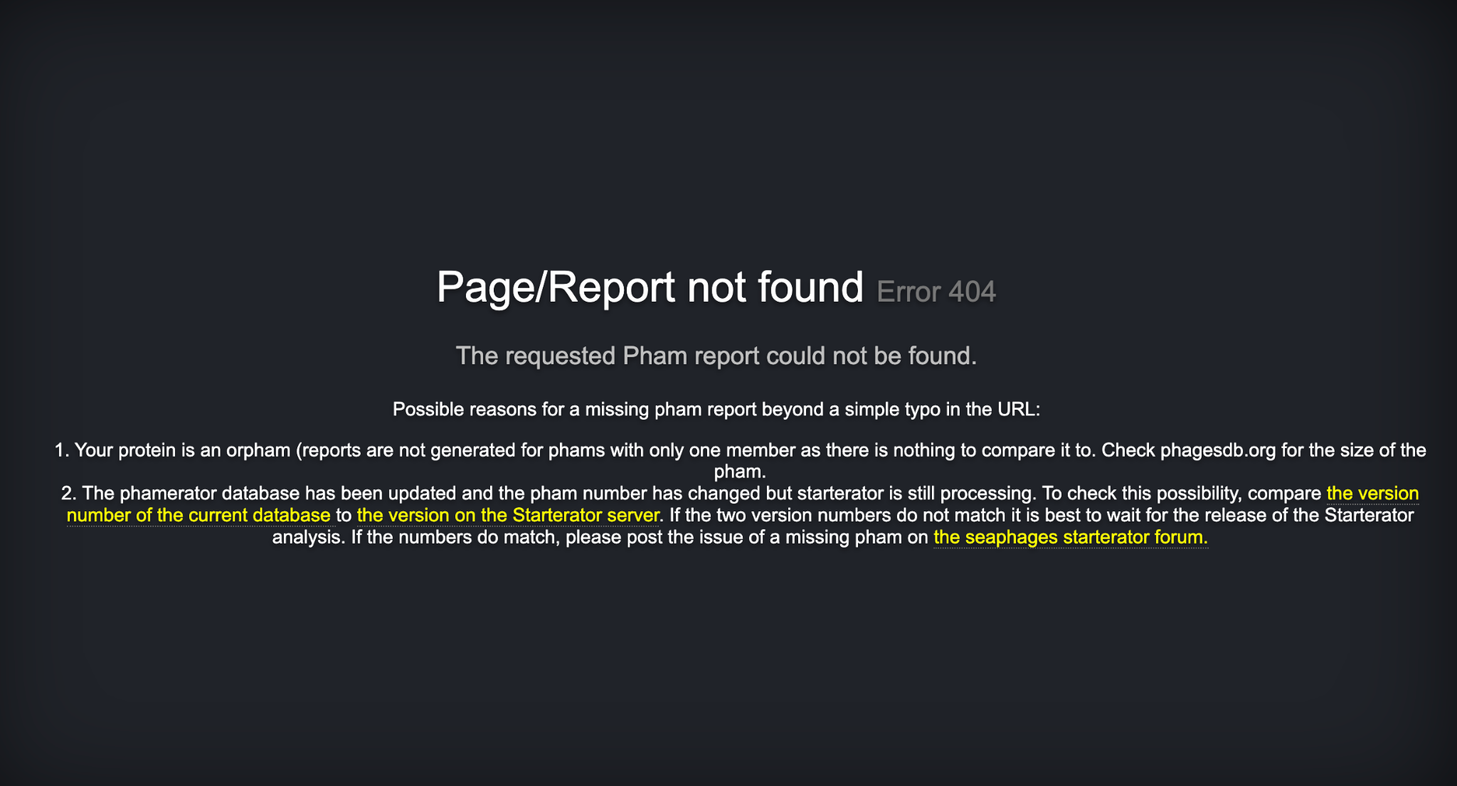
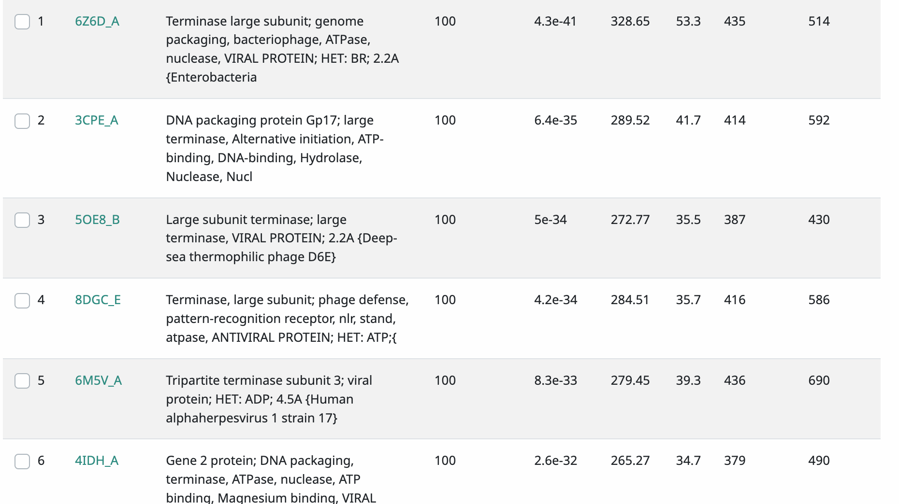
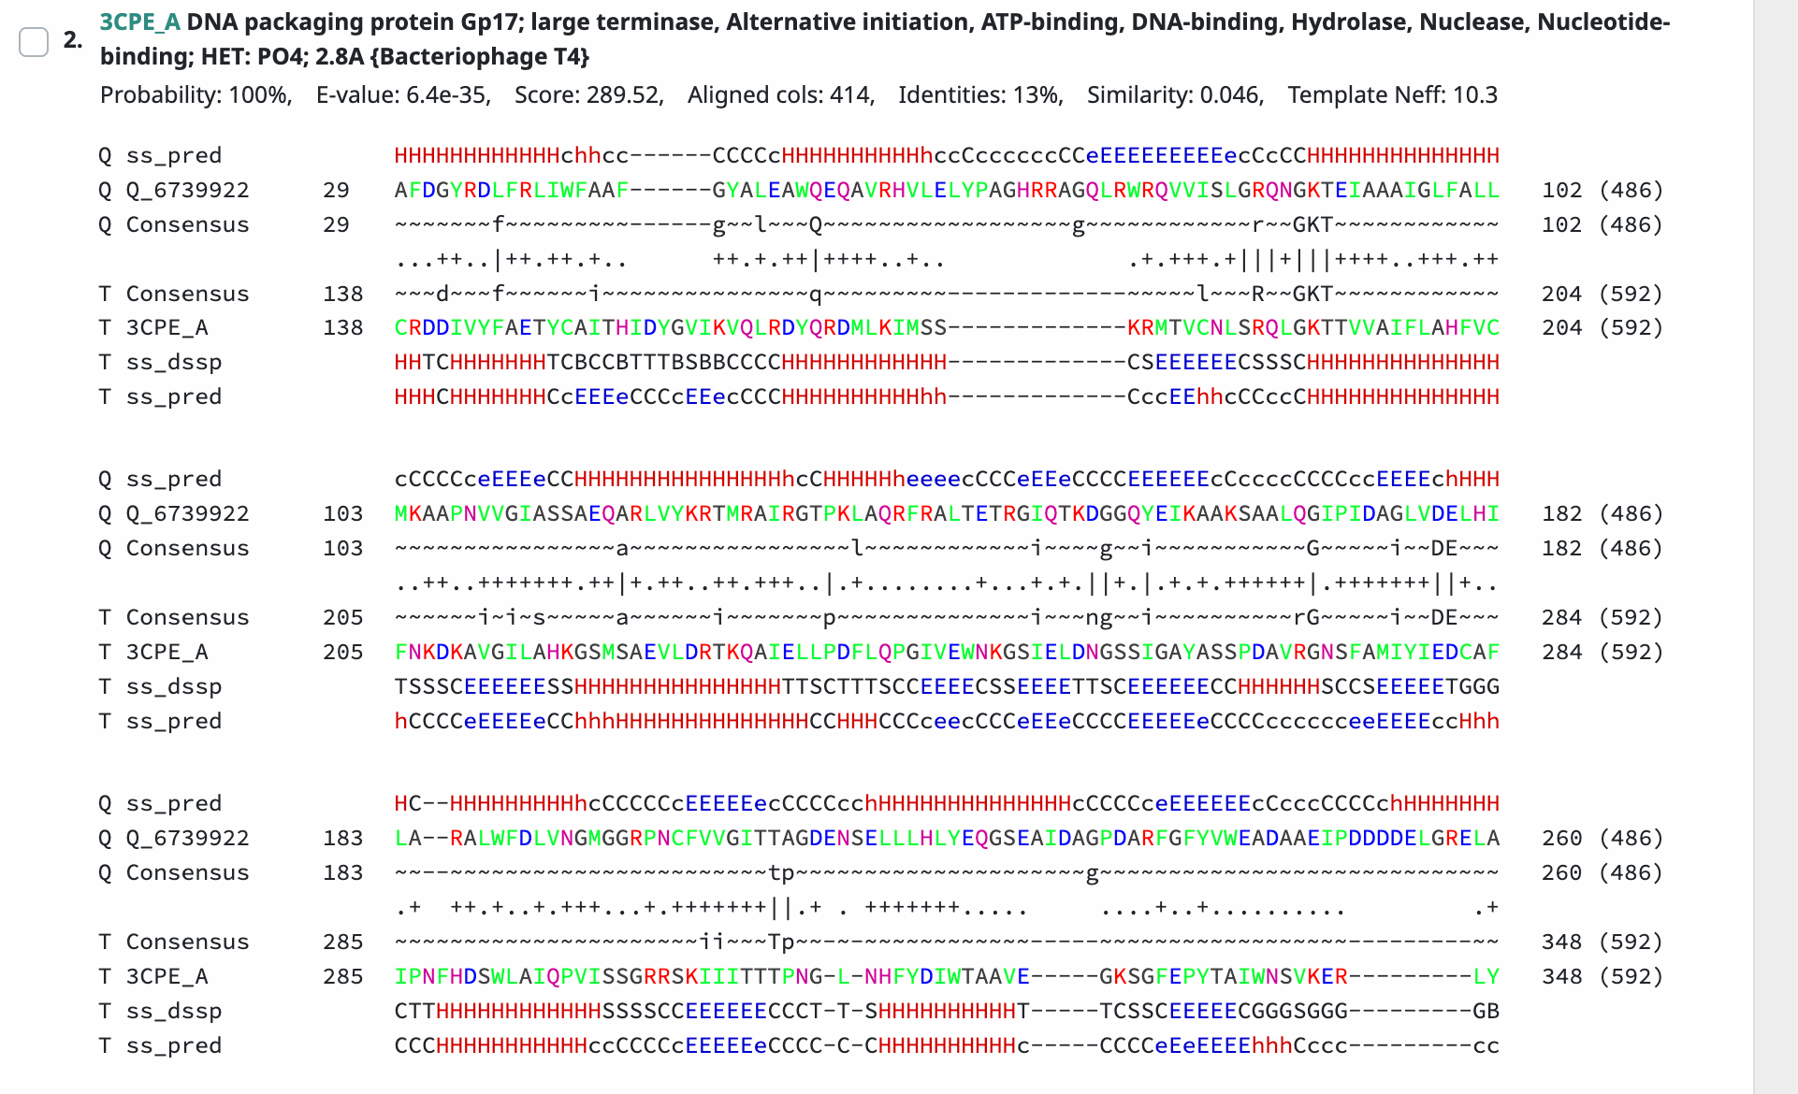
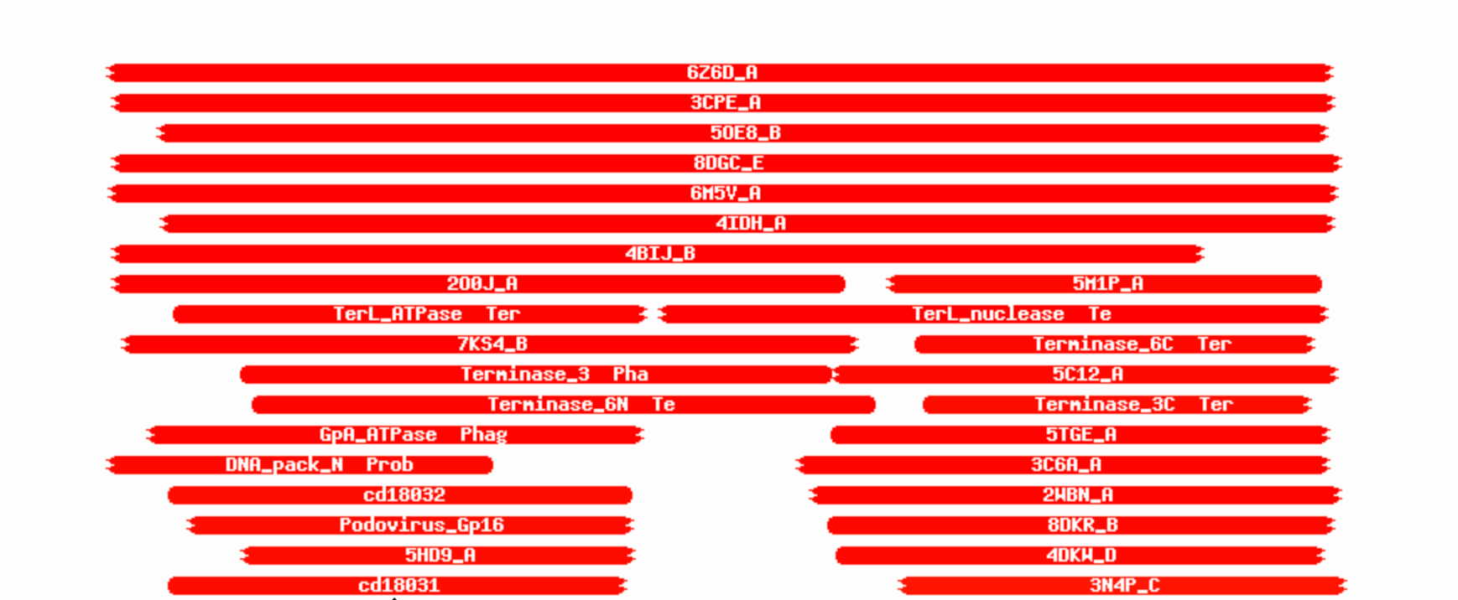
Gene #3 Start: 1071 Stop: 2531
*Highlight start if changed from original call*
1. Is it a gene?
Gene originally called by (delete incorrect):
Both
Coding potential: yes
Other organisms have it? Yes
2. Where does it start?
RBS info: Zscore: 2.491 Final score: -4.932 2nd best z score
BLAST alignments: alignments are 1:1
Local Blast: Yasuo, terminase, e value 0.0/ Lola, terminase, e value 0.0
NCBI Blast: Lola, terminase, e value 0.0/ PaoPu, terminase, e value 0.0
Starterator:
Gap: 2
3. What is its function?
Final Function Decided: Terminase
Must be from approved function list: https://docs.google.com/spreadsheets/d/1FNcTlsU41iI1U8Jq0Yd-YqwJDUa089AInNnULL-K9hE/edit#gid=0
Synteny : Gene 3 is in the same pham, 78091, as Yubaba gene 3. With the function terminase, it is downstream of NKF and upstream of portal protein.
BLAST Results:
Local Blast: Yasuo, terminase, e value 0.0/ Lola, terminase, e value 0.0
NCBI Blast: Lola, terminase, e value 0.0/ PaoPu, terminase, e value 0.0
HHPRED results: Warm colors indicate high similarities and hits. Approximately 250 hits. Best hit is 3cPE_A with the probability of 100%, function large terminase, e value 6.4E-35
Any questions/uncertainties? Record them here for your secondary annotators:
Notes:
Secondary Annotator Notes: Check each piece of evidence provided and confirm whether your interpretation supports that of the primary annotator:
Secondary Annotator #1 Name:
Secondary Annotator #2 Name:

Slide 5
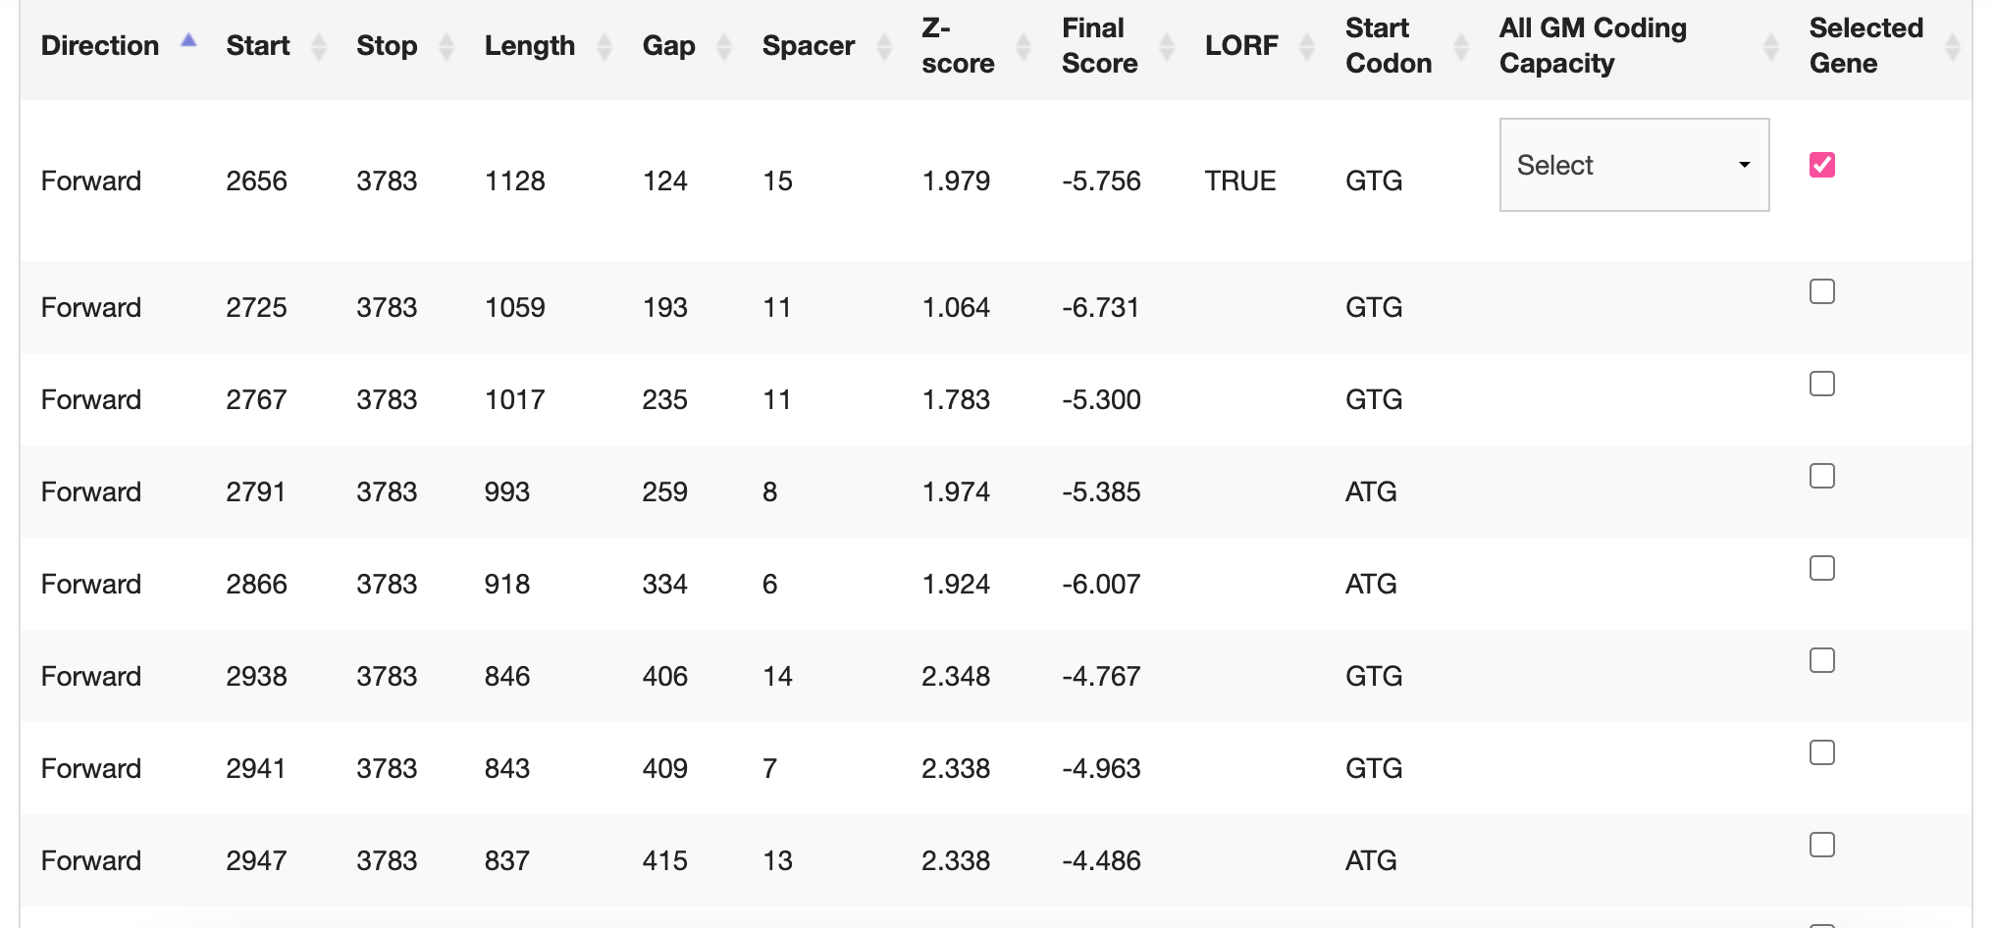
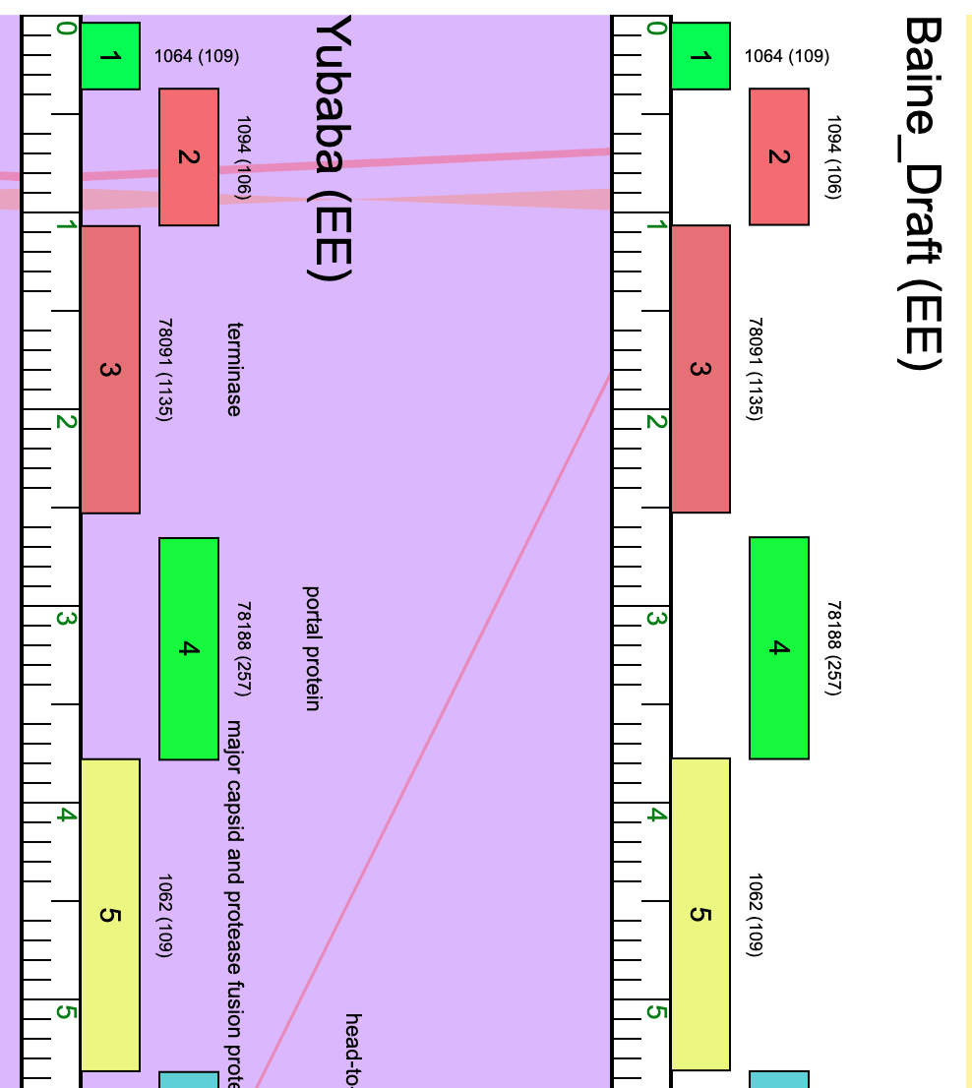
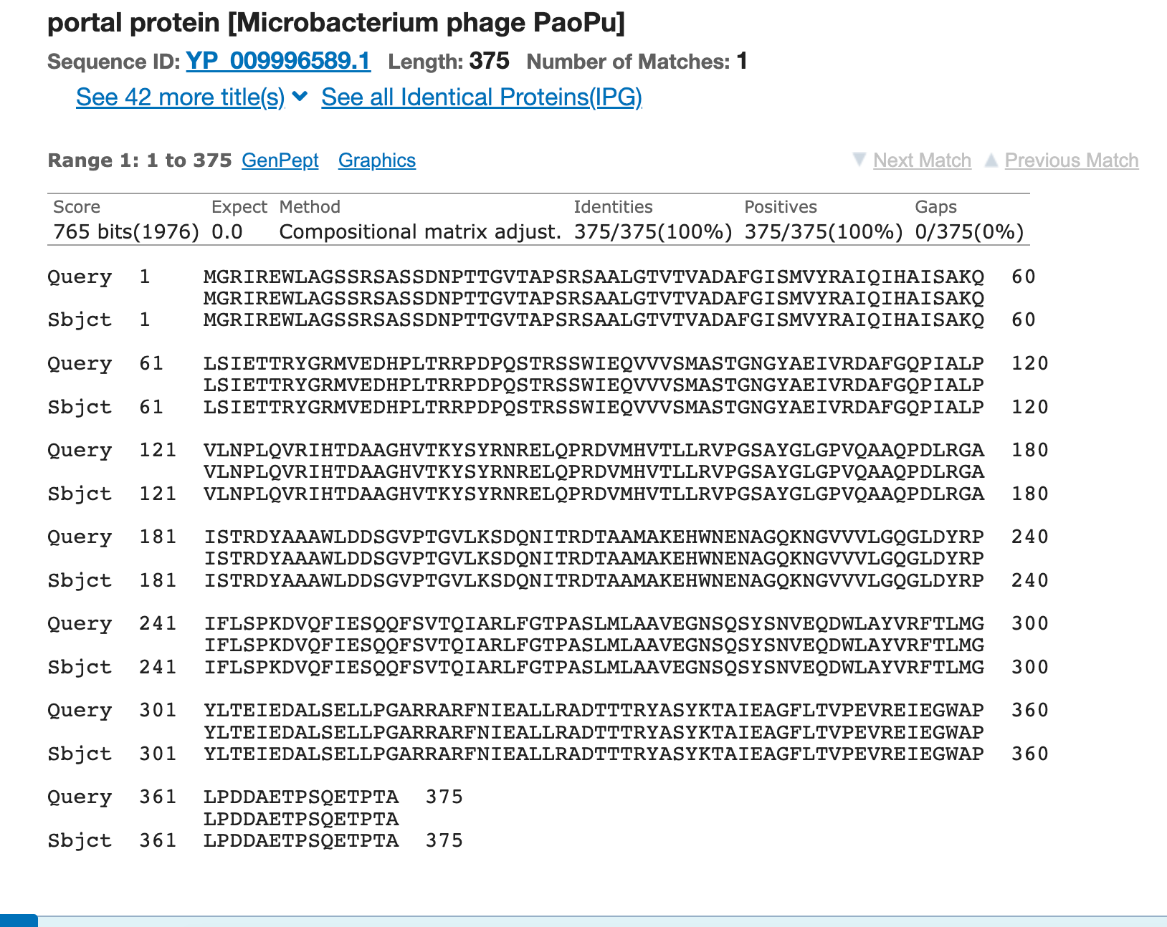
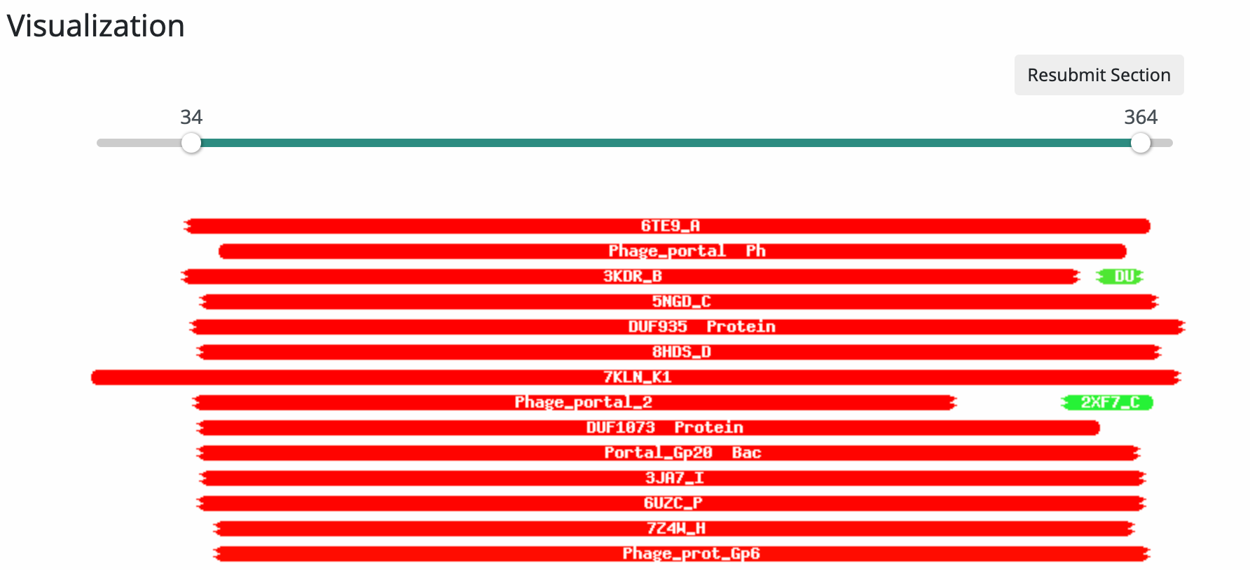
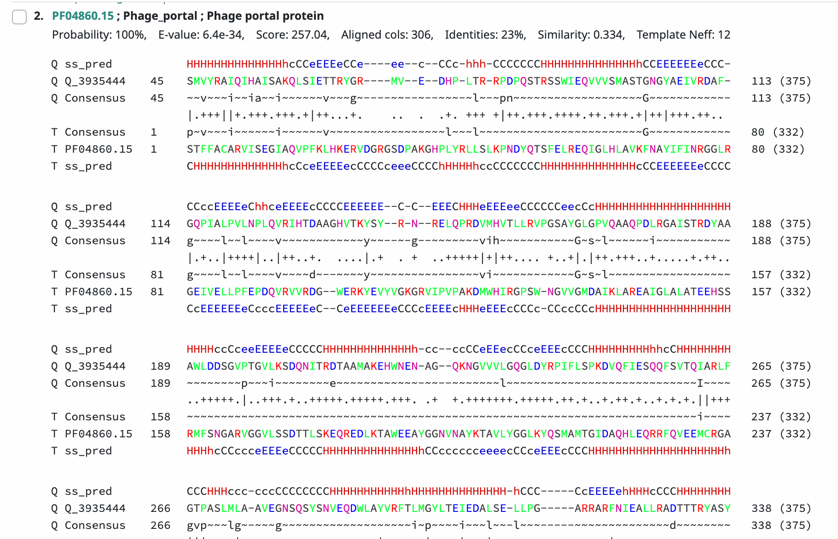
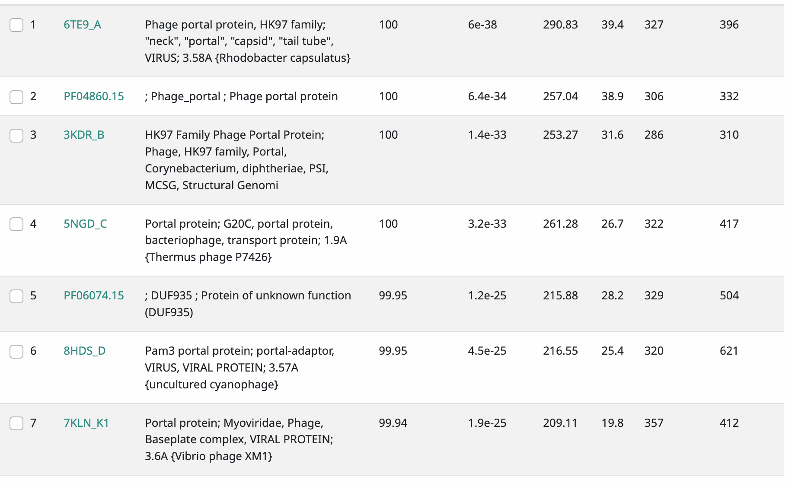
Gene #4 Start:2656 Stop: 3783 \ *Highlight start if changed from original call*
1. Is it a gene?
Gene originally called by (delete incorrect): glimmer
Coding potential: yes, start might be 2725 according to coding potential
Other organisms have it? Yes
2. Where does it start?
RBS info: z score: 1.979 final score: -5.756 none are best
BLAST alignments: alignments are 1:1
Local Blast: Yubaba, portal protein, e value 0.0/ YurtPhresh, portal protein, e value 0.0
NCBI Blast: PaoPu, portal protein, e value 0.0/ Azizam, portal protein, e value 0.0
Starterator: Suggested start
Gap: 124
3. What is its function?
Final Function Decided: Portal Protein
Must be from approved function list: https://docs.google.com/spreadsheets/d/1FNcTlsU41iI1U8Jq0Yd-YqwJDUa089AInNnULL-K9hE/edit#gid=0
Synteny: Gene 4 is in the same pham, 78118, as Yubaba gene 4. With the function of portal protein, it is downstream of terminase and upstream of major capsid and protease fusion protein.
BLAST Results:
Local Blast: Yubaba, portal protein, e value 0.0/ YurtPhresh, portal protein, e value 0.0
NCBI Blast: PaoPu, portal protein, e value 0.0/ Azizam, portal protein, e value 0.0
HHPRED results: Warm colors indicate high hits and similarities, approximately 51 hits. The best hit being phage_portal with the probability of 100%, e value of 6.4e -34.
Any questions/uncertainties? Record them here for your secondary annotators:
Notes:
Secondary Annotator Notes: Check each piece of evidence provided and confirm whether your interpretation supports that of the primary annotator:
Secondary Annotator #1 Name:
Secondary Annotator #2 Name:

Slide 6
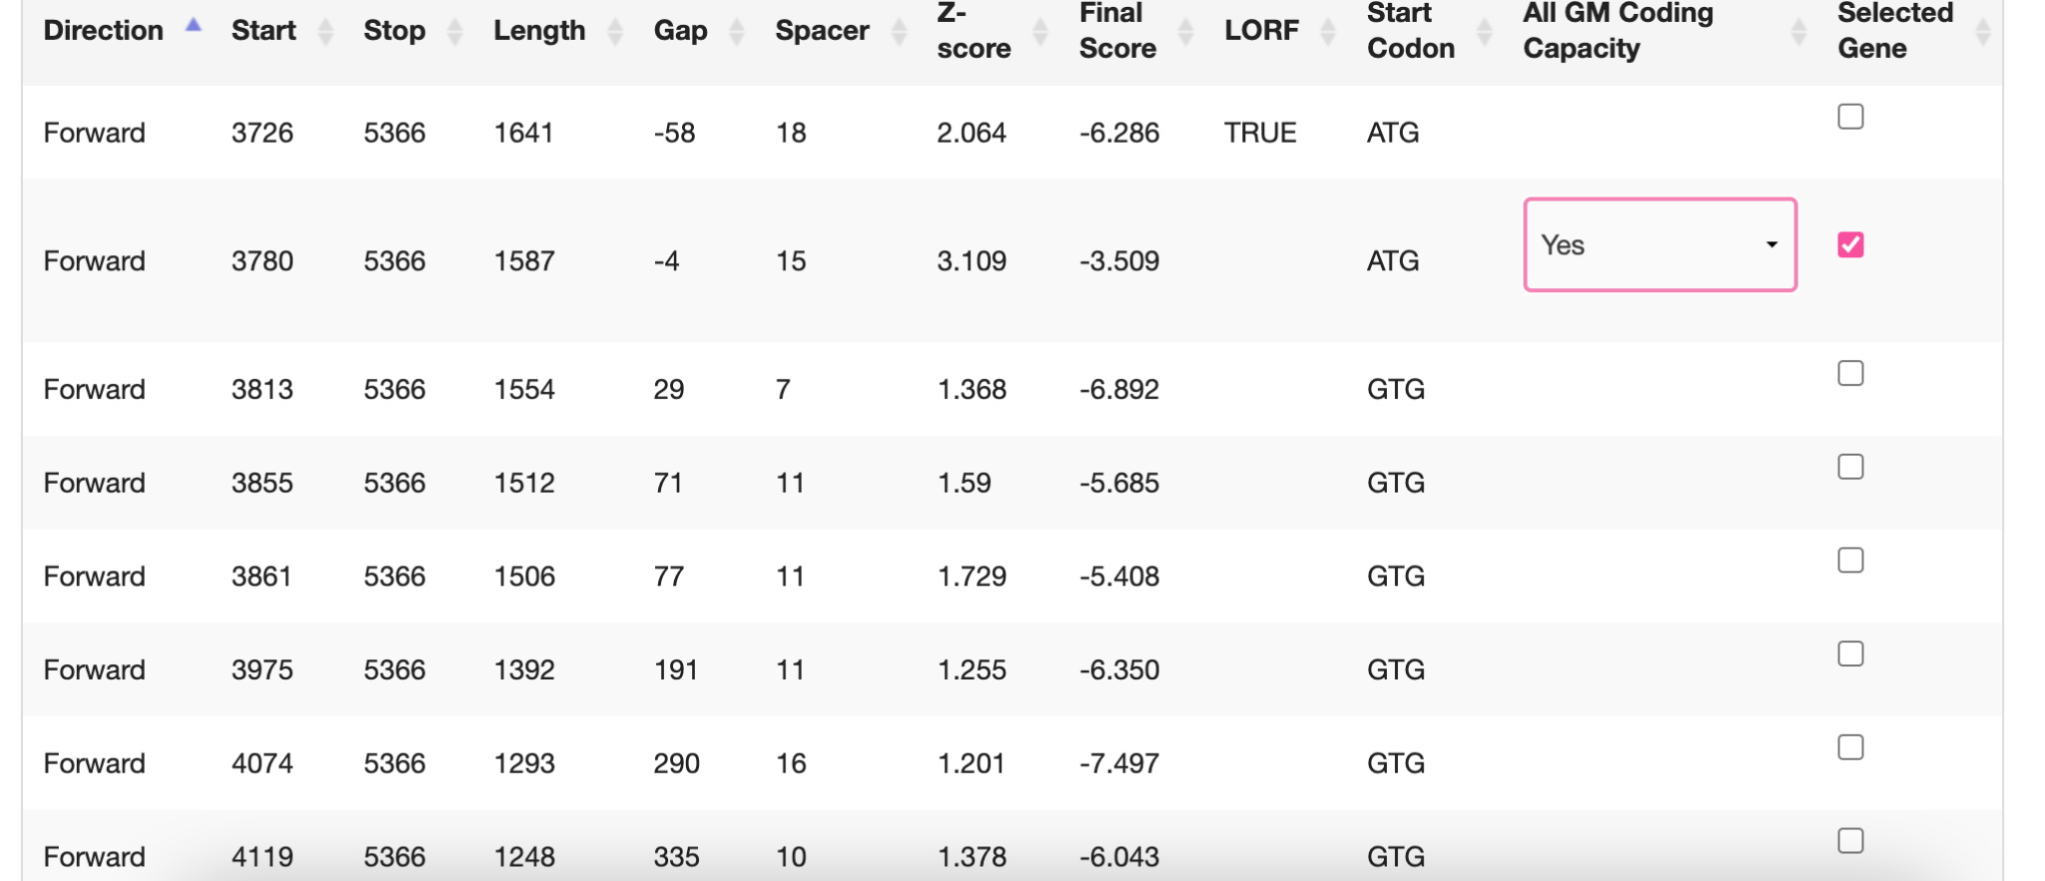
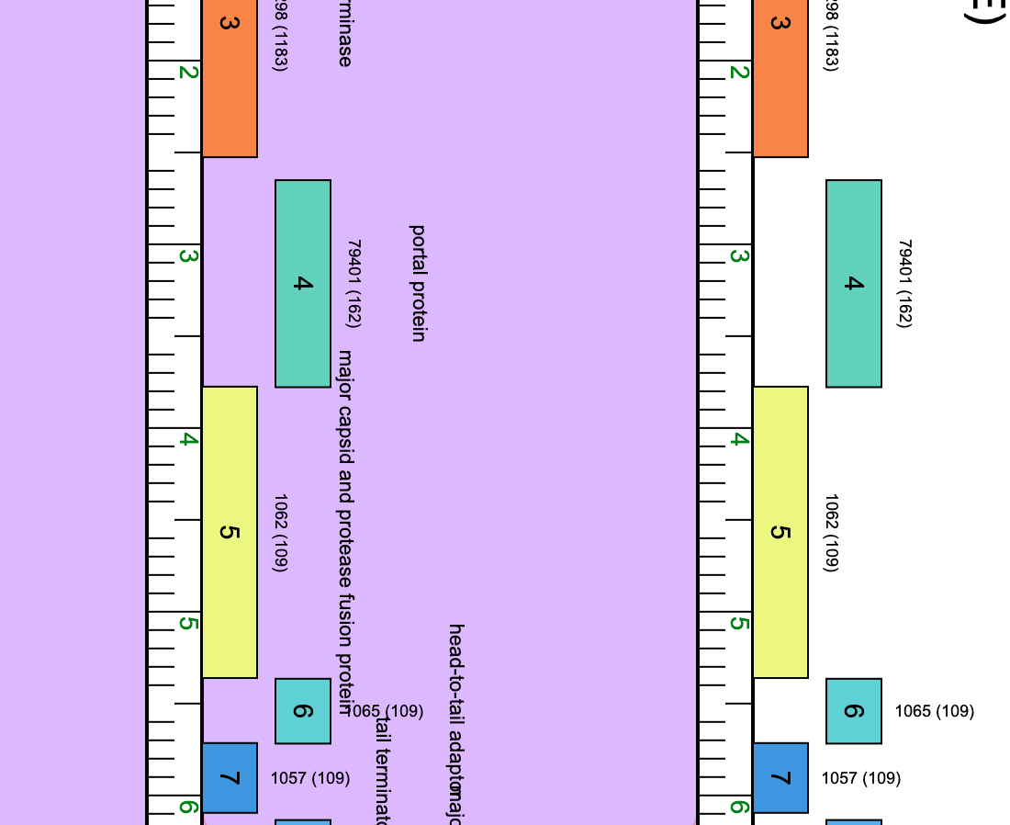
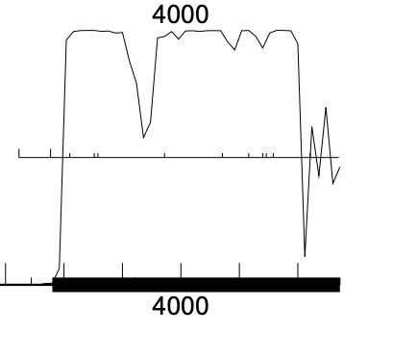
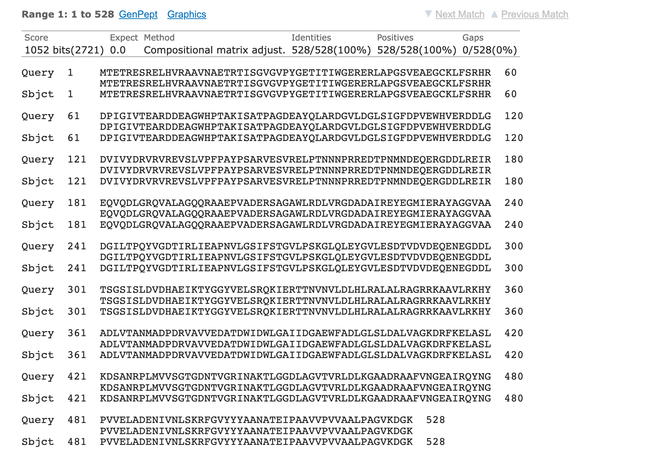
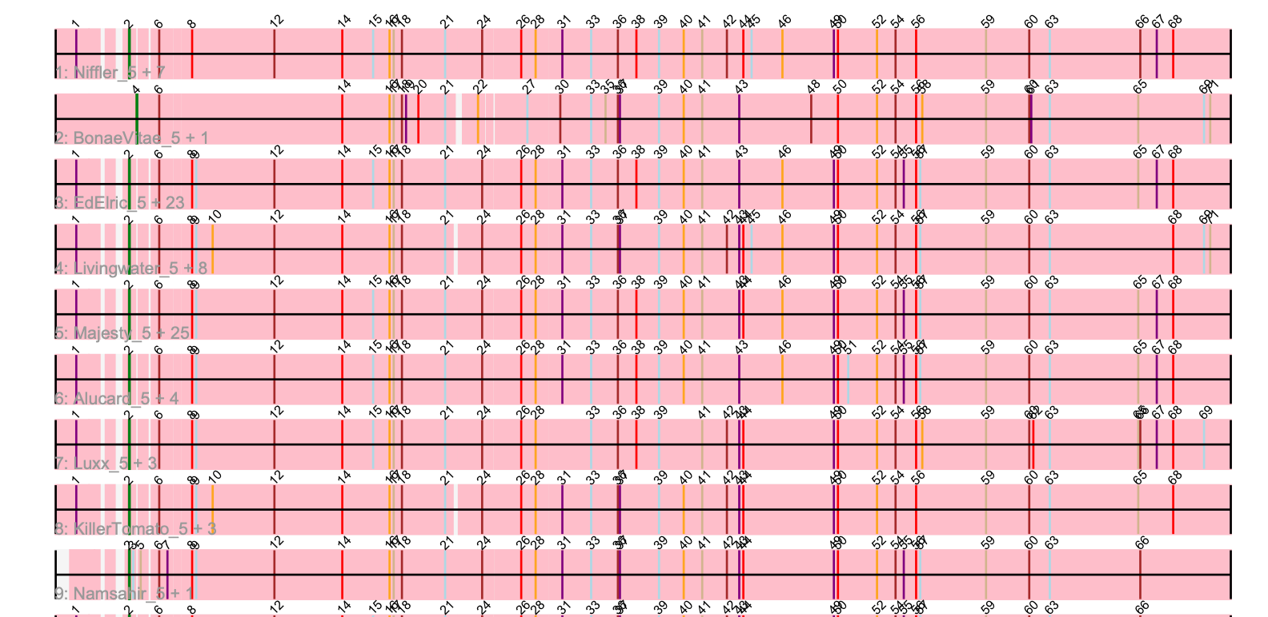
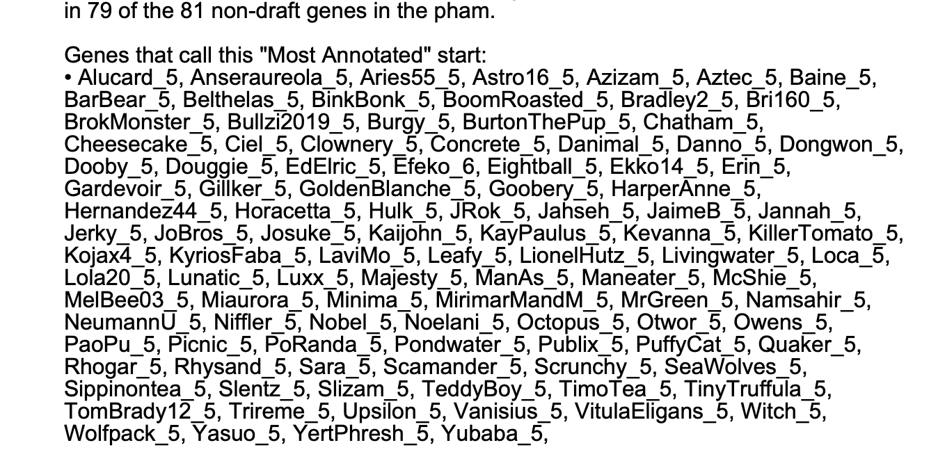
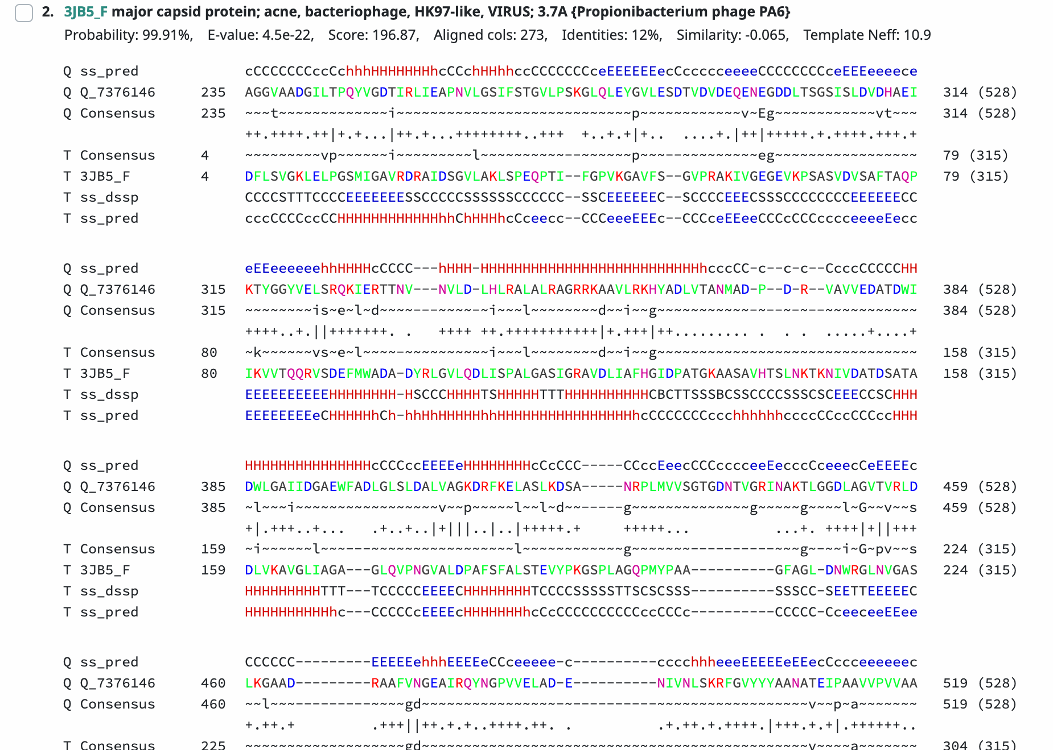
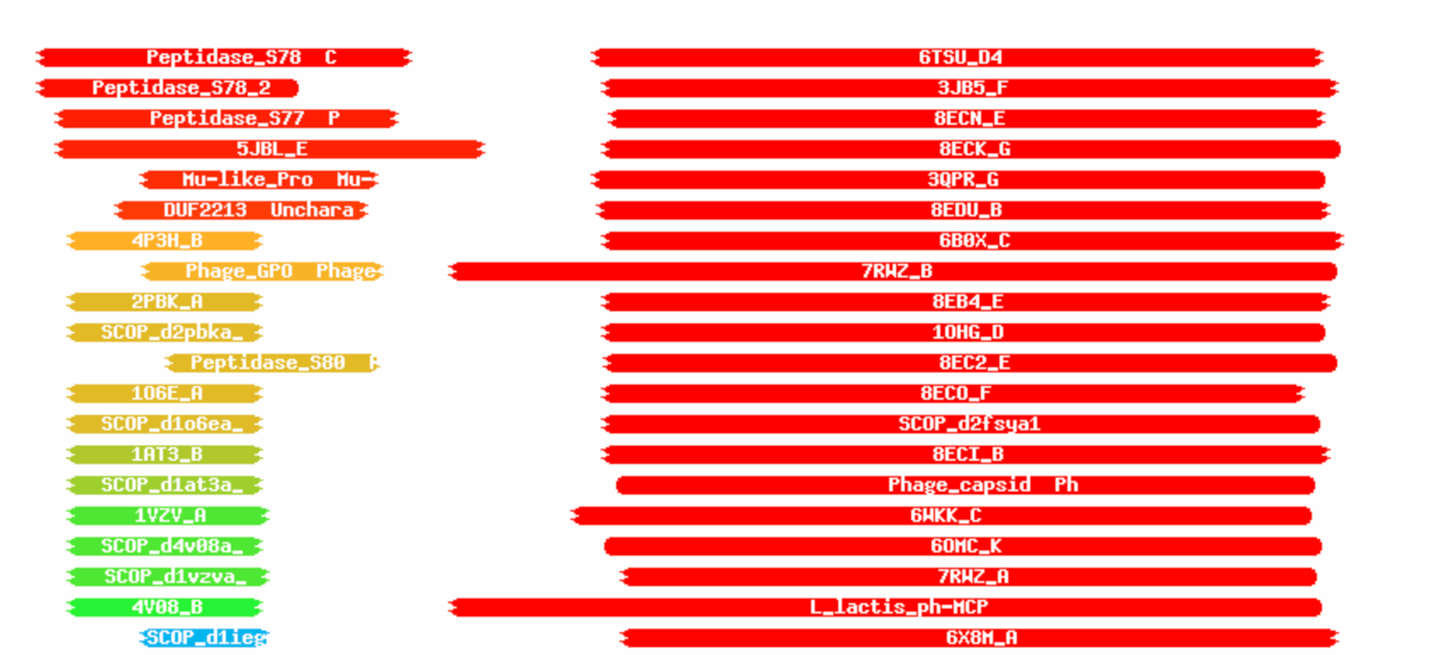
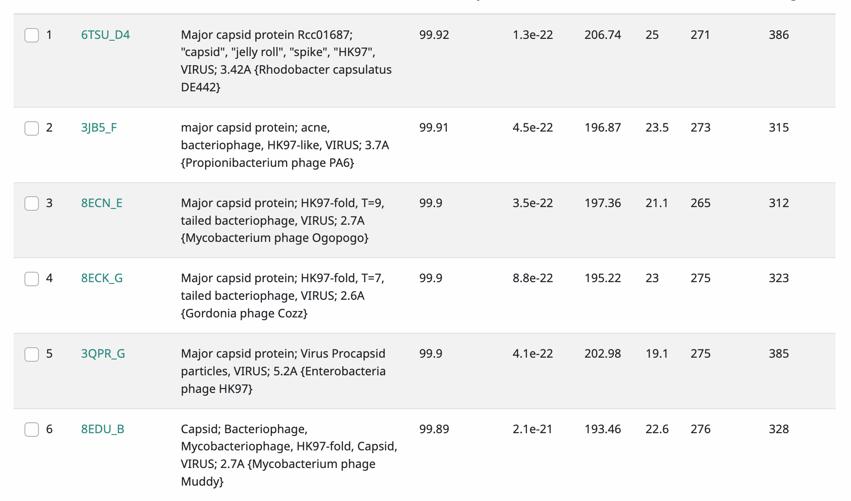
Gene #5 Start:3780 Stop: 5366 *Highlight start if changed from original call*
1. Is it a gene?
Gene originally called by (delete incorrect):
Both
Coding potential: yes
Other organisms have it? Yes
2. Where does it start?
RBS info: Z score: 3.109 final score: -3.509
Best z score not best final score
BLAST alignments: all alignments are 1:1
Local Blast: Yubaba, major capsid and protease fusion protein, e value 0.0/ YertPhresh, major capsid and protease fusion protein e value 0.0
NCBI Blast: PaoPu, major head protein, e value 0.0/ Azizam, major head protein, e value 0.0
Starterator: most called
Gap: -4
3. What is its function?
Final Function Decided: major capsid and protease fusion protein
Must be from approved function list: https://docs.google.com/spreadsheets/d/1FNcTlsU41iI1U8Jq0Yd-YqwJDUa089AInNnULL-K9hE/edit#gid=0
Synteny: Gene 5 is in the same pham, 1062, as gene 5 of Lola20. With the function of major capsid and protease fusion protein, it is downstream of portal protein and upstream of head to tail adaptor.
BLAST Results:
Local Blast: Yubaba, major capsid and protease fusion protein, e value 0.0/ YertPhresh, major capsid and protease fusion protein e value 0.0
NCBI Blast: PaoPu, major head protein, e value 0.0/ Azizam, major head protein, e value 0.0
HHPRED results: Warm colors indicate high hits and similarities. There were 93 hits the closet hit being 3Jb5_F with a probability of 99.9% and an evalue of 4.5E-22.
Any questions/uncertainties? Record them here for your secondary annotators:
Notes:
Secondary Annotator Notes: Check each piece of evidence provided and confirm whether your interpretation supports that of the primary annotator:
Secondary Annotator #1 Name:
Secondary Annotator #2 Name:

Slide 7
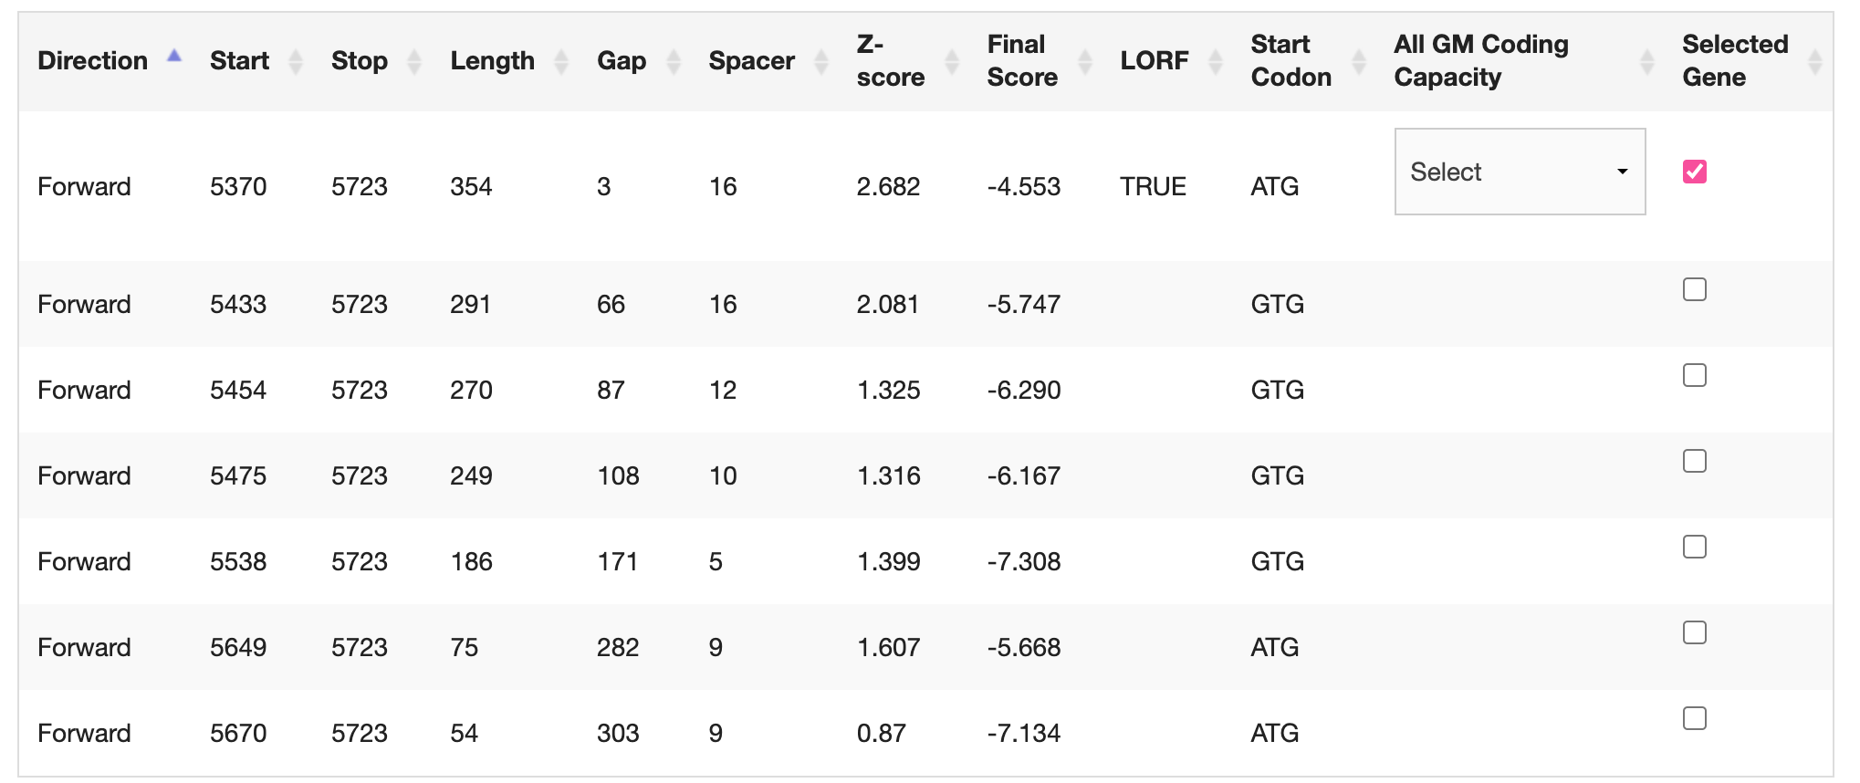
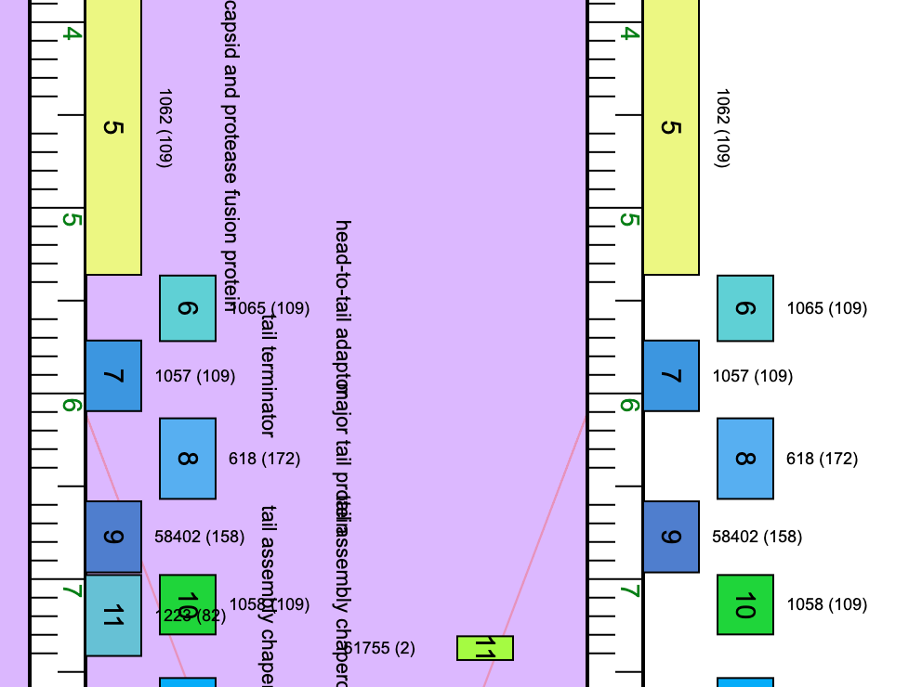
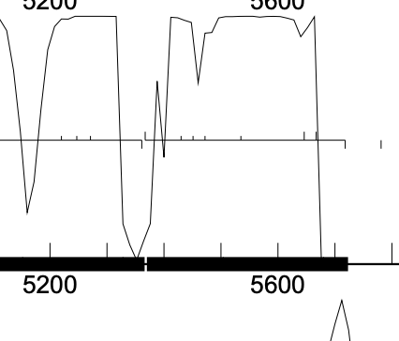
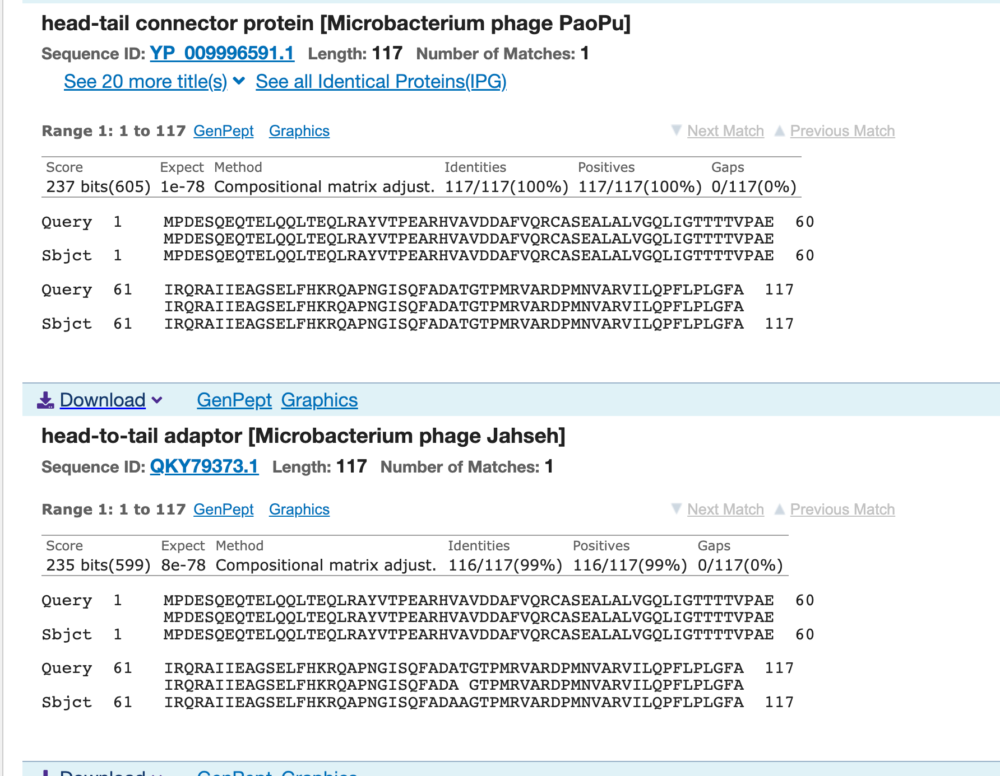
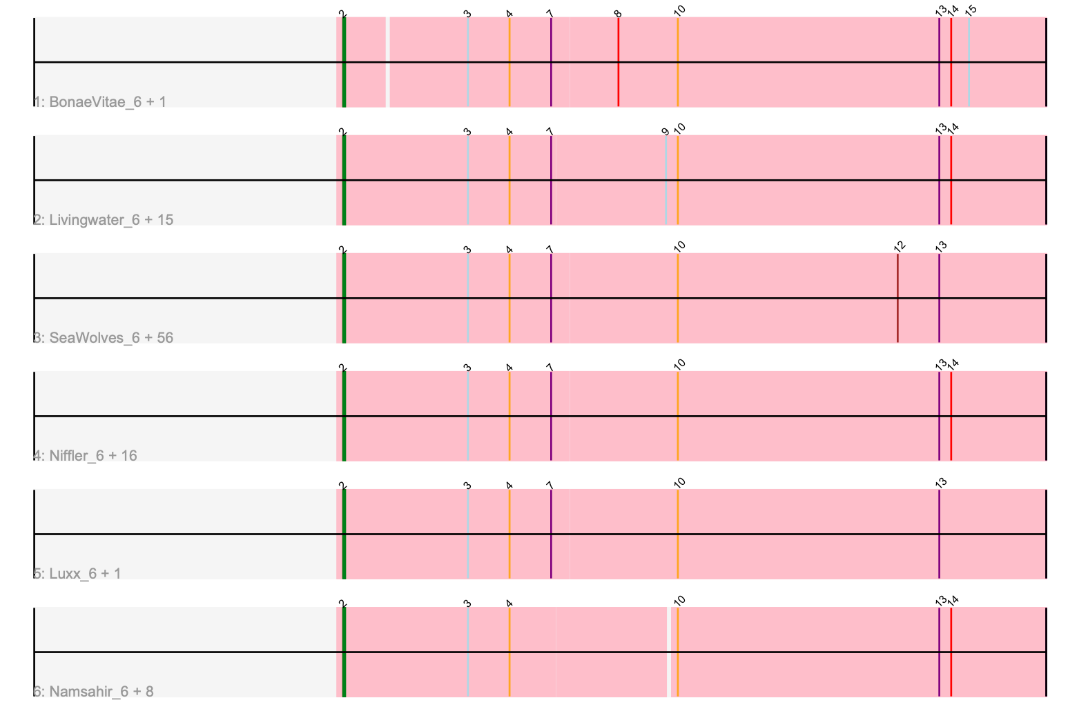
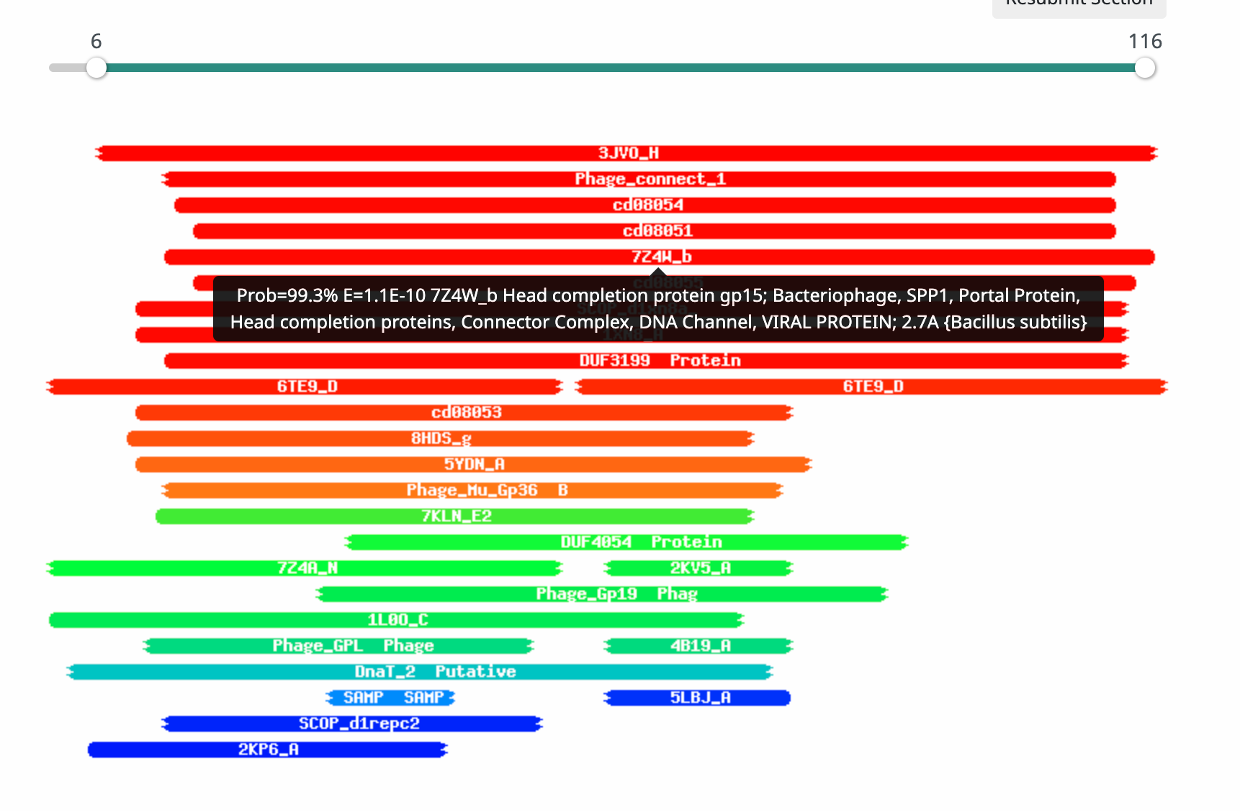
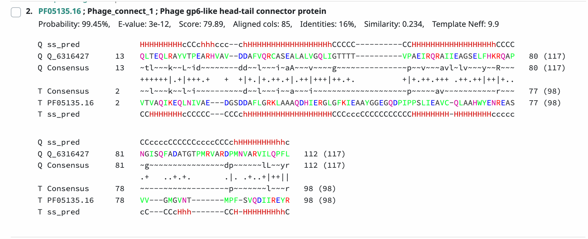
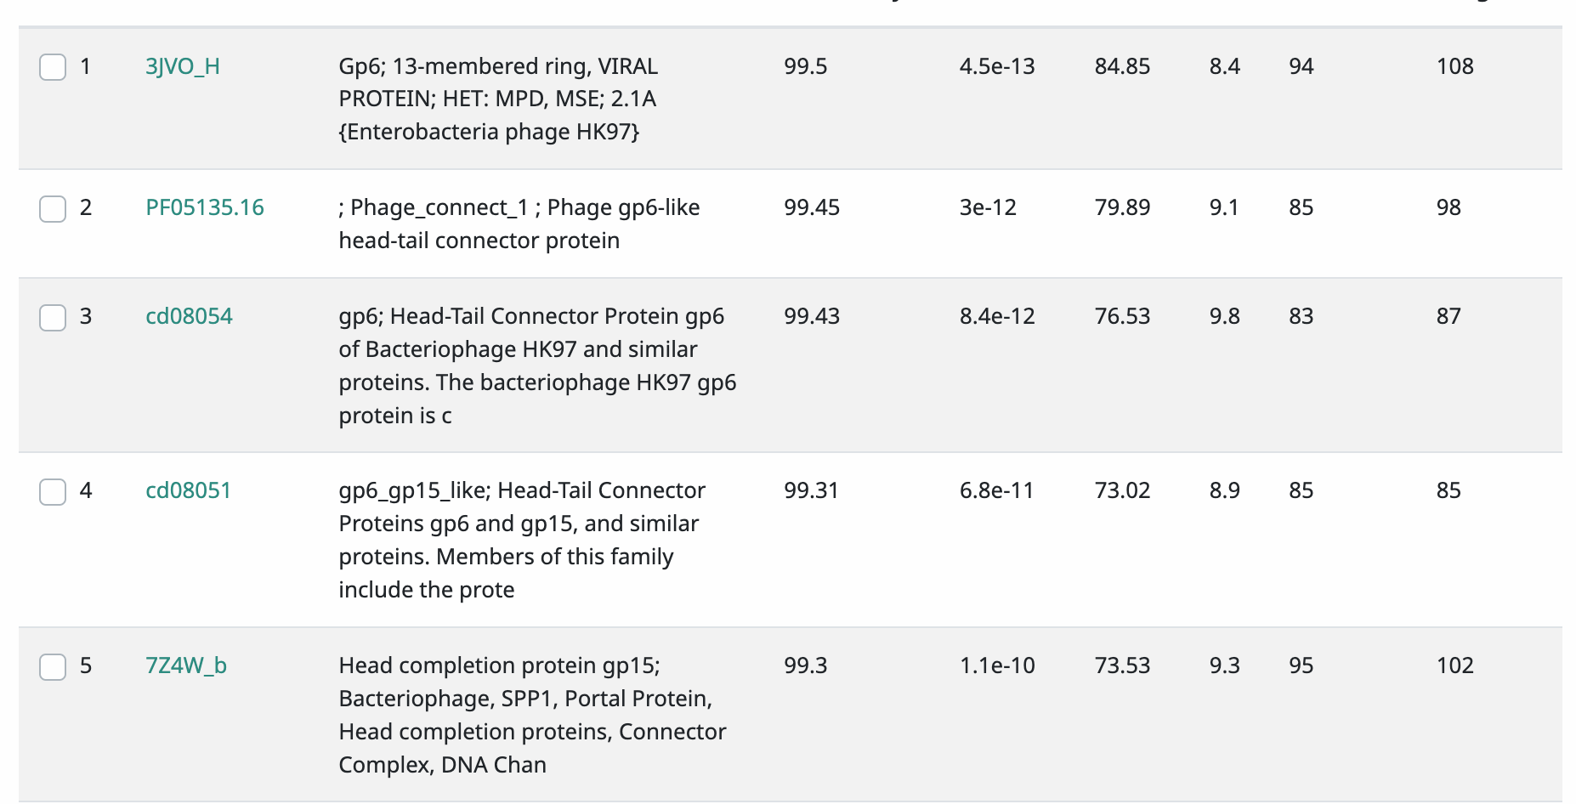
Gene #6 Start: 5,370 Stop: 5,723 *Highlight start if changed from original call*
1. Is it a gene?
Gene originally called by (delete incorrect):
Both
Coding potential: yes
Other organisms have it? Yes
2. Where does it start?
RBS info: Z score: 2.682 Final score: -4.553
Best z score, not best final score
BLAST alignments: all alignments are 1:1
Local Blast: Yubaba, head to tail adapter, e value 1e-60/ YertPhresh, head to tail adaptor, e value 1e-60
NCBI Blast: PaoPu, head to tail connector protein, e value 1e-78/ Jahseh, head to tail adaptor, e value 8e-78
Starterator: most called
Gap: 3
3. What is its function?
Final Function Decided: Head-to-Tail Adaptor
Must be from approved function list: https://docs.google.com/spreadsheets/d/1FNcTlsU41iI1U8Jq0Yd-YqwJDUa089AInNnULL-K9hE/edit#gid=0
Synteny: Gene 6 is in the same pham, 1065, as gene 6 of Lola20. With the function of head to tail adaptor, it is downstream of major capsid and protease fusion protein and upstream of tail terminator.
BLAST Results:
Local Blast: Yubaba, head to tail adapter, e value 1e-60/ YertPhresh, head to tail adaptor, e value 1e-60
NCBI Blast: PaoPu, head to tail connector protein, e value 1e-78/ Jahseh, head to tail adaptor, e value 8e-78
HHPRED results: Warm colors indicate hits and similarities but there are also cool colors. There were 43 hits, the best one being phage_connect_1 with the probability of 99.5% and an e value of 3E-12.
Any questions/uncertainties? Record them here for your secondary annotators:
Notes:
Secondary Annotator Notes: Check each piece of evidence provided and confirm whether your interpretation supports that of the primary annotator:
Secondary Annotator #1 Name:
Secondary Annotator #2 Name:

Slide 8
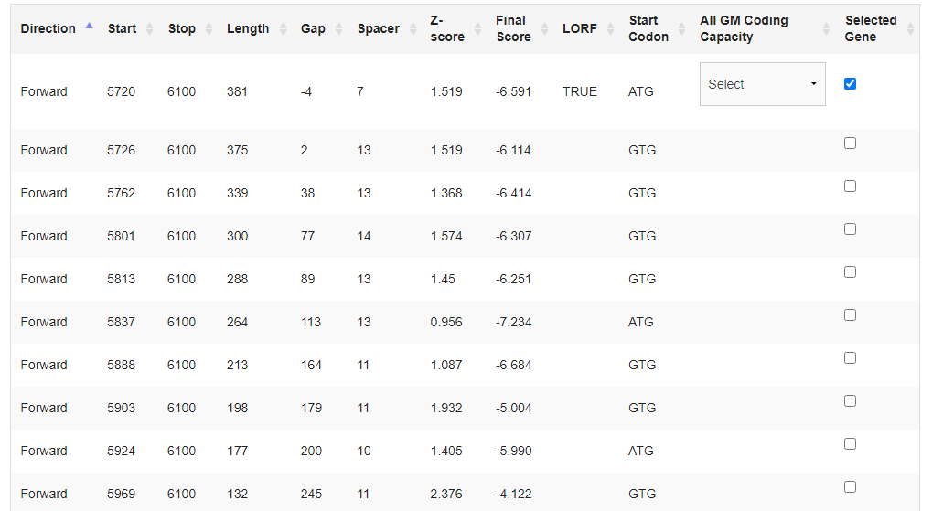
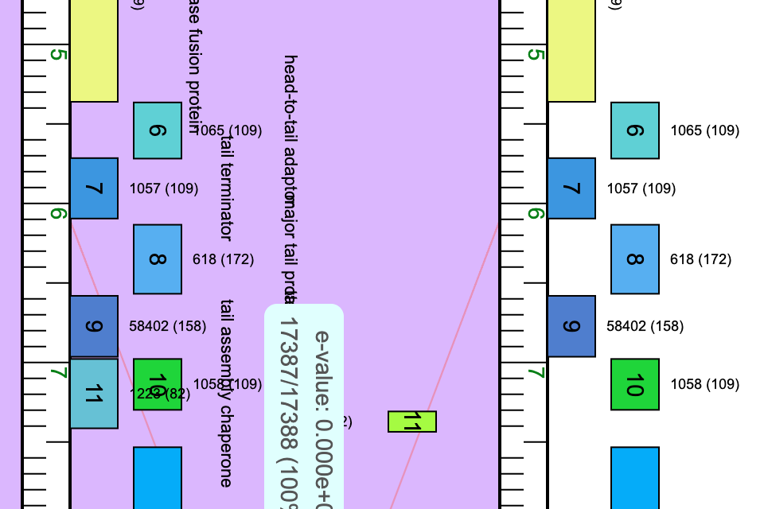
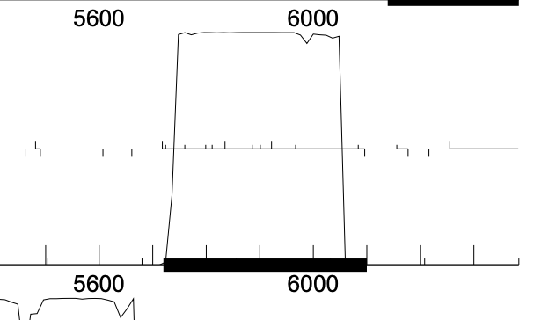
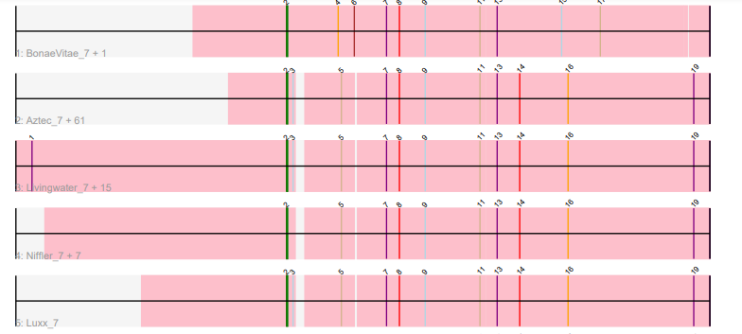
Gene #7 Start: 5,720 Stop: 6,100 *Highlight start if changed from original call*
1. Is it a gene?
Gene originally called by (delete incorrect):
Both
Coding potential: yes
Other organisms have it? Yes
2. Where does it start?
RBS info: Z score: 1.519 Final Score: -6.591
3rd best z score 3rd best final score
BLAST alignments:
Local Blast: Yubaba, tail terminator, e value 3e-65/ YertPhresh, tail terminator, e value 3e-65
NCBI Blast: PaoPu, minor tail protein, e value 5e-84/ Quaker, minor tail protein, e value 1e-83
Starterator: most called
Gap: -4
3. What is its function?
Final Function Decided: Tail Terminator
Must be from approved function list: https://docs.google.com/spreadsheets/d/1FNcTlsU41iI1U8Jq0Yd-YqwJDUa089AInNnULL-K9hE/edit#gid=0
Synteny : Gene 7 is in the same pham, 1057, as gene 7 of Lola20. With the function of tail terminator, it is downstream of head to tail adaptor and upstream of major tail protein.
BLAST Results:
Local Blast: Yubaba, tail terminator, e value 3e-65/ YertPhresh, tail terminator, e value 3e-65
NCBI Blast: PaoPu, minor tail protein, e value 5e-84/ Quaker, minor tail protein, e value 1e-83
HHPRED results: Warm colors indicate hits and similarities, only 30 hits. Best hit is phage_tail-u Ph with a probability of 98.2% and an e value of 0.00046.
Any questions/uncertainties? Record them here for your secondary annotators:
Notes:
Secondary Annotator Notes: Check each piece of evidence provided and confirm whether your interpretation supports that of the primary annotator:
Secondary Annotator #1 Name:
Secondary Annotator #2 Name:

Slide 9
Gene #8 Start: 6,139 Stop: 6,573 *Highlight start if changed from original call*
1. Is it a gene?
Gene originally called by (delete incorrect):
Both
Coding potential: yes
Other organisms have it? Yes
2. Where does it start?
RBS info: z score: 1.533 final score: -5.797 not best z score and not best final score
BLAST alignments: all alignments are 1:1
Local Blast: MrGreen, major tail protein, evalue 1e-81/ Lola, major tail protein, e value 1e-81
NCBI Blast: Leafy, major tail protein, e value 4e-100/ Bri160, major tail protein, e value 1e-99
Starterator: most called
Gap: 38
3. What is its function?
Final Function Decided: Major Tail Protein
Must be from approved function list: https://docs.google.com/spreadsheets/d/1FNcTlsU41iI1U8Jq0Yd-YqwJDUa089AInNnULL-K9hE/edit#gid=0
Synteny: Gene 8 is the same pham, 618, as gene 8 of Lola20. With the function of major tail protein, it is downstream of tail terminator and upstream of NKF.
BLAST Results:
Local Blast: MrGreen, major tail protein, evalue 1e-81/ Lola, major tail protein, e value 1e-81
NCBI Blast: Leafy, major tail protein, e value 4e-100/ Bri160, major tail protein, e value 1e-99
HHPRED results: warm and cool colors, low amount of hits only 23 hits. Best hit is 6TE9_G with a probability of 99.1% and an e value of 1.6E-08.
Any questions/uncertainties? Record them here for your secondary annotators:
Notes:
Secondary Annotator Notes: Check each piece of evidence provided and confirm whether your interpretation supports that of the primary annotator:
Secondary Annotator #1 Name:
Secondary Annotator #2 Name:

Slide 10
Gene # 9 Start: 6586 Stop: 6969 Forward *Highlight start if changed from original call*
1. Is it a gene? Yes
Gene originally called by: Both
Coding potential: Yes
Other organisms have it? Yes, PaoPu and Aries55 are the most similar
2. Where does it start? 6586
Coding potential aligns with predicted start
RBS info: Best, z-score=2.258, final=-4.294
BLAST alignments:
PhagesDB: Aries55, Aztec, 1:1, e-value: 2e-66, 2e-66
NCBI: PaoPu, PoRanda, 1:1, e-value: 4e-85, 1e-84
Starterator: Yes, most annotated start is 3. Found on track 11 with NeumannU.
Gap: 12 bp gap, too small for any coding potential
3. What is its function?
Final Function Decided: NKF
Must be from approved function list: https://docs.google.com/spreadsheets/d/1FNcTlsU41iI1U8Jq0Yd-YqwJDUa089AInNnULL-K9hE/edit#gid=0
Synteny: Same pham and positional similarity as PaoPu_9 and Aries55_9. Located upstream of tail assembly chaperone and downstream of major tail protein.
BLAST Results: Aries55_9, NKF, PhagesDB, e=2e-66. PaoPu_9, NKF, NCBI, e=4e-85
HHPRED results: 1 significant hit. 1.) PF05069.16, Phage tail, prob=98.65, e=2.6e-7, coverage~147%.
Notes:
Secondary Annotator Notes: Check each piece of evidence provided and confirm whether your interpretation supports that of the primary annotator:
Secondary Annotator #1 Name:
Secondary Annotator #2 Name:

Slide 11
Gene #10 Start: 6,983 Stop: 7,303 *Highlight start if changed from original call*
1. Is it a gene?
Gene originally called by (delete incorrect):
Both
Coding potential: yes
Other organisms have it? Yes
2. Where does it start?
RBS info: Z score: 2.493 final score: -3.826 best overall score
BLAST alignments: all alignments are 1:1
Local Blast: Lola, tail assembly chaperone, e value 9e-54/ Wolfpack, tail assembly chaperone, e value 1e-52
NCBI Blast: Lola, tail assembly chaperone, evalue 3e-68/ Quaker, tail assembly chaperone, e value 5e-67
Starterator: most called
Gap: 13
3. What is its function?
Final Function Decided: Tail Assembly Chaperone
Must be from approved function list: https://docs.google.com/spreadsheets/d/1FNcTlsU41iI1U8Jq0Yd-YqwJDUa089AInNnULL-K9hE/edit#gid=0
Synteny : Gene 10 is in the same pham, 1058, as gene 10 of Lola20. With the function of tail assembly chaperone, it is downstream of NKF and upstream of tail assembly chaperone.
BLAST Results:
Local Blast: Lola, tail assembly chaperone, e value 9e-54/ Wolfpack, tail assembly chaperone, e value 1e-52
NCBI Blast: Lola, tail assembly chaperone, evalue 3e-68/ Quaker, tail assembly chaperone, e value 5e-67
HHPRED results: 23 hits, best hit is 96.0% and the evalue is 0.063.
Any questions/uncertainties? Record them here for your secondary annotators:
Notes:
Secondary Annotator Notes: Check each piece of evidence provided and confirm whether your interpretation supports that of the primary annotator:
Secondary Annotator #1 Name:
Secondary Annotator #2 Name:

Slide 12
Gene #11 – second gene in PTFS Start: 7,441 Stop: 7,313 *Highlight start if changed from original call*
Documenting frameshift:
Used Lola 20:
Slippery sequence
shift from N to K
AAC - > AAA
@ 7267bp
3. What is its function?
Final Function Decided: tail assembly chaperone
Must be from approved function list: https://docs.google.com/spreadsheets/d/1FNcTlsU41iI1U8Jq0Yd-YqwJDUa089AInNnULL-K9hE/edit#gid=0
Any questions/uncertainties? Record them here for your secondary annotators:
Notes:
Secondary Annotator Notes: Check each piece of evidence provided and confirm whether your interpretation supports that of the primary annotator:
Secondary Annotator #1 Name:
Secondary Annotator #2 Name:

Slide 13
Gene # 12 Start: 7538 Stop: 9646 Forward *Highlight start if changed from original call*
1. Is it a gene? Yes
Gene originally called by: Both
Coding potential: Yes
Other organisms have it? Yes, Lola20 and Yasuo are the most similar.
2. Where does it start? 7538
Coding potential aligns with predicted start
RBS info: Best, z=2.765, final=-4.386
BLAST alignments:
PhagesDB: Lola20, Anseraureola, 1:1, e-value: 0.0, 0.0
NCBI: Yasuo, Jahseh, 1:1, e-value: 0.0, 0.0
Starterator: Yes, most annotated start is 10
Gap: 96 bp gap,
3. What is its function?
Final Function Decided: Tape Measure Protein
Must be from approved function list: https://docs.google.com/spreadsheets/d/1FNcTlsU41iI1U8Jq0Yd-YqwJDUa089AInNnULL-K9hE/edit#gid=0
Synteny: Same pham and positional similarity as Lola20_12 and Yasuo_12. Located upstream of minor tail protein and downstream of tail assembly chaperone
BLAST Results: Lola20_12, Tape Measure Protein, PhagesDB, e=0.0. Yasuo_12, Tape Measure Protein, NCBI, e=0.0
HHPRED results: Many significant hits. 1.) 6V8I_CF, Tape Measure Protein, prob=99.94%, e=3.9e-18, coverage~1154. 2.) 6V8I_CF, Tape Measure Protein, prob=99.9%, e=4.4e-15, coverage~1154
Notes:
Secondary Annotator Notes: Check each piece of evidence provided and confirm whether your interpretation supports that of the primary annotator:
Secondary Annotator #1 Name:
Secondary Annotator #2 Name:

Slide 14
Gene #13 Start: 9,643 Stop: 10,602 *Highlight start if changed from original call*
1. Is it a gene?
Gene originally called by (delete incorrect):
Both
Coding potential: yes
Other organisms have it?
2. Where does it start?
RBS info: Z score: 2.269 Final score: -4.412 best overall score
BLAST alignments:
Local Blast: Lola, minor tail protein, e value 0.0/ Yubaba, minor tail protein, e value e-169
NCBI Blast: Lola, minor tail protein, e value 0.0/ PaoPu, minor tail protein, e value 0.0
Starterator: most called
Gap: -4
3. What is its function?
Final Function Decided: Minor Tail Protein
Must be from approved function list: https://docs.google.com/spreadsheets/d/1FNcTlsU41iI1U8Jq0Yd-YqwJDUa089AInNnULL-K9hE/edit#gid=0
Synteny: Gene 13 does not exist for baine but instead skips to gene 14 which is in the same pham, 76903, has gene 13 of Lola20. With the function of minor tail protein, it is upstream of minor tail protein and downstream of tape measure protein.
BLAST Results:
Local Blast: Lola, minor tail protein, e value 0.0/ Yubaba, minor tail protein, e value e-169
NCBI Blast: Lola, minor tail protein, e value 0.0/ PaoPu, minor tail protein, e value 0.0
HHPRED results: 118 hits. The best hit is 4XUP_F with a probability of 98.8% and an e value of 2.1E-06.
Any questions/uncertainties? Record them here for your secondary annotators:
Notes:
Secondary Annotator Notes: Check each piece of evidence provided and confirm whether your interpretation supports that of the primary annotator:
Secondary Annotator #1 Name:
Secondary Annotator #2 Name:

Slide 15
Gene #14 Start: 10,602 Stop: 12,662 *Highlight start if changed from original call*
1. Is it a gene?
Gene originally called by (delete incorrect):
Both
Coding potential:
Other organisms have it? Yes
2. Where does it start?
RBS info: Z score: 2.817 final score: -4.089 Best overall score
BLAST alignments: all alignments are 1:1
Local Blast: Lola, minor tail protein, e value 0.0/ Yubaba, minor tail protein, e value e-169
NCBI Blast: Lola, minor tail protein, e value 0.0/ PaoPu, minor tail protein, e value 0.0
Starterator: most called
Gap: -1
3. What is its function?
Final Function Decided: Minor Tail Protein
Must be from approved function list: https://docs.google.com/spreadsheets/d/1FNcTlsU41iI1U8Jq0Yd-YqwJDUa089AInNnULL-K9hE/edit#gid=0
Synteny: gene 14 which is in the same pham, 76903, has gene 13 of Lola20. With the function of minor tail protein, it is upstream of minor tail protein and downstream of tape measure protein.
BLAST Results:
Local Blast: Lola, minor tail protein, e value 0.0/ Yubaba, minor tail protein, e value e-169
NCBI Blast: Lola, minor tail protein, e value 0.0/ PaoPu, minor tail protein, e value 0.0
HHPRED results: 250 results. The best hit is 3T1W_A with a probability of 99.8% and an evalue of 5.6E-15.
Any questions/uncertainties? Record them here for your secondary annotators:
Notes:
Secondary Annotator Notes: Check each piece of evidence provided and confirm whether your interpretation supports that of the primary annotator:
Secondary Annotator #1 Name:
Secondary Annotator #2 Name:

Slide 16
Gene #15 Start: 12,664 Stop: 13,242 *Highlight start if changed from original call*
1. Is it a gene?
Gene originally called by (delete incorrect):
Both
Coding potential:
Other organisms have it? Yes
2. Where does it start?
RBS info: Z score: 2.499 Final score: -3.955 best overall score
BLAST alignments: all alignments are 1:1
Local Blast: Lola, minor tail protein, e value 0.0/ Concrete, minor tail protein, e value 0.0
NCBI Blast: Lola, minor tail protein, e value 0.0/ Concrete, minor tail protein, e value 0.0
Starterator: most called Gap: 1
3. What is its function?
Final Function Decided: Minor Tail Protein
Must be from approved function list: https://docs.google.com/spreadsheets/d/1FNcTlsU41iI1U8Jq0Yd-YqwJDUa089AInNnULL-K9hE/edit#gid=0
Synteny : Gene 15 is in the same pham, 1068, as gene 14 of Lola20. With the function of minor tail protein, it is upstream of minor tail protein and downstream of minor tail protein.
BLAST Results:
Local Blast: Lola, minor tail protein, e value 0.0/ Concrete, minor tail protein, e value 0.0
NCBI Blast: Lola, minor tail protein, e value 0.0/ Concrete, minor tail protein, e value 0.0
HHPRED results: Only 13 hits. Best hit is 7Z4B_DT with a probability of 98.3% and an e value of 4.5E-05.
Any questions/uncertainties? Record them here for your secondary annotators:
Notes:
Secondary Annotator Notes: Check each piece of evidence provided and confirm whether your interpretation supports that of the primary annotator:
Secondary Annotator #1 Name:
Secondary Annotator #2 Name:

Slide 17
Gene #16 Start: 13,286 Stop: 13,558 *Highlight start if changed from original call*
1. Is it a gene?
Gene originally called by (delete incorrect):
Both
Coding potential: yes
Other organisms have it? Yes
2. Where does it start?
RBS info: Z score: 2.765 Final score: -3.365 best overall scores
BLAST alignments: all alignments are 1:1
Local Blast: Lola, NKF, e value e-107/ JRok, NKF, e value e-107
NCBI Blast: Lola, minor tail protein, e value 1e-136/ KayPaulus, minor tail protein, e value 4e-125
Starterator: most called
Gap: 43
3. What is its function?
Final Function Decided: NKF
Must be from approved function list: https://docs.google.com/spreadsheets/d/1FNcTlsU41iI1U8Jq0Yd-YqwJDUa089AInNnULL-K9hE/edit#gid=0
Synteny : Gene 16 is the same pham, 875, as gene 15 of Lola20. With the function of minor tail protein, it is upstream of NKF and downstream of minor tail protein.
BLAST Results:
Local Blast: Lola, minor tail protein, e value e-107/ JRok, minor tail protein, e value e-107
NCBI Blast: Lola, hypothetical protein, e value 1e-136/ KayPaulus, hypothetical protein, e value 4e-125
HHPRED results: NKF only 22 hits. The best one is DUF7667 with a probability of 76% and an evalue of 47.
Any questions/uncertainties? Record them here for your secondary annotators:
Notes:
Secondary Annotator Notes: Check each piece of evidence provided and confirm whether your interpretation supports that of the primary annotator:
Secondary Annotator #1 Name:
Secondary Annotator #2 Name:

Slide 18
Gene #17 Start: 13,583 Stop: 14,275 *Highlight start if changed from original call*
1. Is it a gene?
Gene originally called by (delete incorrect):
Both
Coding potential: yes
Other organisms have it? Yes
2. Where does it start?
RBS info: Z score: 3.355 final score: -2.175 best overall scores
BLAST alignments: alignments 1:1
Local Blast: Lola, function unknown, e value 8e-45/ Wolfpack, function unknown, e value 1e-37
NCBI Blast: most endolysin (Loca, Quaker, etc.)
Starterator: most called
Gap: 24
3. What is its function?
Final Function Decided: endolysin
Must be from approved function list: https://docs.google.com/spreadsheets/d/1FNcTlsU41iI1U8Jq0Yd-YqwJDUa089AInNnULL-K9hE/edit#gid=0
Synteny: Gene 17 is in the same pham, 1097, as gene 16 of Lola20. With the function of NKF it is upstream of endolysin and downstream of minor tail protein.
BLAST Results:
Local Blast:
NCBI Blast: majority endolysin.
HHPRED results:
Any questions/uncertainties? Record them here for your secondary annotators:
Notes:
Secondary Annotator Notes: Check each piece of evidence provided and confirm whether your interpretation supports that of the primary annotator:
Secondary Annotator #1 Name:
Secondary Annotator #2 Name:

Slide 19
Gene #18 Start:14,242 Stop:14,505 *Highlight start if changed from original call*
1. Is it a gene?
Gene originally called by (delete incorrect):
Both
Coding potential: yes
Other organisms have it? Yes
2. Where does it start?
RBS info: Z score: 1.59 Final Score: -6.724 not the best scores
BLAST alignments: alignments are 1:1
Local Blast: BinkBonk, Burgy, NKF
NCBI Blast: membrane protein, Lola20, PoRanda
Starterator: Most called
Gap: -34
3. What is its function?
Final Function Decided: membrane protein
Must be from approved function list: https://docs.google.com/spreadsheets/d/1FNcTlsU41iI1U8Jq0Yd-YqwJDUa089AInNnULL-K9hE/edit#gid=0
Synteny : Gene 18 is in the same pham, 79467, as gene 17 of Lola20. With the function of endolysin, it is upstream of endolysin and downstream of NKF.
BLAST Results:
Local Blast: NKF
NCBI Blast: Membrane protein
HHPRED results: No significant hits
Membrane protein checks – yes!
Any questions/uncertainties? Record them here for your secondary annotators:
Notes:
Secondary Annotator Notes: Check each piece of evidence provided and confirm whether your interpretation supports that of the primary annotator:
Secondary Annotator #1 Name:
Secondary Annotator #2 Name:

Slide 20
Gene #19 Start:14,502 Stop: 14,726 *Highlight start if changed from original call*
1. Is it a gene?
Gene originally called by (delete incorrect):
Both
Coding potential: yes
Other organisms have it? Yes
2. Where does it start?
RBS info: Z score: 2.854 Final score: -3.171 Best scores
BLAST alignments: alignments are 1:1
Local Blast: Lola, function unknown, e value 2e-47/YertPhresh, function unknown, e value 3e-45
NCBI Blast: Many 1:1 hits to holin
Starterator: most called
Gap: -4
3. What is its function?
Final Function Decided: membrane protein
Must be from approved function list: https://docs.google.com/spreadsheets/d/1FNcTlsU41iI1U8Jq0Yd-YqwJDUa089AInNnULL-K9hE/edit#gid=0
Synteny: Gene 19 is in the same pham, 1063, as gene 18 of Lola20. With the function of NKF , it is upstream of NKF, and downstream of membrane protein.
BLAST Results: Local Blast: many hits to NKF
NCBI Blast: Many hits to holin.
HHPRED results: Some weak evidence of it being a holin (membrane protein)
Any questions/uncertainties? Record them here for your secondary annotators:
Notes:
Secondary Annotator Notes: Check each piece of evidence provided and confirm whether your interpretation supports that of the primary annotator:
Secondary Annotator #1 Name:
Secondary Annotator #2 Name:

Slide 21
Gene #20 Start: 15,007 Stop: 14,795 *Highlight start if changed from original call*
1. Is it a gene?
Gene originally called by (delete incorrect):
Both
Coding potential:
Other organisms have it?
2. Where does it start?
RBS info: Z score: 2.664 final score: -3.627 best scores overall
BLAST alignments: alignments are 1:1
Local Blast: Lsr-2 like DNA bridging protein
NCBI Blast: Lsr-2 like DNA bridging protein
Starterator: most called
Gap: 2
3. What is its function?
Final Function Decided: Lsr2-like bridging protein
Must be from approved function list: https://docs.google.com/spreadsheets/d/1FNcTlsU41iI1U8Jq0Yd-YqwJDUa089AInNnULL-K9hE/edit#gid=0
Synteny. Lsr2-like bridging protein – same pham and positional similarity as other EE phages – upstream of membrane protein, downstream of helix-turn-helix
BLAST Results:
Local Blast:Lsr2-like DNA bridging protein
NCBI Blast: Lsr2-like bridging protein
HHPRED results: Significant hits to Lsr2-like bridging protein
Any questions/uncertainties? Record them here for your secondary annotators:
Notes:
Secondary Annotator Notes: Check each piece of evidence provided and confirm whether your interpretation supports that of the primary annotator:
Secondary Annotator #1 Name:
Secondary Annotator #2 Name:

Slide 22
Gene #21 Start: 15,510 Stop: 15,010 *Highlight start if changed from original call*
1. Is it a gene?
Gene originally called by (delete incorrect):
Genemark
Coding potential:
Other organisms have it? Yes
2. Where does it start?
RBS info: No best score, Z score: 0.492 Final score: -7.945
BLAST alignments: all alignments are 1:1
Local Blast: helix-turn-helix DNA binding domain protein, Anseraureola, Jannah
NCBI Blast: PaoPu, Lsr2-like bridging protein, e value 1e-41/ Hulk, Lsr2-like DNA bridging protein, e value 3e-41
Starterator: not most called track 3
Gap: 79
3. What is its function?
Final Function Decided: helix-turn-helix DNA binding domain
Must be from approved function list: https://docs.google.com/spreadsheets/d/1FNcTlsU41iI1U8Jq0Yd-YqwJDUa089AInNnULL-K9hE/edit#gid=0
Synteny : Gene 21 is in the same pham, 781, as gene 20 of Lola20. With the function of ,Lsr2-like DNA bridging protein, it is downstream of NKF and upstream of helix-turn-helix DNA binding domain protein
BLAST Results:
Local Blast: Yubaba, Lsr2-like DNA bridging protein, e value 8e-34/Yertphresh, Lsr2-like DNA bridging protein, e value 8e-34
NCBI Blast: PaoPu, Lsr2-like bridging protein, e value 1e-41/ Hulk, Lsr2-like DNA bridging protein, e value 3e-41
HHPRED results: helix turn helix DNA binding
Any questions/uncertainties? Record them here for your secondary annotators:
Notes:
Secondary Annotator Notes: Check each piece of evidence provided and confirm whether your interpretation supports that of the primary annotator:
Secondary Annotator #1 Name:
Secondary Annotator #2 Name:

Slide 23
Gene #22 Start: 15,820 Stop: 15,590 *Highlight start if changed from original call*
1. Is it a gene?
Gene originally called by (delete incorrect):
Both
Coding potential:
Other organisms have it? Yes
2. Where does it start?
RBS info: Z score: 0.931 Final score: -7.839 best z score and 3rd best final score
BLAST alignments: 1:1
Local Blast: Yubaba, helix turn helix DNA binding domain protein, e value 4e-77/ YertPhresh, helix turn helix DNA binding domain protein, E value 4e-77
NCBI Blast: Dongwon, helix turn helix DNA binding domain protein, e value 1e-97/ VitulaEligans, helix turn helix DNA binding domain protein, e value 2e-94
Starterator: most called
Gap: 509
3. What is its function?
Final Function Decided: Helix-Turn-Helix DNA Binding Domain Protein
Must be from approved function list: https://docs.google.com/spreadsheets/d/1FNcTlsU41iI1U8Jq0Yd-YqwJDUa089AInNnULL-K9hE/edit#gid=0
Synteny :
BLAST Results:
Local Blast: Yubaba, helix turn helix DNA binding domain protein, e value 4e-77/ YertPhresh, helix turn helix DNA binding domain protein, E value 4e-77
NCBI Blast: Dongwon, helix turn helix DNA binding domain protein, e value 1e-97/ VitulaEligans, helix turn helix DNA binding domain protein, e value 2e-94
HHPRED results: Helix-turn-helix motif/ regulatory proteins
Any questions/uncertainties? Record them here for your secondary annotators:
Notes:
Secondary Annotator Notes: Check each piece of evidence provided and confirm whether your interpretation supports that of the primary annotator:
Secondary Annotator #1 Name:
Secondary Annotator #2 Name:

Slide 24
Gene #23 Start:16,330 Stop: 16,716 *Highlight start if changed from original call*
1. Is it a gene?
Gene originally called by (delete incorrect):
Glimmer
Coding potential:
Other organisms have it? Yes
2. Where does it start?
RBS info: Z score: 1.753 Final score: -5.825 both second best scores
BLAST alignments: all alignments are 1:1
Local Blast: NKF, Anseraureola, Bradley, NKF
NCBI Blast: Aztec, Timotea – 1:1, NKf
Starterator: most called
Gap: 509
3. What is its function?
Final Function Decided: NKF
Must be from approved function list: https://docs.google.com/spreadsheets/d/1FNcTlsU41iI1U8Jq0Yd-YqwJDUa089AInNnULL-K9hE/edit#gid=0
Synteny : Downstream and upstream from helix-turn-helix DNA binding protein, NKF, Same pham and positional similarity as other EE phages.
BLAST Results: NKF
HHPRED results: No significant hits
Any questions/uncertainties? Record them here for your secondary annotators:
Notes:
Secondary Annotator Notes: Check each piece of evidence provided and confirm whether your interpretation supports that of the primary annotator:
Secondary Annotator #1 Name:
Secondary Annotator #2 Name:

Slide 25
Gene #24 Start:16,800 Stop: 17,018 *Highlight start if changed from original call*
1. Is it a gene?
Gene originally called by (delete incorrect):
Glimmer, genemark calls 16,809 and I believe that is the proper start
Coding potential: yes but start is 16,809
Other organisms have it? Yes
2. Where does it start?
RBS info: Z score: 1.287 Final score: -6.575 both second best scores
BLAST alignments: all alignments are 1:1
Local Blast: Anseraureola, Aztec, Helix-turn-helix DNA binding domain
NCBI Blast:
Starterator: most called
Gap: 83
3. What is its function?
Final Function Decided: helix-turn-helix DNA binding domain
Must be from approved function list: https://docs.google.com/spreadsheets/d/1FNcTlsU41iI1U8Jq0Yd-YqwJDUa089AInNnULL-K9hE/edit#gid=0
Synteny : Gene 24 is in the same pham, 1383, as gene 23 of Lola20. With the function of helix-turn-helix DNA binding domain it is downstream of NKF and upstream of helix-turn-helix DNA binding domain protein
BLAST Results:
Local Blast: helix-turn-helix
NCBI Blast: helix-turn-helix
HHPRED results: Dna binding domain, winged helix-turn-helix
Any questions/uncertainties? Record them here for your secondary annotators:
Notes:
Secondary Annotator Notes: Check each piece of evidence provided and confirm whether your interpretation supports that of the primary annotator:
Secondary Annotator #1 Name:
Secondary Annotator #2 Name:

Slide 26
Gene # 25 Start:17015 Stop: 17314 Forward *Highlight start if changed from original call*
1. Is it a gene? Yes
Gene originally called by: Both
Coding potential: Yes
Other organisms have it? Yes, Aztec and BarBear are the most similar
2. Where does it start? 17015
Coding potential aligns with predicted start
RBS info: Best, z=1.415, final=-6.051
BLAST alignments:
PhagesDB: Aztec, BarBear, 1:1, e-value: 3e-56, 3e-56
NCBI: PaoPu, Bri160, 1:1, e-value: 7e-68, 3e-67
Starterator: Yes, most called start is 21, found on track 6 with KyriosFaba
Gap: -4bp overlap, no gap
3. What is its function? HNH Endonuclease
Final Function Decided:
Must be from approved function list: https://docs.google.com/spreadsheets/d/1FNcTlsU41iI1U8Jq0Yd-YqwJDUa089AInNnULL-K9hE/edit#gid=0
Synteny:
BLAST Results:
HHPRED results:
Date Reviewed:
Notes:
Secondary Annotator Notes: Check each piece of evidence provided and confirm whether your interpretation supports that of the primary annotator:
Secondary Annotator #1 Name:
Secondary Annotator #2 Name:

