Slide 1
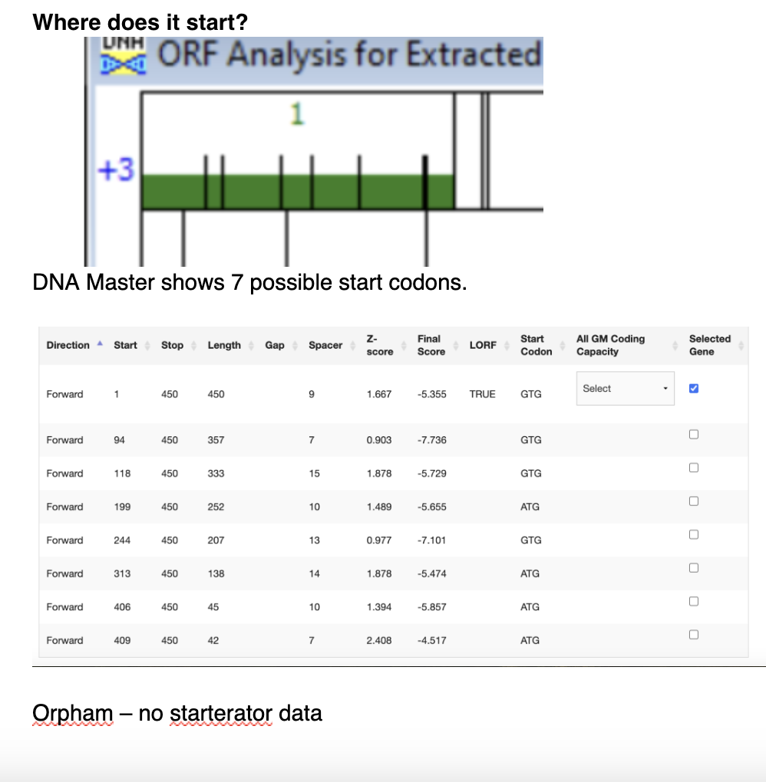
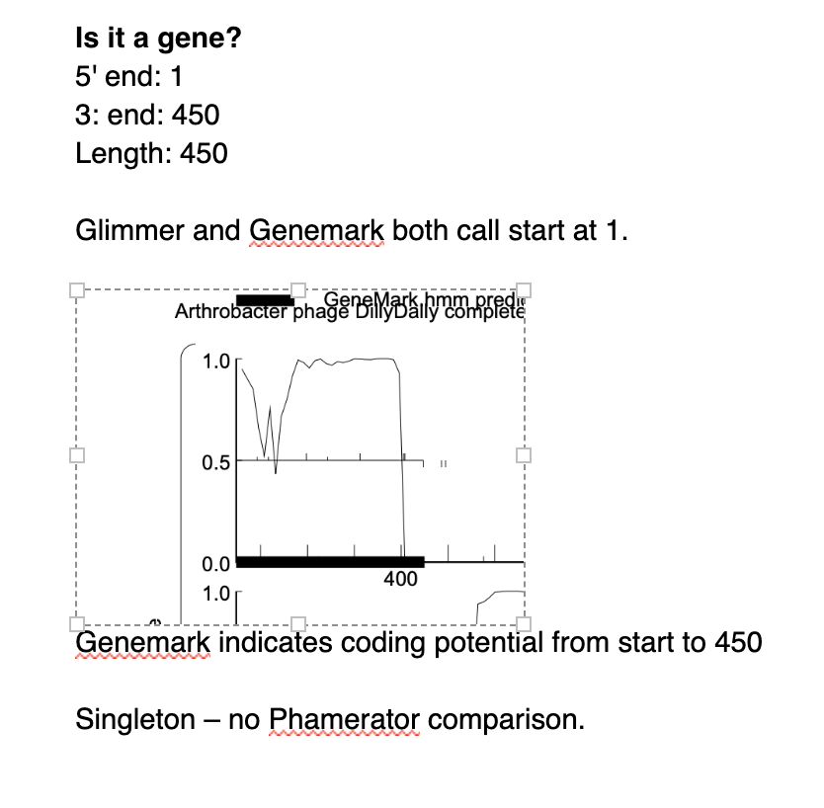
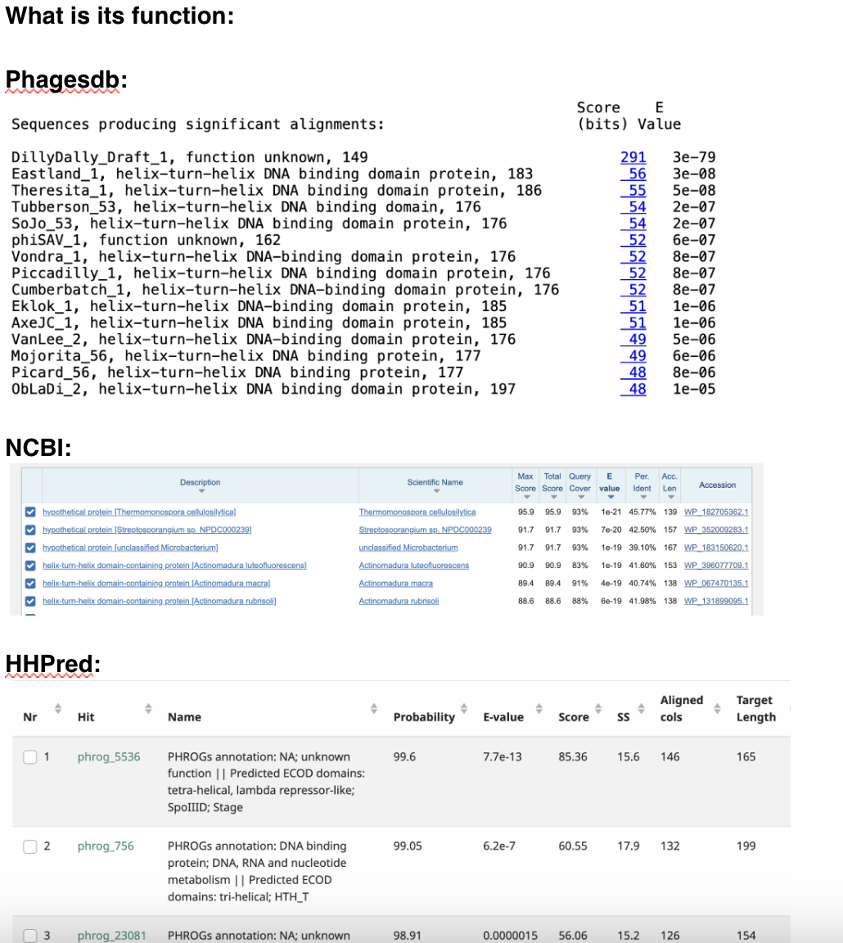
DillyDally Gene 1 – helix-turn-helix DNA binding protein

Slide 2
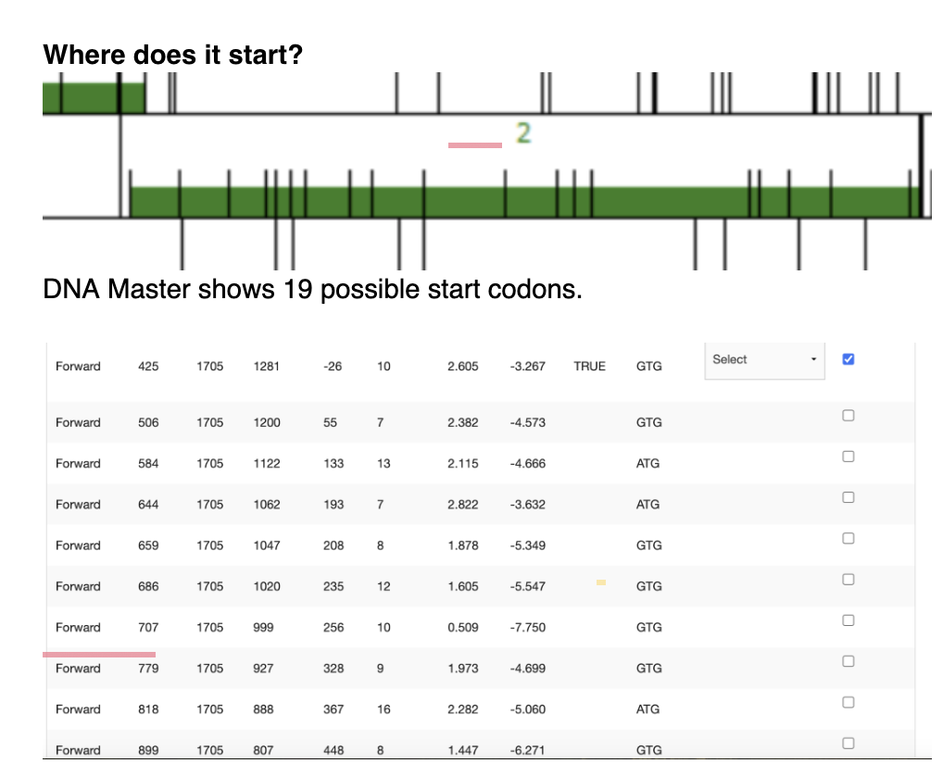
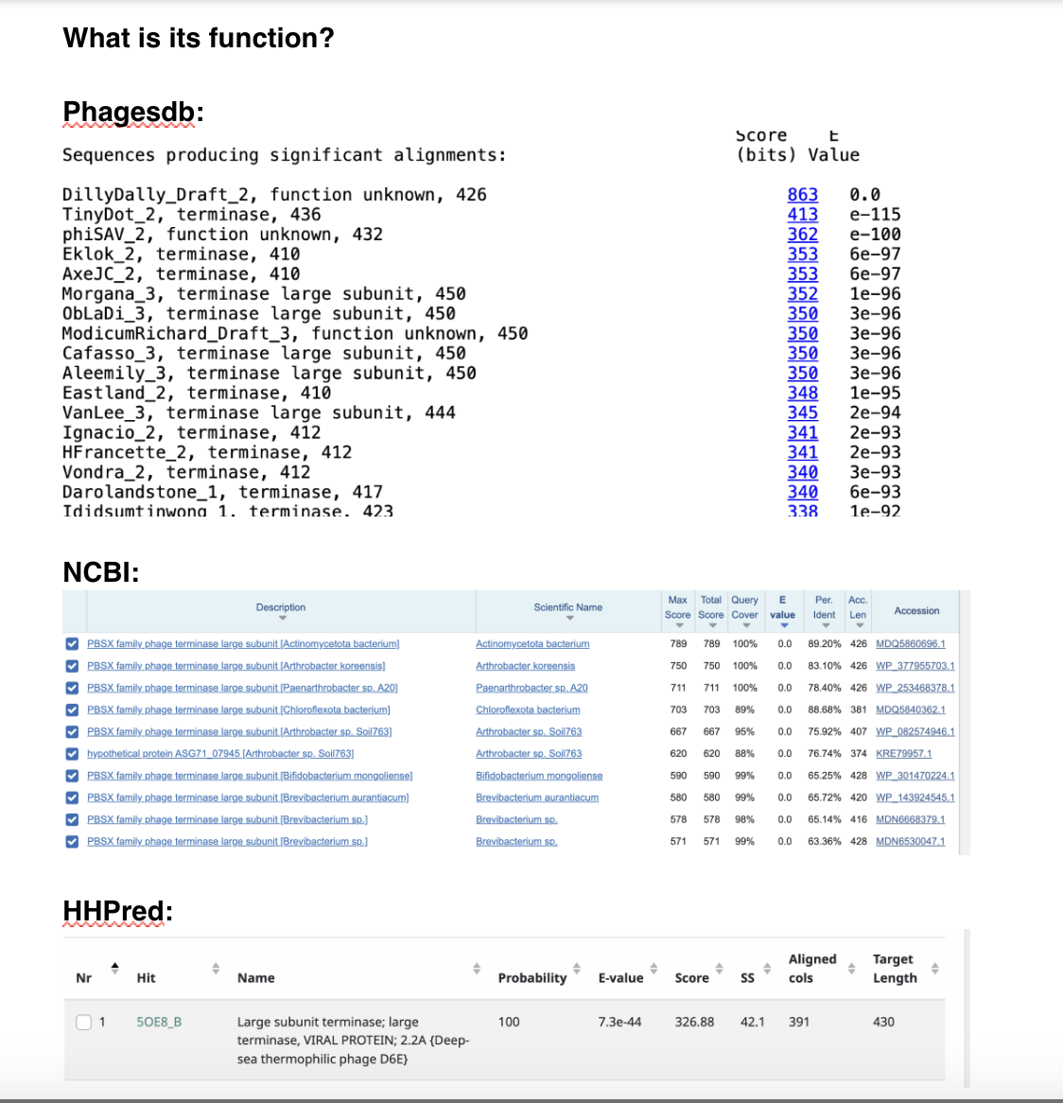
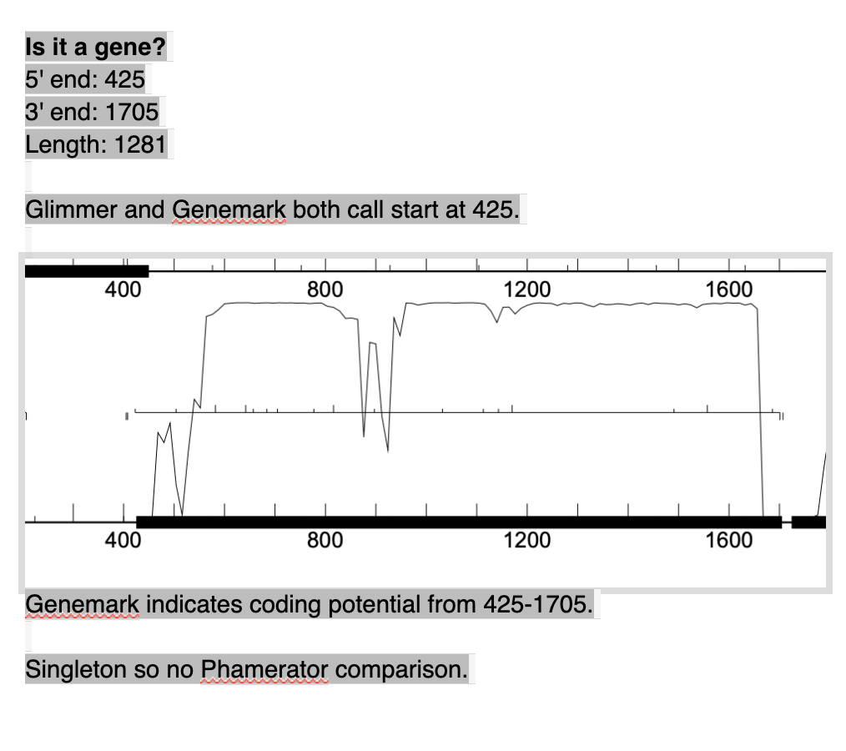
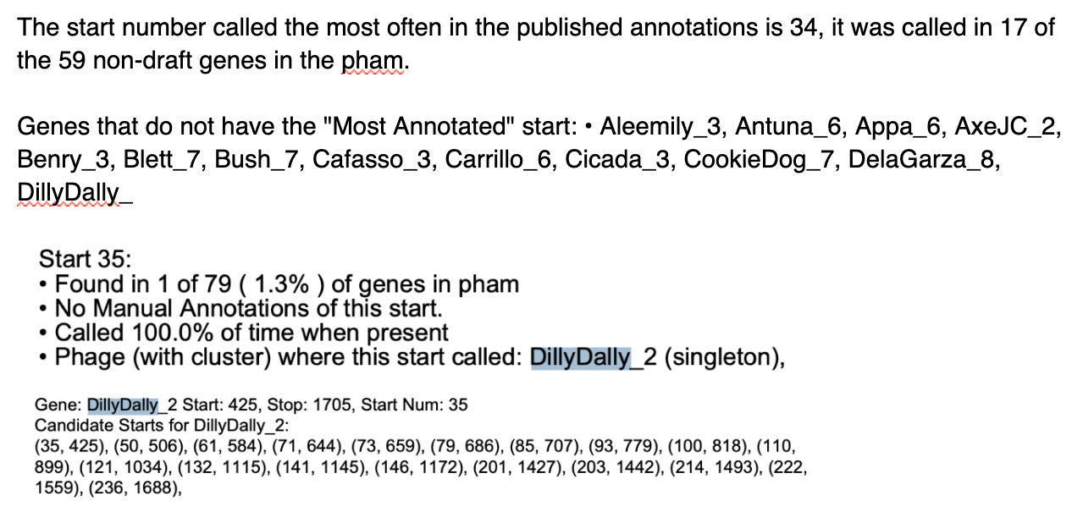
DillyDally Gene 2 – terminase, large subunit

Slide 3
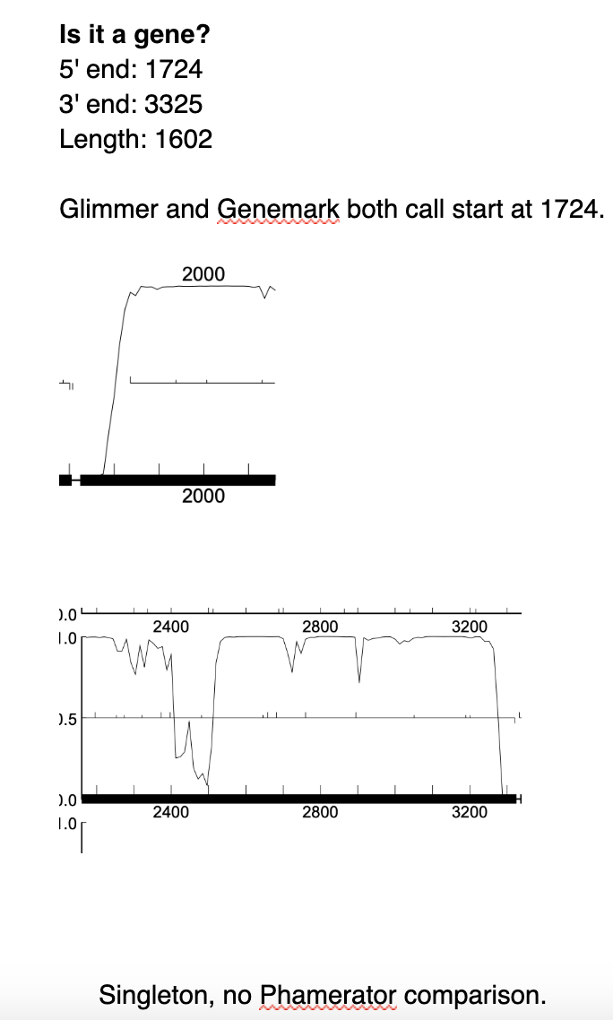
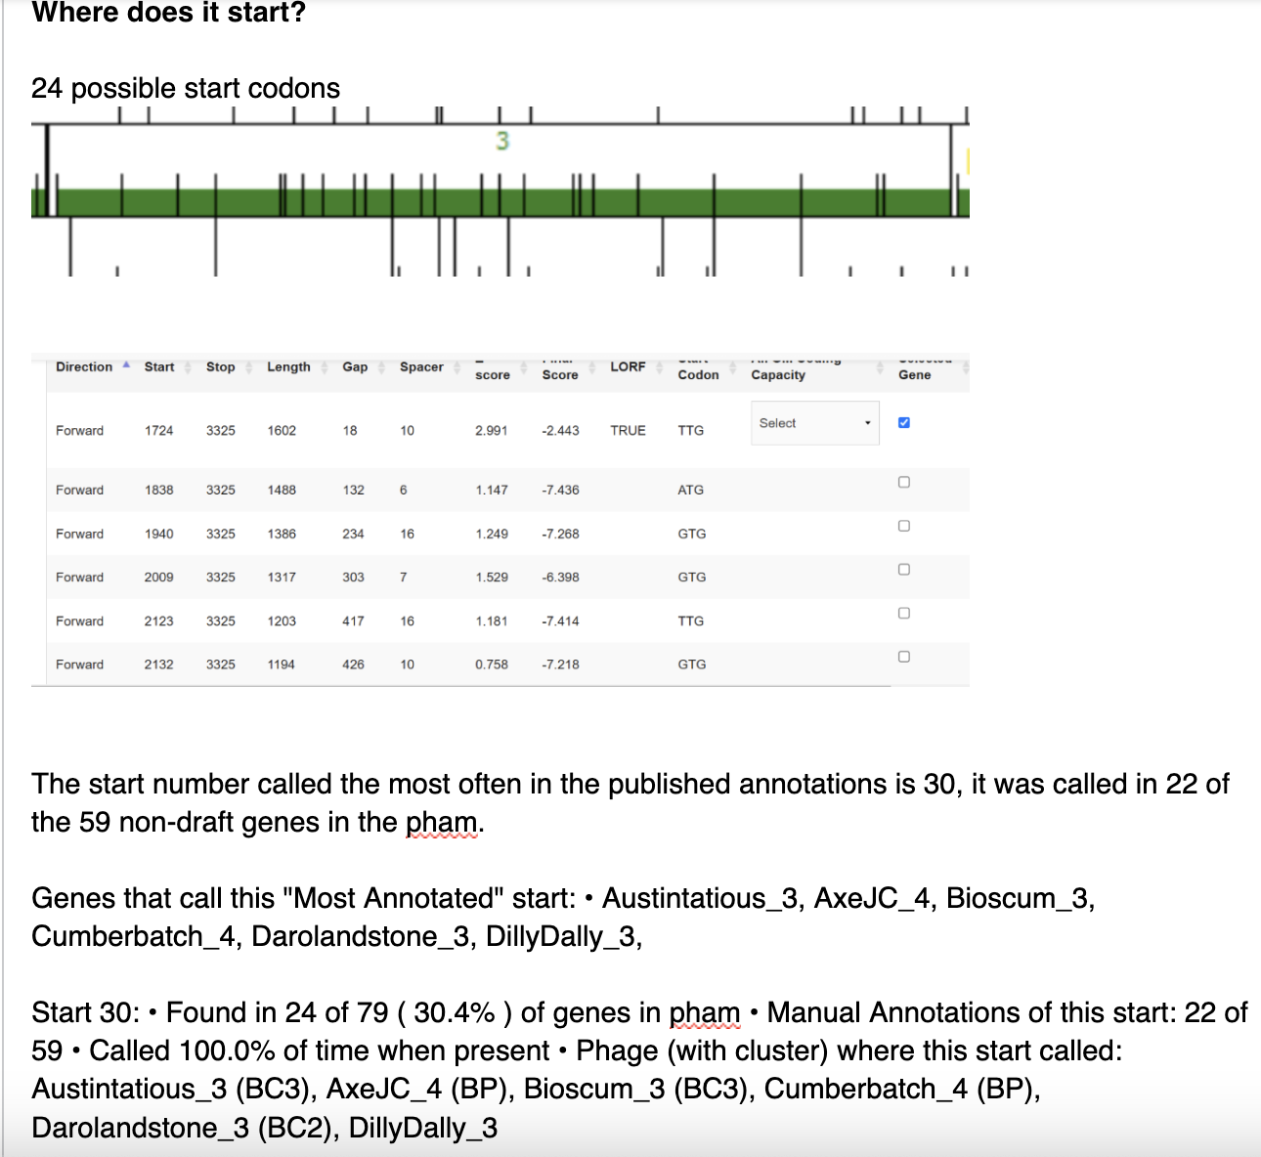
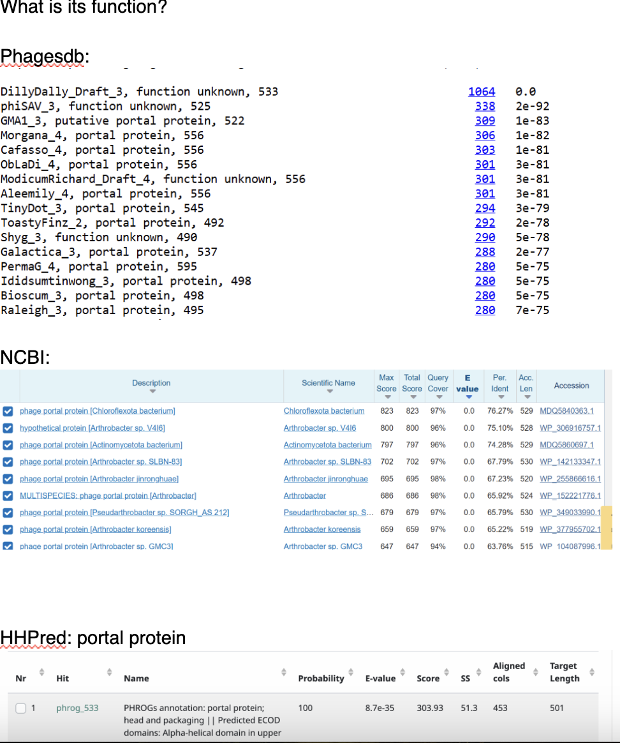
DillyDally Gene 3 – portal protein

Slide 4
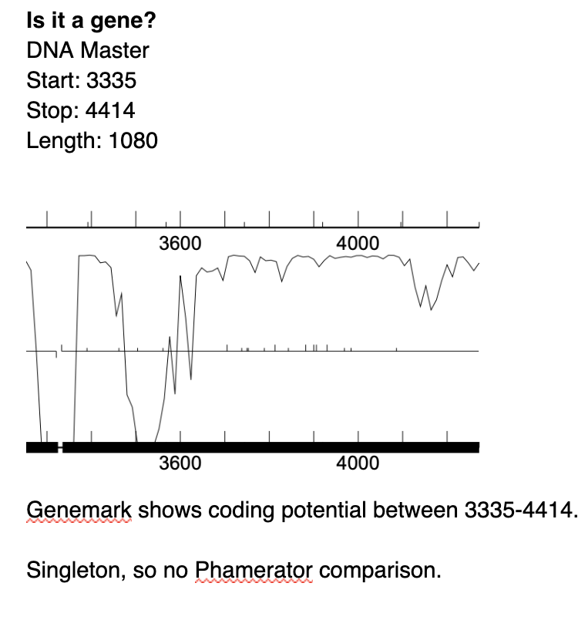
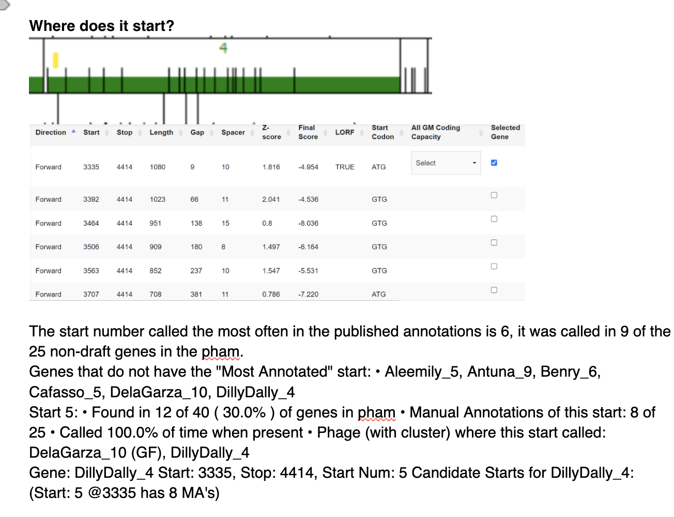
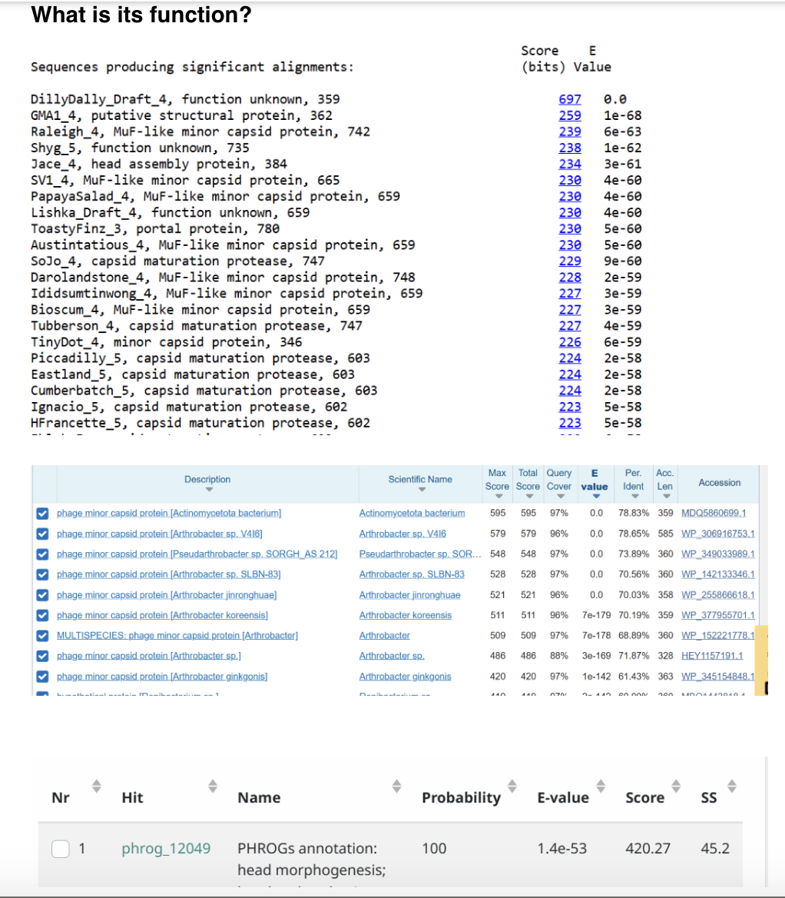
DillyDally Gene 4 – minor capsid protein

Slide 5
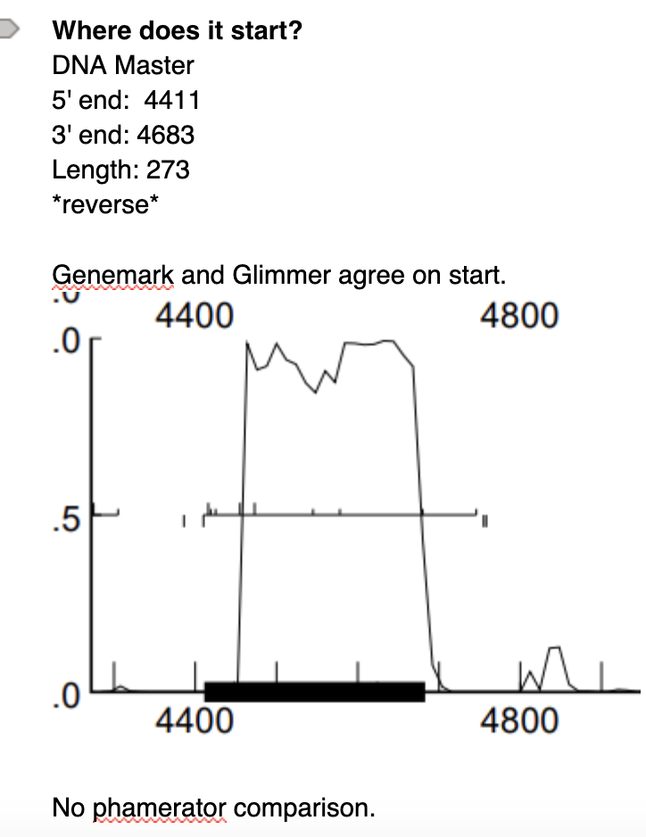
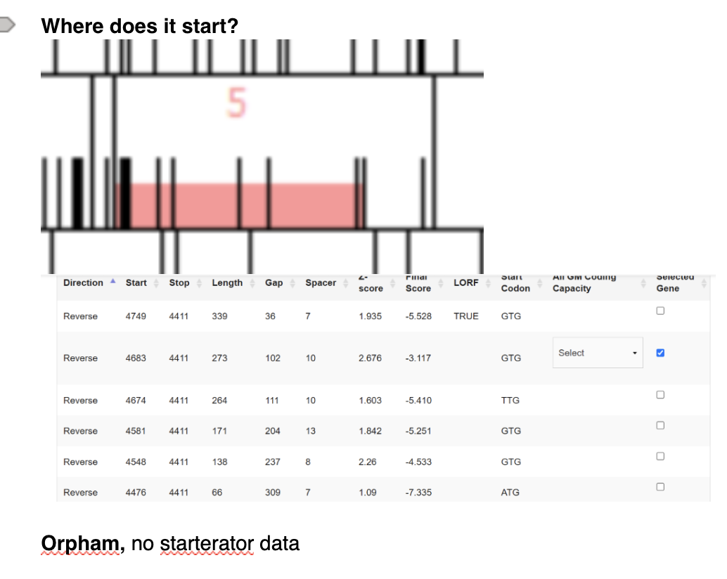
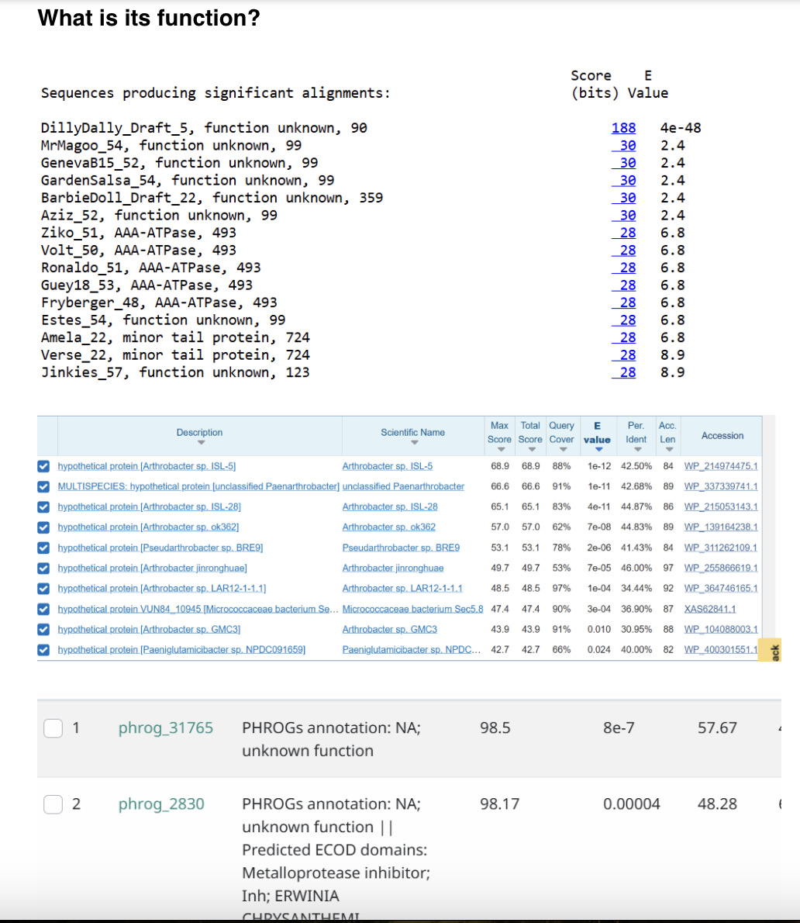
DillyDally Gene 5 – hypothetical protein

Slide 6
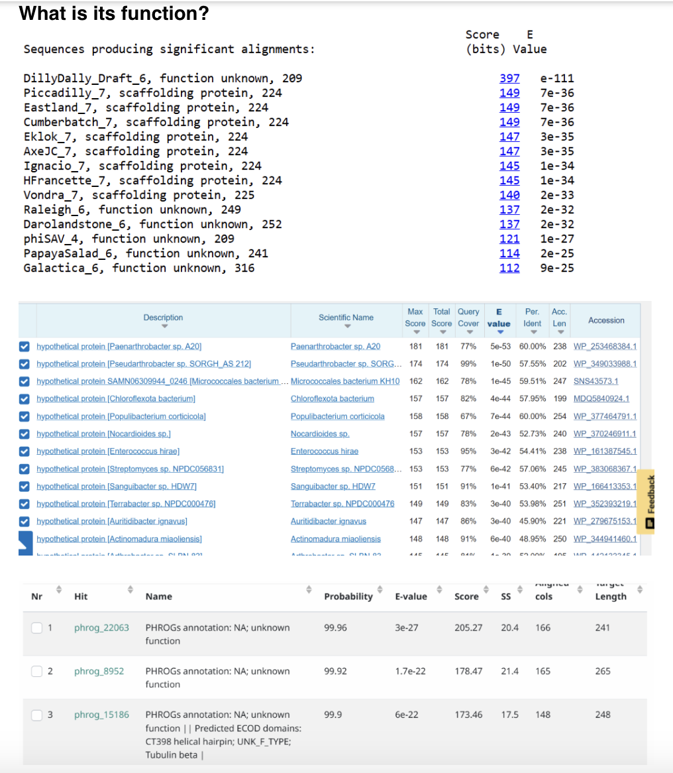
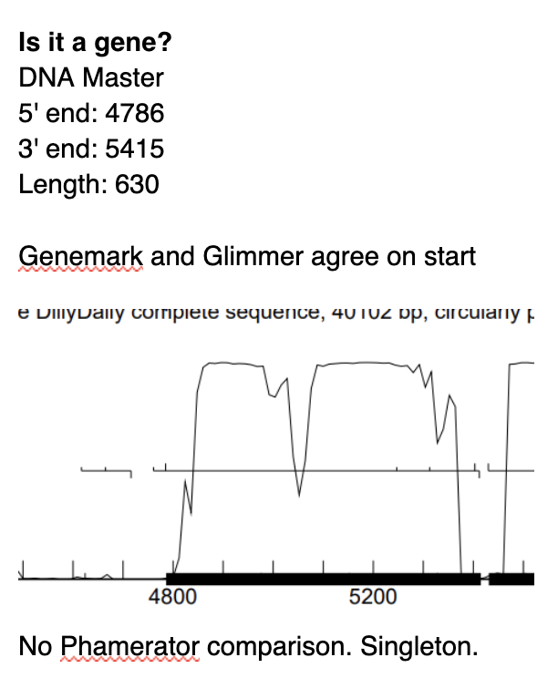
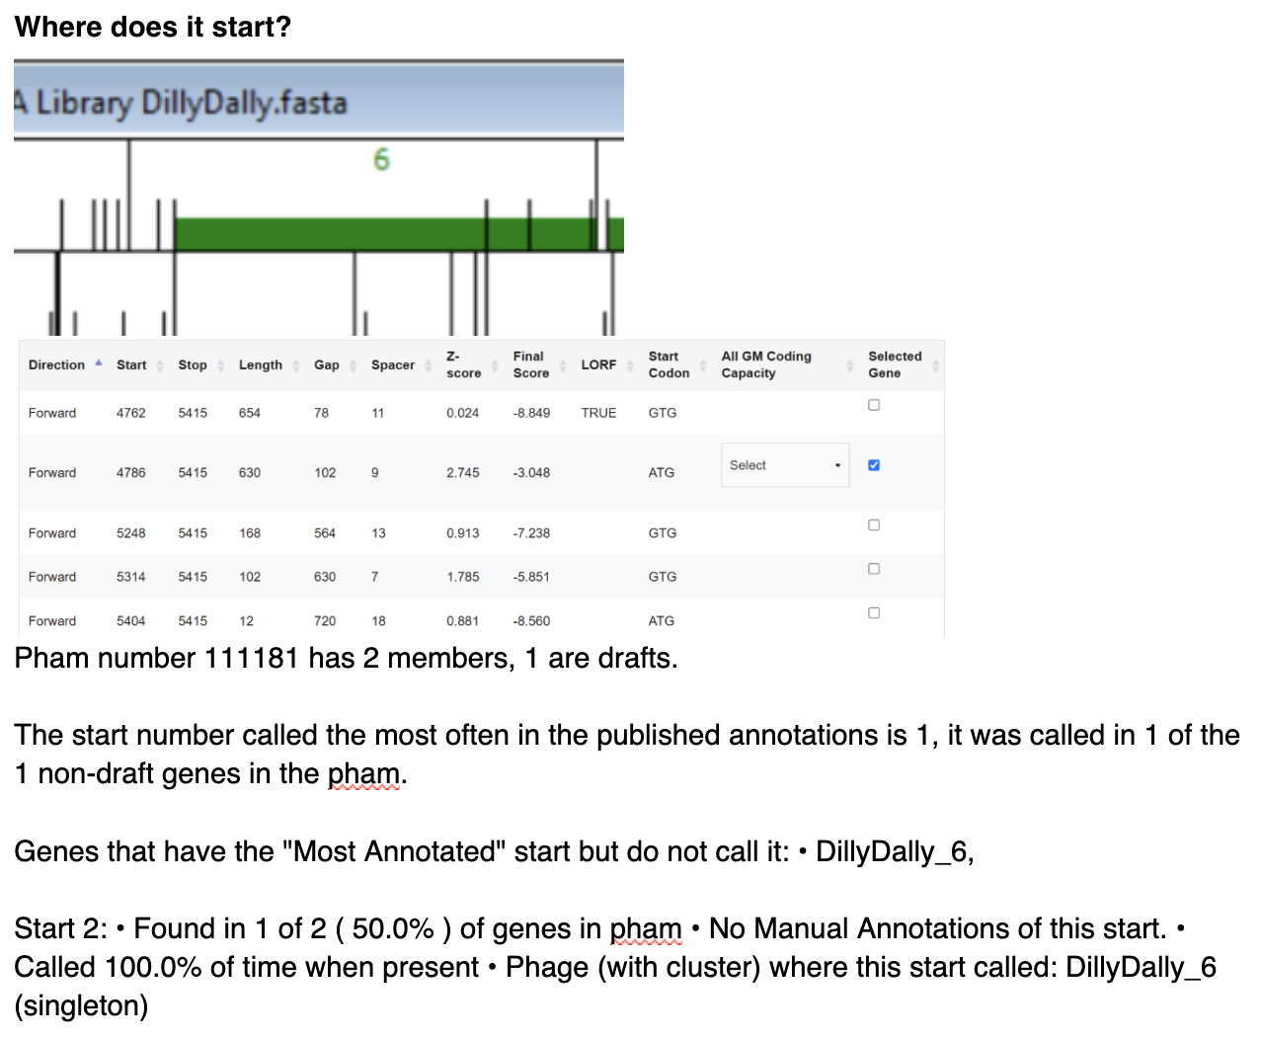
DillyDally Gene 6 – scaffolding protein

Slide 7
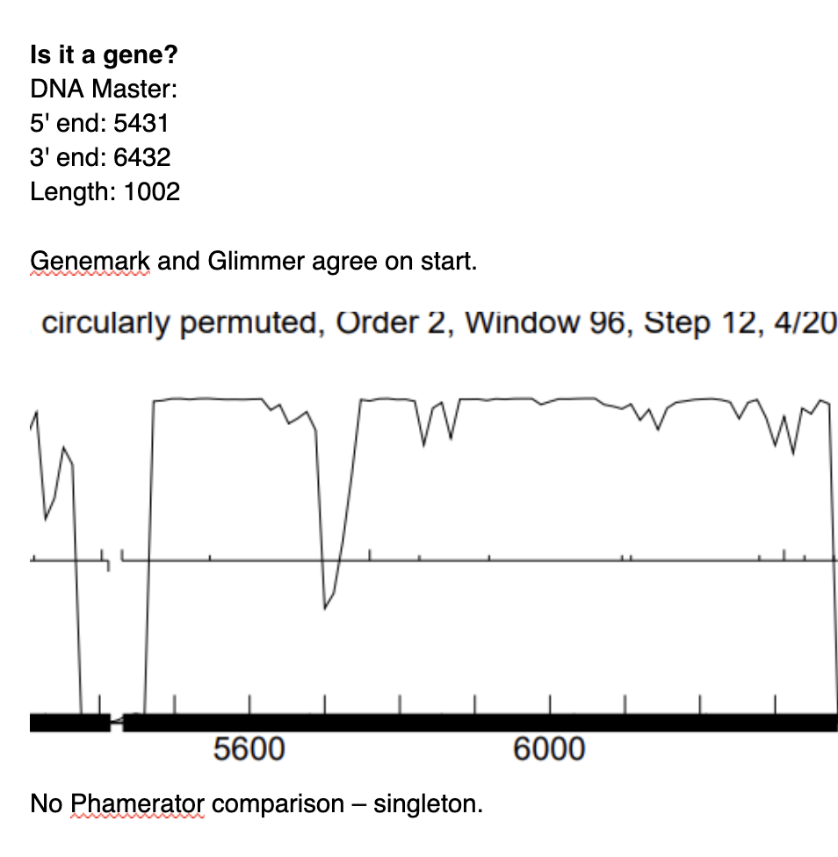
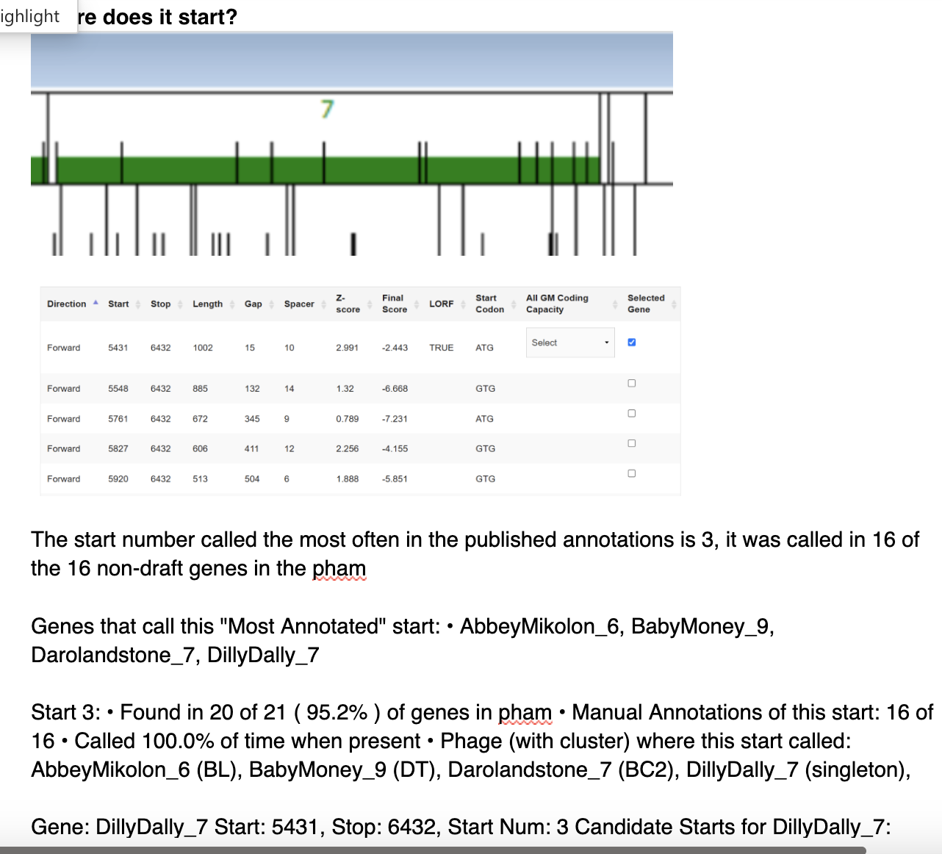
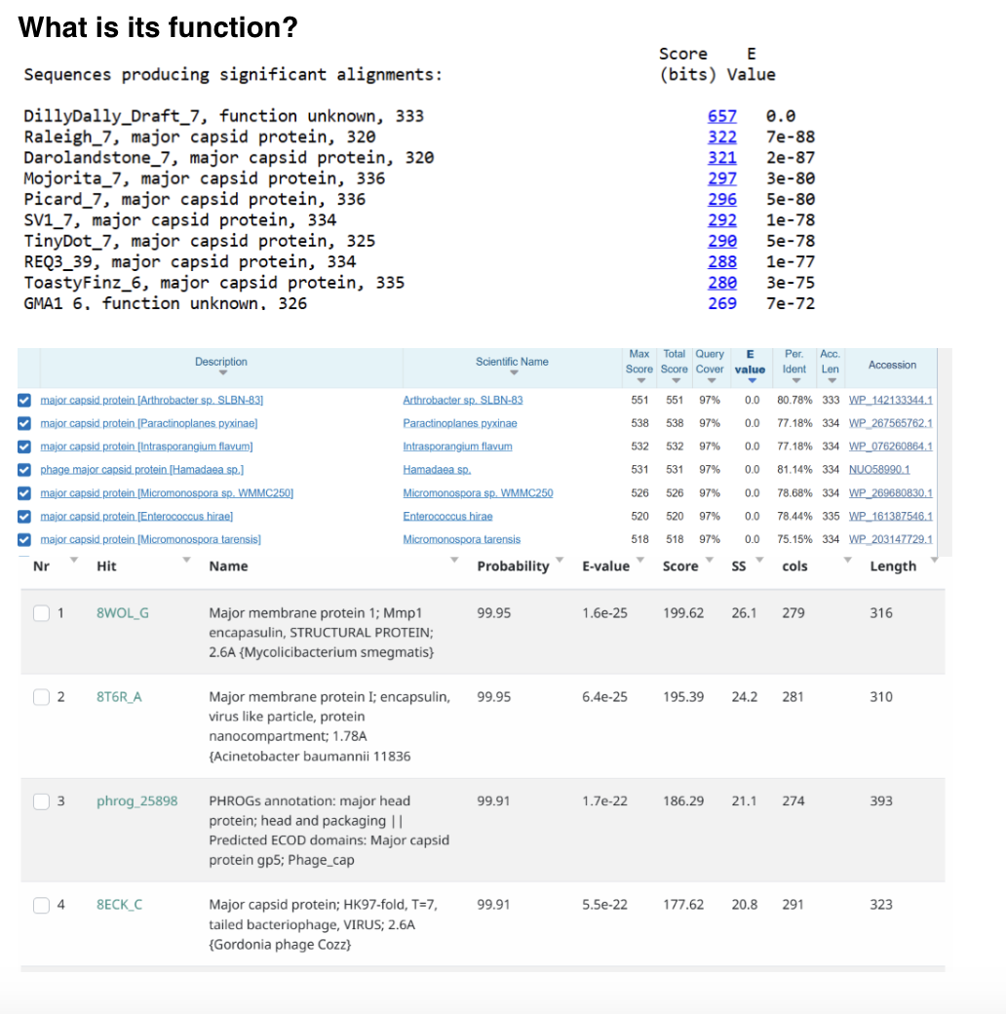
DillyDally Gene 7 – major capsid protein

Slide 8
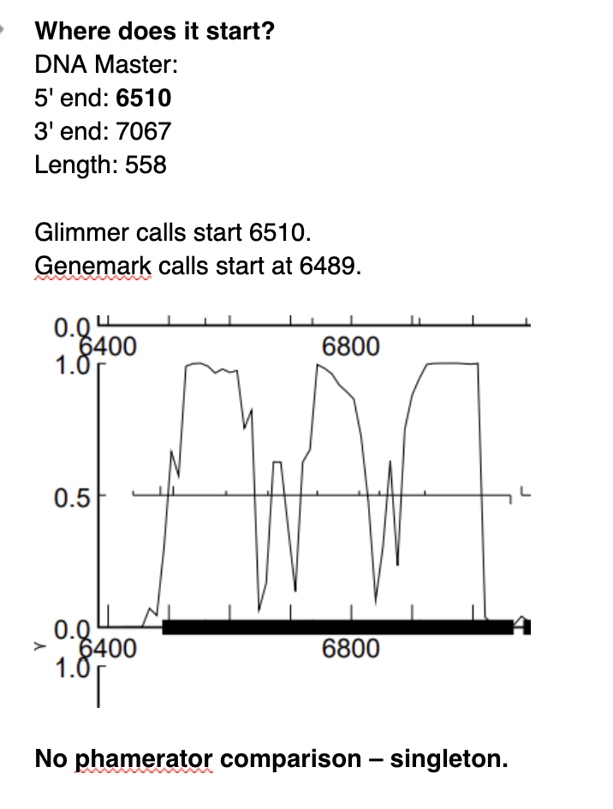
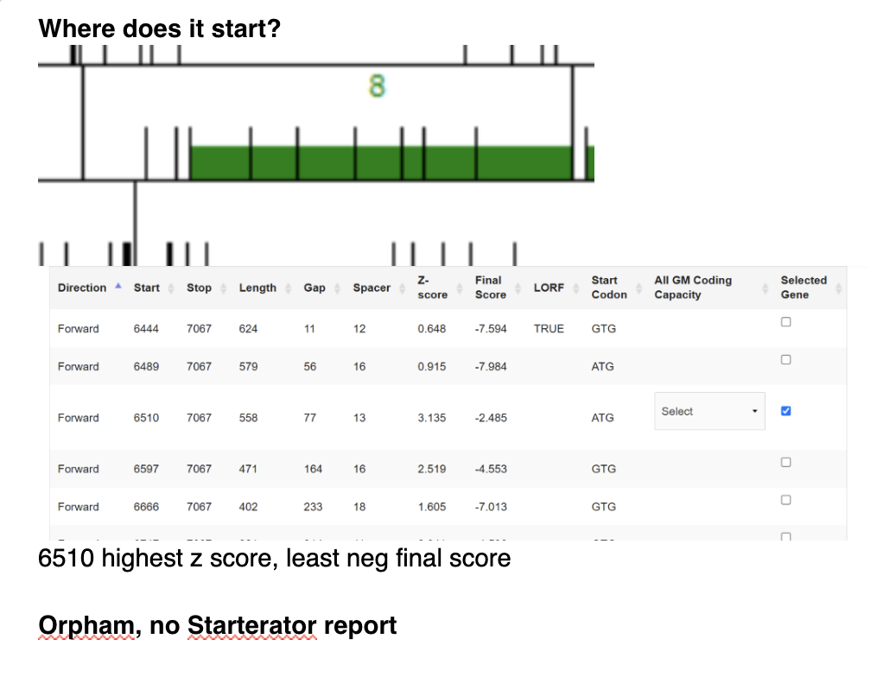
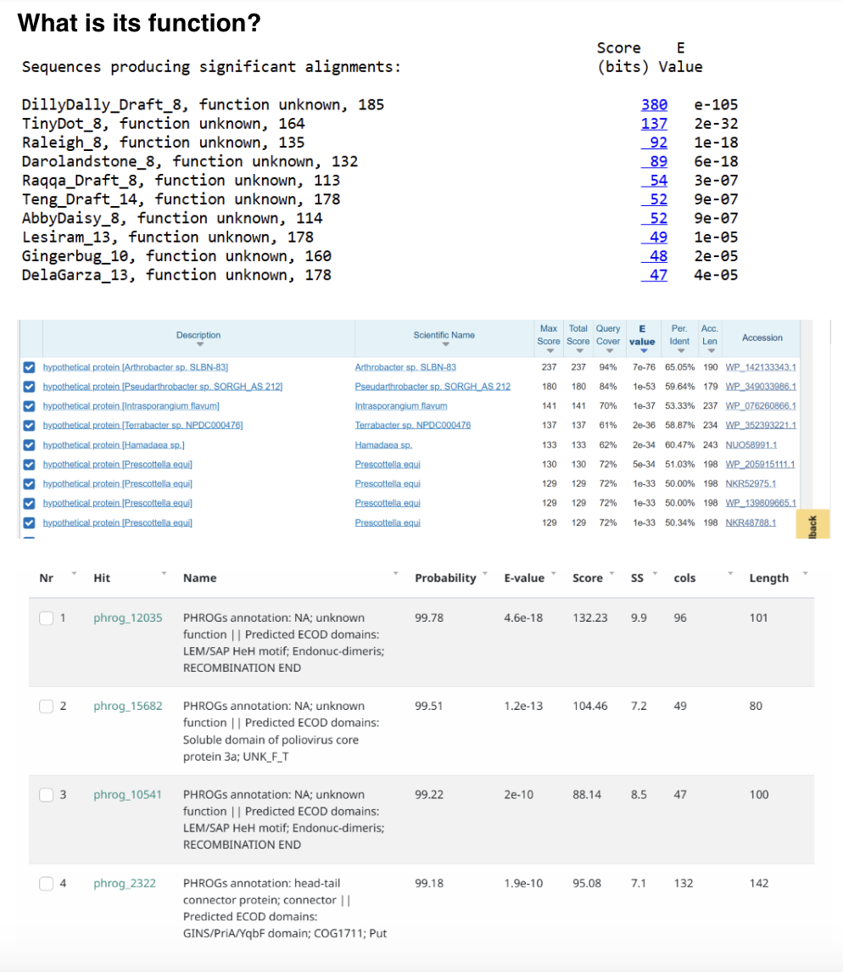
DillyDally Gene 8 – hypothetical protein

Slide 9
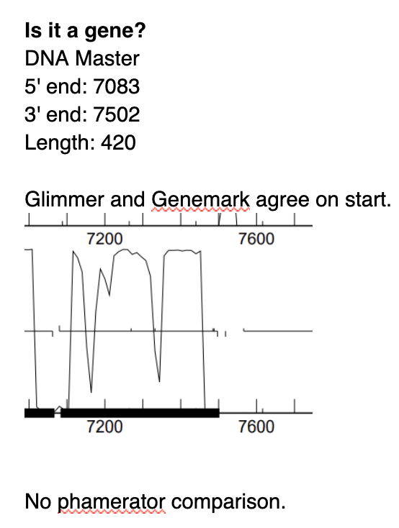
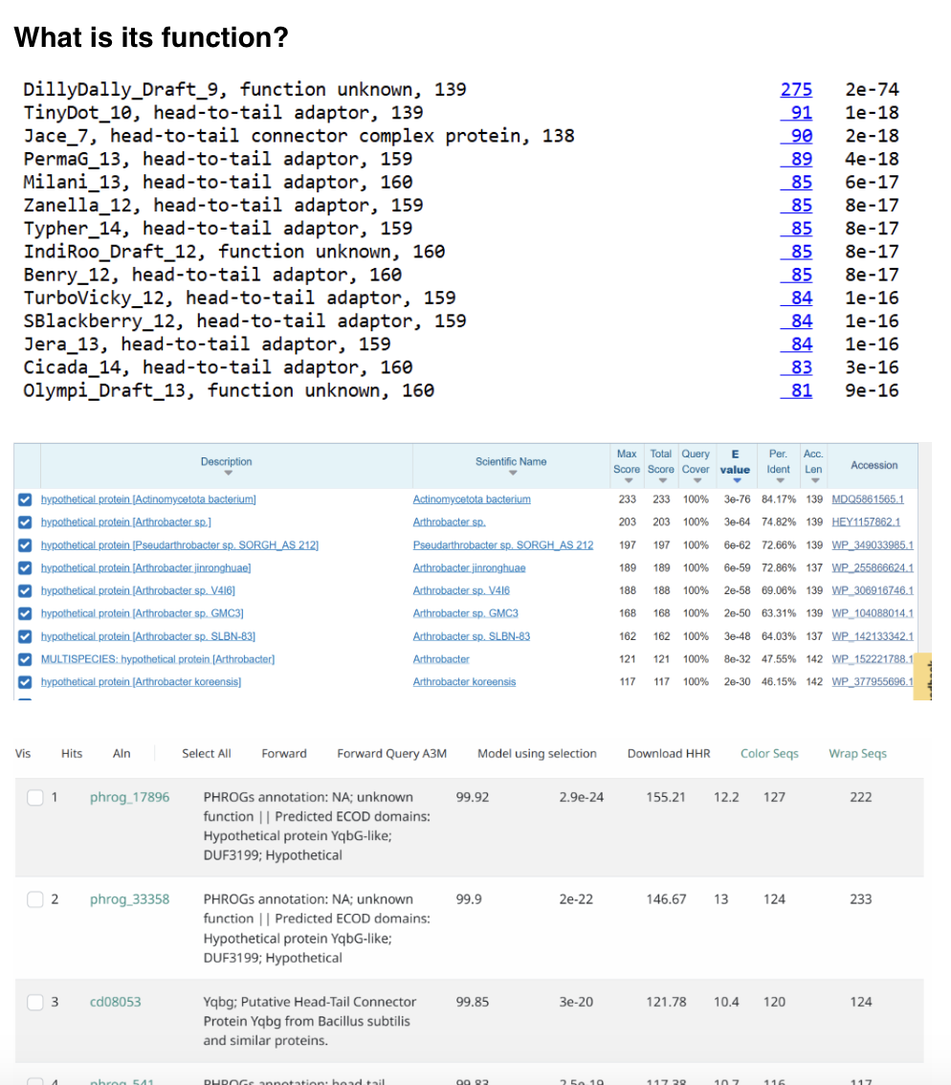
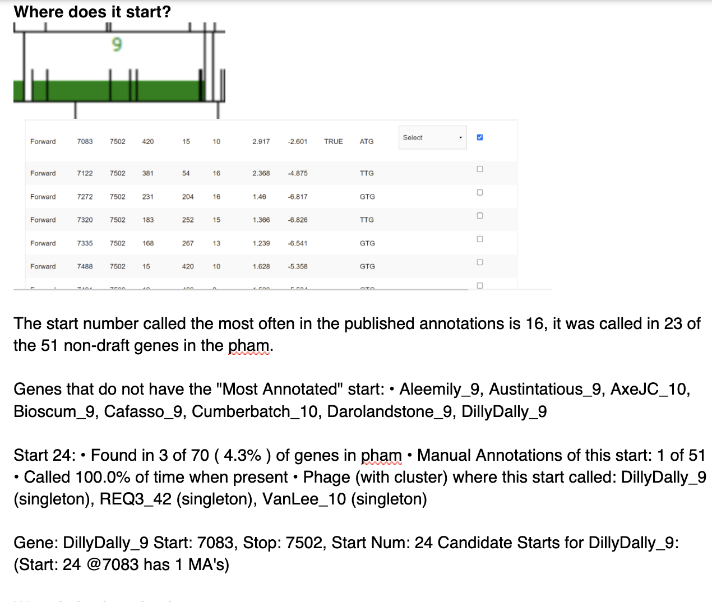
DillyDally Gene 9 – head-to-tail adaptor

Slide 10
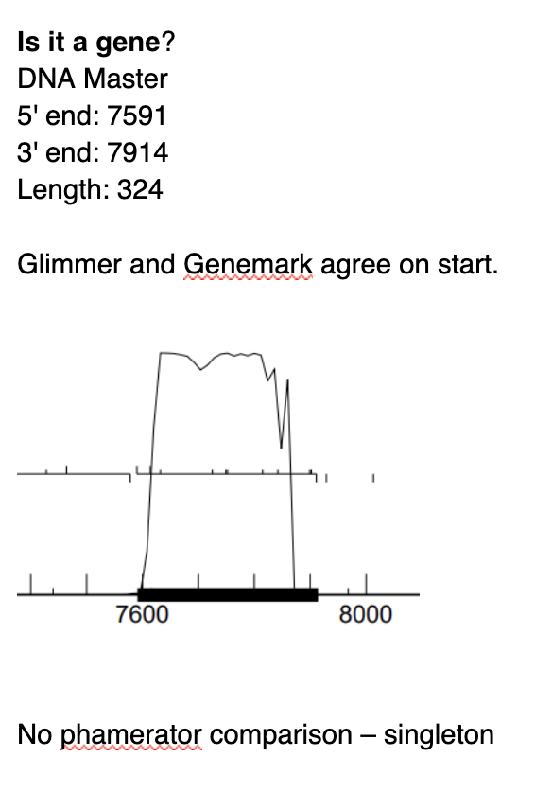
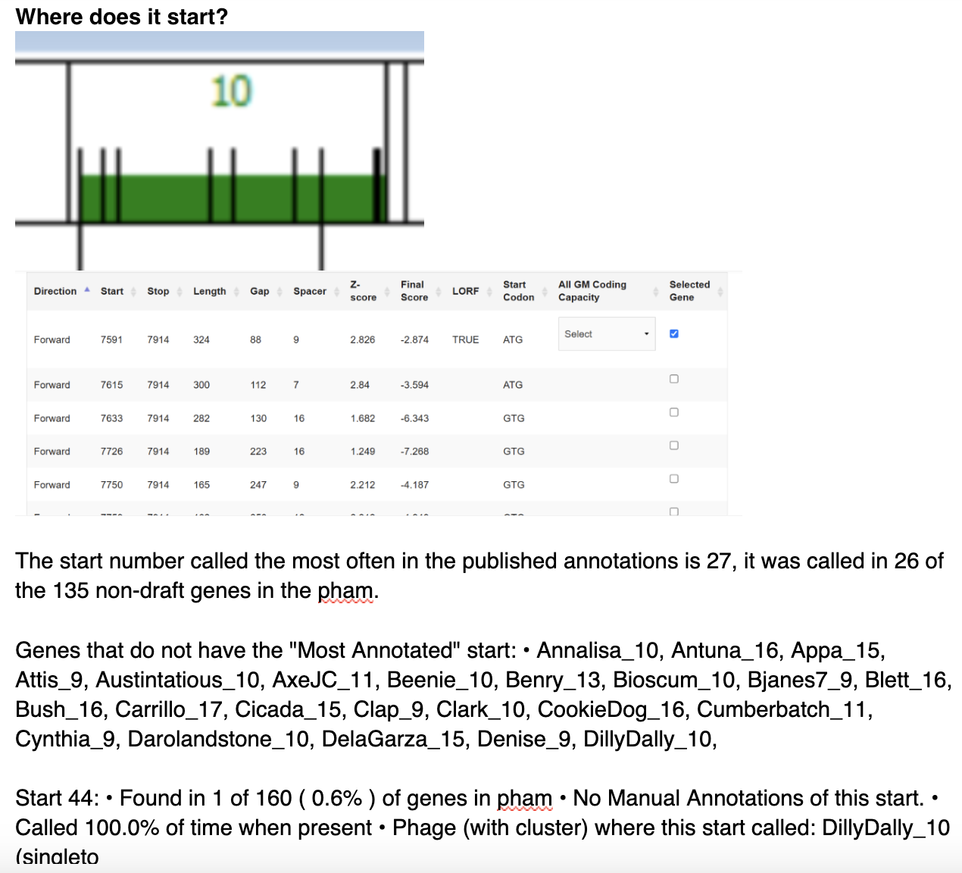
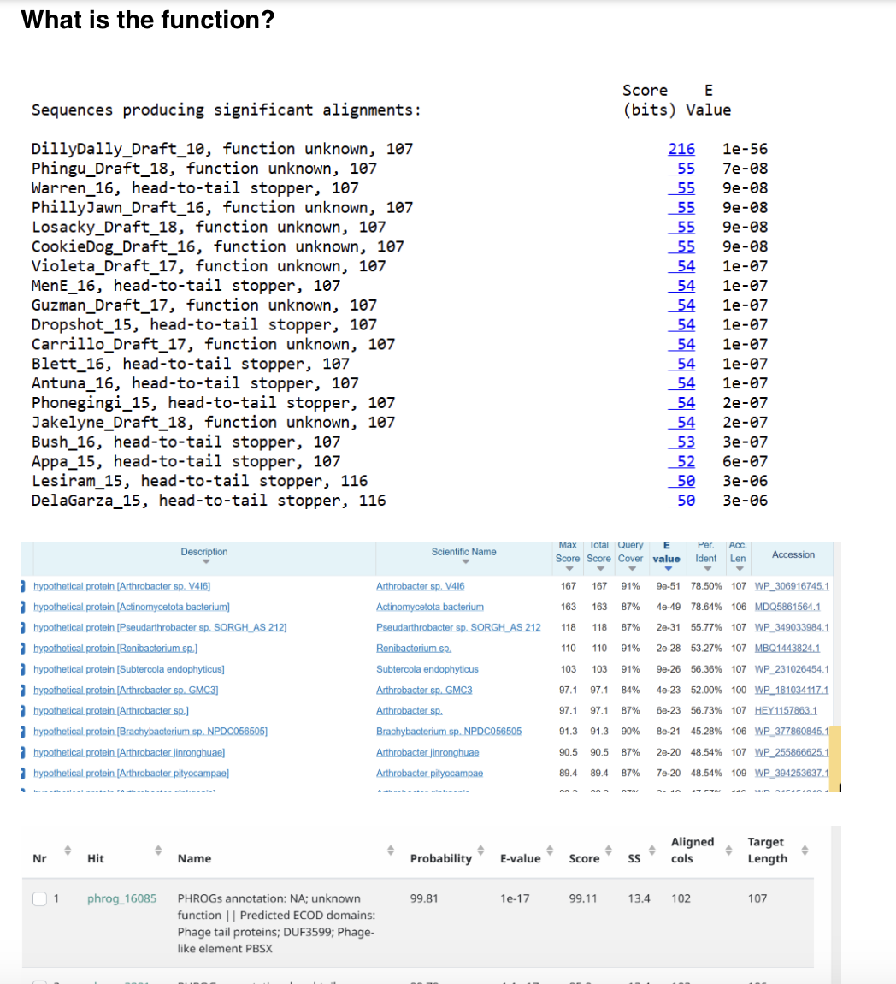
DillyDally Gene 10 – head-to-tail stopper

Slide 11
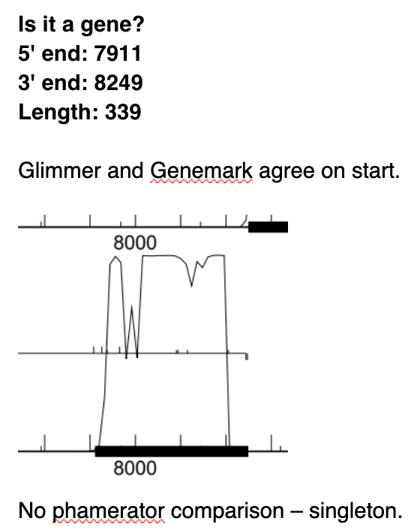
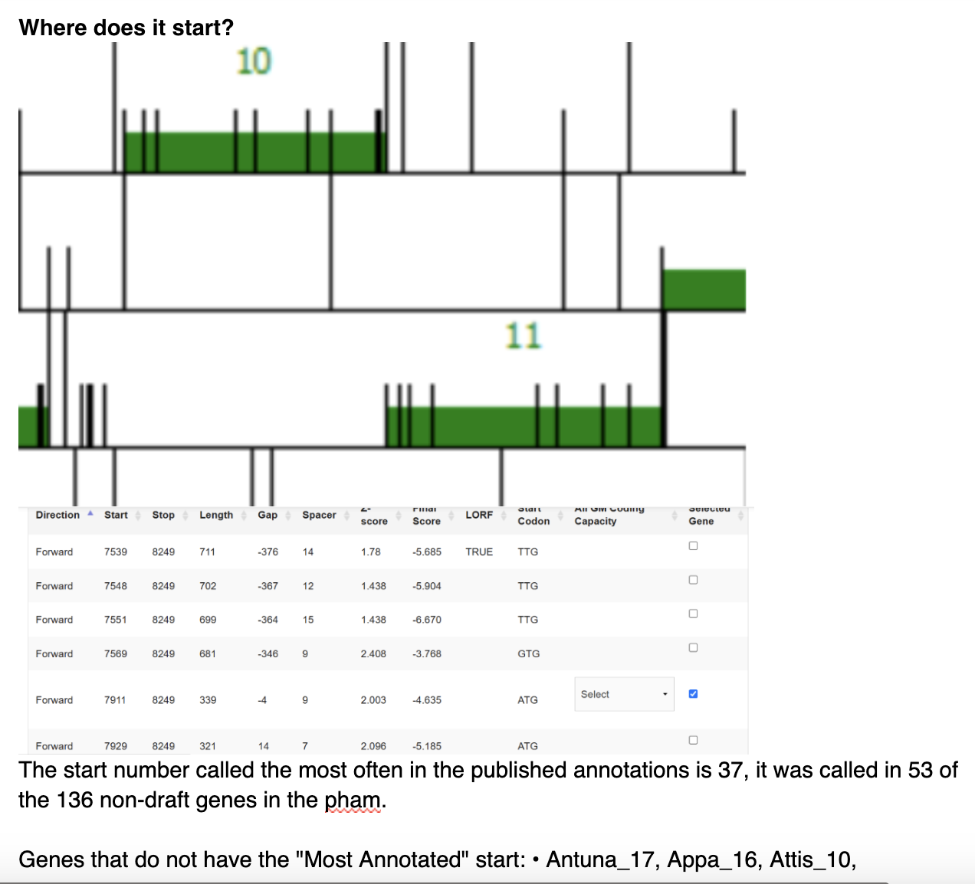
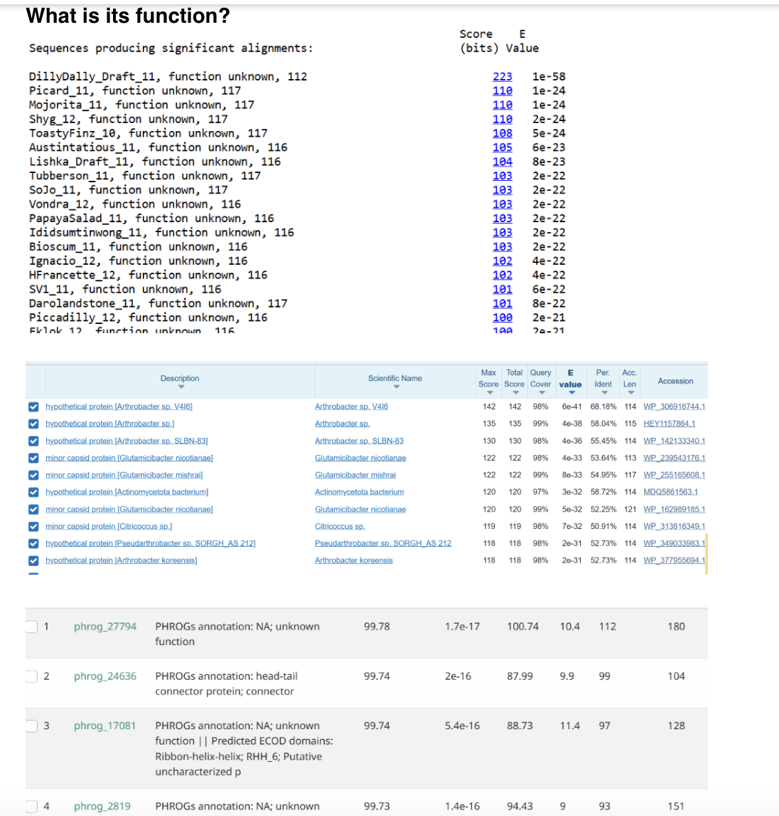
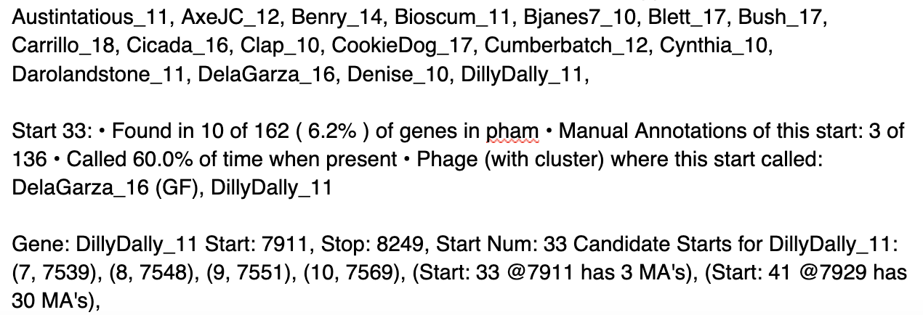
DillyDally Gene 11 – hypothetical protein

Slide 12
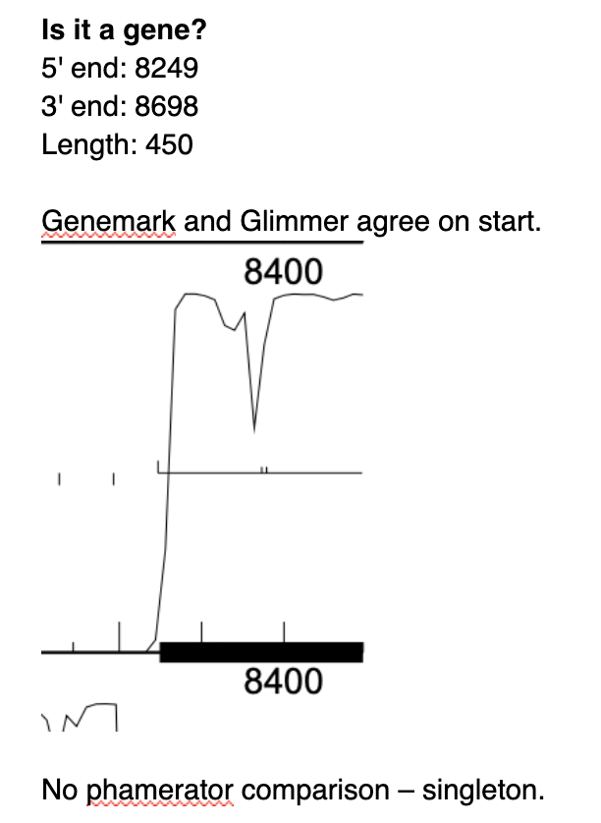
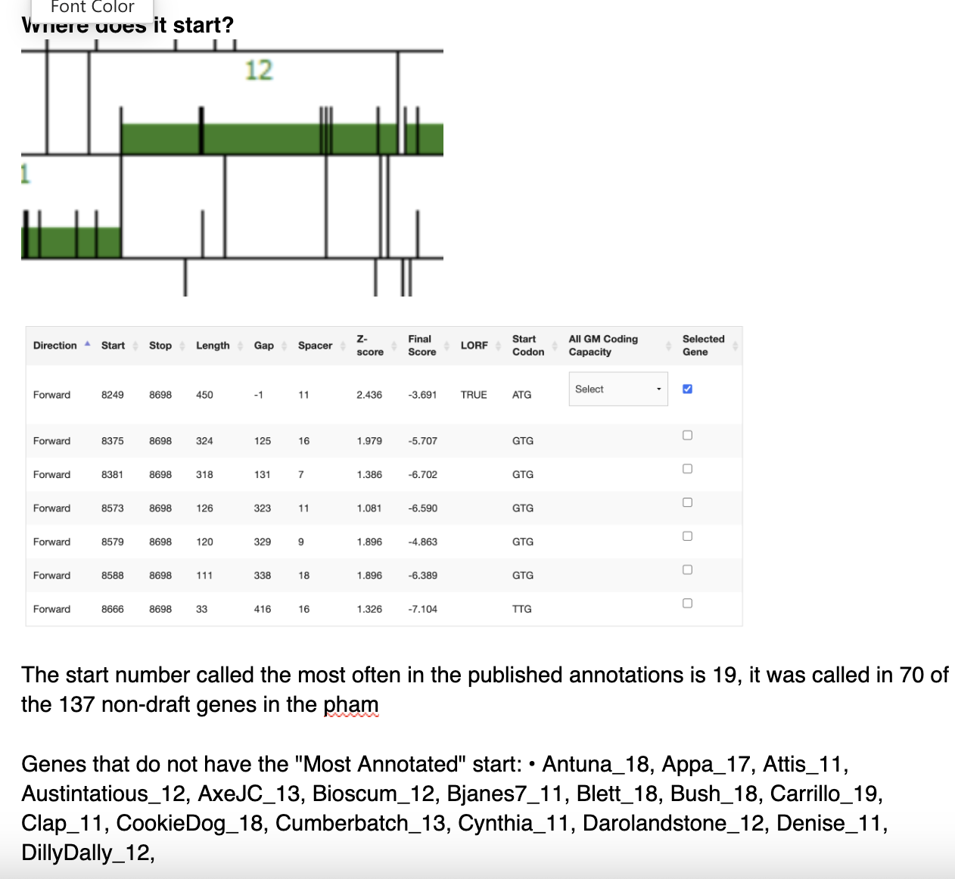
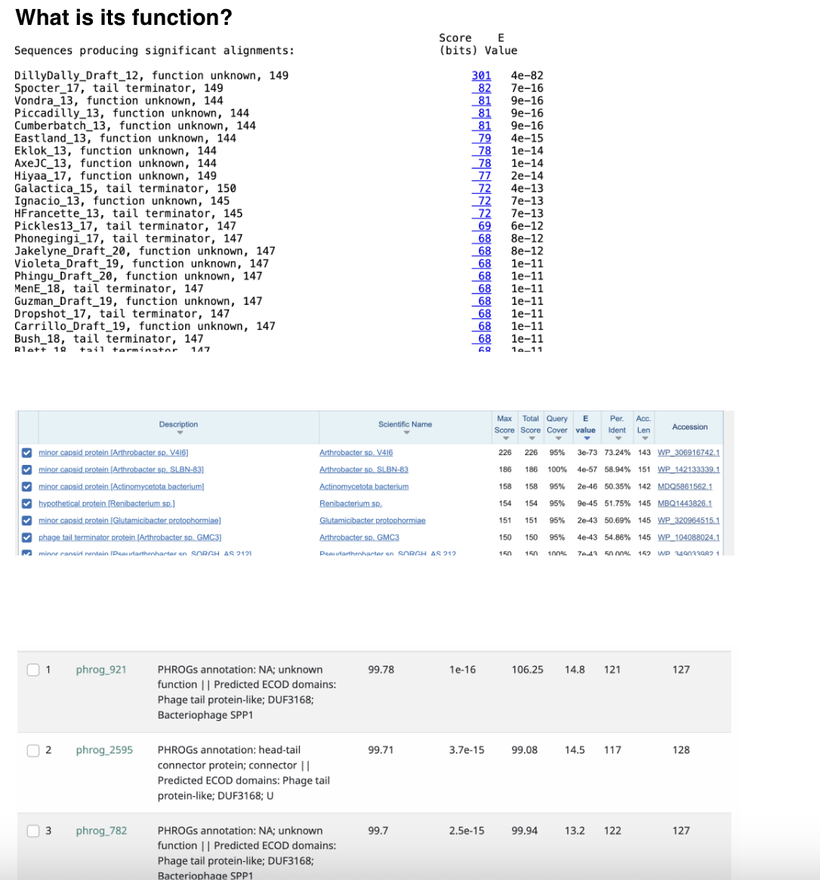
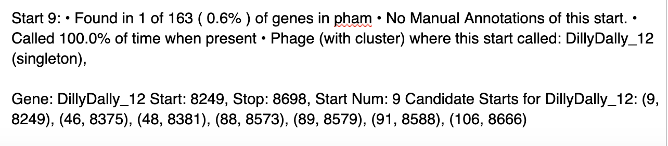
DillyDally Gene 12 – tail terminator

Slide 13
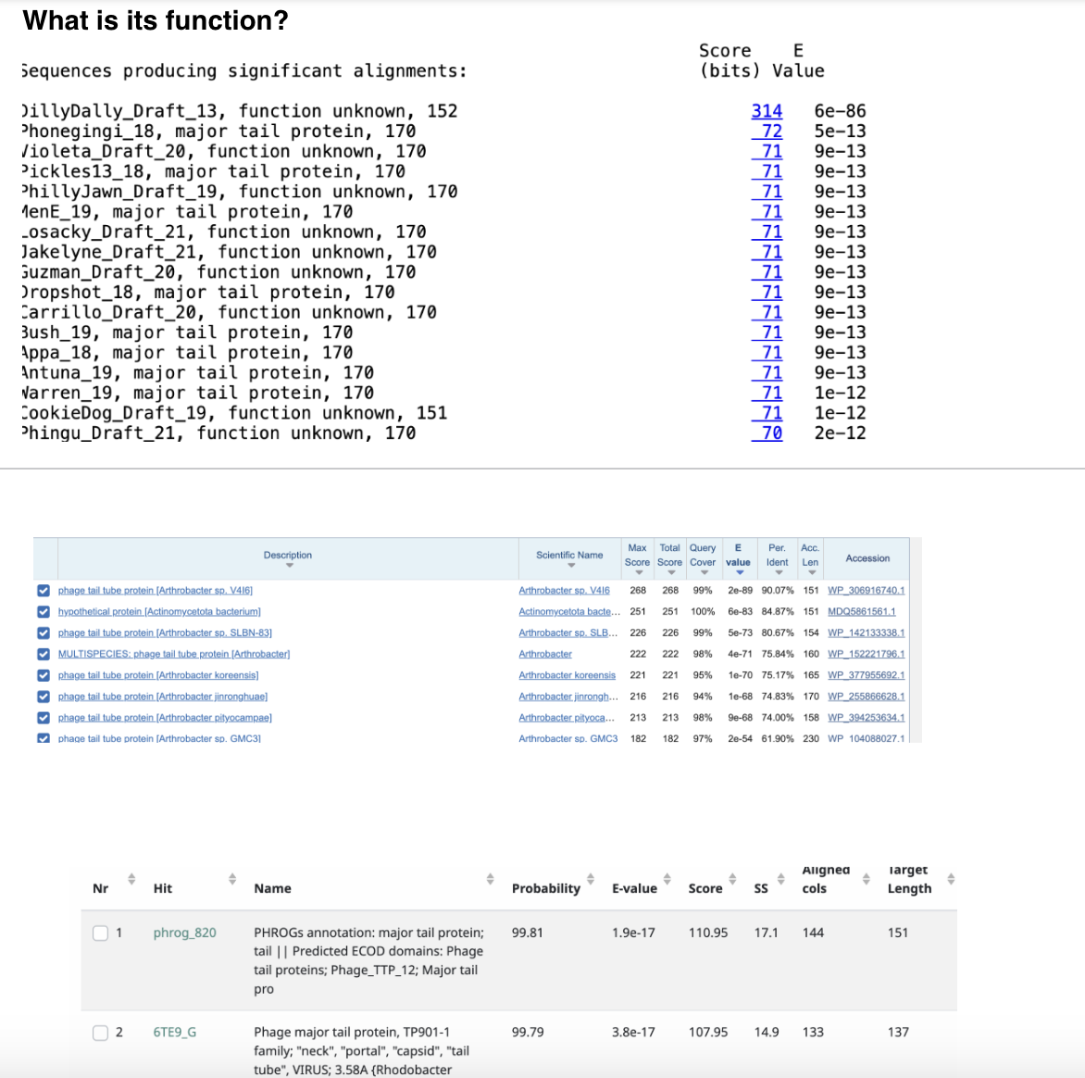
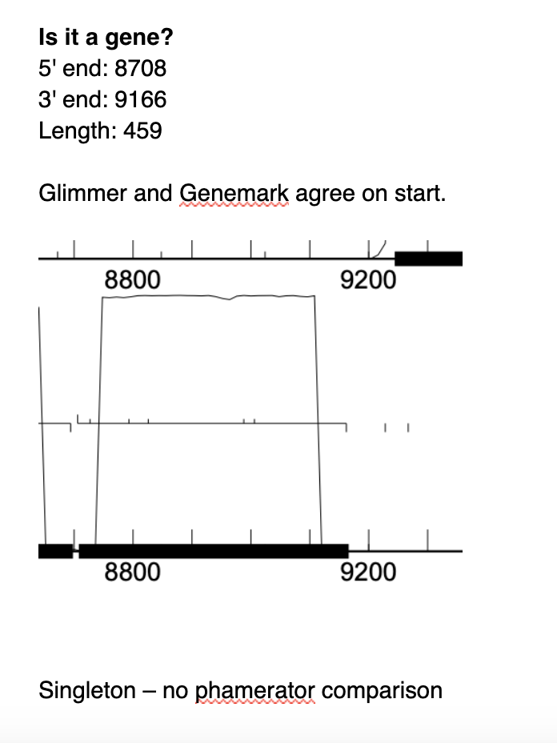
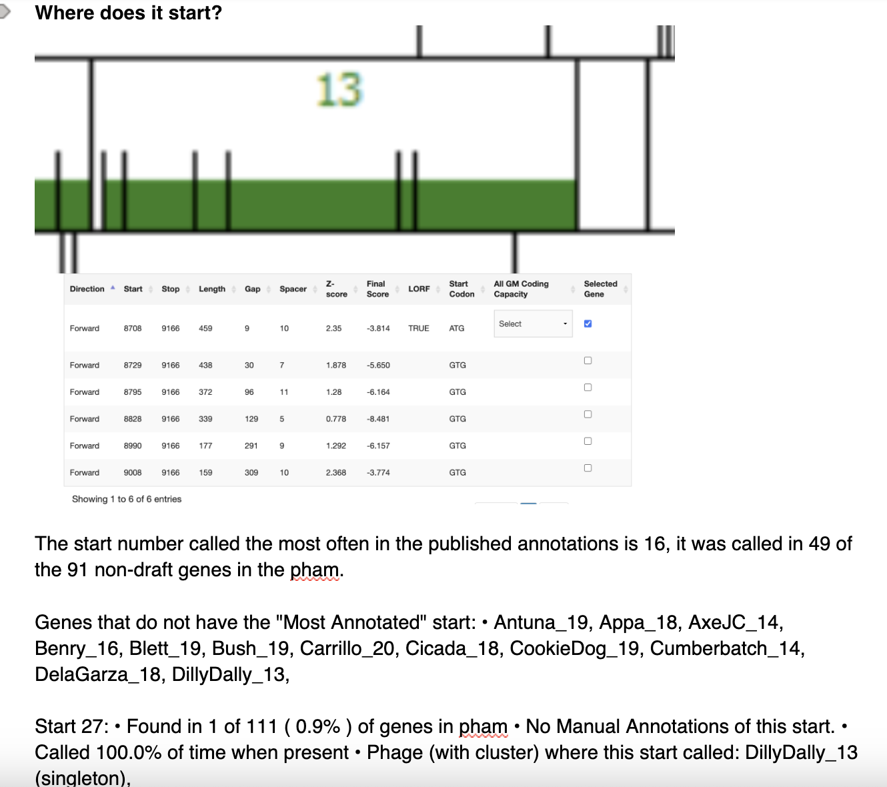
DillyDally Gene 13 – major tail protein

Slide 14
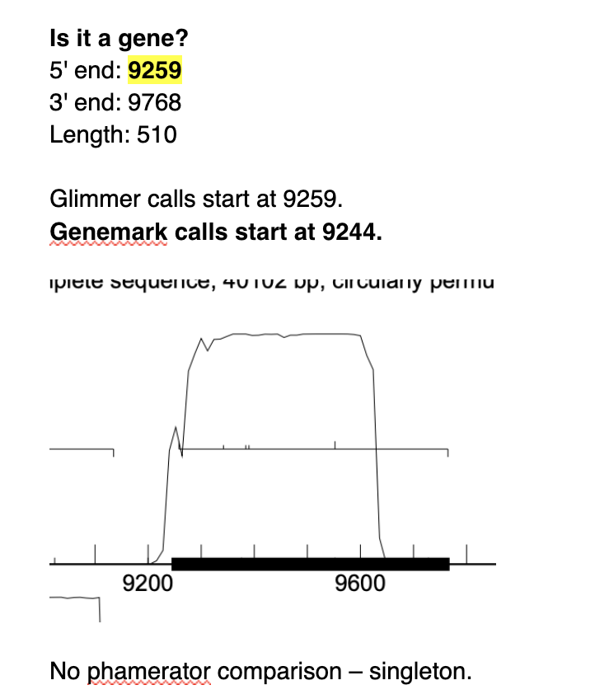
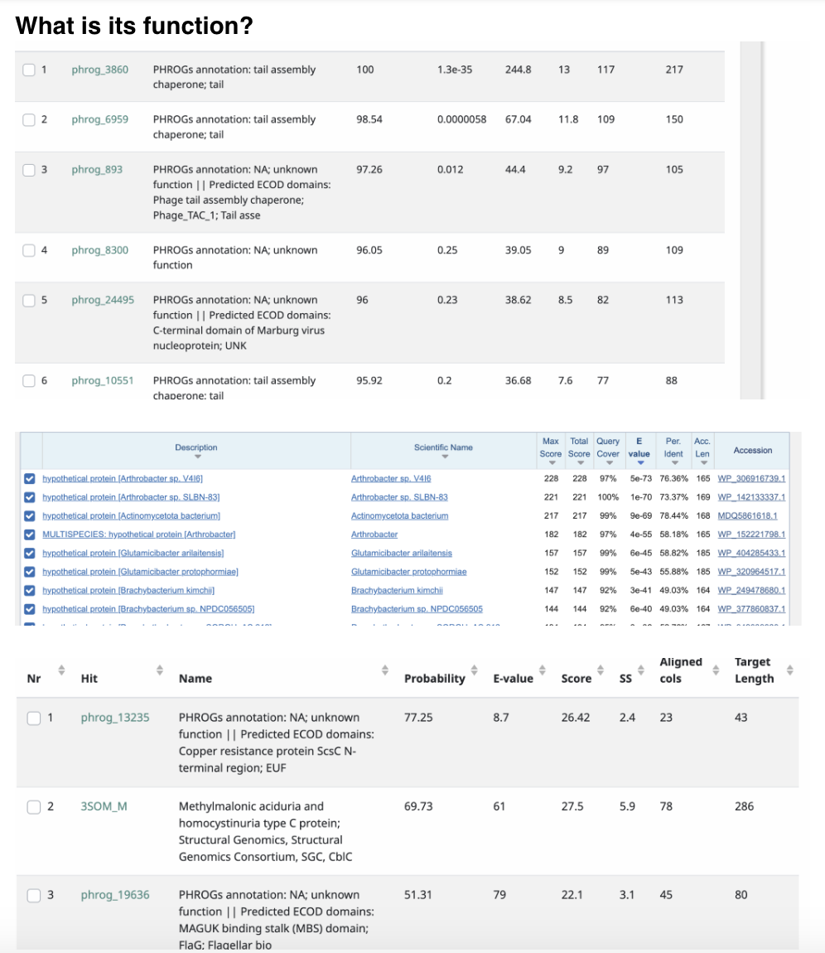
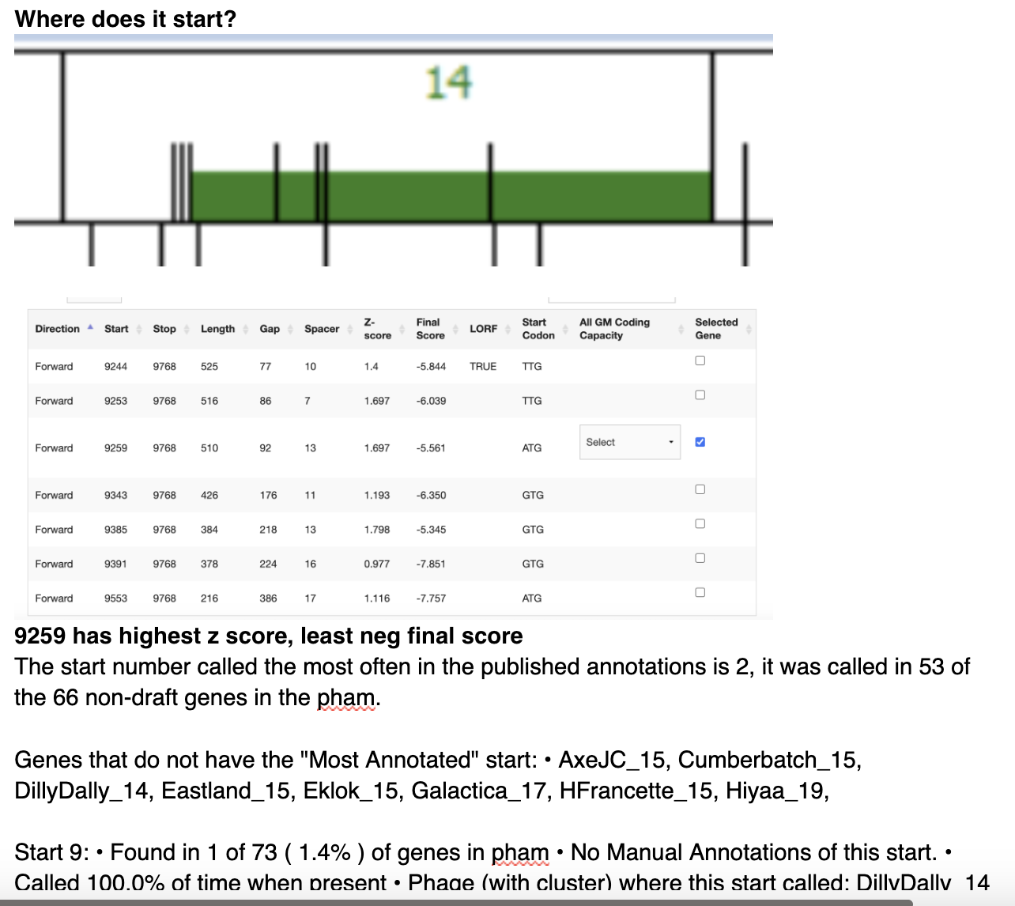
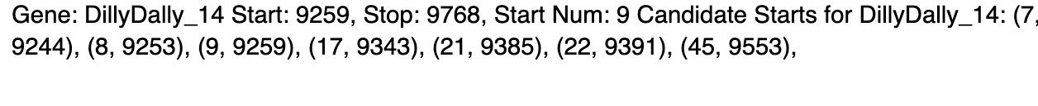
DillyDally Gene 14 – tail assembly chaperone

Slide 15
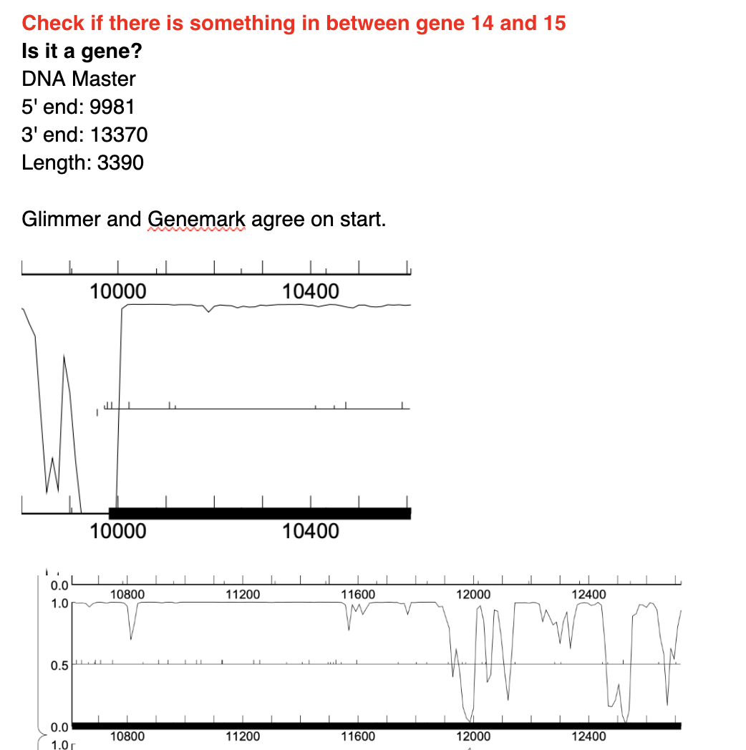
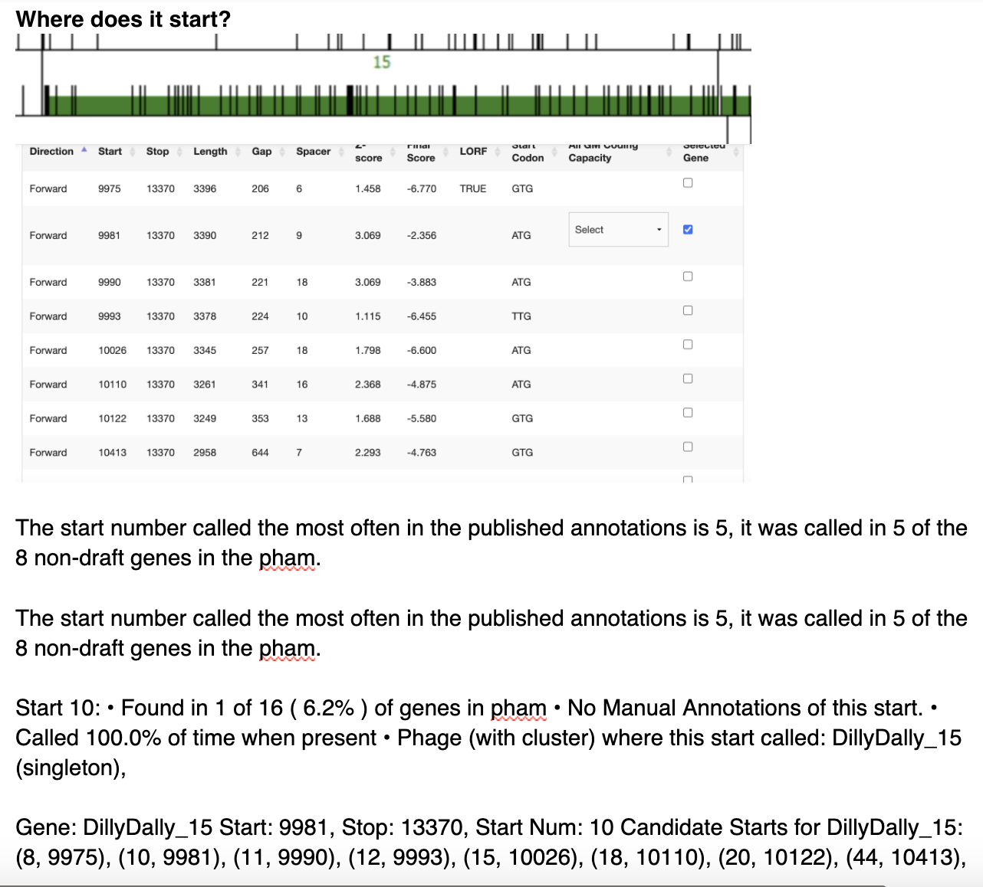
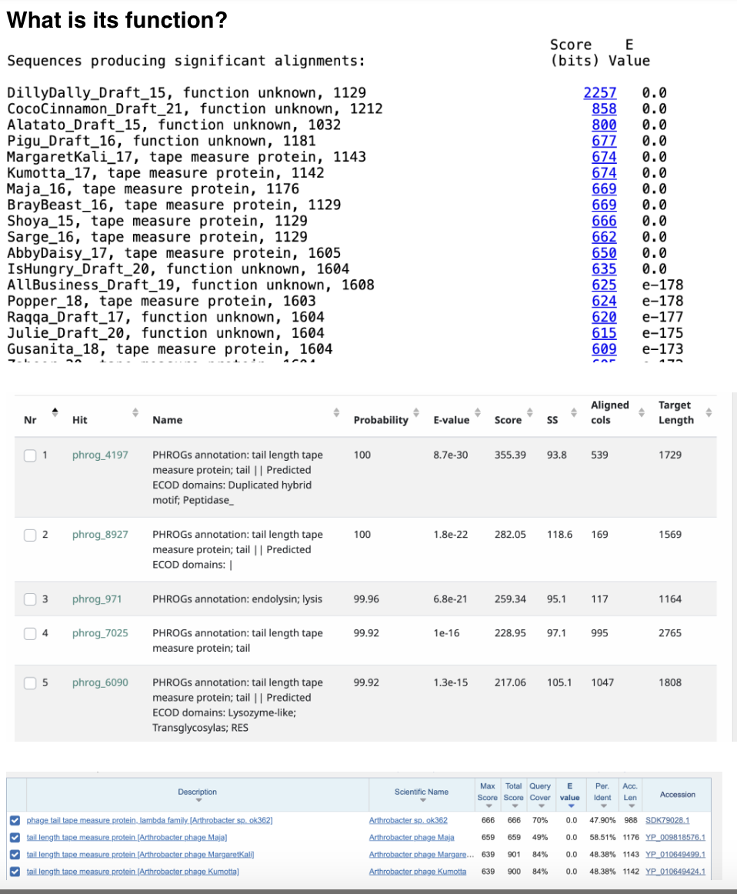
DillyDally Gene 15 – tape measure protein

Slide 16
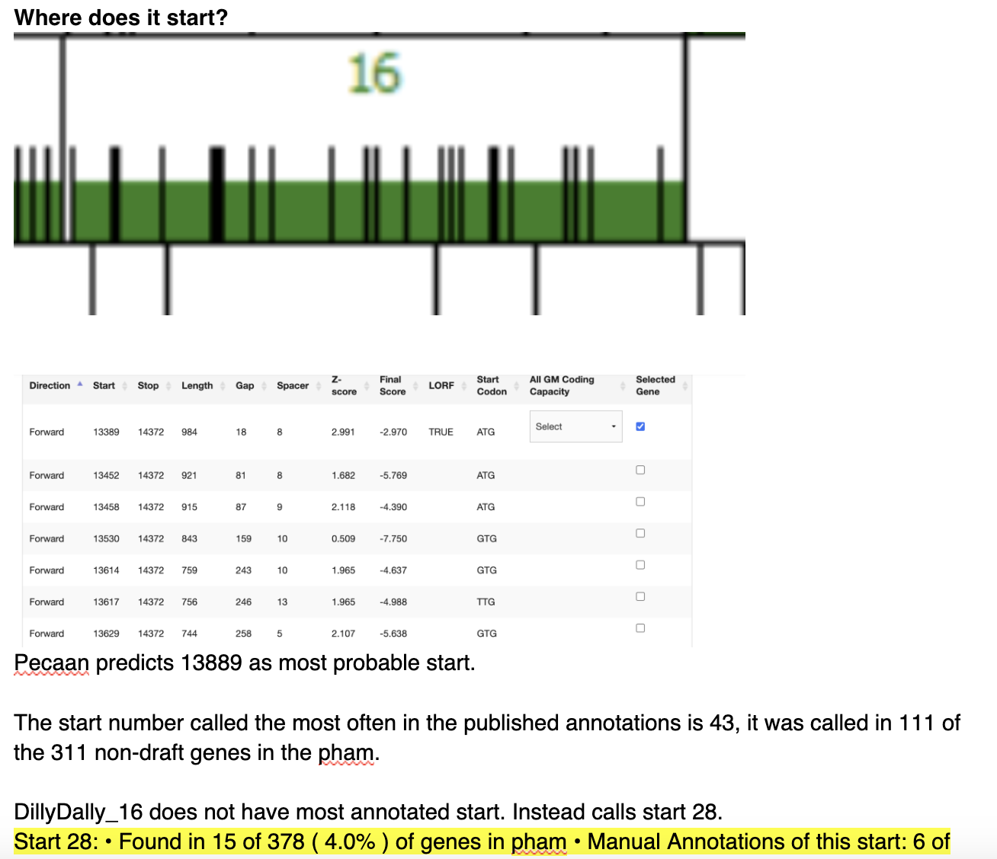



DillyDally Gene 16 – minor tail protein

Slide 17



DillyDally Gene 17 – minor tail protein

Slide 18




DillyDally Gene 18 – minor tail protein

Slide 19



DillyDally Gene 19 – membrane protein

Slide 20



DillyDally Gene 20 – minor tail protein

Slide 21




DillyDally Gene 21 – endolysin

Slide 22



DillyDally Gene 22 – hypothetical protein

Slide 23



DillyDally Gene 23 – hypothetical protein

Slide 24



DillyDally Gene 24 – hypothetical protein

Slide 25




DillyDally Gene 25 – not a gene

Slide 26




DillyDally Gene 26 – not a gene

Slide 27



DillyDally Gene 27 – hypothetical protein

Slide 28



DillyDally Gene 28 – hypothetical protein

Slide 29




DillyDally Gene 29 – tyrosine integrase

Slide 30



DillyDally Gene 30 – hypothetical protein

Slide 31



DillyDally Gene 31 – not a gene

Slide 32



DillyDally Gene 32 – helix-turn-helix DNA binding domain

Slide 33



DillyDally Gene 33 – hypothetical protein

Slide 34




DillyDally Gene 34 – hypothetical protein

Slide 35




DillyDally Gene 35 – hypothetical protein

Slide 36



DillyDally Gene 36 – hypothetical protein

Slide 37




DillyDally Gene 37 – helix-turn-helix DNA binding domain

Slide 38



DillyDally Gene 38 – hypothetical protein
Orpham, no starterator data

Slide 39



DillyDally Gene 39 – hypothetical protein

Slide 40



DillyDally Gene 40 – hypothetical protein

Slide 41



DillyDally Gene 41 – hypothetical protein

Slide 42




DillyDally Gene 42 – hypothetical protein

Slide 43




DillyDally Gene 43 – RecA-like exonuclease

Slide 44




DillyDally Gene 44 – DNA binding protein

Slide 45




DillyDally Gene 45 – hypothetical protein

Slide 46



DillyDally Gene 46 – hypothetical protein
Where does it start?

Slide 47



DillyDally Gene 47 – HNH endonuclease

Slide 48
DillyDally Gene 48 – ssDNA binding protein

Slide 49



DillyDally Gene 49 – not a gene

Slide 50



DillyDally Gene 50 – hypothetical protein
Orpham; no Starterator data/

Slide 51



DillyDally Gene 51 – DNA methyltransferase

Slide 52



DillyDally Gene 52 – hypothetical protein

Slide 53



DillyDally Gene 53 – repA-like replication initiator

Slide 54




DillyDally Gene 54 – DNAb-like dsDNA helicase

Slide 55



DillyDally Gene 55 – HNH endonuclease

Slide 56




DillyDally Gene 56 – RusA-like resolvase

Slide 57



DillyDally Gene 57 – not a gene

Slide 58



DillyDally Gene 58 – hypothetical protein

Slide 59



DillyDally Gene 59 – hypothetical protein

Slide 60




DillyDally Gene 60 – hypothetical protein

Slide 61




DillyDally Gene 61 – hypothetical protein

Slide 62




DillyDally Gene 62 – hypothetical protein

Slide 63



DillyDally Gene 63 – hypothetical protein

Slide 64




DillyDally Gene 64 – hypothetical protein

Slide 65




DillyDally Gene 65 – hypothetical protein

Slide 66




DillyDally Gene 66 – hypothetical protein

Slide 67



DillyDally Gene 67 – hypothetical protein

Slide 68



DillyDally Gene 68 – hypothetical protein

Slide 69




DillyDally Gene 69 – helix-turn-helix DNA binding domain

