Slide 1
POINTIS
Complete Genome Annotation
Principles of Genetics
Spring 2024

Slide 2
Gene 1 (Reverse)
Original Glimmer call a start @bp 468, GTG, this not called by GeneMark.
We consider start at 384, ATG that has highest Z score 3.06 and final score -2,217
Stop at 68811
Starterators data are not available.
Our start correlate with draft data from MellowYellow_Draft 126
There is a 680 base pair gap with the previous gene, not resulting in longest ORF.
Hypothetical protein
Phamerator family #133029
BLAST: High probability hypothetical protein (match with Sea Odyssey and Beagle)

Slide 3
Gene 2 (Forward)
SSC: Start: bp at 1065 at ATG
Stop: bp at 1313 at TGA
SO: Score of -2,443; Z score 2.928
Agree/Disagree: Agree with start at 1065
CD: All CP preserved in sequence
Gap: 569bp
LO: Not the Longest ORF
ST: Start found and called in 5/5 of AP2
BLAST: High probability hypothetical protein (match with Sea Odyssey and Beagle)
Function: Hypothetical protein

Slide 4
Gene 3 (forward)
SSC:
Start: bp 1310 at ATG
Stop: bp 1540 at TGA
Glimmer and GeneMark agree
SO: Best score of -5.238
Agree/Disagree: Agree with start 1310
CP: coding potential appears to be covered
Gap: 4 bp overlap with gene 2
LO: Longest ORF
ST: Start found and called in ⅘ of AP2
BLAST on NCBI:
Function: hypothetical protein

Slide 5
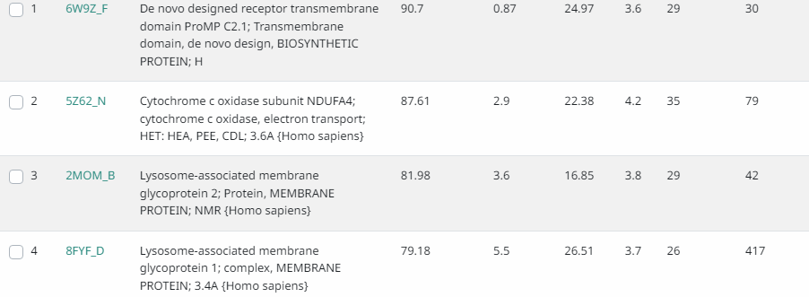
Gene 4 (Forward)
Glimmer calls 1554, GeneMark calls 1614
SSC:
Start: 1554 starts at GTG, 1614 starts at ATG
Stop: 1709 at TGA
SO: Start 1614 has a better score than 1554, but 1614 is <100 nucleotides, best score of -5.950 with start at 1554
Agree/Disagree: Pick 1554 start
CP:Some CP lost with 1614 start
Gap: 13 bp
LO: 1554 has longer ORF than 1614
ST:
BLAST on NCBI:
Function: 91% match with
Protein on HHPred

Slide 6
Gene 5 (Forward)
Glimmer calls start 1709, GeneMark calls 1733
SSC:
Start:1709 at ATG
Stop: 1837 at TGA
SO: 1733 has better score than 1709
Agree/Disagree: Pick 1709
CP: All CP sustained with 1709 start
Gap:1709 has 1 bp overlap with gene 4
LO: 1709 has longer ORF than 1733
ST: Start found and picked by ⅘ of AP2
BLAST on NCBI:
Function: Potentially a DNA binding protein (Phamerator)

Slide 7
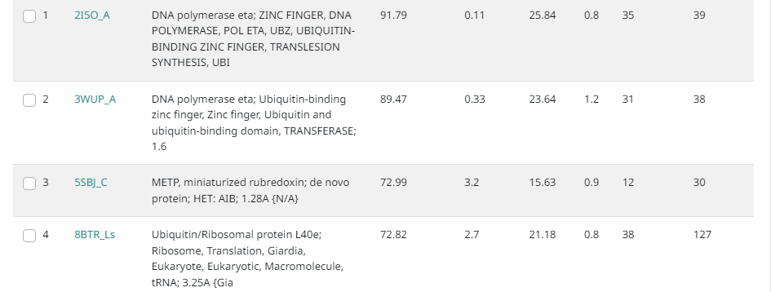
Gene 6 (Forward)
Glimmer and Genemark agree
SSC:
Start: 1837 at ATG
Stop: 2073 at TGA
SO: 1837 has best score (-3.234)
Agree/Disagree: Agree with 1837
CP:
Gap: 1 bp overlap with Gene 5
LO: Longest ORF
ST: Found and called in 5/5 of AP2
BLAST on NCBI:
Function: 92% match with potential
Protein on HHPred:HP

Slide 8
Gene 7 (Forward)
Glimmer and GeneMark agree
SSC:
Start: 2070 at ATG
Stop: 2921 at TGA
SO: 2070 has one of the best scores (-4.409)
Agree/Disagree: Agree with 2070 start
CP: CP preserved within sequence
Gap: 4 bp overlap with gene 6
LO: Longest ORF
ST: Found and called in ⅘ of AP2
BLAST on NCBI
Function: HP

Slide 9
Gene 8 (Forward)
Glimmer calls start 2918, GeneMark calls start 2924
SSC:
Start: 2918 at GTG
Stop: 3463 at TGA
SO: 2918 has better score (-3.854)
Agree/Disagree: Pick 2918
CP: CP preserved with start at 2918
Gap: 2918 has 4 bp overlap with gene 7
LO: 2918 has longer ORF
ST: Start found and called in 5/5 of AP2
BLAST on NCBI:
Function: Hypoth. pr.

Slide 10
Gene 9 (Forward)
Glimmer and GeneMark agree
SSC:
Start: 3460 at ATG
Stop: 3867 at TGA
SO: Best score (-4.109)
Agree/Disagree: Agree with 3460
CP: CP preserved
Gap: 4 bp overlap with gene 8
LO: Longest ORF
ST: Start found and called in 5/5 of AP2
BLAST on NCBI:
Function: 92% match with potential
Hypothetical Protein; (HHPred)

Slide 11
Gene 10 (Forward)
Glimmer calls this a gene, GeneMark does not
SSC:
Start: 3997 at ATG
Stop: 4125 at TAA
SO: Best score (-4.589)
Agree/Disagree: Agree with 3997
CP: All CP contained within chosen sequence
Gap: 129 nucleotide gap between previous gene and start 3997
LO: Longest ORF
ST: Found and called in 5/5 of AP2
BLAST on NCBI: 100% identity with membrane protein of Odyssey395
Function: hypothetical protein

Slide 12
Gene 11 (Forward)
Glimmer and GeneMark agree
SSC:
Start: 4125 at ATG
Stop: 4280 at TGA
SO: Best score
Agree/Disagree: Agree with 4125
CP: 4125 is only start that preserves all CP
Gap: 1 bp overlap with gene 10
LO: Longest ORF
ST: Found and called in 5/5 of AP2
BLAST on NCBI:
Function: Hyp Prot

Slide 13
Gene 12 (Forward)
Glimmer and GeneMark agree
SSC:
Start: 4277 at GTG
Stop: 4525
SO: 4277 score = -5.071. Second best score. Only start with Z-Score 2 >
Agree/Disagree: Agree with 4277
CP: 4277 preserves all CP
Gap: 4 bp overlap with gene 11
LO: Longest ORF
ST: Found and called in 5/5 of AP2
BLAST on NCBI:
Function:

Slide 14
Gene 13 (Forward)
Glimmer and GeneMark agree
SSC:
Start: 4522 at ATG
Stop: 4728
SO: Best score
Agree/Disagree: Agree with 4522
CP: All CP preserved with 4522 start
Gap: 4 bp overlap with gene 12
LO: Longest ORF
ST: Found and called in ⅗ of AP2
BLAST on NCBI:
Function:

Slide 15
Gene 14 (Forward)
Glimmer and GeneMark agree
SSC:
Start: 4725 at ATG
Stop: 4898 at TGA
SO: Best score
Agree/Disagree: Agree with 4725
CP: All CP preserved in sequence
Gap: 4 bp overlap with gene 13
LO: 174 ORF. Longest without excessive overlap
ST: Called in ⅗ of AP2
BLAST on NCBI:
Function:

Slide 16
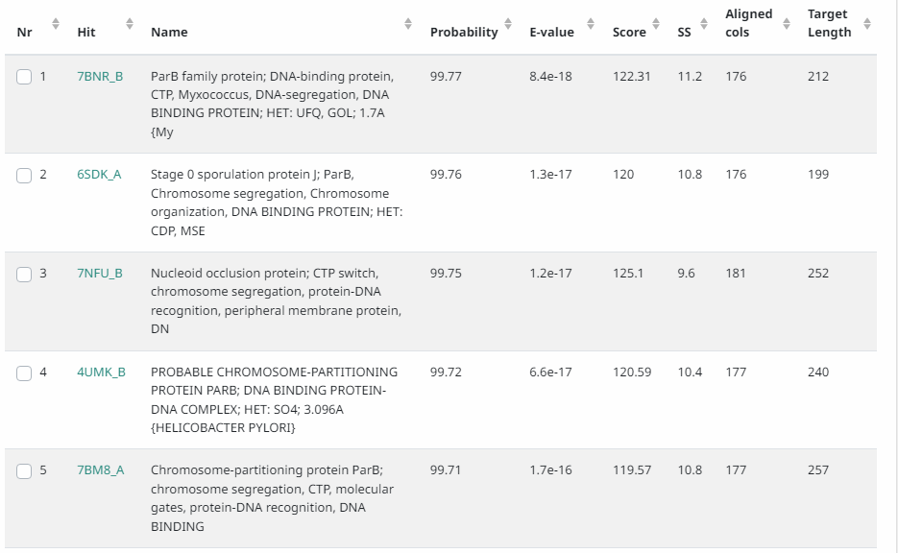
Gene 15 (Forward)
Glimmer and GeneMark agree
SSC:
Start: 4895 at ATG
Stop: 5476 at TGA
SO: 4895 score = -3.945 second best score
Agree/Disagree: Agree with 4895
CP: All CP preserved in sequence
Gap: 4 bp overlap with gene 14
LO: Longest ORF
ST: Found and called in 5/5 of AP2
BLAST on NCBI:
Function: ParB protein

Slide 17
Gene 16 (Forward)
Glimmer and GeneMark agree to start of 5476 (start ATG)
But- suggested start at 5473 (Start GTG)
SSC:
Start: 5476 or 5473
Stop: 5715
SO: 5473 has better score than 5476
Agree/Disagree: Disagree- pick 5473
CP: All CP preserved in chosen sequence
Gap: 1 or 4 bp overlap with gene 15
LO: 5473 has longer ORF than 5476
ST: Start 5476 is chosen by 3 other members of AP2, but Beagle has a different manual annotation start site
BLAST on NCBI:
Function: Hypoth protein

Slide 18
Gene 17 (Forward)
Glimmer and GeneMark agree of start at 5700 (start ATG)
But- suggested start of 5712 (start ATG)
SSC:
Start: 5700 or 5712
Stop:
SO: 5712 has best score
Agree/Disagree: Disagree- pick 5712
CP: Some CP lost with 5712 start.
Gap: 15 or 4 bp overlap with gene 16
LO: 5700 has longest ORF
ST: Start 5700 chosen by 2 others in AP2 (MellowYellow & Odyssey), but the other 2 choose a different start site (Beagle & Pureglobe5)
BLAST on NCBI:
Function: Hypoth protein

Slide 19
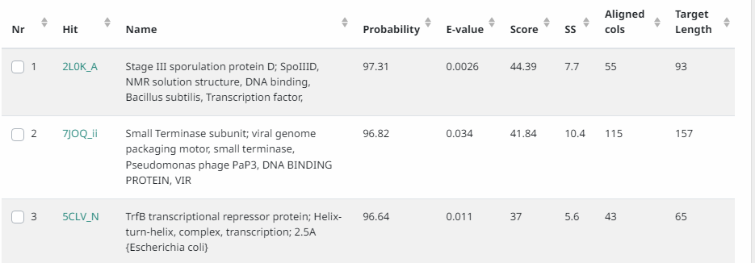
Gene 18 (Forward)
Glimmer and GeneMark agree
SSC:
Start: 5785 at ATG
Stop: 6303
SO: Best score
Agree/Disagree: Agree with 5785
CP: All CP preserved w/ selected start
Gap: 13 bp overlap with gene 17
LO: Longest ORF
ST: Found and called in 5/5 of AP2
BLAST on NCBI:
Function: Potentially terminase small subunit (Pureglobe) or helix-turn-helix DNA binding domain protein (Odyssey) or DNA binding protein (Beagle) - (Phamerator)

Slide 20
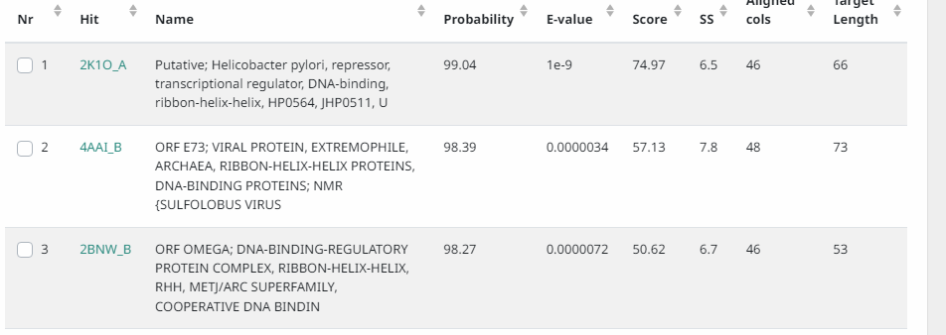
Gene 19 (Forward)
Glimmer and GeneMark agree
SSC:
Start: 6296 at GTG
Stop: 6715
SO: 6296 score = -4.863
Agree/Disagree: Agree with 6296
CP: All CP preserved w/ selected start
Gap: 8 bp overlap with gene 18
LO: Longest ORF
ST: Found and called in 5/5 of AP2
BLAST on NCBI:
Function: Potentially ribbon-helix-helix DNA binding domain protein (Pureglobe5, Odyssey)

Slide 21
Gene 20 (Forward)
SSC:
GeneMark calls at 6728 (ATG), Glimmer calls at 6971(ATG)
Stop 7444
SO: 6728 = -6.329. Not best.
Agree/Disagree: Agree w/ 6728. This start has a high probability NCBI product match in addition to having the longest ORF.
CP: All CP preserved w/ selected start
Gap: 12 nucleotide gap with end of previous gene
LO: Longest ORF (717)
ST: No data
BLAST
Function: terminase

Slide 22
Gene 21 (Forward)
SSC: Start: 7441 ATG. Glimmer and GeneMark agree.
SO: Not best score. Z-Score 2>.
Agree/Disagree: Agree with 7441. Not best score, but this SC is longest ORF and preserves most CP along with a small overlap.
CP: In coding potential
Gap: 3 nucleotide overlap
LO: Longest ORF
ST: 7441 most chosen start site for AP2.
BLAST: terminase beagle 100%
Function: 100% NCBI match for Large Subunit Terminase in Beagle and PureGlove

Slide 23
Potential Gene between 21 & 22 (Forward)
Not called in Glimmer or GeneMark
Start codon is ATG at 9130; stop codon is TAA at 9441
Final score of -5.771 with a Z score of 1.845
Contains all coding potential
Gap- 58
Longest ORF at 312
Starterator: Start 17: Found in 60 of 60 ( 100.0% ) of genes in pham
Manual Annotations of this start: 42 of 44
Called 95.0% of time when present
Found and called in ⅘ of AP2 cluster
Phamerator map shows gene in all 5 of AP2
Blast: 99-100% match with Beagle and Odyssey- membrane protein
HPPred Function: low probability match

Slide 24
Gene 22/23 (Forward)
SSC: Glimmer call at 9444, strength 14.85. GeneMark call at 9453. Stop codon is 11366.
SO: Best score. -3.532. Z value 2.506
Agree/Disagree: Agree with 9444 GTG.
CP: In coding potential
Gap: 2 bp
LO: 9444 has longest ORF with 1893
ST: Start 24 found in 452 out of 711 (63.6%) of genes in pham
BLAST: 100% NCBI match for Portal Protein of Beagle and Odyssey.
Function: Phage portal protein (99.95 probability)

Slide 25
Gene 23/24 (Forward)
SSC: Glimmer and GeneMark agree with 11333 ATG SC.
SO: 11333 best final score. Z-Score 2 >.
Agree/Disagree: Agree with 11333 SC.
CP: In coding potential
Gap: 4 nucleotide overlap with preceding gene.
LO: Longest ORF of 144.
ST: Start 1 in 5 of 5 (100%) genes in pham
BLAST: 100% NCBI match with Beagle 24 hypothetical protein
Function: hypothetical protein

Slide 26
Gene 24/25 (Forward)
SSC: Glimmer and GeneMark call at 11473 ATG SC.
SO: 11473 best final score. Z-Score 2 >.
Agree/Disagree: Agree with 11473 SC.
CP: All coding potential contained within sequence
Gap: 4 nucleotide overlap with preceding gene.
LO: 2664 length
ST: Most chosen start in AP2.
BLAST: 100% NCBI match for Capsid Maturation Protease in Beagle, Odyssey, BruhMoment, and Silent RX.
Function: Capsid maturation protease (> 98% identity with Odissey359)

Slide 27
Gene 25/26 (Forward)
SSC: Original Glimmer call at 14139 bp, not called by GeneMark. Strength 3.27
SO: 14139 best score, -3.649
Agree/Disagree: Not called by GeneMark
CP: All coding potential contained within sequence
Gap: 2 bp
LO: Longest, 144
ST: Found in 11 out of 11 (100%) of genes in pham
BLAST: 95.9% hypothetical protein in Odyssey 395, Beagle
Function: unknown function (86.9 probability)

Slide 28
Gene 26/27 (Forward)
SSC: Glimmer and GeneMark call at 14433 ATG SC
SO: 14433 best score. Z-Score 2 >.
Agree/Disagree: Agree with 14433.
CP: All CP contained within sequence
Gap: 87 bp
LO: ORF length 1728, second longest.
ST: Most chosen start site for AP2.
BLAST: 100% NCBI match for Major Capsid Hexamer Protein in Beagle, Odyssey, BruhMoment, and Silent RX.
Function: Major capsid hexamer protein

Slide 29
Gene 27/28 (Forward)
SSC: Glimmer and GeneMark call at 16228 ATG SC
SO: 16228 best score and Z-Score 2 >.
Agree/Disagree: Agree with 16228.
CP: All coding potential contained within sequence
Gap: 67 bp
LO: Longest ORF (759)
ST: Start 2 found in 10 of 13 (76.9%) of genes in pham
BLAST: 100% NCBI match for hypothetical protein in Beagle, Odyssey, Silent RX, and BruhMoment.
Function: Hypothetical protein

Slide 30
Gene 2829 (Forward)
SSC: Glimmer and GeneMark call at 16998 ATG SC
SO: 16998 best score and Z-Score 2 >
Agree/Disagree: Agree with 16998
CP: All CP contained within sequence
Gap: 11 bp
LO: Second longest ORF (450)
ST: Most called start in AP2
BLAST: 100% NCBI match for hypothetical protein in Beagle
Function: Hypothetical protein

Slide 31
Gene 29/30 (Forward)
SSC: Glimmer and GeneMark call at 17451 ATG SC
SO: 17451 best final score. Z-Score 1.936
Agree/Disagree: Agree with 17451
CP: All CP contained within sequence
Gap: 3 bp
LO: Longest ORF (921)
ST: Most chosen start in AP2
BLAST: 100% NCBI match for Major Tail Protein in Beagle
Function: Major tail protein (86% probability)

Slide 32
Gene 30/31 (Forward)
SSC: Glimmer and GeneMark call at 18438
SO: 18348 best score, -2.292
Agree/Disagree: Agree with 18438 ATG
CP: All coding potential contained within sequence
Gap: 66 bp
LO: Not Longest ORF (774)
ST: Start 2 found in 13 out of 13 (100%) of genes in pham
BLAST: 100% NCBI match for Endolysin protein in Odyssey
Function: Peptidase (97% probability)

Slide 33
Gene 31/32 (Forward)
1. Original Glimmer call @ 19214 bp with 13.22 strength
2. Start codon 19214 and Stop 19831
3. Score for start is -4.656 with z value of 2.008.
4. Within coding potential
5. 2 bp gap
6. Longest ORF: 618
7. Starterator – very high sequence match with 3 in pham
Start 93: • Found in 388 of 706 (55.0%) of genes in pham • Manual Annotations of this start: 306 of 598 • Called 89.4% of time when present.
8. Product is 99.81 probability of a Head-tail adaptor.

Slide 34
Gene 32/33 (Forward)
1. Original Glimmer call @ 19828 bp with 18.54 strength and Genemark calls start at 19831.
2. Start codon 19828 and Stop 20328
3. Score for start is -3.486 with z value of 2.490.
4. Within coding potential
5. 4 bp overlap.
6. Longest ORF is 531
7. Starterator – very high sequence match with 2 in pham
Start 34: • Found in 387 of 456 (84.9%) of genes in pham • Manual Annotations of this start: 337 of 396 • Called 98.4% of time when present.
8. Product is unknown.

Slide 35
Gene 33/34 (Forward)
1. Original Glimmer call @bp 20358 has strength 12.08.
2. Start and stop codon - 20358 and 20888.
3. Score for the start is -5.070 with a z 1.815.
4. Within coding potential
5. overlap 1 bp
6. Longest ORF: 531bp
7. Starterator very high sequence match with 2 in pham
Start 9: • Found in 5 of 13 (38.5%) of genes in pham • Manual Annotations of this start: 3 of 8 • Called 100.0% of time when present. BLAST on phadesdb: minor tail protein
8. HHPred: Hypothetical protein.

Slide 36
Gene 34/35 (Forward)
1. Original Glimmer call @bp 20952 has strength 8.29.
2. Start and stop codon - 20952 and 21368.
3. Score for the start is -4.534 with a z 2.065.
4. Within coding potential
5. 63 bp gap
6. Longest ORF: 435 bp
7. Starterator very high sequence match with 2 in pham
Start 3: • Found in 10 of 13 (76.9%) of genes in pham • Manual Annotations of this start: 5 of 8 • Called 90.0% of time when present.
8. Product is 94% probability of tail assembly chaperon.

Slide 37
Gene 35/36 (Forward)
1. Original Glimmer call @bp 21398 has strength 10.42.
2. Start and stop codon - 21398 and 21526.
3. Score for the start is -7.407 with a z 0.684.
4. Within coding potential
5. 11 bp gap
6. Not the Longest ORF
7. Starterator very high sequence match with 2 in pham
Start 4: • Found in 4 of 6 (66.7%) of genes in pham • Manual Annotations of this start: 2 of 4 • Called 100.0% of time when present.
8. BLASTp NCBI: Hypothetical protein.

Slide 38
Gene 36/37 (Forward)
1. Original Glimmer call @bp 21547 has strength 17.96.
2. Start and stop codon - 21547 and 26424.
3. Score for the start is -4.749 with a z 1.936.
4. Within coding potential
5. 20 bp gap
6. Longest ORF: 4878 bp
7. Starterator very high sequence match with 3 in pham
Start 1: • Found in 11 of 12 (91.7%) of genes in pham • Manual Annotations of this start: 7 of 8 • Called 100.0% of time when present.
8. Product is tape measure protein.

Slide 39
Gene 37/38 (Forward)
1. Original Glimmer call @bp 26434 has strength 17.53.
2. Start and stop codon - 26434 and 27642.
3. Score for the start is -3.837 with a z 2.326.
4. Within coding potential
5. 9 bp gap
6. Longest ORF : 1209bp
7. Starterator very high sequence match with 2 in pham
Start 16: • Found in 24 of 30 (80.0%) of genes in pham • Manual Annotations of this start: 18 of 21 • Called 100.0% of time when present.
8. Phagesdb BLAST: minor tail protein
9. HHPred hit: 94% distal tail protein.

Slide 40
Gene 38/39 (Forward)
1. Original Glimmer call @bp 27647 has strength 14.70.
2. Start and stop codon - 27647(GTG) and 28780.
3. Score for the start is -3.649 with a z 2.479.
4. Within potential
5. 4 bp gap
6. Longest ORF: 1134bp
7. Starterator very high sequence match with beagle in pham
Start 54: • Found in 272 of 580 (46.9%) of genes in pham • Manual Annotations of this start: 238 of 498 • Called 96.3% of time when present.
8. Phagesdb BLAST: minor tail protein
9. HHPred hit: tail protein.

Slide 41
Gene 39/40 (Forward)
1. Original Glimmer call @bp 29013 has strength 13.49.
2. Start and stop codon - 29013 and 30083.
3. Score for the start is -2.786 with a z 2.883
4. Within potential
5. 232bp gap.
6. Longest ORF : 1071bp
7. Starterator very high sequence (>97.3%) match with 3 in pham
Start 1: Found in 15 of 16 ( 93.8% ) of genes in pham • Manual Annotations of this start: 8 of 9 • Called 100.0% of time when present
8. Product is (97.93 probability) of a minor tail protein.

Slide 42
Gene 40/41 (Forward)
1. Original Glimmer call @bp 30083 has strength 11.90.
2. Start and stop codon - 30083 and 32215.
3. Score for the start is -5.155 with a z 2.
4. Within potential
5. 1 bp overlap
6. This is Longest ORF: 2133bp
7. Starterator very high sequence (>97.3%) match with 3 in pham
Start 2: • Found in 5 of 13 (38.5%) of genes in pham • Manual Annotations of this start: 3 of 8 • Called 100.0% of time when present.
8. BLAST on Phagedb: minor tail protein
8. NCBI BLAST: Minor tail protein, 100% identity

Slide 43
Gene 41/42 (Forward)
Original Glimmer calls a start at 32243 bp, strength 18.12
Start codon is ATG at 32243; stop codon is TGA at 34246
Final score for the start is -2.958 with a z score of 2.803
Contains all coding potential
Gap - 27 bp
Longest ORF at 2004
Starterator - Start 2: Found in 7 of 7 ( 100.0% ) of genes in pham Manual Annotations of this start: 4 of 4Called 100.0% of time when present Phage (with cluster) where this start called: Beagle_43 (AP2), BruhMoment_39AP3), MellowYellow_36 (AP2), Odyssey395_44 (AP2), Pointis_41 (AP2),Pureglobe5_44 (AP2)
Blast - 100% match with Beagle, Odyssey, and Pureglobe- minor tail protein
Function - high probability Probable central straight fiber; Bacteriophage, Siphophage, T5, baseplate, VIRAL PROTEIN
Pureglobe, Odyssey, and Beagle call this gene a minor tail protein

Slide 44
Potential gene between 41 & 42 (43) (Forward)
Glimmer and GeneMark did not mark this a gene
Start codon is ATG at 34245; stop codon is TGA at 34593
Final score for the start is 3.138 with a z score of 2.718
Contains all coding potential
1 bp overlap with gene 41
#2 longest ORF at 348
Starterator - Appears to be in Odyssey and Beagle (Phamerator map)
Function- low probability match

Slide 45
Gene 42/44 (Forward)
Original Glimmer calls a start at 34580 bp, strength 4.15
Start codon is ATG at 34580; Stop codon is TGA at 34759
Final score for the start is -4.741 with a z score of 1.902
Contains all coding potential
Gap - 333 bp gap (with upstream gene); (14 bp overlap with potential gene)
Longest ORF at 180
Starterator - Start 1: Found in 6 of 6 ( 100.0% ) of genes in pham Manual Annotations of this start: 3 of 3 Called 100.0% of time when present Phage (with cluster) where this start called: Beagle_45 (AP2), MellowYellow_37 (AP2), Odyssey395_46 (AP2), Pointis_42 (AP2), Pureglobe5_45 (AP2), Ranunculus_37 (AP),
Blast - 100% match with only beagle- hypothetical protein
Function - low probably - unknown

Slide 46
Gene 43/45 (Forward)
Original Glimmer calls at 34764 bp; strength 6.24
Start codon is ATG at 34764; Stop codon is TGA at 35108
Final score for the start is -3.836 with a z score of 2.355
Contains all Coding potential
Gap - 5 bp
#3 longest ORF longest at 345
Starterator - Start 8: Found in 6 of 12 ( 50.0% ) of genes in pham Manual Annotations of this start: 4 of 9 Called 100.0% of time when present Phage (with cluster) where this start called: Beagle_46 (AP2), BruhMoment_42 (AP3), MellowYellow_38 (AP2), Odyssey395_47 (AP2), Pointis_43 (AP2), Pureglobe5_46 (AP2),
NCBII Blast - 100% match with Beagle and Odyssey- membrane protein
Function - membrane protein

Slide 47
Gene 44/46 (Forward)
Original Glimmer calls a start at 35105 bp, strength of 6.80
Start codon is ATG at 35105; Stop codon is at TGA 35320
Final core for the start is -3.818 with a z score of 2.363
Covers all coding potential
4 bp overlap
Longest and only ORF at 216
Starterator - Start 6: Found in 9 of 9 ( 100.0% ) of genes in pham Manual Annotations of this start: 7 of 7 Called 100.0% of time when present Phage (with cluster) where this start called: Beagle_47 (AP2), BruhMoment_43 ( AP3), MellowYellow_39 (AP2), Odyssey395_48 (AP2), Pointis_44 (AP2), Pureglobe5_47 (AP2)
Blast - 100% match with beagle- hypothetical protein
Function - low probability - unknown

Slide 48
Gene 45/47 (Forward)
Original Glimmer calls a start at 35317 bp, strength 17.67
Start codon is ATG at 35317; Stop codon is TGA at 35700
Final score for the start is -4.602 with a z score of 2.355
Covers all coding potential
4 bp overlap
Longest ORF at 384
Starterator - Start 2: Found in 5 of 8 ( 62.5% ) of genes in pham Manual Annotations of this start: 3 of 5 Called 100.0% of time when present Phage (with cluster) where this start called: Beagle_48 (AP2), MellowYellow_40 (AP2), Odyssey395_49 (AP2), Pointis_45 (AP2), Pureglobe5_48 (AP2),
Blast -MEMBRANE PROTEIN
Function - hypothetical proten

Slide 49
Gene 46/48 (Forward)
Original Glimmer calls a start at 35693 bp, strength 15.41
Start codon is ATG at 35693; Stop codon is TAA at 35986
Final Score for the start is -2.316 with a z score of 3.066
Covers all Coding potential
8 bp overlap
#2 longest ORF at 294
Starterator - Start 3: Found in 7 of 7 ( 100.0% ) of genes in pham Manual Annotations of this start: 4 of 4 Called 100.0% of time when present Phage (with cluster) where this start called: Beagle_49 (AP2), BruhMoment_45 (AP3), MellowYellow_41 (AP2), Odyssey395_50 (AP2), Pointis_46 (AP2), Pureglobe5_49 (AP2)
Blast - 100% match with beagle- membrane protein
Function -poor probability - unknown

Slide 50
Gene 47/49 (Forward)
Original Glimmer calls at 35996 bp, strength 13.87
Start codon is ATG at 35996; Stop codon is TAG at 37693
Final score for the start is -2.011 with a z score of 3.217
Covers all coding potential
Gap - 9 bp
Longest ORF at 1698
Starterator -Start 2: Found in 5 of 13 ( 38.5% ) of genes in pham Manual Annotations of this start: 3 of 8 Called 100.0% of time when present Phage (with cluster) where this start called: Beagle_42 (AP2), MellowYellow_35 (AP2), Odyssey395_43 (AP2), Pointis_40 (AP2), Pureglobe5_43 (AP2),
Blast -100% match with Pureglobe, Beagle, and Odyssey- minor tail protein
Function - poor probability - unknown protein; Pureglobe, Beagle, Odyssey call this a minor tail protein

Slide 51
Gene 48/50 (Reverse)
Original Glimmer calls a start at 38268 bp; Strength 12.44
Start codon is ATG at 38268; Stop codon is TGA at 37831
Final score for the start is -3.293 with a z score of 2.827
Covers all coding potential
Overlap 11 bp
Longest ORF at 438
Starterator -Start 9
• Found in 6 of 34 ( 17.6% ) of genes in pham
Called 83.3% of time when present
• Phage (with cluster) where this start called: Beagle_51 (AP2), BruhMoment_47 (AP3), Odyssey395_52 (AP2), Pointis_48 (AP2), Pureglobe5_51 (AP2),
Blast - 100% match with odyssey- RusA like resolvase
Function - 99.27 probability RusA like resolvase/endonuclease

Slide 52
Gene 49/51 (Reverse)
Original Glimmer calls a start at 38500 bp, strength 14.32
Start codon is ATG at 38500; Stop codon is TGA at 38258
Final core for the start is -4.916 with a z score of 1.858
Covers all coding potential
Overlap 4 bp
Longest ORF at 243
Starterator - Start 3:
• Found in 6 of 8 ( 75.0% ) of genes in pham
• Manual Annotations of this start: 3 of 4
• Called 100.0% of time when present
• Phage (with cluster) where this start called: Beagle_52 (AP2), MellowYellow_45, (AP2), Odyssey395_53 (AP2), Pointis_49 (AP2), Pureglobe5_52 (AP2), Ranunculus_45 (AP),
Blast - 100% match with Odessey and Beagle- hypothetical protein
Function - low probability, unknown function

Slide 53
Gene 50/52 (Reverse)
Original Glimmer calls a start at 38688 bp, strength 12.20; GeneMark disagrees- calls a start at 38700
Start codon is GTG at 38688; Stop codon is TGA at 38497
Final score for the Glimmer start is -5.141 with a z score of 1.715
Covers all coding potential
Gap 4 bp in Glimmer start
#2 longest ORF at 192 for Glimmer start
Starterator - Start 2:
• Found in 6 of 6 ( 100.0% ) of genes in pham
• Manual Annotations of this start: 3 of 3
• Called 83.3% of time when present
• Phage (with cluster) where this start called: Beagle_53 (AP2), MellowYellow_46, (AP2), Odyssey395_54 (AP2), Pureglobe5_53 (AP2), Ranunculus_4(AP)
Blast - 100% match with Pureglobe, Odyssey, Beagle- hypothetical protein
Function - hypothetical protein

Slide 54
Gene 51/53 (Reverse)
SSC: Start 38986, Stop 38693
SO: -3.934, Best Score
Agree/Disagree: Agree
CP: 1
Overlap 4bp with preceded gene
LO: Second longest ORF 294bp. Longest ORF is 306
Starterator: Start 5, Found in 3 of 5 ( 60.0% ) of genes in pham. Called 66.7% of time when present
Blast: very high match with beagle
Function: 96.9 probability helix-turn-helix DNA-binding protein

Slide 55
Gene 52/54 (Reverse)
SSC: Start 39279, Stop 38983
SO: -4.580, Third Best Score
Agree/Disagree: Agree
CP: 1
Overlap: 4 bp with previous Gene
LO: yes, 297bp
Starterator - Start 6, Found in 12 of 12 ( 100.0% ) of genes in pham, Called 100.0% of time when present
Blast: 100 match with beagle and high percent match with 2 in pham
Function: hypothetical protein

Slide 56
Gene 53/55 (Reverse)
SSC: Start 39683, Stop 39276
SO: -5.005, Best Score
Agree/Disagree: Agree
CP: 1
Gap: 11 bp with previous Gene
LO: no, the third one, 408bp. Longest ORF is 519
Starterator: Start 119, Found in 58 of 391 ( 14.8% ) of genes in pham. Called 94.8% of time when present.
Blast: 100% match with hypothetical Protein in Beagle
Function: hypothetical protein

Slide 57
Gene 54/56 (Reverse)
SSC: Start GTG @ 39913 end at 39695
SO: -2.590, Best Score
Agree/Disagree: Agree
CP: high coding potential
Overlap 4 bp
Lo: no, the second longest one, 219 bp. Longest ORF is 459 bp
ST: Start 2, Found in 5 of 5 ( 100.0% ) of genes in pham. Called 100.0% of time when present.
BLAST: 100% and 97.2% match with BEagle and Pureglobe5 respectively
Function: only low probability scores

Slide 58
Gene 55/57 (Reverse)
SSC: Start ATG @ 40164 to Stop @ 39910
SO: -2.372
Agree/Disagree: Agree with gene.
CP: high coding potential, all covered
Gap: 4bp overlap with 56
LO: yes, 255 bp
ST: Start 3, Found in 7 of 9 ( 77.8% ) of genes in pham. Called 100.0% of time when present
BLAST: DNA binding domain protein; 100% match with Beagle
Function: DNA binding protein, 99.09 Probability score

Slide 59
Gene 56/58 (Reverse)
Original Glimmer call @bp 40391 has strength 10.43; GeneMark calls start at 40415
SSC: Start ATG @ 40415, Stop 40161
SO: -2.367
Agree/Disagree: Disagrees. ChoseGeneMark start at 40415
CP: High coding potential
Overlap: 16 bp with 57
LO: yes, 255 bp.
ST: They chose start 40391. For start at 40391, Start 4 was Found in 6 of 6 ( 100.0% ) of genes in pham. Called 16.7% of time when present.
BLAST: Helix-turn-helix DNA binding protein; 100% match with Beagle and Odyssey
Function: helix-turn-helix DNA binding domain protein

Slide 60
Gene 57/59 (Reverse)
SSC: Start GTG 40596, Stop 40408
S: -5.332, Second Best Score
Agree/Disagree: Agree
CP: 1
Gap: 103bp with Gene 58
LO: no, 189 bp. Longest ORF 255
ST: Start 3, Found in 2 of 2 ( 100.0% ) of genes in pham; Manual Annotations of this start: 1 of 1. Called 100.0% of time when present. Phage (with cluster) where this start called: Beagle_60 (AP2), Pointis_57 (AP2),
BLAST: "Hypothetical protein" match with Beagle.
Function: Unknown

Slide 61
Gene 58/60 (Reverse)
SSC: Start 41126, Stop 40698
SO: -2.423, Best Score
Agree/Disagree: Agree
CP: 1
Overlap: 4bp with Gene 59
LO: no, 429. Longest ORF is 576
ST: Found in 10/10 (100%) of genes in pharma, called 100% when present
BLAST: 98% match with Beagle_62
Function: Hypothetical protein

Slide 62
Gene 59/61 (Reverse)
SSC: Start 41311, Stop 41123
SO: -2.933, Best Score
Agree/Disagree: Agree
CP: 1
Overlap: 4bp with Gene 60
LO: yes, 189
ST: Start 2 found 3/3 (100%) of genes in pham, called 100% when present
Blast: 100% match Beagle_63
Function: Unknown

Slide 63
Gene 60/62 (Reverse)
SSC: Start 41439, Stop 41308
SO: -2.909, best Score
Agree/Disagree: Agree
CP: 1
Overlap: 1bp with Gene 61
LO: no, 132. Longest ORF is 354
ST: Start 4, found in 3/3 (100%) of genes in pham, called 66.7% of the time when present
Blast: 100% match Beagle_64
Function: Hypothetical protein

Slide 64
Gene 61/63 (Reverse)
Original Glimmer call @bp 41756 has strength 13.83
SSC: Start codon is: ATG stop codon is: TGA
SO: -4.473 (2/8) Z score: 2.066
Agree/Disagree: Agree
CD: Covers
overlap 4bp
LO: 318 (2/8 longest)
ST: Start 17 Found 5/13 genes in pham, called 100% of the time when present
Blast: 99% match with Beagle_64
Funcation: hypothetical protein

Slide 65
Gene 62/64 (Reverse)
Original Glimmer call @bp 42133 has strength 11.33
SSC: Start codon: ATG Stop codon: TGA
SO: -4.252 (2/9 smallest) Z score:2.883
Agree/Disagree: Agree
CD: Covers
Overlap of 4bp
LO: 381 longest
ST: Start 9 6/18 (33.33%) of genes in pham, called 100% of time when present
Blast: 100% match with Beagle_64
Function: Unknown

Slide 66
Gene 63/65 (Reverse)
Original Glimmer call @bp 42133 has strength 11.33
SSC: Start codon: ATG Stop codon: TGA
SO: -5.116 (smallest) Z score: 1.793
GM&G: Agree
CD: Covers
Overlap of 4bp
LO: 42405 (longest)
ST: 6/15 called 100%
BLAST: hypothetical protein
FUNCTION: N/A

Slide 67
Gene 64/66 (Reverse)
Original Glimmer call @bp 42710 has strength 5.14
SSC: Start ATG, 42710
Stop TGA, 42402
SO: start, 42710 (OFR 309, score -3.657)
Agree/Disagree: agree
CD: agrees with GeneMark
Overlap of 1bp
LO: 396, No
ST: Start 4: • Found in 5 of 9 ( 55.6% ) of genes in pham • Manual Annotations of this start: 3 of 6
BLAST NCBI: Hypothetical Protein

Slide 68
Gene 65/67 (Reverse)
Original Glimmer call @bp 42958 has strength 10.25
SSC: Start GTG, 42958
Stop TGA, 42710
SO: start, 42958 (OFR 249, score -6.491)
Agree/Disagree: agree
CD: agrees with GeneMark
Gap: Gap of 14 bp
LO: 264, No
ST:Start 15: • Found in 29 of 29 ( 100.0% ) of genes in pham • Manual Annotations of this start: 1 of 20 • Called 13.8% of time when present
BLAST NCBI: Hypothetical Protein

Slide 69
Gene 66/68 (Reverse)
Original Glimmer call @bp 43497 has strength 12.72
SSC: Start ATG, 43497
Stop TGA, 42973
SO: start, 43497 (OFR 525, score -2.645)
Agree/Disagree: agree
CD: agrees with GeneMark
Gap: 32bp gap
LO: 525, yes
ST:Start 1: • Found in 5 of 5 ( 100.0% ) of genes in pham • Manual Annotations of this start: 3 of 3 • Called 100.0% of time when present
BLAST NCBI: Hypothetical Protein

Slide 70
Gene 67/69 (Reverse)
Original Glimmer call @bp 43748 has strength 12.72
SSC: Start ATG, 43748
Stop TGA, 43530
SO: start, 43748 (OFR 219, score -3.430)
Agree/Disagree: agree
CD: agrees with GeneMark
Gap: Overlap of 4
LO: 558, No
ST:Start 5: • Found in 6 of 6 ( 100.0% ) of genes in pham • Manual Annotations of this start: 3 of 3 • Called 100.0% of time when present
BLAST NCBI: Hypothetical Protein

Slide 71
Gene 68/70 (Reverse)
Original Glimmer call @bp 44287 has strength 4.43
SSC: Start ATG, 44287
Stop TGA, 43745
SO: start, 44287 (OFR 543, score -2.584)
Agree/Disagree: agree
CD: agrees with GeneMark
Gap: Overlap of 4
LO: 543, No
ST: Start 9: • Found in 6 of 6 ( 100.0% ) of genes in pham • Manual Annotations of this start: 4 of 4 • Called 100.0% of time when present
BLAST NCBI: Hypothetical Protein

Slide 72
Gene 69/71 (Reverse)
Original Glimmer call @bp 44817 has strength 18.58
SSC: Start Codon: ATG Stop Codon:TGA
SO: -2.297 (smallest) Z score: 3.112
CD: In coding potential
GAP: GAP 74
Largest ORF: 534, yes
ST: Found in 9/9, 100% genes in pham, Called 100% of time when present
BLAST: 100% Identity Pureglobe5
Function: Hypothetical protein

Slide 73
Gene 70/72 (Reverse)
Original Glimmer call @bp 45164 has strength 16.97
SSC: Start codon: ATG Stop codon: TAA
SO: -2.804 (smallest) Z score: 3.055
CD: Not in coding potential
GAP: Overlap of 8
Longest ORF: 273, yes
ST: Found in 6/6 (100%) of genes in pham, Called 100% of time when present
BLAST: 100% Identical to Beagle
Function: Hypothetical Protein

Slide 74
Gene 71/73 (Reverse)
GeneMark and Glimmer Agree
SSC: Start: ATG @ 45390, Stop: 45157; strength 12.40
SO: -3.709
CD: Coding potential covers this whole stretch
GAP: 2 bp gap between 71 and 72
Longest ORF: 234, not the longest
Blast: 96% Identity with Beagle 76
Function: Hypothetical Protein

Slide 75
Gene #72/74 (Reverse)
Original Glimmer call start 45703; strength 9.94
SSC: Start codon is GTG @ 45703 - 45392
SO: -3.693; 2nd strongest score; Z-value 2.557
CP: Covers this stretch, there might be more that CP doesn’t cover
GAP: Overlap of 4bp with 73
LO: 312 (4/8 longest)
ST: 10/13 called 90% of the time
BLAST: high probability "hypothetical protein"; 100% identity match with Beagle
FUNCTION: N/A

Slide 76
Gene #73/75 (Reverse)
SSC: Original Glimmer call @bp 45945; strength 13.16 with start codon ATG. Stop at bp 45700
SO: -4.836, strongest. Z-value is 1.858
GM&G: Agree
CP: Covers this stretch, may have more gene not covered by coding potential starting around 46200
GAP: Overlap of 4
LO: 246 (5th out of 12 longest)
ST: 4/4 found in pham; called 100% of the time when present
BLAST: high probability "hypothetical protein"
FUNCTION: N/A

Slide 77
Gene #74/76 (Reverse)
Original Glimmer call @bp 46271 has strength 7.13
SSC: GTG @ 46271 - 45942
SO: -4.624 (best score), Z-value 1.987
CP: Covers all of the gene
GAP: 8 bp overlap with #75
LO: 330, longest
ST: Found in 5 out of 6 members of pham, called 100% of the time when present
BLAST: high probability "hypothetical protein"; 100% identity match with Pureglobe5, 97.2 % match with Beagle
FUNCTION: N/A

Slide 78
Gene #75/77 (Reverse)
Original Glimmer call @bp 47436 has strength 16.17
SSC: Start with ATG @ 47436 - 46264;
SO: -2.441, best score; Z-value 3.143
CP: Covers
GAP: 203 bp overlap with #76
LO: 1173 (3rd longest out of 21)
ST: Found in 7 out of 13; called 85.7% of the time when present
BLAST: high probability "hypothetical protein"
FUNCTION: hypothetical protein

Slide 79
Gene #76/78 (Reverse)
Original Glimmer call @bp 48527 with ATG; strength 15.64, Stop @ 47640
SO: -5.297; 7th best score out of 17; Z-value 1.642
CP: Covers completely
GAP: 152 bp
LO: 888, is the longest
ST: found in 9/24 members of the pham; called 78% of the time when present
BLAST: high probability “DNA binding protein”
FUNCTION: DNA binding protein

Slide 80
Gene #77/79 (Reverse)
Original Glimmer call @bp 48895 has strength 10.25; GeneMark calls start at 48892
SSC: Start with GTG @ 48895 - 48680
SO: -4.541, best score; Z-value 2.034
CP: Covers
Overlap of 4bp with 78
LO: 216, is the longest
ST: Found in 3/12 members of pham; called 33% of the time when present
BLAST: high probability "hypothetical protein"
FUNCTION: N/A

Slide 81
Gene 78/80 (Reverse)
SSC: Glimmer and GeneMark call at 49311 with GTG start; Original Glimmer call @bp 49311 has strength 14.90
SO: -4.898 final score. Not best score, 6th out of 14. Z-Score 1.858
Agree/Disagree: Agree with 49311, as all of the surrounding possible starts have worse final and Z-scores. Additionally, all of the CP is contained within this sequence and there is concurrence in Starterator.
CD: All CP contained within sequence
Gap: 50 nucleotide gap present as previous gene ends at 49362,
LO: ORF length of 420, not the longest
ST: found in 6/41; called 33.3% of the time when present
BLAST: 100 % deoxyuridine triphosphatase
Function:82% NCBI match for Deoxyuridine Triphosphatase in Odyssey395, Beagle, PureGlobe395, and Silent RX

Slide 82
Gene 79/81 (Reverse)
SSC: Glimmer and GeneMark call at 49568 ATG start codon. Strength: 3.31 Stop at 49362.
SO: Final score -3.514, second best final score. Z-Score 2.506
Agree/Disagree: Agree with 49568 due to longest ORF compared to the best score which has a shorter ORF. Additionally, the score differences are negligible.
CD: All CP contained within sequence
Gap: Start codon starts with the last nucleotide of the previous gene’s stop codon (1 bp overlap)
LO: Longest ORF (207)
ST: Start 14 (49568) is most called in 6 of 9 Pointis annotations.
BLAST: 100% NCBI protein match for hypothetical protein in PureGlobe395 and Beagle
Function:hypothetical protein

Slide 83
Gene 80/82 (Reverse)
SSC: Glimmer call at 49894 GTG start codon. Stop at 49568. Not called by GeneMark.
SO: Final score -4.532. Z-score 2.066.
Agree/Disagree: Agree with Glimmer on existence and call at 49568.
CD: All CP contained within sequence
Gap: 4 nucleotide overlap with previous gene
LO: Longest ORF (327)
ST: Start 111 (49894) most called with 37 manual annotations.
BLAST
Function: 100% NCBI match for HNH Endonuclease in Odyssey 395 and PureGlobe5.

Slide 84
Gene 81/83 (Reverse)
SSC: Glimmer and GeneMark call at 50088 GTG Start codon. Stop at 49891.
SO: Final score -4.024. Z-Score 2.238.
Agree/Disagree:
CD: All CP contained within sequence
Gap: 4 nucleotide overlap with previous gene
LO: Second longest ORF (198)
ST: Start 2 (50088) most chosen start. 3 manual annotations of this start.
BLAST 100% NCBI protein match with Hypothetical protein of Beagle and Odyssey 395.
Function:

Slide 85
Gene 82/84 (Reverse)
SSC: Start 50438 Stop 50085
SO: -2.828 Best score
Agree/Disagree: Agree with glimmer which has a start at 50438
CD: Within Potential
Gap: Has an overlap of 4 with gene 83
LO: Second longest open reading frame at 354 base pairs
ST: Stararator say the start is at 2 which is 50438. This start is called 100% when present.
BLAST From NCBI
Function:

Slide 86
Gene 83/85 (Reverse)
SSC: Start 50770 Stop 50435
SO: -4.862 2nd best score
Agree/Disagree: Disagree with genemark as it called the start at 50752. Agree with glimmer as it says the start would be 50770
CD: Within Potential
Gap: Has an overlap of 4 with Gene 84
LO: Has the longest open reading frame at 336 base pairs
ST: Starterator marks it at start 1 which is called 100% of the time when present.
BLAST From NCBI
Function:

Slide 87
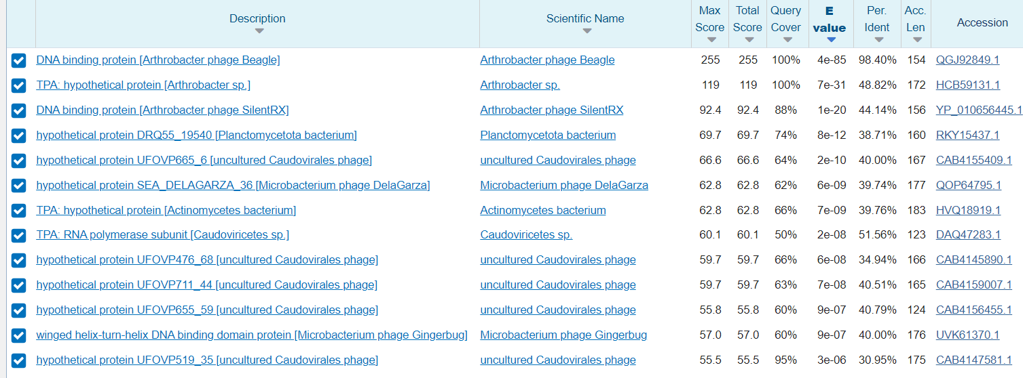
Gene 84/86 (Reverse)
SSC: Start 51231 Stop 50767
SO: -5.496 10th best score
Agree/Disagree: Agree genemark said 51231 would be the start. Disagree with glimmer as it says the start would be 51144.
CD: Within Potential
Gap: Overlap of 4 with gene 85
LO: Longest open reading frame at 465 base pairs
ST: Starterator says 12 but all the other AP2 phages say the start should be 7 and start 7 matches with start 51231. Start 7 is called 80% of the time when present.
BLAST From NCBI
Function: DNA binding protein

Slide 88
Gene 85/87 (Reverse)
SSC: Start 51785 Stop 51228
SO: -4.637 4th best
Agree/Disagree: Agree with genemark as it calls for 51785. Disagree with glimmer as it says 51806 would be the start.
CD: Within Potential
Has an overlap of 4 with gene 86
LO: 2nd longest open reading frame at 558 base pairs
ST: Startarator says 4 but 5 is what matches 51785 and all other AP2 phages share 5 as their start value. Start 5 is also called 80% of the time when present.
BLAST From NCBI
Function:

Slide 89
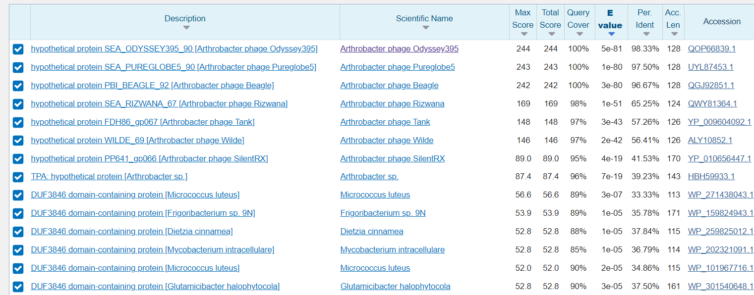
Gene 86/88 (Reverse)
SSC: Start 52144 Stop 51782
SO: Z score 2.911 Final score: -2.559
Agree/Disagree: agree with the glimmer as it said 52144
CD: Within Potential
Gap: Overlap of 4 with gene 88
LO:Longest open reading frame at 387
ST: Starterator says 9 but it has more of the AP2 family with start 7 which is the 52168. Also start 7 has a 60% when present and 9 has a 62.5 when present so not much of a difference.
BLAST From NCBI
Function: hypothetical protein

Slide 90
Gene 87/89 (Reverse)
SSC: Start 52683 & Stop 52165
SO: -5.797 7th best score
Agree/Disagree: Agree with the glimmer which placed it at 52683
CD: Within Potential
Gap: Gap of 40 with gene 88
LO: longest open reading frame with 519 BP
ST: Startarator said 5 which is similar to the other phages in the AP2 group. Has an 87.5 % chance to be start 5 with phages with this gene.
BLAST: From NCBI
Function: hypothetical protein

Slide 91
Gene 88/90 (Reverse)
SSC: Start 54784, Stop 53180
SO: -3.314, not the best Score
Agree/Disagree: Agrees
CP: 1
Gap: 15 bp
LO: yes, 441 bp
ST: Start 3, Found in 13 of 13 ( 100.0% ) of genes in pham. Called 100.0% of time when present
BLAST: 87% match with hypothetical protein in Beagle and Odyssey
Function: hypothetical protein

Slide 92
Gene 89/91 (Reverse)
SSC: Start 54784, Stop 53180
SO: -3.314, Best Score
Agree/Disagree: Agrees
CP: 1
Gap: 41
LO: yes, 1605
ST: Start 3, Found in 13 of 13 ( 100.0% ) of genes in pham. Called 100.0% of time when present
BLAST: 99% match with DNA primase/helicase in PureGlobe5, and DNA primase/polymerase/helicase in Beagle

Slide 93
Gene 90/92 (Reverse)
SSC: Start 55569, Stop 54826
SO: -2.310, Best Score
Agree/Disagree: Agree
CP: 1
Gap: 268 bp
LO: 744, 2nd Longest
ST: Start 6, Found in 11 of 12 ( 91.7% ) of genes in pham. Called 90.9% of time when present
BLAST: 99% Match with Beagle DNA Binding Protein
Function: 4PT7_C, Replication initiator A family protein; replication initiation, multidrug resistance, PROTEIN BINDING or
8OJJ_C, DNA binding protein ; 98.09% and 98.07% probability respectively

Slide 94
Gene 91/93 (Reverse)
SSC: Start 56338, Stop 55838
SO: -6.283, 6rd best score
Agree/Disagree: Agree
CP: 1
Gap: 69 with gene 92
LO: yes, 501
ST: Start 3, Found in 5 of 5 ( 100.0% ) of genes in pham. Called 100.0% of time when present
BLAST: 100% and 98% match with Hypothetical protein of Beagle and Pureglobe
Function: Nothing Found

Slide 95
Gene 92/94 (reverse)
=Start and stop codon: 57013 stop 56408
=Score for the start: -5.187
=Genemark & Glimmer: agree
=Coding potential: within potential
=Gap: 3 bp gap with gene 93
=ORF longest: 606, longest ORF
=Starterator - Start 89:
=• Found in 240 of 505 ( 47.5% ) of genes in pham
=• Manual Annotations of this start: 196 of 431
=• Called 98.8% of time when present
=Blast - high match beagle good match oddessey
=Function - 100 probability Single-stranded DNA-binding protein

Slide 96
Gene 93/95 (reverse)
=Start and stop codon - Start 57319 stop 57017
=Score for the start - -2.794 z 2.978
=Genemark & Glimmer - agree
=Coding - potential within potential
=Gap: 3 bp gap
=ORF 4th longest - 303
=Starterator - Start 7:
=• Found in 7 of 12 ( 58.3% ) of genes in pham
=• Manual Annotations of this start: 2 of 7
=• Called 71.4% of time when present
=• Phage (with cluster) where this start called: AWGoat_71 (AP4), MellowYellow_94 (AP2), Odyssey395_97 (AP2), Pointis_93 (AP2), Pureglobe5_97 (AP2),
=Blast - high match with odyssey and beagle
=Function - 99.29 probability hypothetical protein

Slide 97
Gene 94/96 (Forward)
SSC: Start 57323 Stop 57442
SO: -6.039
Agree/Disagree: Agree with Genemark
CD: Within potential
Gap: Gap of 3 with gene 93
ORF: 12th longest at 120
ST: Start 12 was found 100% of the time when present
BLAST with NCBI nothing similar was found
Function: N/A

Slide 98
Gene 95/97 (reverse)
=Start and stop codon - start 57955 stop 57464
=Score for the start - -5.76 z .941
=Genemark & Glimmer - disagree with glimmer
=Coding potential - within potential
=Gap - Gap of 3 with gene 96
=ORF longest - 492
=Starterator -Start 1:
=• Found in 5 of 6 ( 83.3% ) of genes in pham
=• Manual Annotations of this start: 3 of 3
=• Called 100.0% of time when present
=• Phage (with cluster) where this start called: Beagle_100 (AP2), MellowYellow_96 (AP2), Odyssey395_98 (AP2), Pointis_95 (AP2), Pureglobe5_98 (AP2),
=Blast - good match with 3 in pham
=Function - probability 100 uncharacterized protein

Slide 99
Gene 96/98 (reverse)
=Start and stop codon - start 59281 stop 57959
=Score for the start - -4.355
=Genemark & Glimmer - agree with glimmer
=Coding potential - within potential
=Gap - gap of 11 with gene 97
=ORF longest - 1323
=Starterator -Start 1:
=• Found in 5 of 6 ( 83.3% ) of genes in pham
=• Manual Annotations of this start: 3 of 3
=• Called 100.0% of time when present
=• Phage (with cluster) where this start called: Beagle_100 (AP2), MellowYellow_96 (AP2), Odyssey395_98 (AP2), Pointis_95 (AP2), Pureglobe5_98 (AP2),
=Blast - good match with 3 in pham
=Function - probability 100 uncharacterized protein

Slide 100
Gene #97/99 (Reverse)
SSC:60204 - 59293
SO: -2.236
GM&G: Agree
CP: Covers
GAP: Gap of 36 with gene 98
LO: 912 longest ORF
ST: 6/6 called start 1 100%
BLAST: high probability "hypothetical protein"
FUNCTION: N/A

Slide 101
Gene #98/100 (Reverse)
SSC: 60486 - 60241
SO: -3.298
GM&G: Agree
CP: Covers
GAP: Overlap of 8
LO: 246 (3/5 longest)
ST: 6/6 called start 8 100%
BLAST: high probability "hypothetical protein"
FUNCTION: N/A

Slide 102
Gene #99/101 (Reverse)
SSC: 60679 - 60479
SO: -4.778
GM&G: Agree
CP: Covers
GAP: Overlap of 17 with gene 100
LO: 201 (4/6 longest)
ST: 5/8 called start 10 80%
BLAST: high probability "hypothetical protein"
FUNCTION: According to HHpred, 63.46% probability to 3W6K_B (ScpB; regulatory subcomplex, SMC, winged HTH)

Slide 103
Gene #100/102 (Reverse)
SSC: 61313 - 60663
SO: -4.197
GM&G: Agree
CP: Overlap
GAP: Gap of 123 with gene 101
LO: 651 longest
ST: 6/6 called start 1 100%; Found and called in 5/5 of Ap2
BLAST: high probability "hypothetical protein"
FUNCTION: According to HHpred, no good match

Slide 104
Gene #101/103 (Reverse)
SSC: 61691 ATG or 61694 GTG - 61434
SO: -4.437 for 61691, better score; -5.407 of 61694
GM&G: Disagree
CP: Covers
GAP: Overlap of 4 for 61694, 1 for 61696
LO: 258 (5/9 longest) for 61691, 261 for61694
ST: 4/22 called 50%; Autostart of 61694 called only in Pointis, other 4 of AP2 choose different start
BLAST: High probability of “hypothetical protein”
FUNCTION: Pick 61694 due to functionality of this start

Slide 105
Gene #102/104 (Reverse)
SSC: 62362 - 61691
SO: -5.474
GM&G: Agree
CP: Covers
GAP: 66 bp
LO: 672 the longest
ST: 9/9 called 100%; Found and called in 5/5 of AP2
BLAST: high probability "hypothetical protein"
FUNCTION: According to HHpred, 60.47% probability to 5LG9_A (uncharacterized protein)

Slide 106
Gene #103/105 (Reverse)
SSC: 62815 - 62429
SO: -4.481
GM&G: Agree
CP: Covers
GAP: Overlap of 4
LO: 387 (3/8 longest)
ST: 5/8 called 80%; Found and called in ⅘ of AP2
BLAST: High probability “Hypothetical protein”
FUNCTION: Hypothetical protein

Slide 107
Gene #104/106 (Reverse)
SSC: 63645 - 62812
SO: -3.365
GM&G: Agree
CP: Covers
GAP: 2 bp
LO: 834 (2/9 longest)
ST: 6/6 called 100%; Found and called in 5/5 of AP2
BLAST: high probability "hypothetical protein"
FUNCTION: According to HHpred, no high probability

Slide 108
Potential Gene (Reverse) also 104/107
SSC: (64037 GTG-63576)
SO: -6.225
GM&G: Not in DNA master
CP: Has coding potential
GAP: Many with potential forward gene, possibly with genes 104 and 105
LO: longest (171)
ST: Not in starterator
BLAST:
FUNCTION:

Slide 109
Gene (Forward) 105/108
SSC: 63648 ATG to 63959
SO: -3.626
GM&G: Not in DNA master
CP: Has coding potential
GAP: 2 bp
LO: Longest, 312
ST: Also called in Pureglobe5
BLAST:
FUNCTION: hypothetical protein

Slide 110
Gene #105/109 (Reverse)
SSC: 63964 - 63836
SO: -5.155
GM&G: Agree
CP: Covers
GAP: Overlap of 4
LO: 129 (4/9 longest)
ST:Found and called in 5/5 of AP2
BLAST: high probability "hypothetical protein"
FUNCTION: According to HHpred, no good match

Slide 111
Gene #106/110 (Reverse)
SSC: 64074 - 63961
SO: -5.541
GM&G: Agree
CP: Covers
GAP: Overlap of 4
LO: 114 longest
ST: Found and called in 5/5 of AP2
BLAST: high probability "hypothetical protein"
FUNCTION: According to HHpred, no good match

Slide 112
Gene #107/111 (Reverse)
SSC: 64172 - 64071
SO: -3.812
GM&G: Agree
CP: Covers
GAP: Overlap of 1
LO: 102 (3/5 longest)
ST: Found and called in 4/4 of AP2
BLAST: high probability "hypothetical protein"
FUNCTION: According to HHpred, no good match

Slide 113
Gene #108/112 (Reverse)
SSC: 64432 - 64172
SO: -2.297
GM&G: Agree
CP: Covers
GAP: 36 bp
LO: 261 (2/9 longest)
ST: Found and called in ⅘ of AP2
BLAST: high probability "hypothetical protein" or "membrane protein"
FUNCTION: n/a

Slide 114
Gene #109/113 (Reverse)
SSC: 64588 ATG - 64469
SO: -3.791 Best score
GM&G: Agree
CP: Covers
GAP: Overlap of 4 bp
LO: 120 longest
ST: Found and called in 5/5 of AP2
BLAST: high probability "hypothetical protein"
FUNCTION: According to HHpred, sno good match with known protein
Agree with 64588

Slide 115
Gene #110-114 (Reverse)
SSC: 64830 ATG - 64585
SO: -3.298
GM&G: Agree
CP: Covers
GAP: 45 bp
LO: 246 longest
ST: 5/5 called 100%
BLAST: high probability "hypothetical protein", 100% similar to Odyssey, 98% to Beagle
FUNCTION: According to HHpred, no good match)
Agree with 64830

Slide 116
Gene #111-115 (Reverse)
SSC: 65046 GTG - 64876
SO: -5.621
GM&G: Agree
CP: Covers
GAP: Overlap 4 with 112
LO: 171 longest
ST: Found and called in ⅘ AP2
BLAST: high probability "hypothetical protein"
FUNCTION: unknown
Agree with 65046

Slide 117
Gene #112-116 (Reverse)
SSC: 65324 ATG - 65043
SO: -2.395, best score
GM&G: Agree
CP: Covers
GAP: 78 bp
LO: 282 longest
ST: 4/5 in AP2 called 100%
BLAST: high probability "hypothetical protein"
FUNCTION: n/a
Agree with 65324

Slide 118
Gene #113/117 (Reverse)
SSC: 65630 ATG - 65403
SO: -3.086, best score
GM&G: Agree
CP: Covers
GAP 147 bp
LO: 228 longest
ST: Found and called in ⅗ of AP2
BLAST: high probability "hypothetical protein"
FUNCTION: N/A; Agree with 65630

Slide 119
Gene #114/118 (Reverse)
SSC: 66158 ATG or 66251 ATG- 65778
SO: -2.236, best score for 66158
GM&G: Disagree with Genemark start 66158, choose Glimmer picks 66251
CP: Covers
4 bp overlap
LO: 381 (2/8 longest) for 66158; 66251 has longest ORF (474)
ST: 66251 Called in 4/5 in AP2- Odyssey chose different start
BLAST: high probability "hypothetical protein"
FUNCTION: N/A; autostart (66251) has only a 51% match in HHPred
Pick 66251

Slide 120
Gene 115/119
SSC: Start 66436 ATG, stop 66248
SO: Best score, -3.756
GM&G: Not called by GeneMark
CP: Doesn’t appear to be any coding potential; may not be a gene
GAP: 1 bp overlap with gene 116
LO: Not longest, 189 bp
ST: Found and called in ⅘ of Ap2
BLAST: High probability of “hypothetical protein”
FUNCTION: n/a
Agree with 66436

Slide 121
Gene #116/120
SSC: Start (66600 ATG), stop (66437
SO: Best score -3.306
GM&G: not called by genemark
CP: minimal to no coding potential; might not be a gene
Overlap 11 bp
LO: Not longest, but is 165 nucleotides
ST: Found and called in 5/5 of AP2
BLAST: High probability “hypothetical protein”
FUNCTION: n/a
Agree with 66600

Slide 122
Gene #117/121 reverse
SSC:
Start: 66769
Stop: 66590
SO: Score: -2.940
GM&G: Agree
CP: Within potential
GAP: 32 bp
LO: ORF Length: 180
ST: Found and called in 4/5 of AP2
BLAST: High probability hypothetical protein
FUNCTION: no match on HHPred

Slide 123
Gene #118/122
SSC:
Start: 66939
Stop: 66802
SO: Score: -4,669
GM&G: agree
CP: Within potential
GAP: 80 bp
LO: ORF Length: 216
ST: Found and called in 5/5 of AP2
BLAST: High probability hypothetical protein
FUNCTION: n/a

Slide 124
Gene #119/123
SSC:
Start: 67295
Stop: 67017
SO: Score: -2.236
GM&G: Agree
CP:Within potential
GAP: 56 bp
LO: longest ORF Length: 279
ST: Found and called in ⅘ of AP2
BLAST: High probability hypothetical protein
FUNCTION: n/a

Slide 125
Gene #120/124 reverse
SSC:
Start: 67624
Stop: 67352
SO: Score: -2.133
GM&G: Disagree with geneMark
CP: Within potential
GAP: 292 bp
LO: ORF Length: 273
ST: Found and called in 5/5 of AP2
BLAST: High probability hypothetical protein
FUNCTION: n/a

Slide 126
Gene #121/125
SSC:
Start: 68771
Stop: 67917
SO: Score: -2.297
GM&G: Disagree
CP: Within potential
GAP: 40 bp
LO: ORF Length: 855
ST: Found and called in ⅘ of AP2
BLAST: High probability hypothetical protein
FUNCTION: n/a

