Slide 1
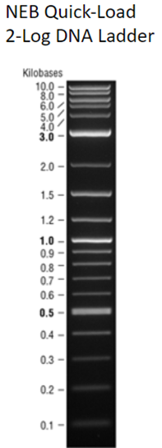
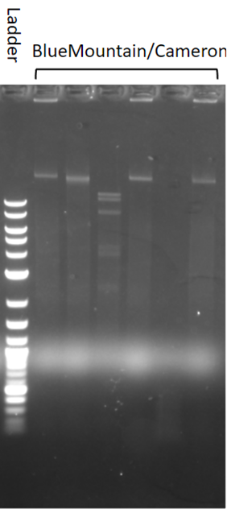
Blue Mountain/Cameron Lyons
BamH1
Hind3
Hae3
EcoR1
Cla1
1kb ladder
Undigested
10000
3000
1000
500

