Slide 2
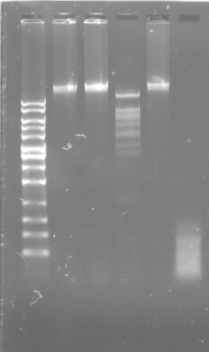
Control
EcoRI
BamHI
ClaI
HaeIII
HindIII
DNA Ladder
10,000
8,000
6,000
5,000
4,000
3,000
2,500
2,000
1,500
1,000
700
500
300

