Slide 1
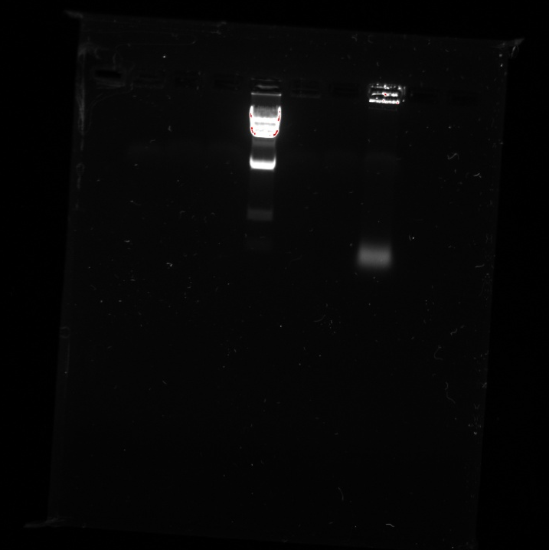
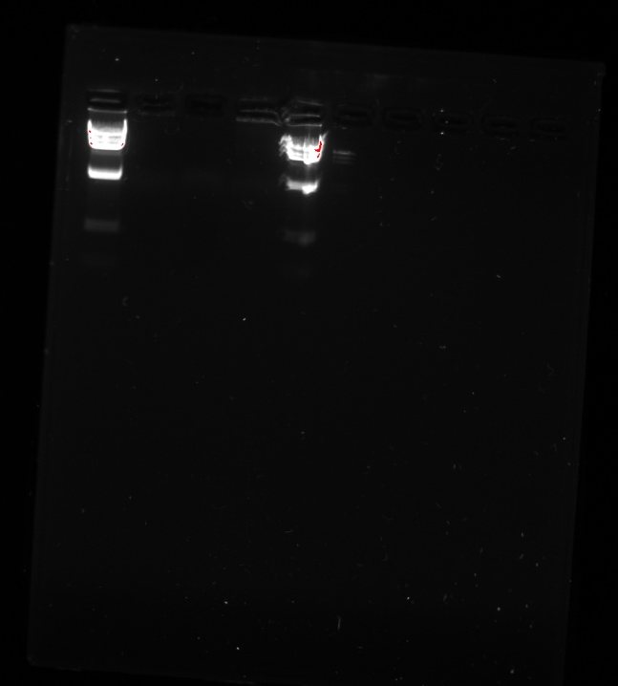
The very first gels we ran: 10/22
Gel 1
Gel 2
1 2 3 4 5 6 7 8 9 10
1 2 3 4 5 6 7 8 9 10

Slide 2
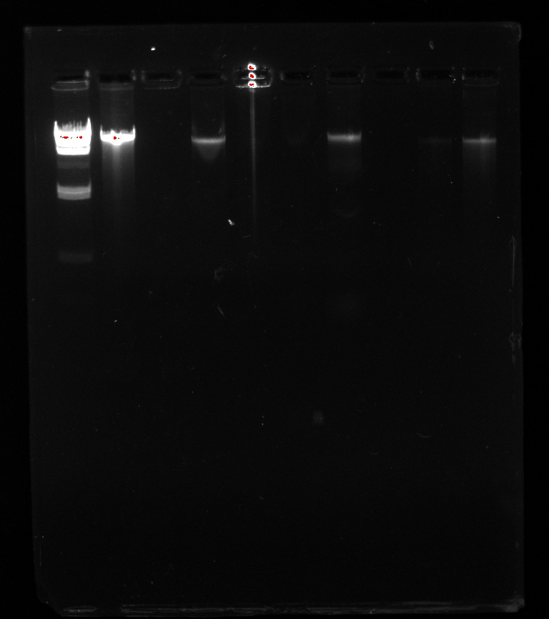
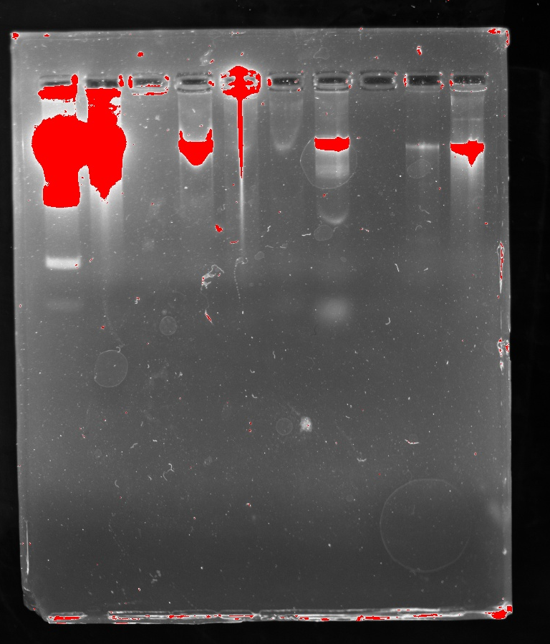
Gel 1 (DNA loaded at the start of class)
Date: 10/29/25
1 2 3 4 5 6 7 8 9 10
1 2 3 4 5 6 7 8 9 10
Same gel, very overexposed

Slide 3
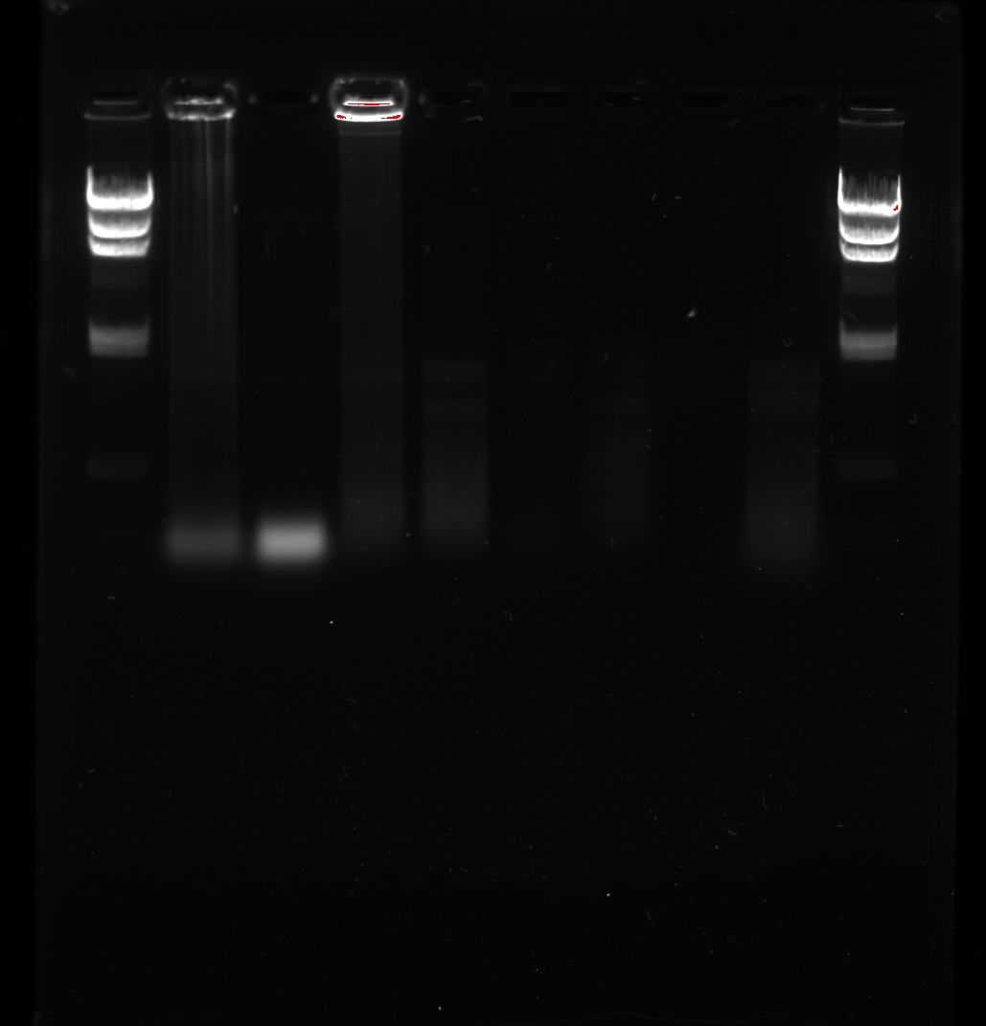
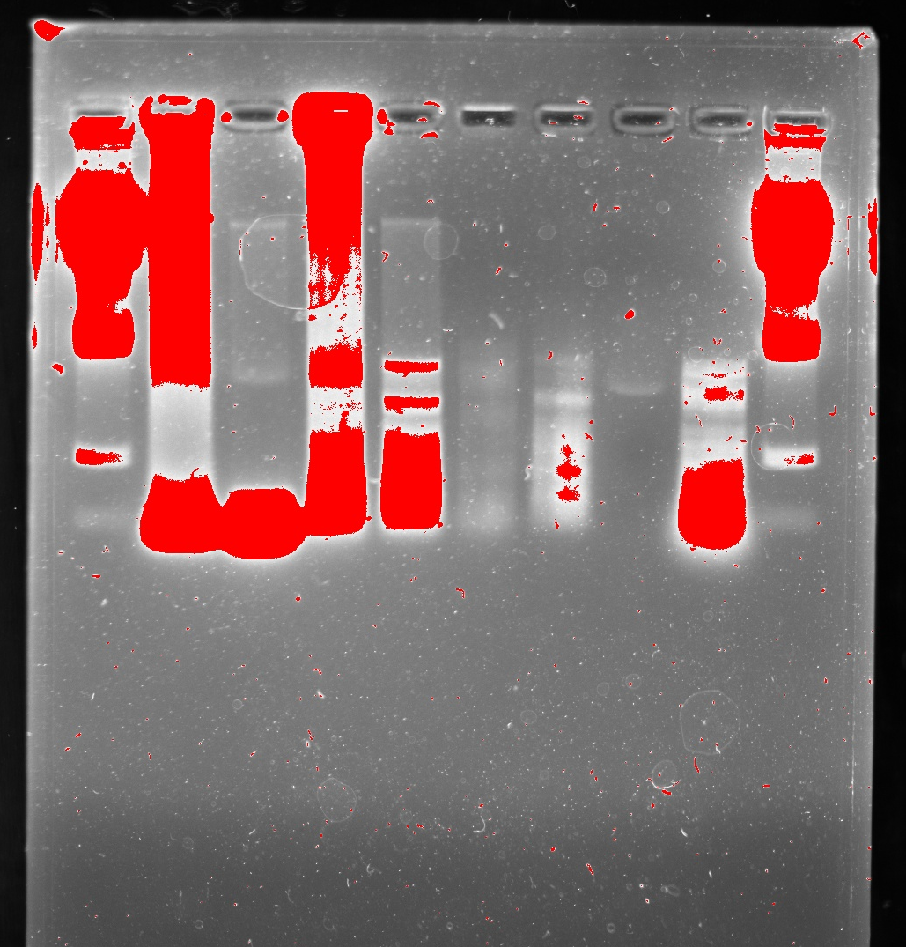
Gel 2 (Restriction Digest)
Date: 10/29/25
1 2 3 4 5 6 7 8 9 10
1 2 3 4 5 6 7 8 9 10
Same gel, very overexposed

Slide 4
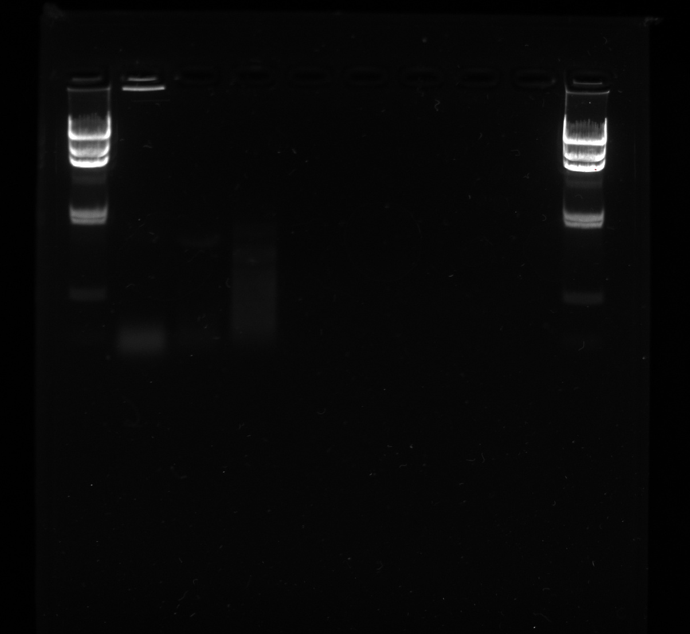
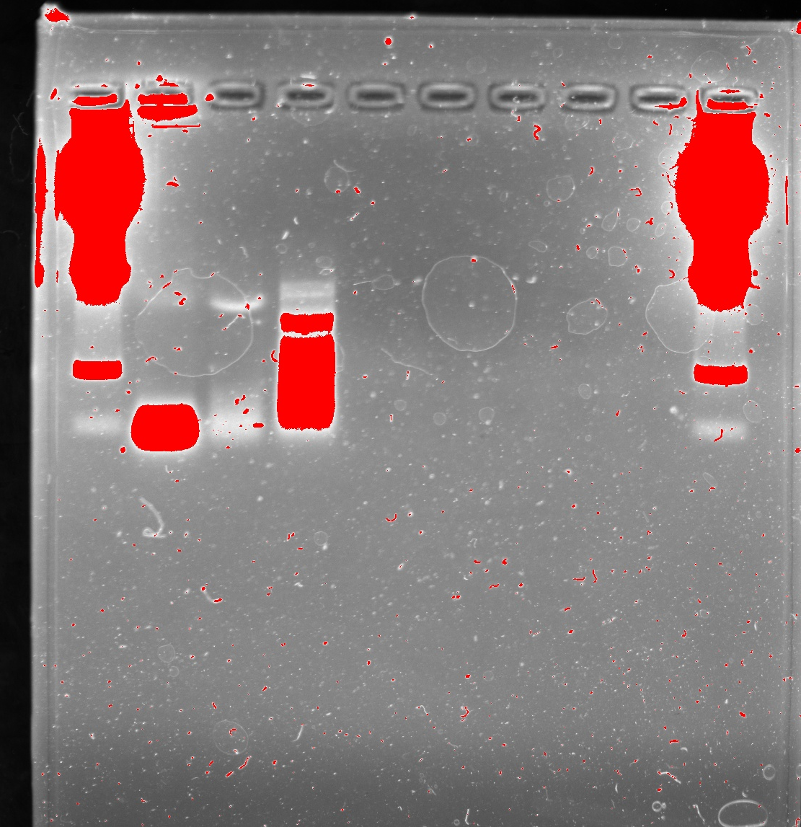
Gel 3 (Restriction Digest)
Date: 10/29/25
1 2 3 4 5 6 7 8 9 10
1 2 3 4 5 6 7 8 9 10
Same gel, very overexposed

Slide 5
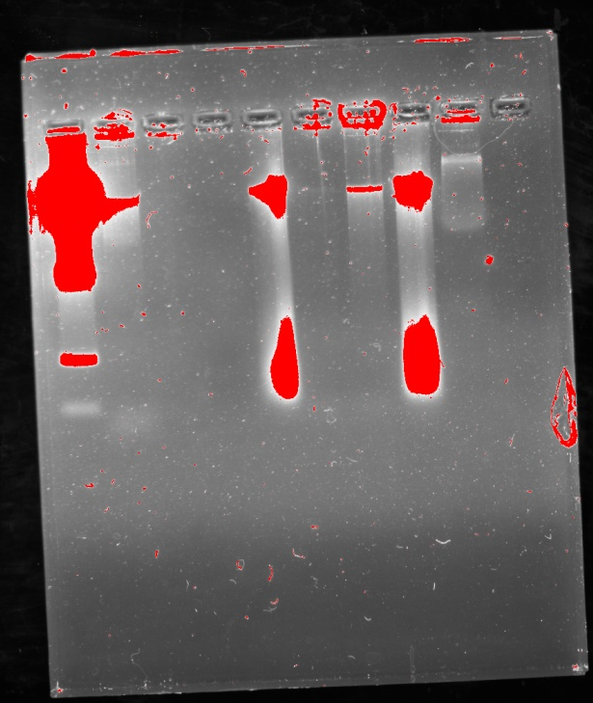
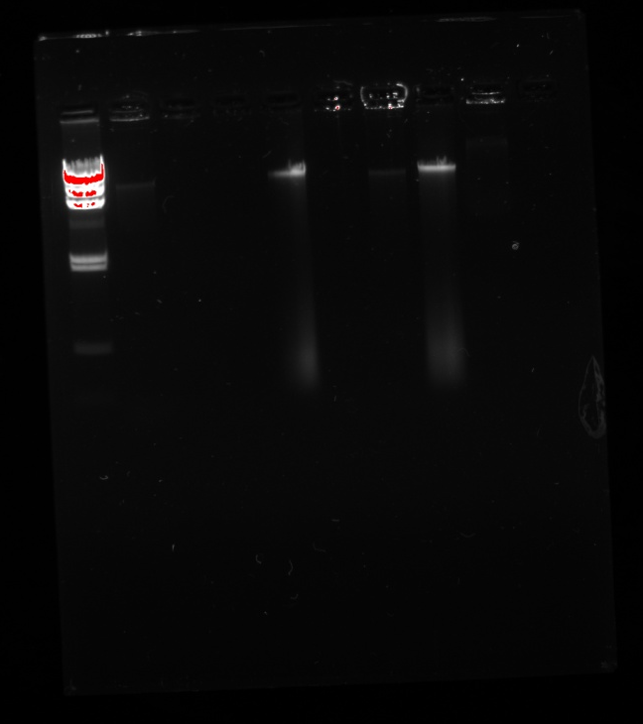
Gel 1 (DNA loaded at the start of class)
Date: 11/5/25
1 2 3 4 5 6 7 8 9 10
1 2 3 4 5 6 7 8 910
Same gel, very overexposed

Slide 6
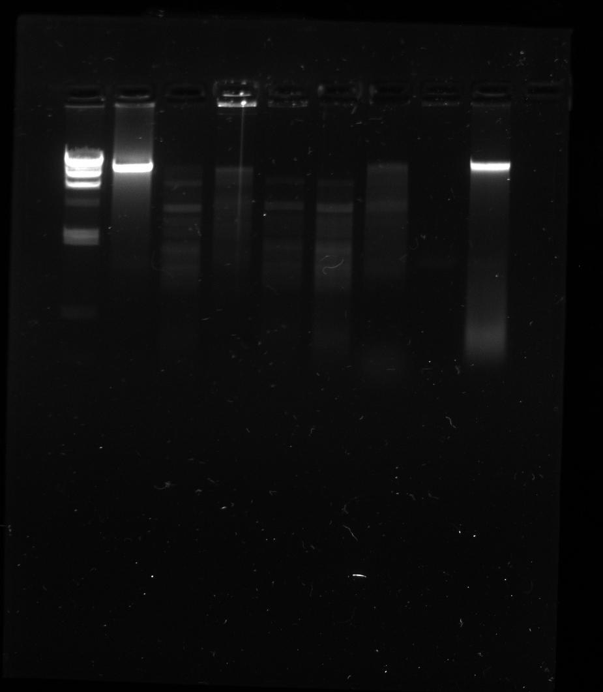
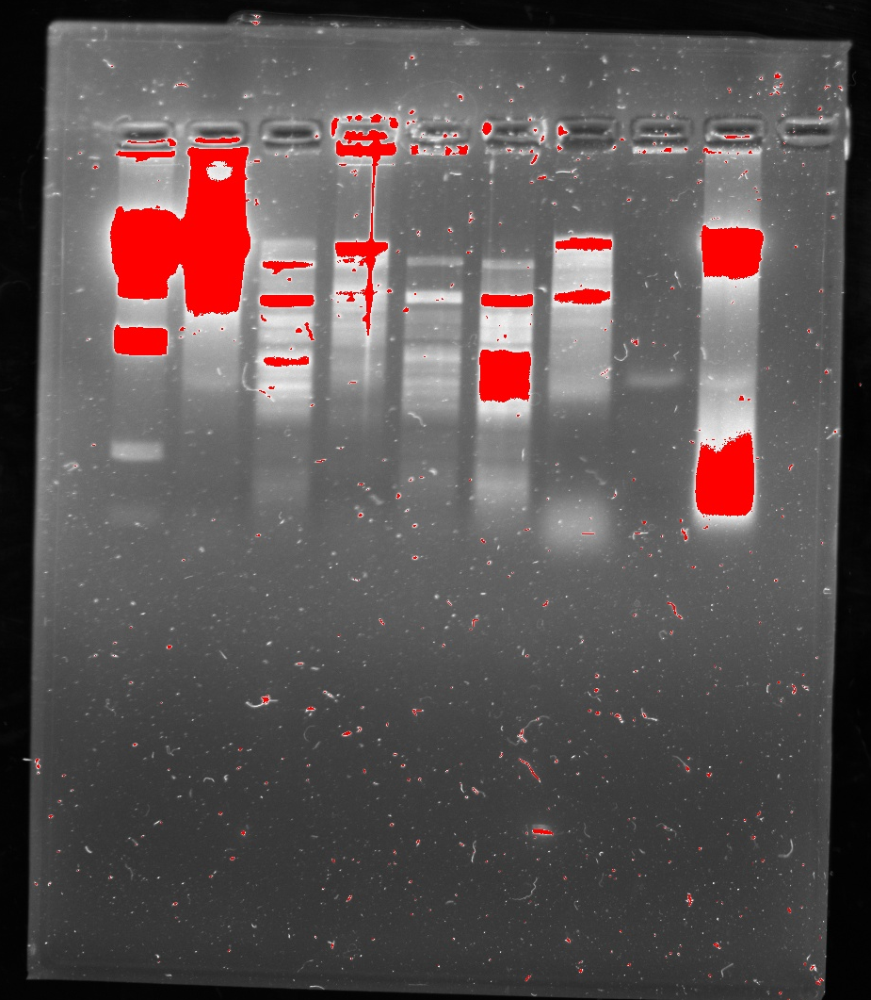
Gel 2 (Restriction digest)
Date: 11/5/25
1 2 3 4 5 6 7 8 9 10
1 2 3 4 5 6 7 8 9 10
Same gel, very overexposed

Slide 7
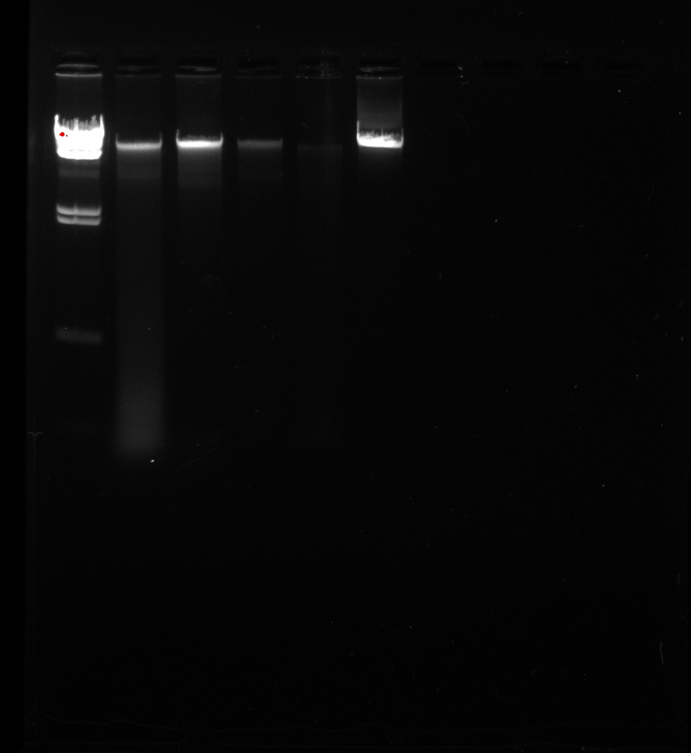
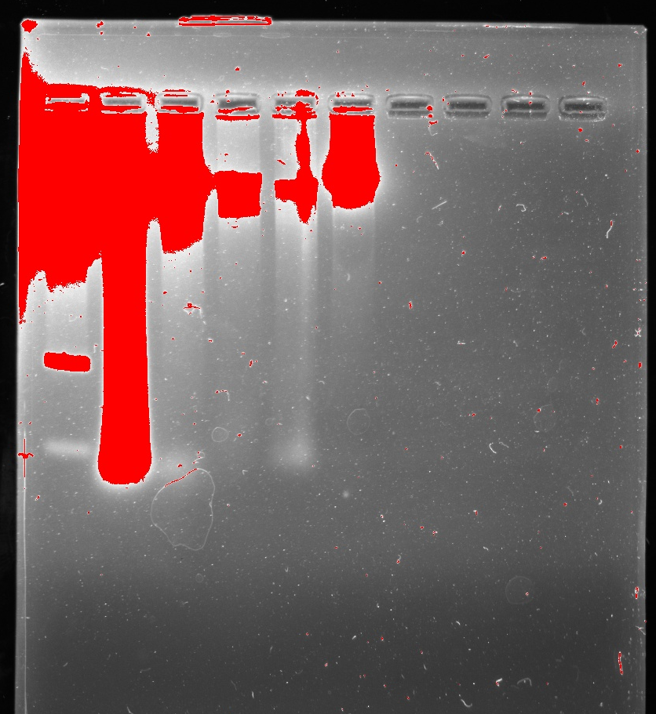
Gel 1 (DNA loaded at the start of class)
Date: 11/10/25
1 2 3 4 5 6 7 8 9 10
1 2 3 4 5 6 7 8 9 10
Same gel, very overexposed

Slide 8
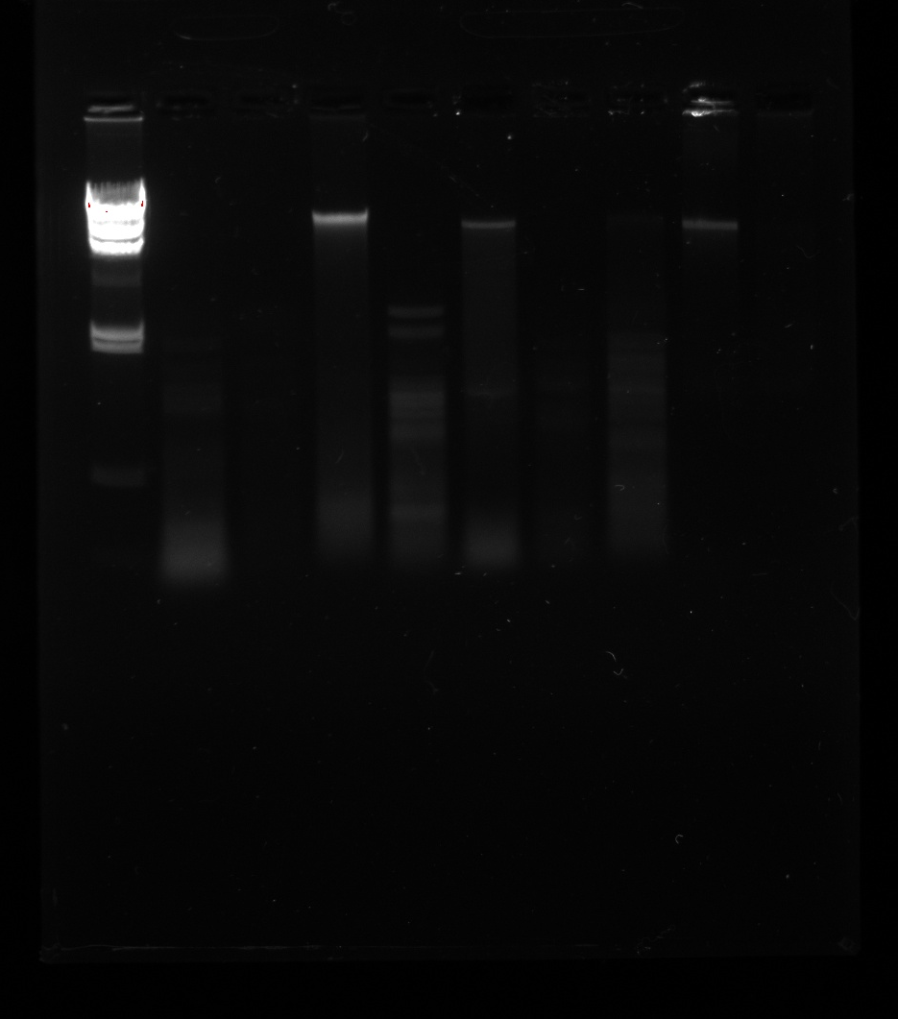
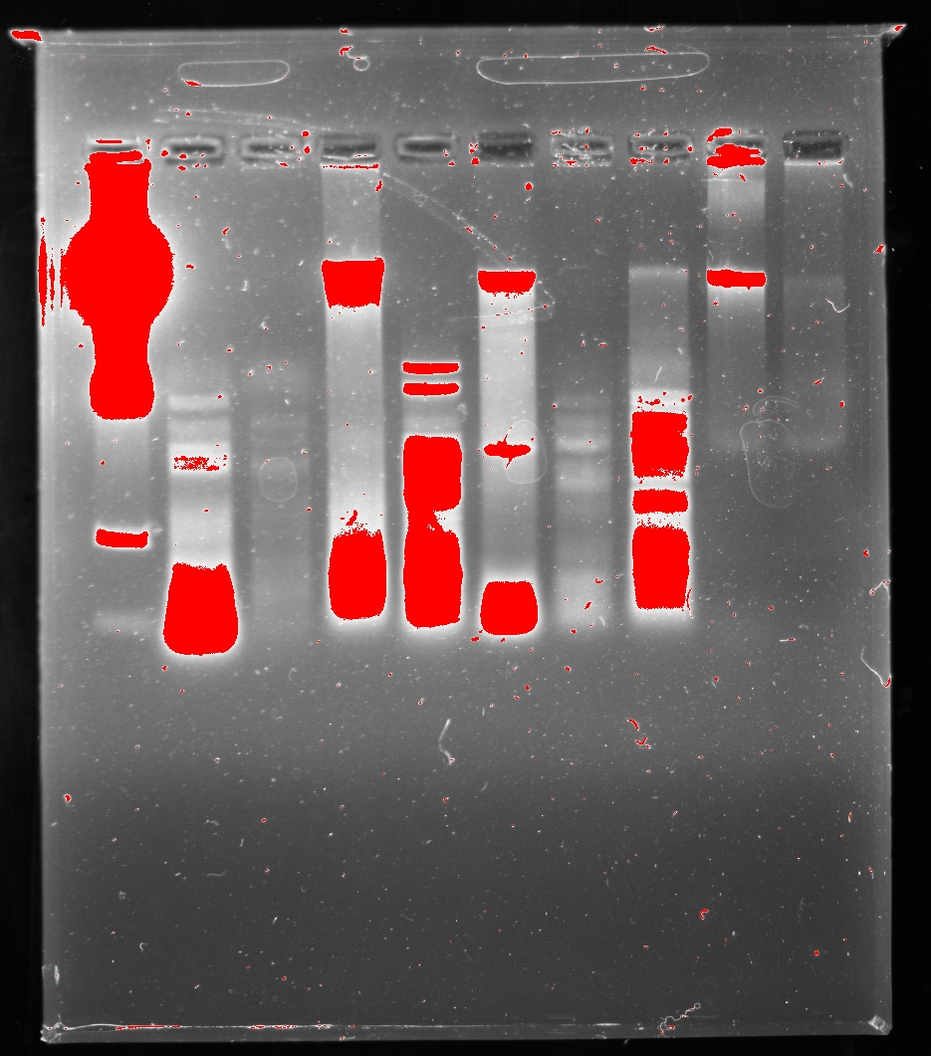
Gel 2 (Restriction Digest)
Date: 11/10/25
1 2 3 4 5 6 7 8 9 10
1 2 3 4 5 6 7 8 9 10
Same gel, very overexposed

Slide 9
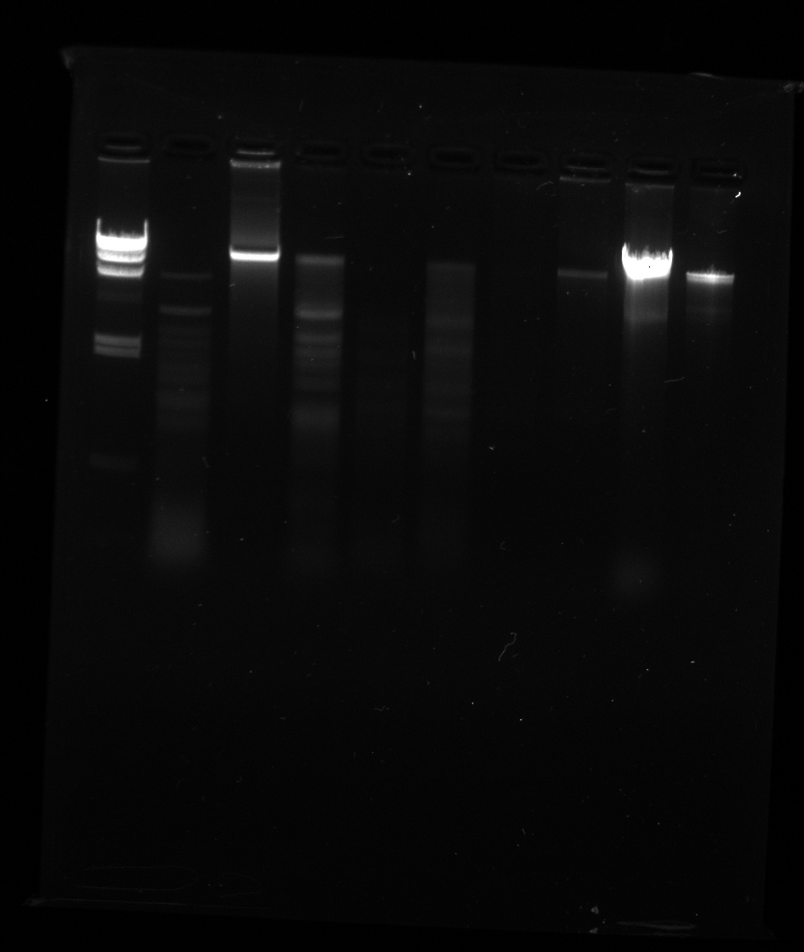
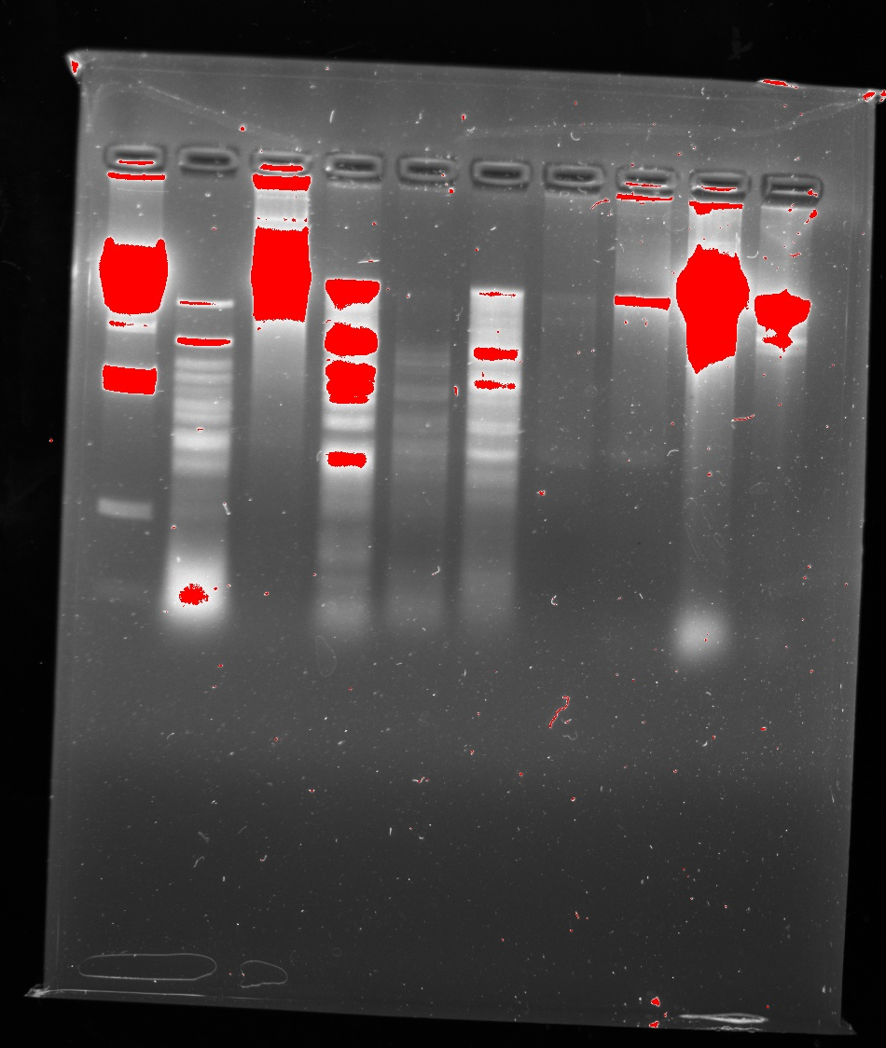
Gel
Date: 11/12/25
1 2 3 4 5 6 7 8 9 10
1 2 3 4 5 6 7 8 9 10
Same gel, very overexposed

Slide 10
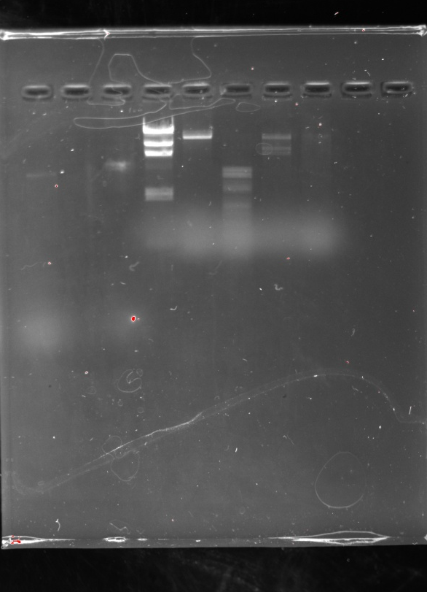
Gel 1
Date: 11/17/25
1 2 3 4 5 6 7 8 9 10

Slide 11
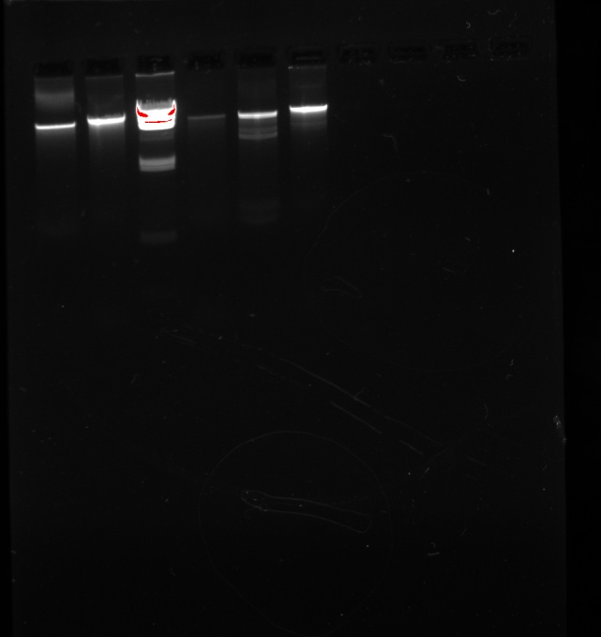
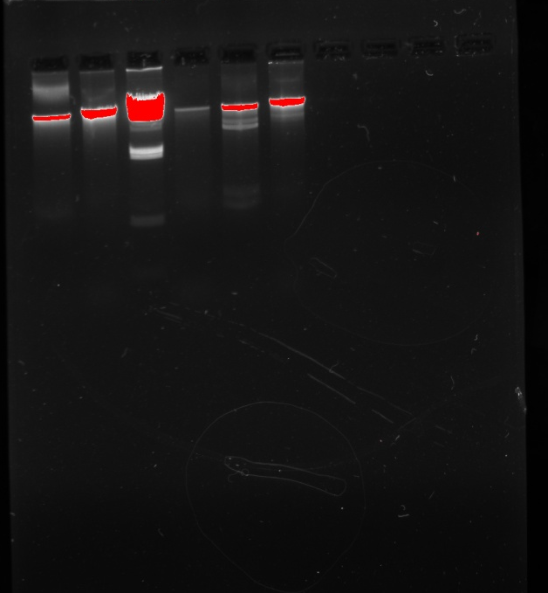
Gel 2
Date: 11/17/25
1 2 3 4 5 6 7 8 9 10
1 2 3 4 5 6 7 8 9 10
Same gel, very overexposed

Slide 12
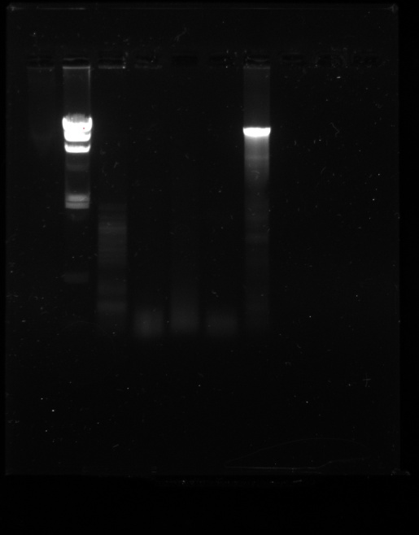
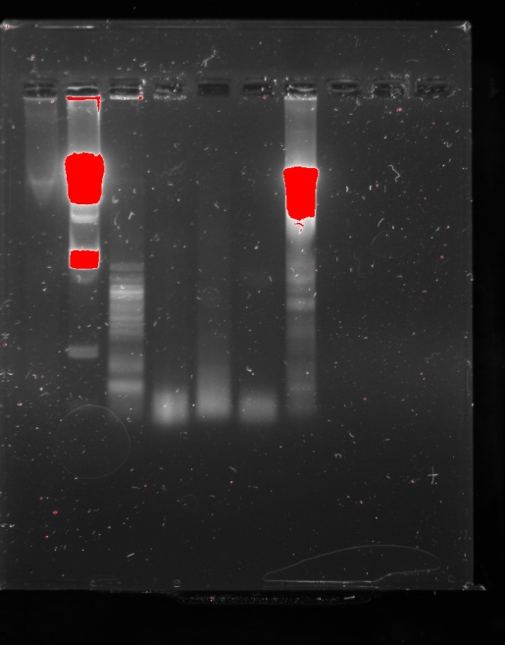
Gel 11/19/25
1 2 3 4 5 6 7 8 9 10
1 2 3 4 5 6 7 8 9 10
Same gel, very overexposed

Slide 13
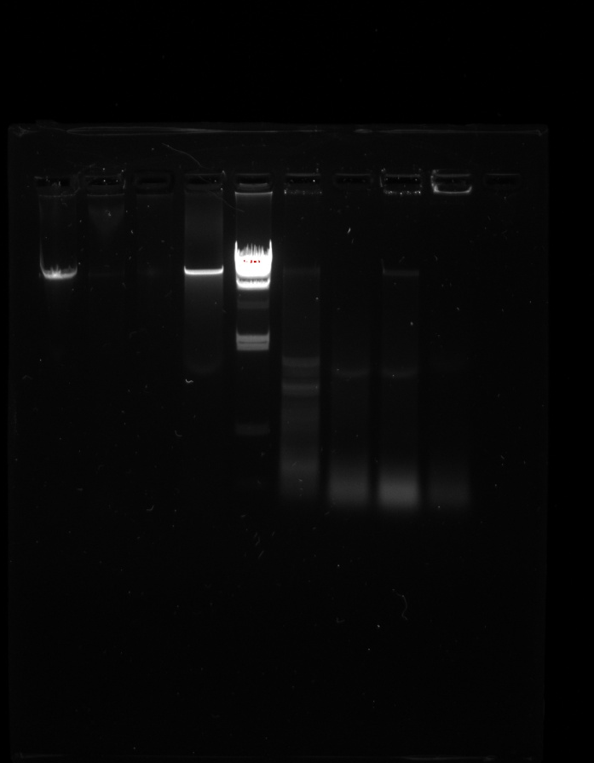
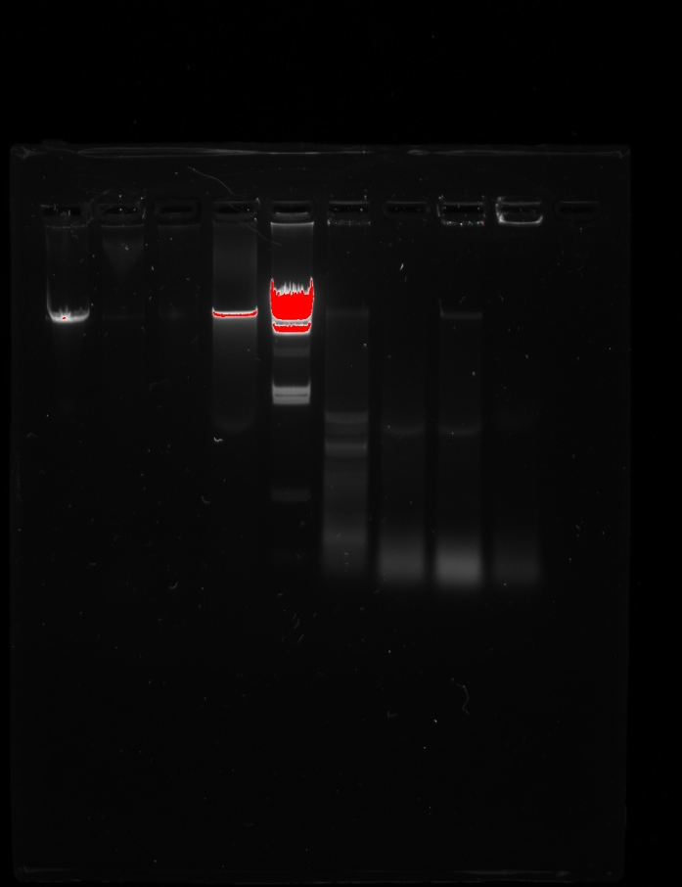
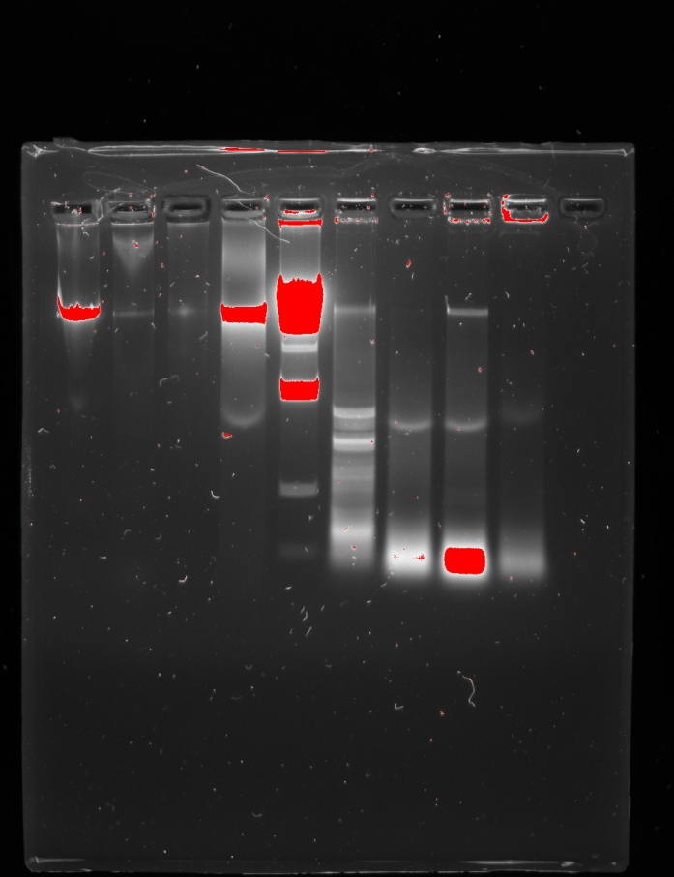
Gel 11/24/25
Ladder
Marley
Paulina
Paulina
Nancy
Marley
Nancy
Ladder
Ladder
Gabe
Gabe
Paulina
Paulina
Paulina
Paulina
Marley
Marley
Marley
Marley
Nancy
Nancy
Nancy
Nancy
Gabe
Gabe
Gabe
Gabe
DNA only
HaeIII digest
DNA only
HaeIII digest
DNA only
HaeIII digest

