Slide 1
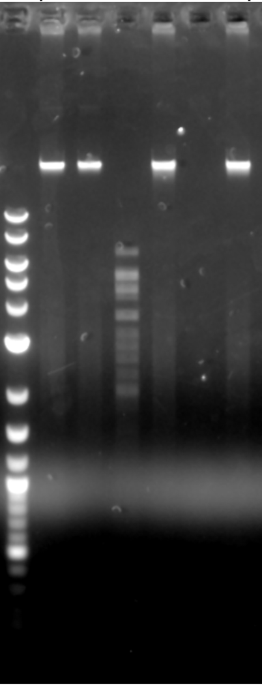
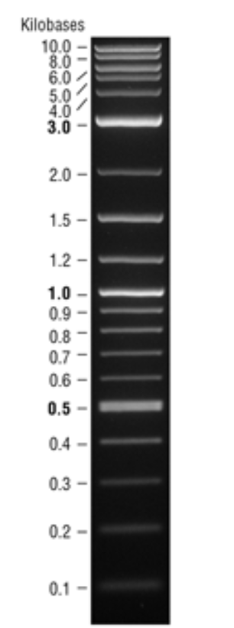
1Kb Ladder
ClaI
Undigested
EcoRI
BamHI
HindIII
Haelll
10000
Thomas
Maeterlinck
3-23-23
3000
1000
500

