Slide 1
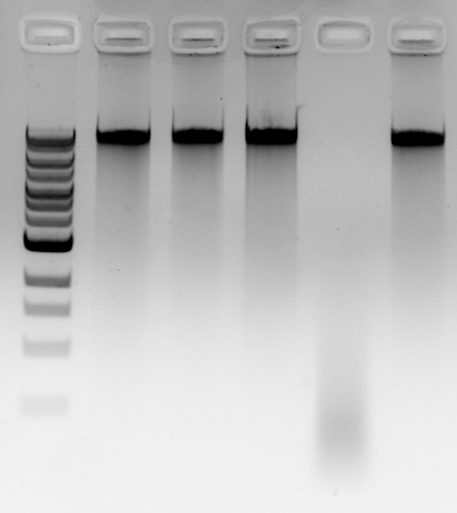
Ladder
BamHI
ClaI
EcoRI
HaeIII
HindIII
NspI
SalI

