Slide 1
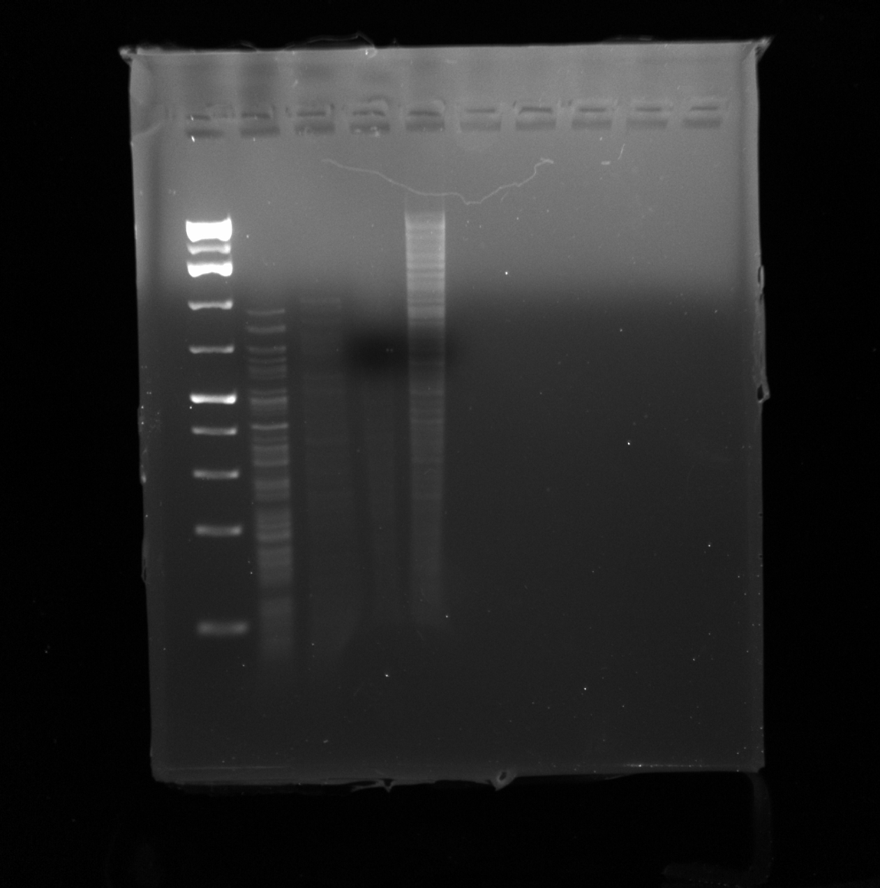
DNA ladder
Neoevie
Shown here is the EM grid containing Neoevie’s DNA sample after being cut by the HaeIII enzyme. Bands appear to form between the 1500bp and 500 bp mark, however there are two many bands to count the individual amount. The DNA ladder used for the procedure was the Thermo Fisher Gene Ruler 1kb Plus DNA Ladder (0.1ug/uL). The gel was run at 200 volts for 1hr 30 min.
5000bp
1500bp
500bp

