Slide 1
PhrankthaTank
Rion Cain

Slide 2
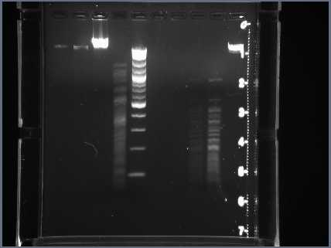
Uncut DNA 2% gel Lane3

Slide 3
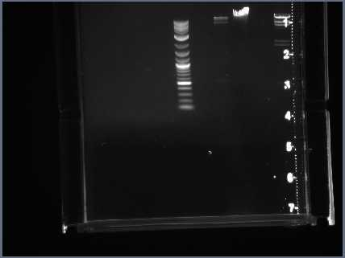
Uncut DNA .8% gel Lane 8

Slide 4
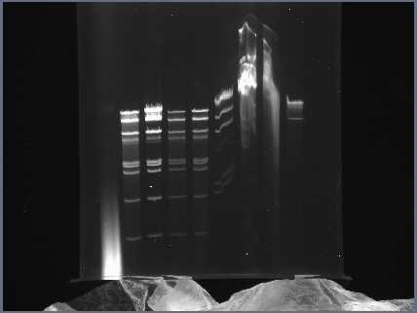
Cla I lane2 HinDIII lane7

Slide 5
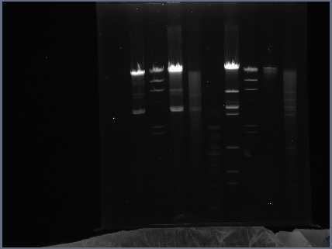
BamHI lane7 EcoRI lane 2

Slide 6
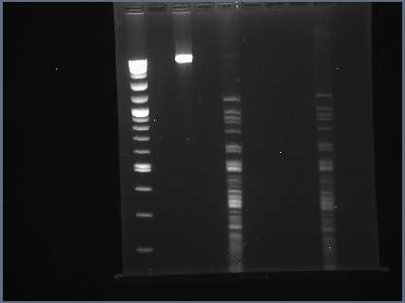
HaeIII lane 9

Slide 7
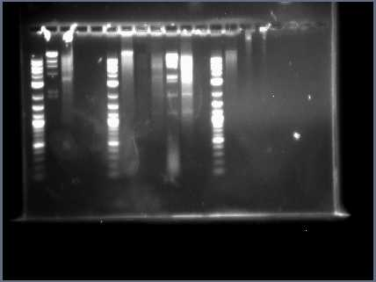
HinDIII lane 6

