Slide 1
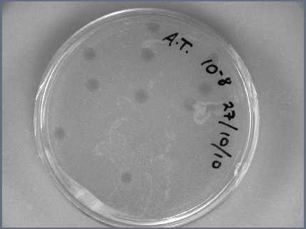

Slide 2
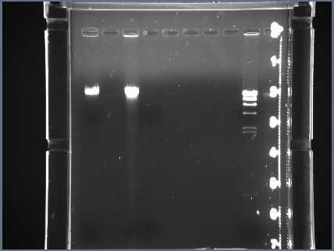
SankungSillah
Whole dna

Slide 3
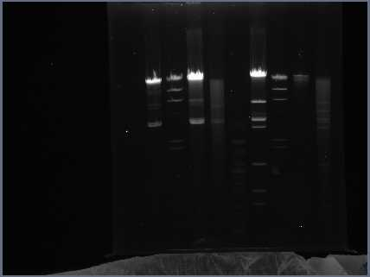
EcorI lane 4 SankungSillah

Slide 4
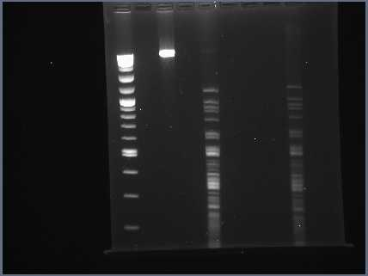
HaeIII lane5 SankungSillah

Slide 5
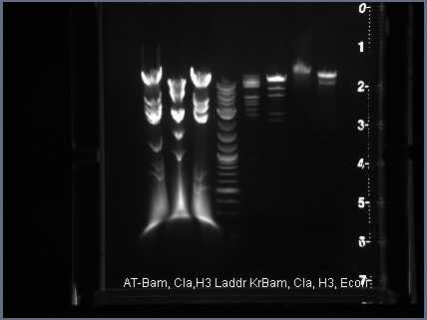
Cla1
HindIII
BamH1

