Slide 1
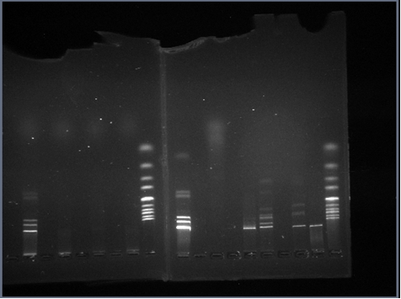
Restriction enzyme digest gels run on November 2, 2017.
Carina and Ruben
Alec and Isabella

