Slide 1
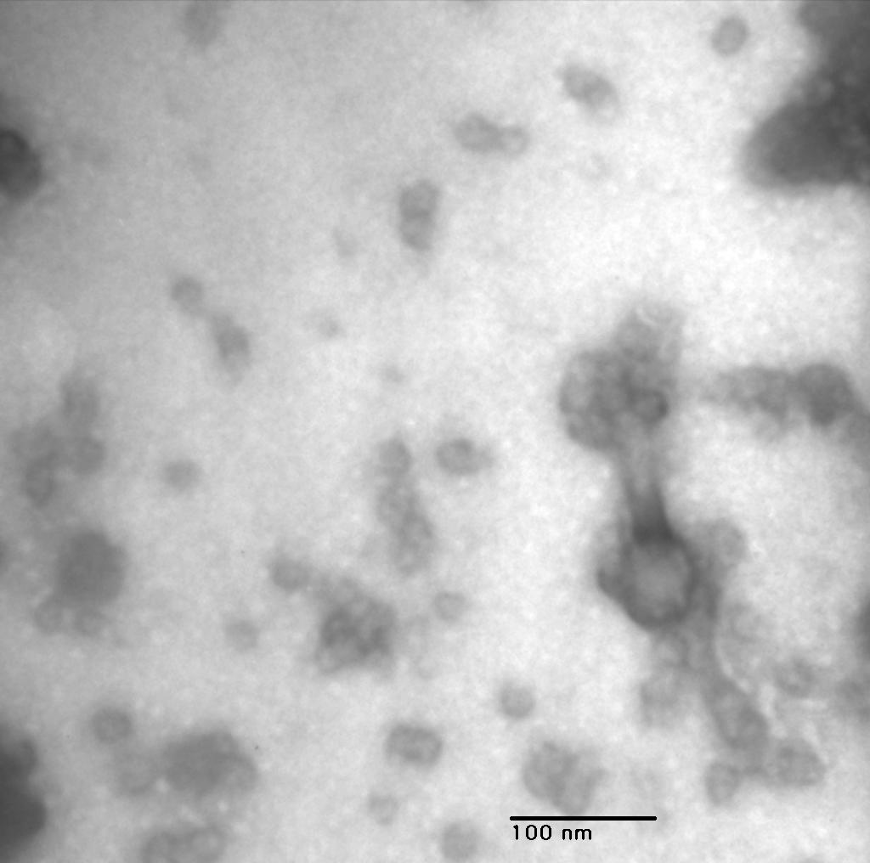
KM 1, 150,000x

Slide 2
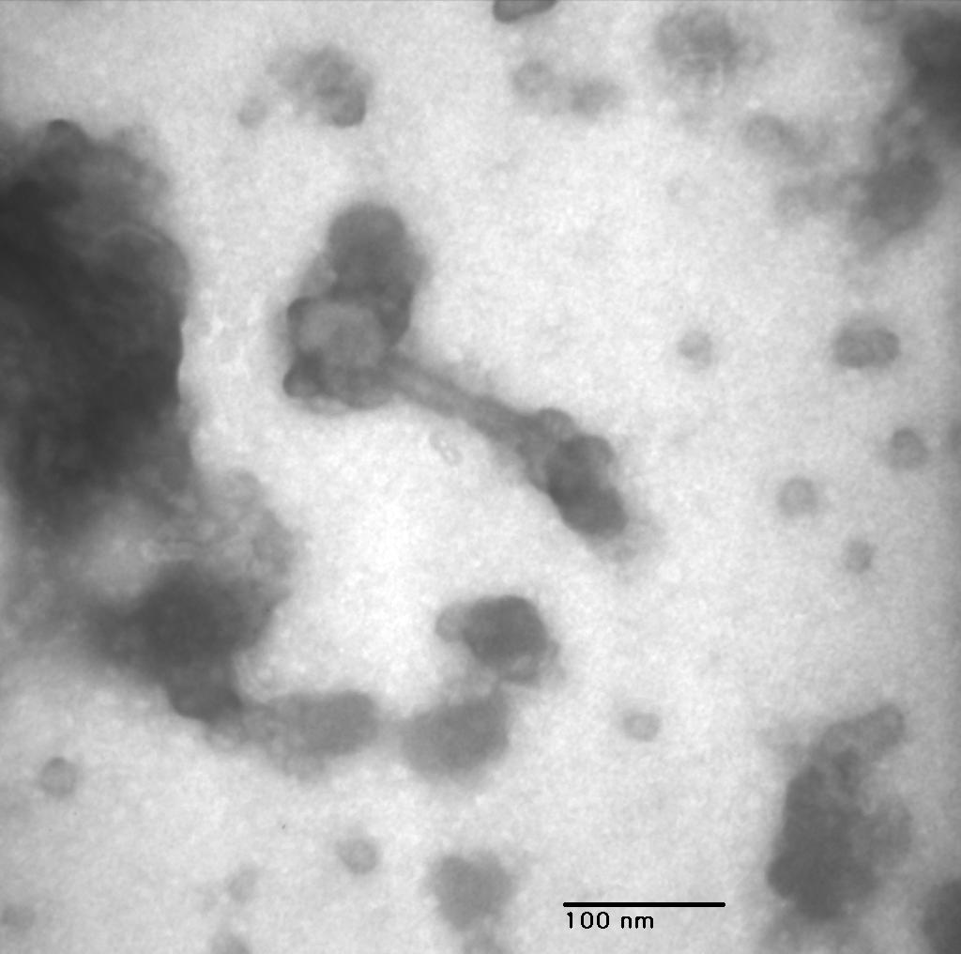
KM 2, 150,000x

Slide 3
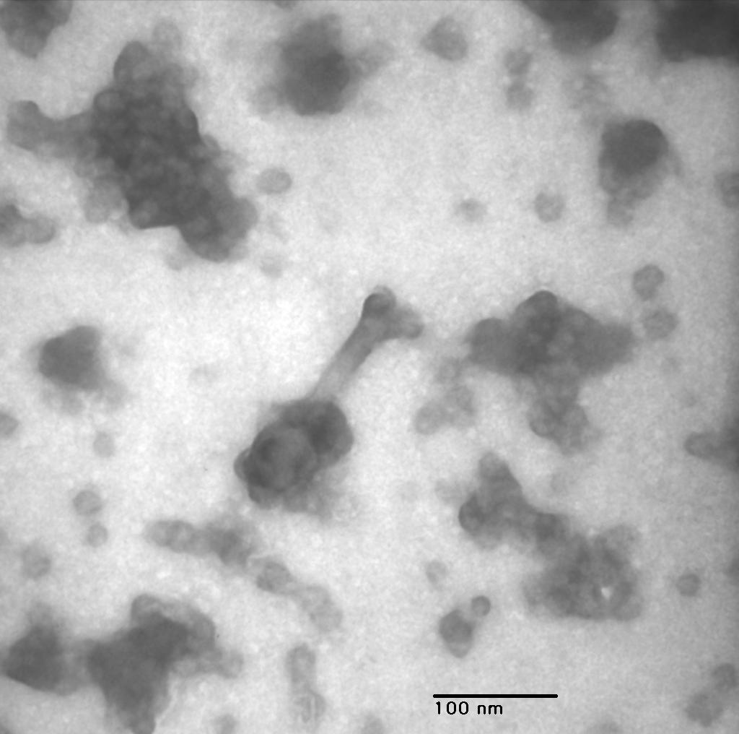
KM 3, 150,000x

Slide 4
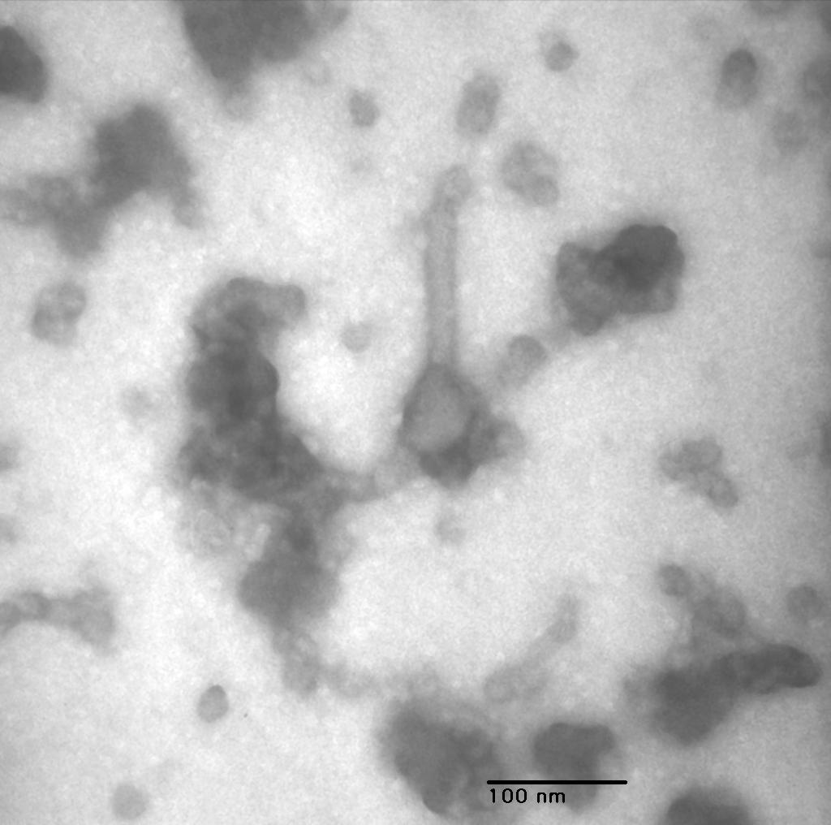
KM 4, 150,000x

Slide 5
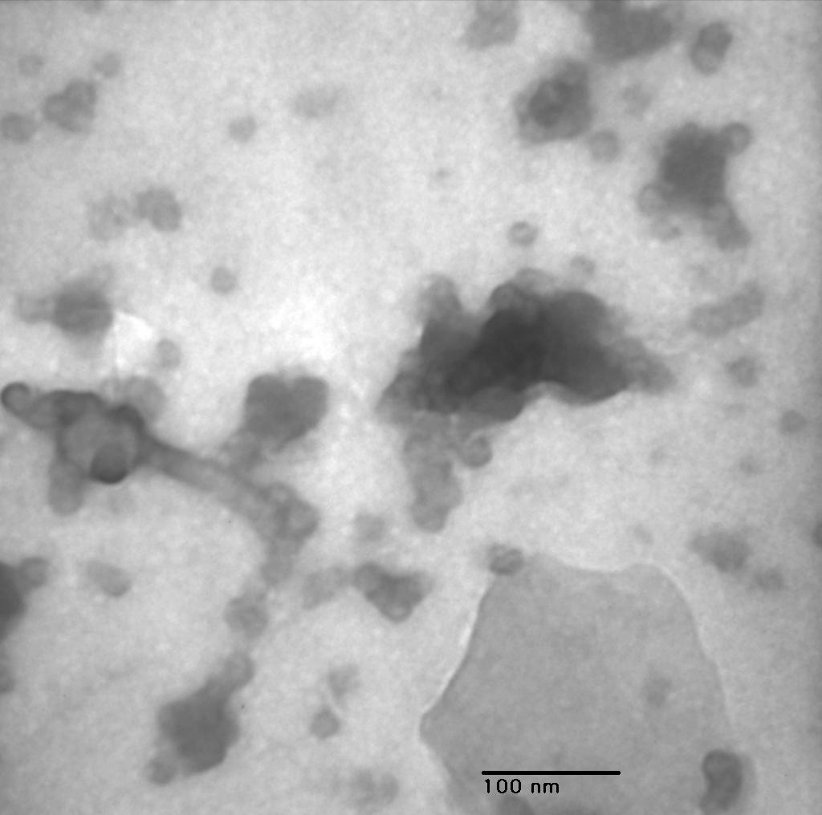
KM 5, 150,000x

Slide 6
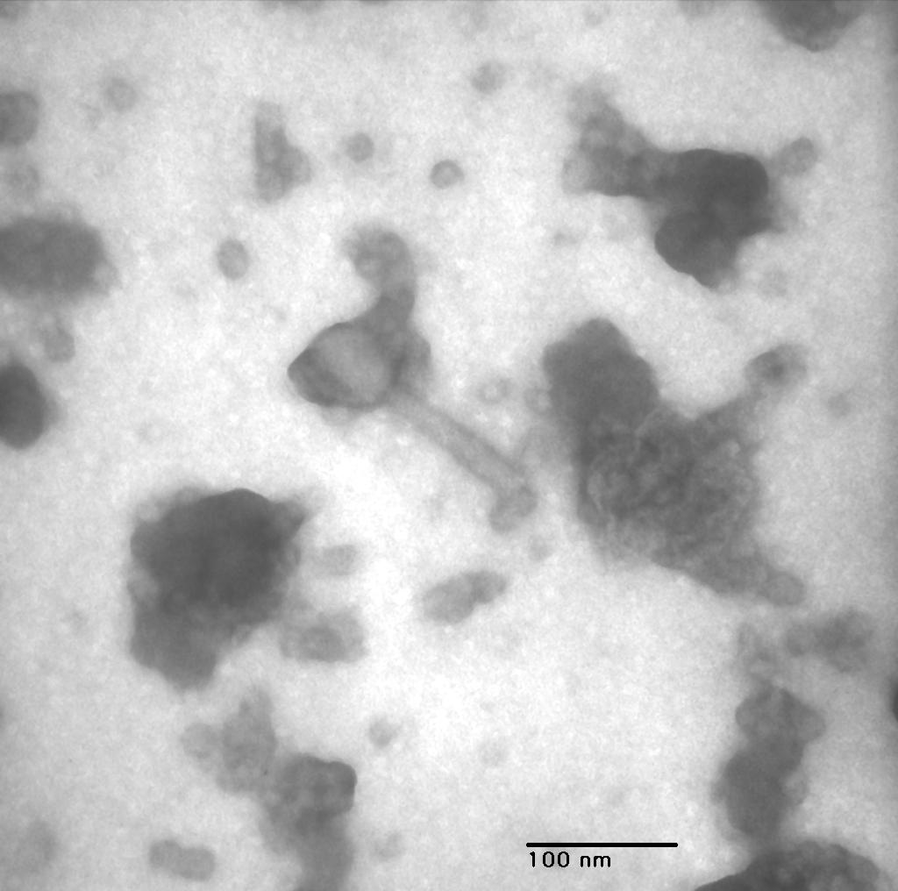
KM 6, 150,000x

