Slide 1
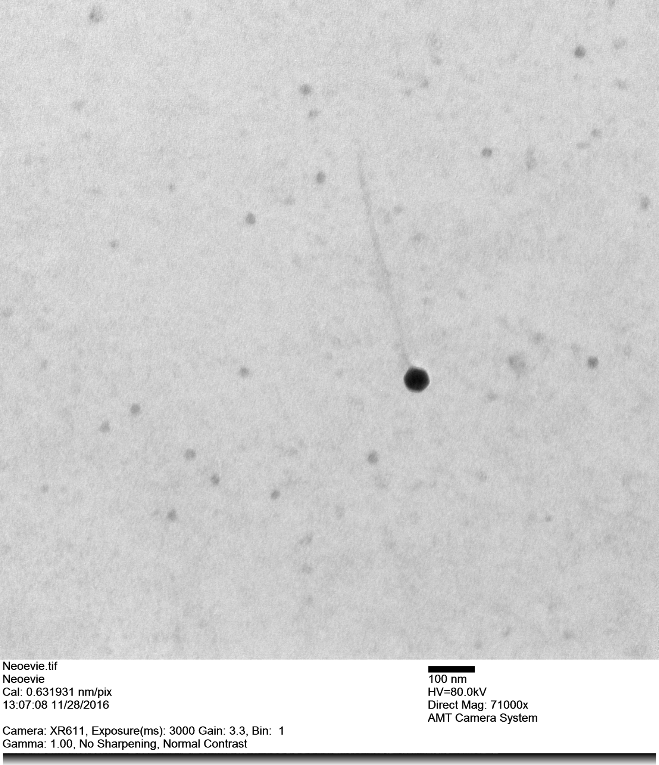
Shown here is the EM photo of bacteriophage Neoevie. The photo was produced using uranyl acetate stain and produced a positively stained image. Neoevie appears to be siphaverdae with a long flexible tail(about 470nm in length) and an icosahedral head(about 50nm in diameter).

