Slide 1
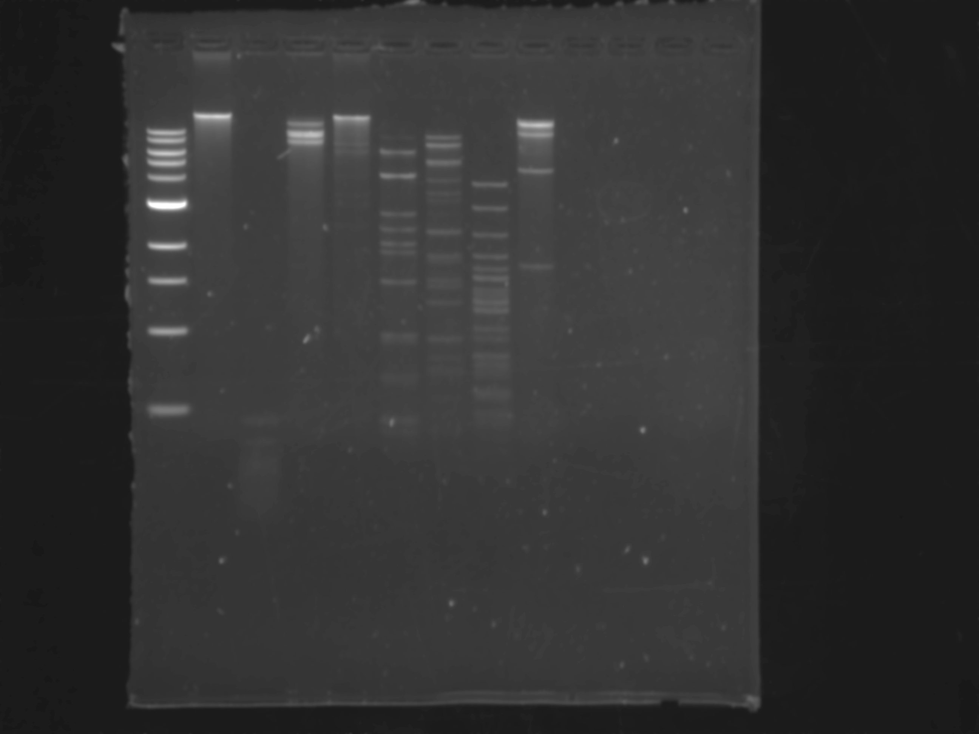
Uncut DNA
HaeIII
KpnI
PmlI
SacI
SfiI
RedLock
Streptomyces antibioticus
1 kb ladder
StyI
MseI
10 kbp
6 kbp
8 kbp
5 kbp
4 kbp
3 kbp
2 kbp
1.5 kbp
1 kbp
0.5 kbp

